Slide 1
How to Register on MUEngage
Notes:
Hi Service Learners! This PowerPoint is going to walk you through how to view Service Learning opportunities before registration and how to register for an event

Slide 2
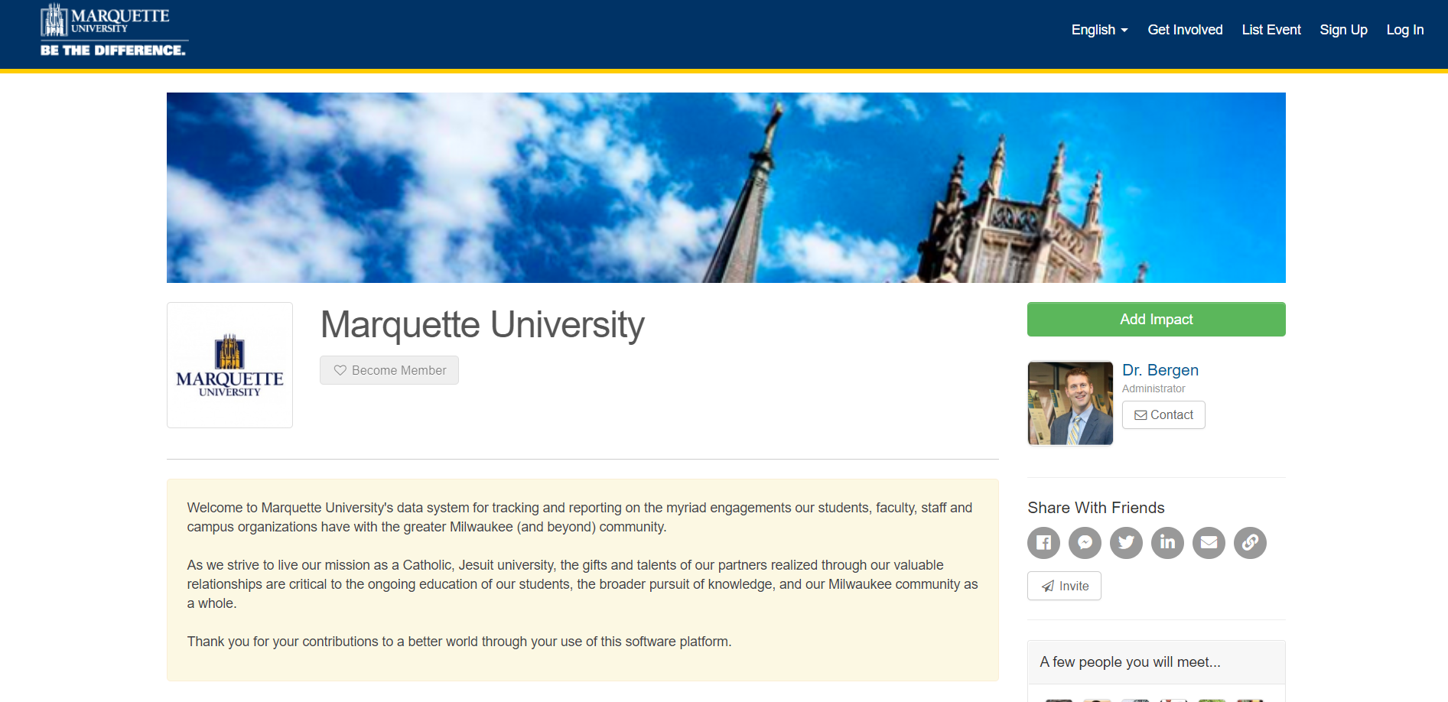
Logging In
Go to engage.mu.edu and click LOG IN
Select “Log in via CheckMarq”
Notes:
Before you can register for a site, you must set up your MUEngage profile (if you haven’t already). To do this, go to engage.mu.edu and click LOG IN in the upper right hand corner. Select the log in via checkmarq option, even if this is your first time using MUEngage. Logging in using your Marquette information will ensure that you are seeing the information that you need for your Service Learning course. After you click log in via checkmarq, you will enter your MU credentials - the same credentials you use to log in to D2L and CheckMarq. Once you have logged in, you can set up your profile. You can add a picture, for example, and add in as much information as you would like.

Slide 3
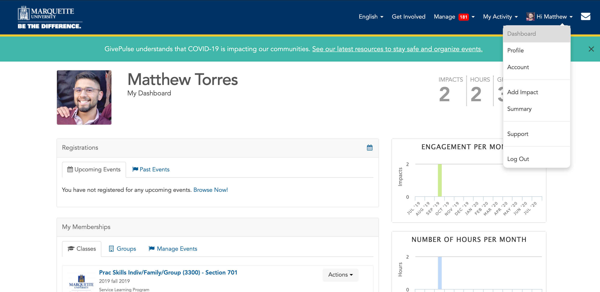
OPTION 1) Finding your Service Learning Course
Notes:
After you have created your profile, you are able to browse MUEngage and see what Service Learning opportunities are available for your course. To see available Service Learning events, click your name in the top bar on the right and select DASHBOARD from the dropdown menu. In your dashboard, there is a MEMBERSHIPS section, and within that section there is a CLASSES tab that you can click on to see the list of your service learning courses. Select the course that you are interested in seeing the Service Learning opportunities for

Slide 4
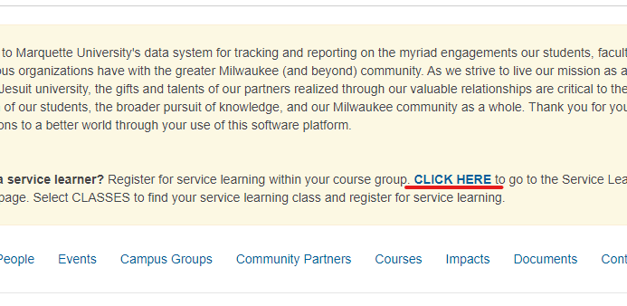
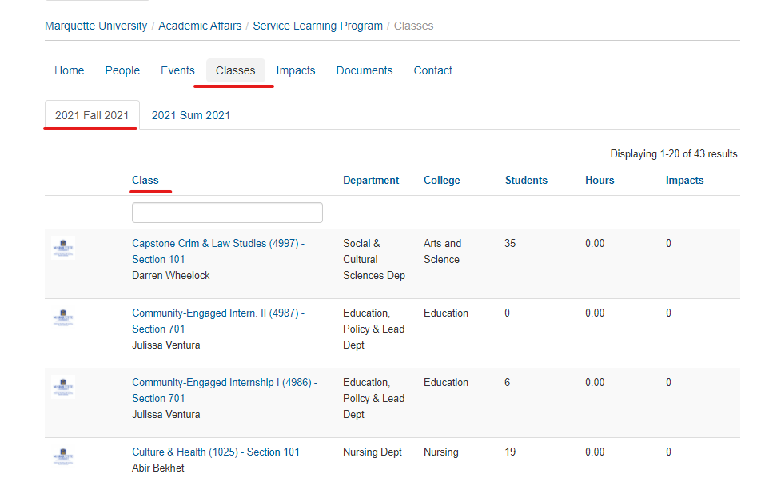
OPTION 2) Finding your Service Learning Course
Notes:
After you have created your profile, you are able to browse MUEngage and see what Service Learning opportunities are available for your course. To see available Service Learning events, click your name in the top bar on the right and select DASHBOARD from the dropdown menu. In your dashboard, there is a MEMBERSHIPS section, and within that section there is a CLASSES tab that you can click on to see the list of your service learning courses. Select the course that you are interested in seeing the Service Learning opportunities for

Slide 5
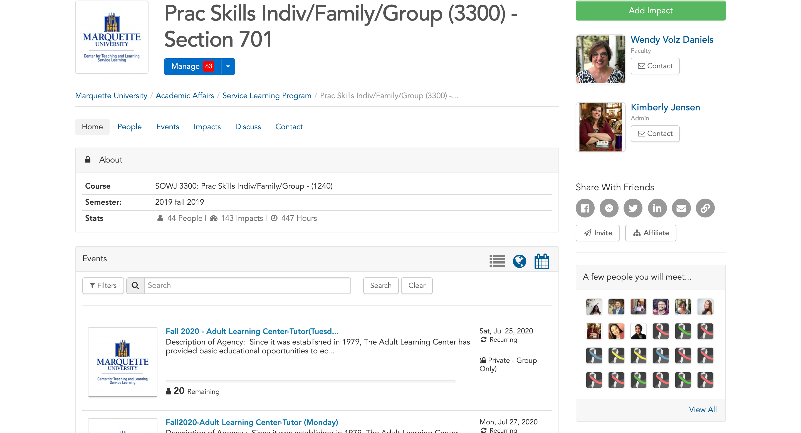
Recurring Events
Notes:
You can select the events tab to begin browsing! Something to note is that we are constantly updating MUEngage with more opportunities based on community organizations’ interest, so if you do not see many organizations listed when you look the first time, do not panic! There will be more opportunities as it gets closer to registration day, so check MUEngage frequently! Be sure you're looking for events in your service learning class- NOT the "get involved" tab. Only look for opportunities listed in your service learning course.
The title of every event will tell you the organization’s name and a brief description of your responsibilities/tasks as a service learner. As you review service learning opportunities, notice the day and time. Some opportunities are “recurring events”; this means you will work at the organization the same day and time each week for the duration of the semester. If a service learning opportunity is recurring, you will see the day and time listed in the event title.

Slide 6
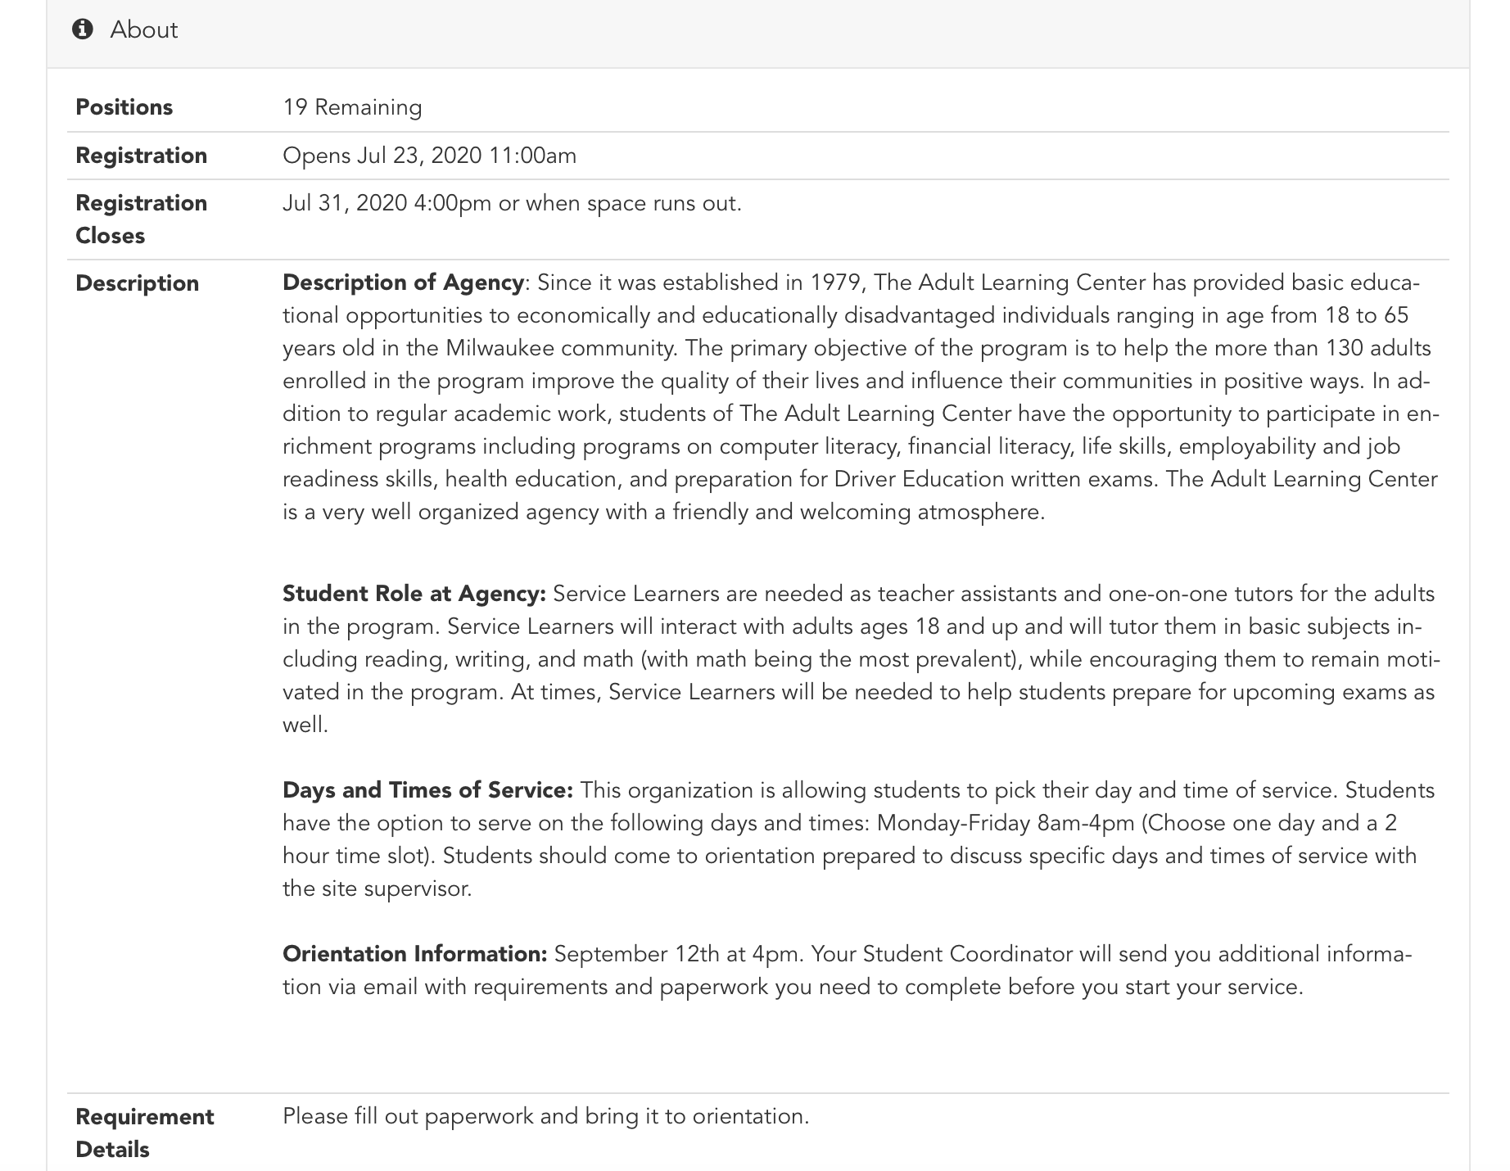
Open Opportunities
Notes:
Some service learning opportunities, however, do not have a day in the title line, which means the service learning opportunity is open. The line directly under the event title will simply say “Open Opportunity” instead of specific day and time. Organizations that are open opportunities allow the student to pick their day and time of service. Sometimes organizations will ask students to choose from a list of days and times or students will contact the organization directly to set up their day and time of service. Make sure you read the description carefully. Even open opportunities have restrictions, of course, and you can learn more about what days and times are available to complete your Service Learning hours by clicking on the title of the event and scrolling down to the Description box. The description will list days and times that the organization is accepting Service Learners along with other important information. Students registered for an open opportunity will work out a day and time that works best for them with the site contact after registration.

Slide 7
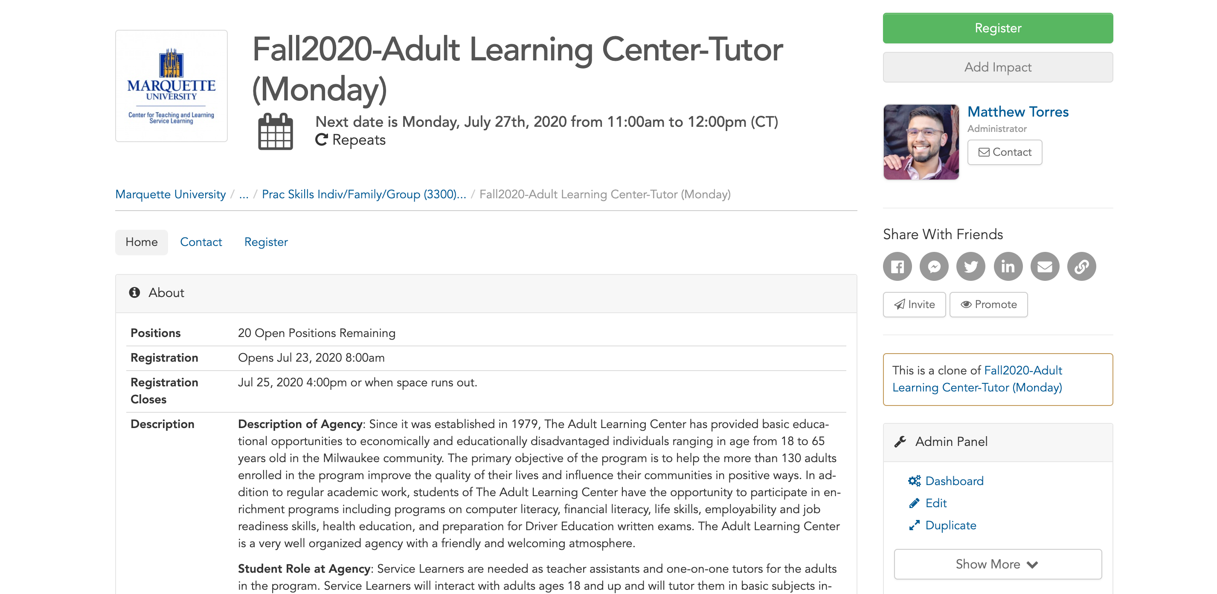
Notes:
Regardless of whether the event is an open opportunity or a recurring event, it is very important to look at the description box of every event that you are interested in. The description will give you a brief description of the organization, (again) your job responsibilities, days and times you can choose from (for open opportunities only), orientation dates, and any other special information you will need to know. Be very careful and closely look over all of the information for sites you are interested in before registering for a site.

Slide 8
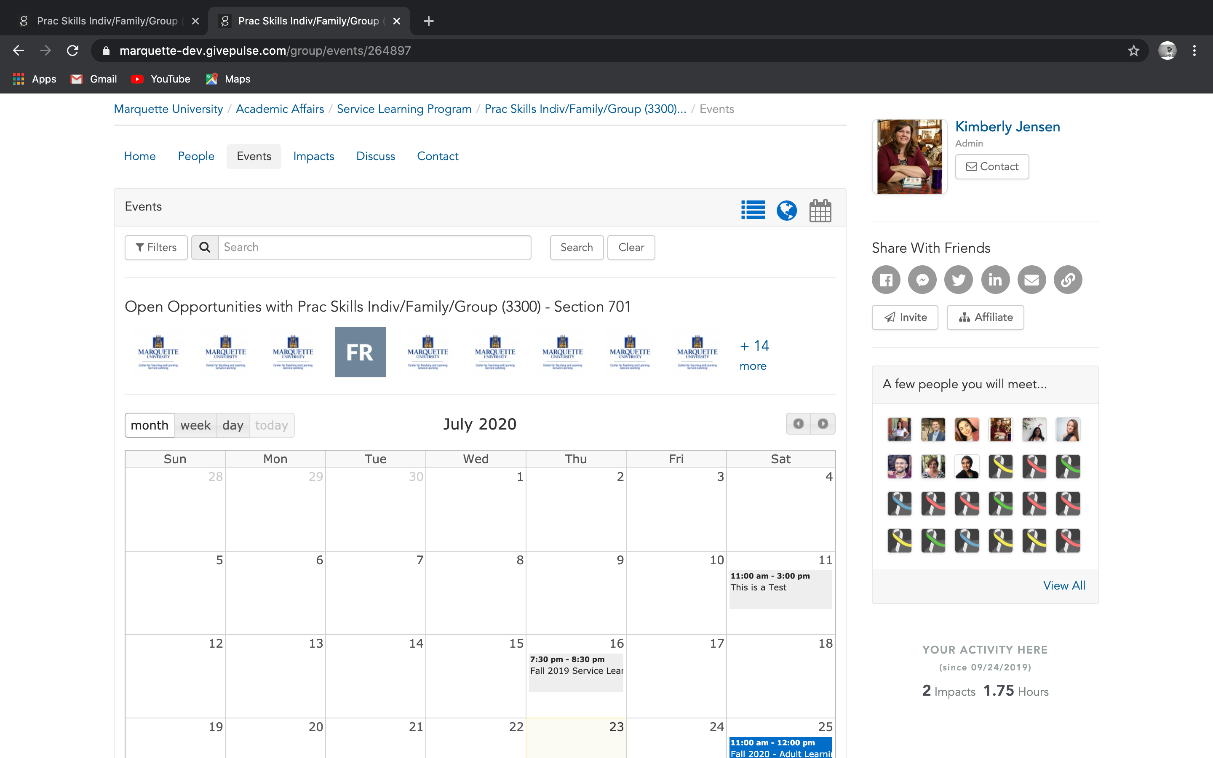
Calendar View
Notes:
It can be a lot to take in when you are looking at all the opportunities, and if you have a day in mind that works best for you, there is a calendar view feature! This format puts all opportunities into a calendar view and can help to narrow down sites that will work in your schedule.

Slide 9
Registering
Check the Service Learning Website for the official registration date
Only register for 1 event
Notes:
Keep in mind that although you can preview Service Learning opportunities before the registration week, you cannot register early. Check the service learning website for the official registration date. Also, we know that so many of the Service Learning opportunities sound very cool; however, only register for 1 event.
You have one week to register for service learning. To register, choose the opportunity that you would like to register for and click the green “Register” button on the right side of the screen. To avoid confusion and to make verification of hours easier, only register for events listed within your course group on MUEngage.

Slide 10
Registering
Notes:
Once you’ve clicked “register,” there will be a few more steps until your registration is complete. In the add attendees tab, you will see your name. You must check the boxes to agree to liability waivers and release forms.

Slide 11
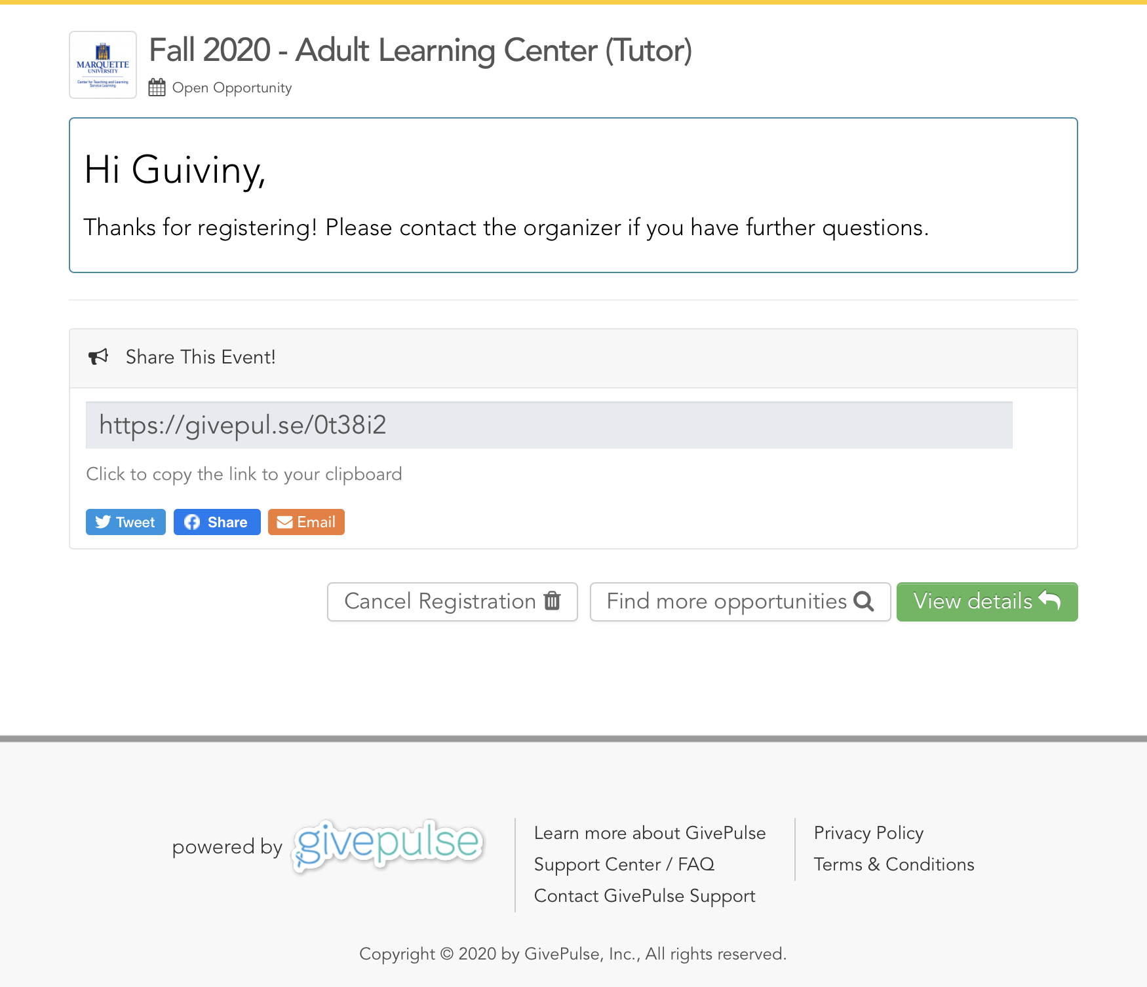
Confirmation
Notes:
Once you’ve checked the liability forms, you should see a confirmation page. Make sure all the information is correct! If you are registering for a recurring event, you will see a list of dates that you will be doing your service, like the picture on the left. However, if you are registering for an open opportunity you will not see a list of dates and your confirmation page will look like the screenshot on the right.
Congratualations, you have officially registered for a Service Learning event! You will also receive two confirmation emails. One will be an automatic confirmation email from MUEngage. The second email will be from your service learning student coordinator. This email will include important information about your next steps, so be sure to check your email and your MUEngage mailbox regularly.

Slide 12
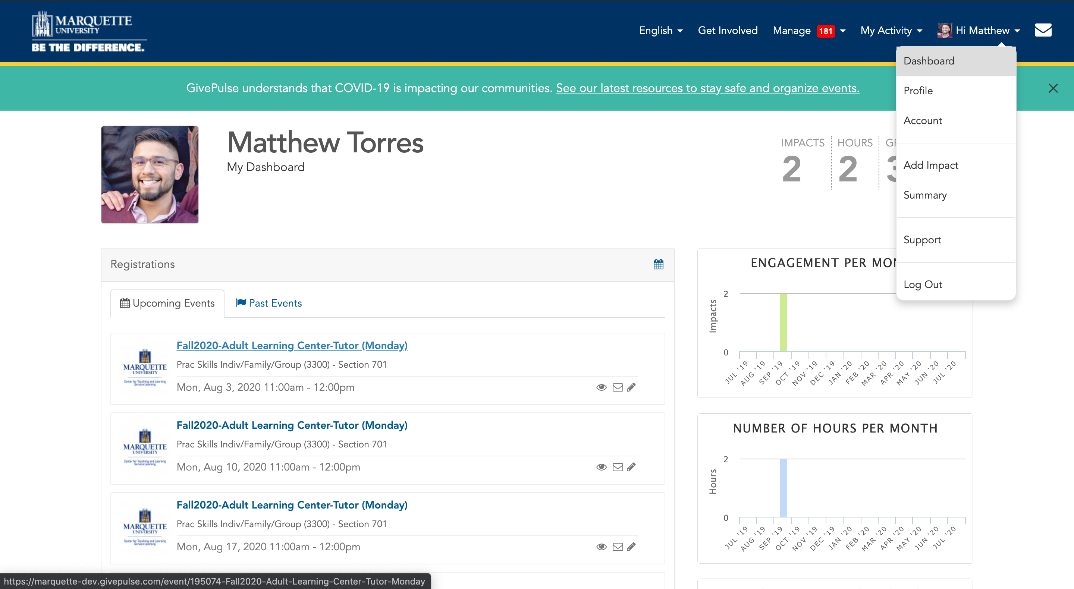
Canceling Registration
Notes:
If after you have registered your schedule changes or you notice a conflict, you can cancel your registration. However, you must cancel the registration before the end of the week-long sing-up period. Cancelling registrations can be very frustrating, so be sure to look over all of the information carefully before registering for an event. In order to cancel your registration, click on your name in the top corner and select DASHBOARD from the dropdown menu. Look under the UPCOMING EVENTS tab and select the event that you want to cancel.

Slide 13
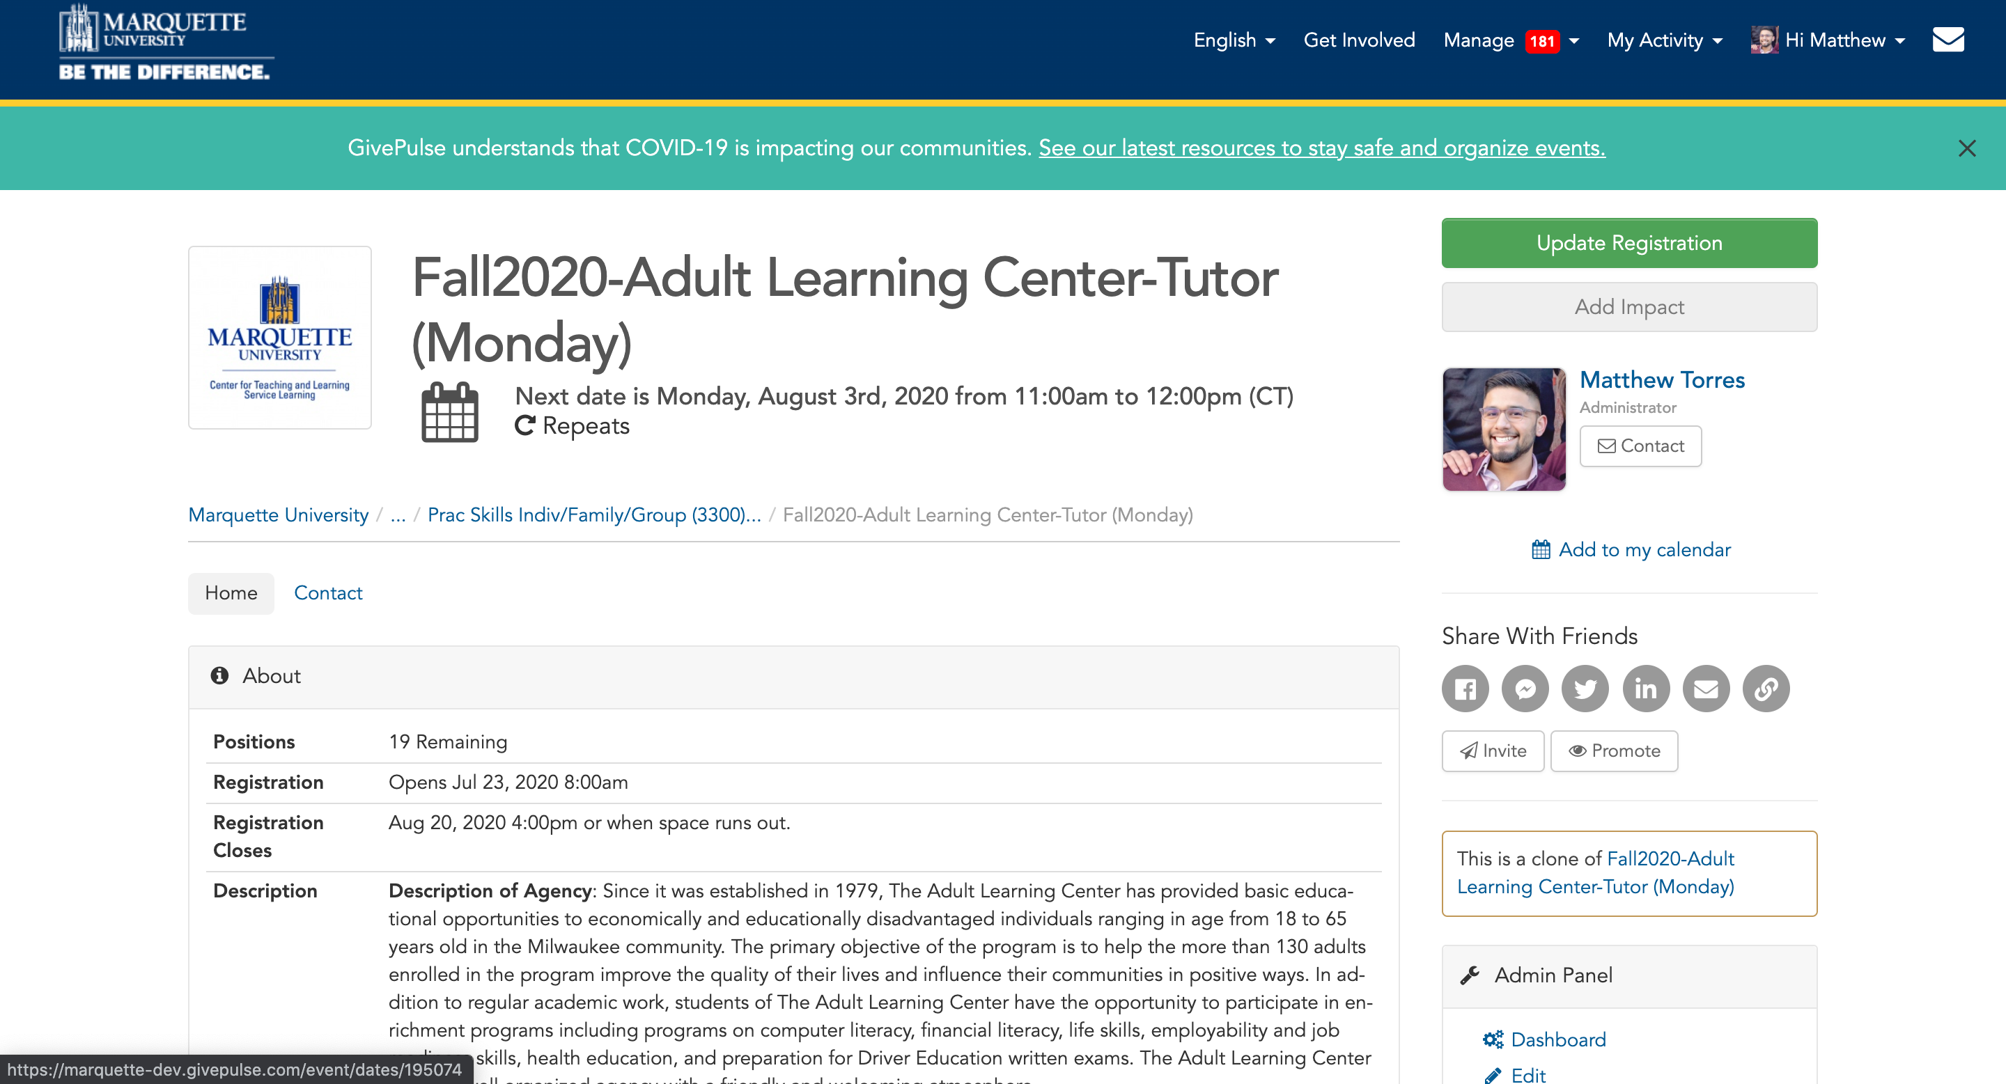
Canceling Registration
Notes:
Once you are in the event, select UPDATE REGISTRATION

Slide 14
Canceling Registration
Notes:
At the bottom of the screen, there is a CANCEL ALL button. Click cancel all and update to cancel your registration.

Slide 15
Need more help? Check out more resources on our website!
https://www.marquette.edu/service-learning/muengage.php
Email us: servicelearning@marquette.edu
Call us: 414-288-3262
Notes:
You can also find all this information in the student MUEngage guide that is on our website. It is linked here, and if you find yourself struggling with anything, please consult the guide before reaching out to our office. If you still do have questions, however, after watching this video and reading through the guide, please feel free to reach out to us at servicelearning@marquette.edu.

