Slide 1
Pausing, Support, and other Strategies for Self-Care: Lessons from Black Women Activists in Milwaukee
Soup With Substance, Marquette University
November 30, 2022
Photo Credit: Jonathan Bachman
Notes:
Ieshia Evans
Needs activists in title
https://globalnews.ca/news/2816652/the-woman-in-the-dress-black-lives-matter-protest-photo-hailed-as-iconic/

Slide 2
About Me
Black queer certified coach and full-spectrum doula who supports clients in accessing the pleasure and intimacy they desire.
My work is grounded in Black Feminist Praxis. I’ve been a part of the reproductive and racial justice movement for over a decade as an organizer, trainer, and facilitator.
A Forever Echoing Ida, from South Central, Los Angeles, and lives in North Carolina. Find me on the dance floor, traveling, or writing about queer and pleasurable things.

Slide 3
Outline of Presentation
Research Questions
Definitions of Activists and Self-Care
Sample
Ethnographic Methods
Findings
Embodied Practice
Photo Credit: CreateHER Stock

Slide 4
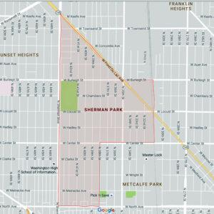
“We’re conditioned to be strong, to carry the weight of the community, our families, the world. That’s something that I think we all struggle to identify with until we learn to get the excess baggage off, and to take care of ourselves, feed ourselves. We’re not strong all the time, as the expectation is. I think that is a struggle for us all as Black women” -Ida
SHERMAN PARK
Notes:
1. Between 2011 and 2019, I engaged in reproductive justice and Black Lives Matter activism in Milwaukee and wanted to use my personal experiences as data for my dissertation. 2. During my activism in Milwaukee, I became connected to other Black women activists in the city and wanted to share their stories of community and care. 3. Although Milwaukee is often regarded as an epicenter for anti-Black racism and discrimination, activism in Milwaukee, particularly Black women’s activism, is often overlooked.

Slide 5
Research Questions:
How do Black women activists in Milwaukee, WI practice self-care?
What are the major stressors Black women activists experience?

Slide 6
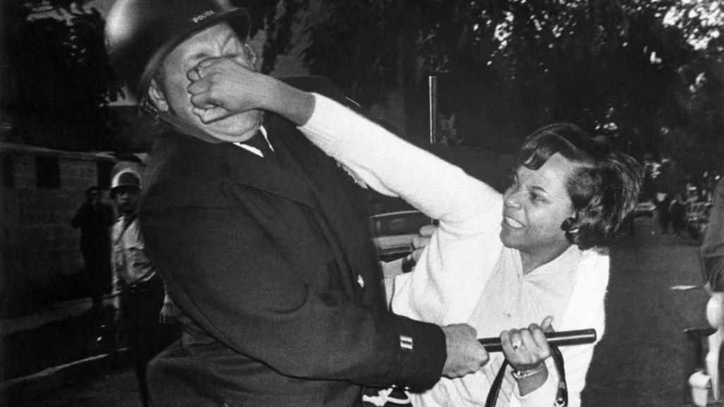
I define activists as “a person who uses their resources (monetary, Time, energy, body, talents, skills) for social change that will benefit the greater good.”
Notes:
According to this definition, each of the participants are activists, although they may use different descriptors, such as “resource finder” to explain their work on behalf of their communities.

Slide 7
Definitions of Self-Care
Orem defines self-care as deliberate actions that “can be reproduced from one time to another (practices), and… are selected and performed with the goal of keeping internal and external conditions constant according to some standard.”
The World Health Organization (WHO) defines health as “a state of complete physical, mental and social well-being and not merely the absence of disease or infirmity.”
My definition: “a transformative, on-going process involving practices that can be pleasurable, joyful, or mundane, and leads to optimal mental, emotional, spiritual and physical health”- Charmaine Lang
Notes:
Talk about why I group actions together. Talk about importance/relevance of using nursing self-care theory

Slide 8
Sample (n=39)
AGE:
median age was thirty-four; mean was thirty-seven
MARITAL STATUS:
(n=21) Single; (n=9) Married; (n=6) Divorced; (n=2) Widowed; (n=1) Separated
SEXUAL ORIENTATION:
(n=24) straight/heterosexual; (n=13) bisexual, queer, pan-sexual, same gender loving, or fluid; (n=2) preferred not to answer
GENDER IDENTITY:
(n=38) participants identified as women; (n=1) participant identified as gender non-conforming
EDUCATION:
(n=30) Participants attained a degree; (n=8) had “some college”; (n=1) did not answer
Annual INCOME:
(n=24) >$40k; (n=14) <$40k; (n=1) did not answer
Notes:
80k participants
How did I find participants?? Snowball
Mary

Slide 9
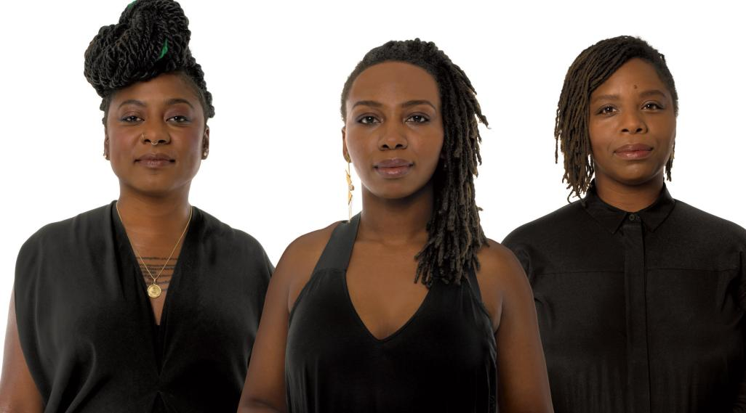
Popularity and Possibilities of Self-Care: An Ethnographic Study of Black Women Activists
in Milwaukee, Wisconsin
Black women activists defining self-care
Self-care practices:
The being and doing of self-care
Step up-step back
Taking a day off
Personal support network
Pausing
Photo Credit: Glamour Magazine
Notes:
Coping and self-care (differences/similarities). Why did I group coping and cannabis?

Slide 10
Thank you!!
Now, for some practice…
Photo Credit: CreateHER Stock

