Slide 1
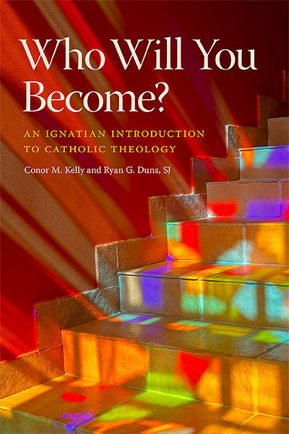

Who Will You Become?
Rev. Ryan G. Duns, S.J. and Conor M. Kelly

Slide 2
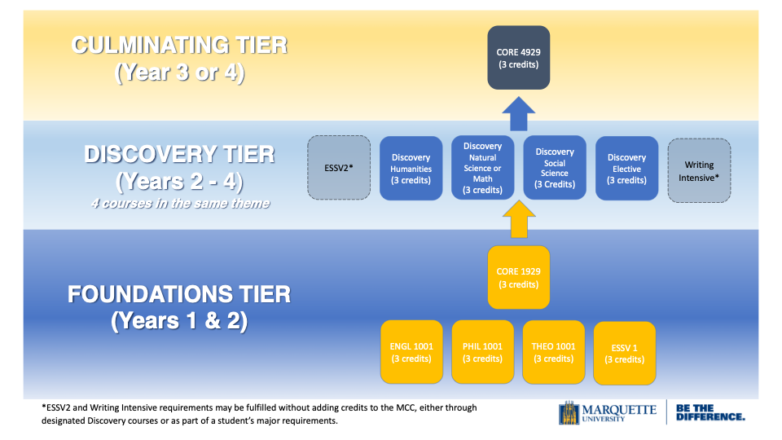
Marquette Core Curriculum (2018 – )

Slide 3
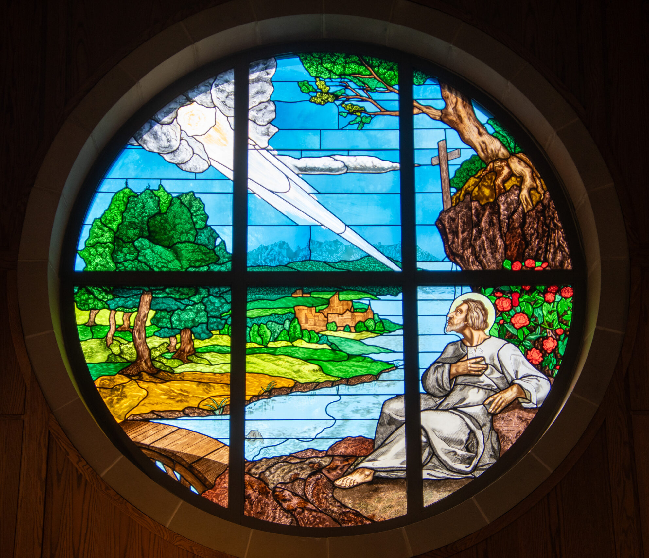
The Ignatian B.U.T.
Become Aware
Understand
Take Action

Slide 4
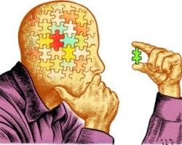
Becoming Aware
Chapter 1 – Where Are You?
Chapter 2 – Who Will You Become?
Chapter 3 – Why is Discernment Difficult?

Slide 5

understanding
Chapter 4 – The Light Side of a Dark Story
Chapter 5 – A New Vision
Chapter 6 – Consequential Living
Chapter 7 – Ready for Action

Slide 6

Taking Action
Chapter 8 – Finding a Place in It All
Chapter 9 – To Give and Not to Count the Cost
Chapter 10 – Finding God in All Things

Slide 7


Goals

Slide 8

Examen

Slide 9

Q & A

