Slide 1
Standard Operating Procedure for the Cadet Command Form 104-R,
Dated SEP 2013
(Planned Academic
Program Worksheet)
Notes:
ICO needs to focus on retention

Slide 2
Purpose of the CC Form 104-R
Verification of graduation date
Correct Graduation Date in Cadet Database for only one major.
Academic alignment with ROTC Classes
To ensure Cadet completes all required Army ROTC courses and that Cadet will graduate and commission as planned.
Correct CC Form 104-R equals correct ROTC contract length
Imperative initial CC Form 104-R reflects accurate length of study toward graduation
Initial CC Form 104-R will lock number of contract semesters in Cadet Database at time of signing the Army contract
While most academic majors are 4-year programs, you cannot assume e.g. some engineering students require 9 semesters to graduate because little to no ROTC courses count towards completing the undergraduate requirements.

Slide 3
Procedure

Slide 4
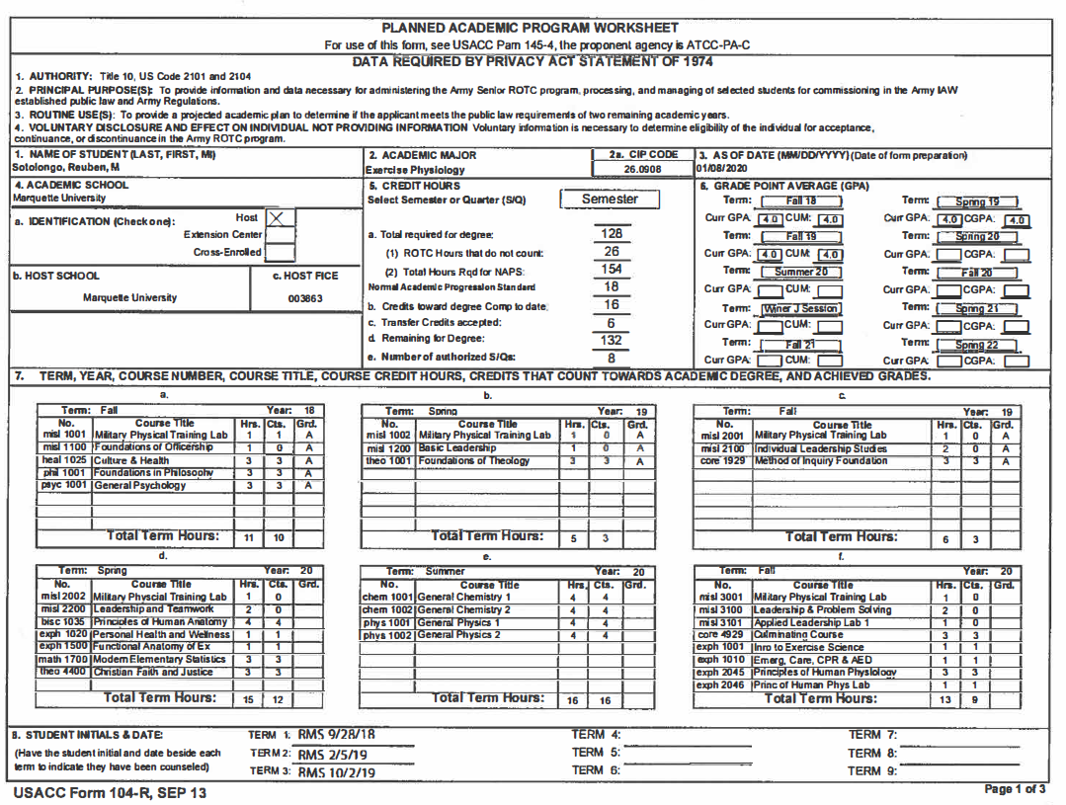
Cadre Initials
Change of Major Example
= all hrs
Only add up the ROTC hours that do not count towards your undergraduate degree. If it counts toward your degree place the appropriate number in Cts as used for misl 1001 below.
106
= remaining cts
Ensure misl courses are listed first, the remaining courses are then listed in all lower-case alphabet and numeric order.
These are the dates that you met with your Military Science Instructor for initial counseling at the beginning of each semester.

Slide 5
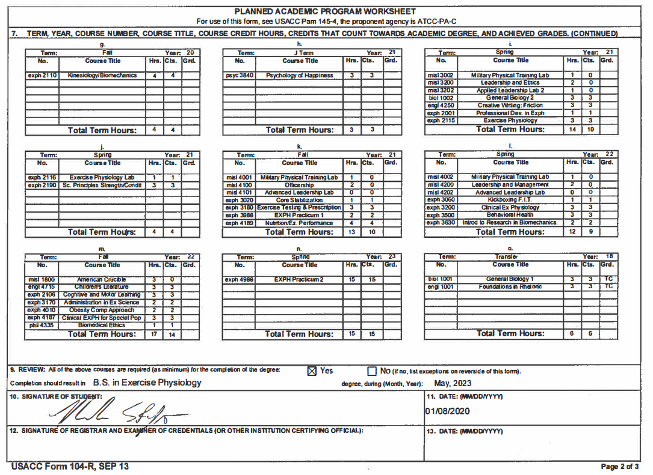
Cadre highlights misl 1800 or equivalent
This date should match block 3, 11, and on page 3.

Slide 6
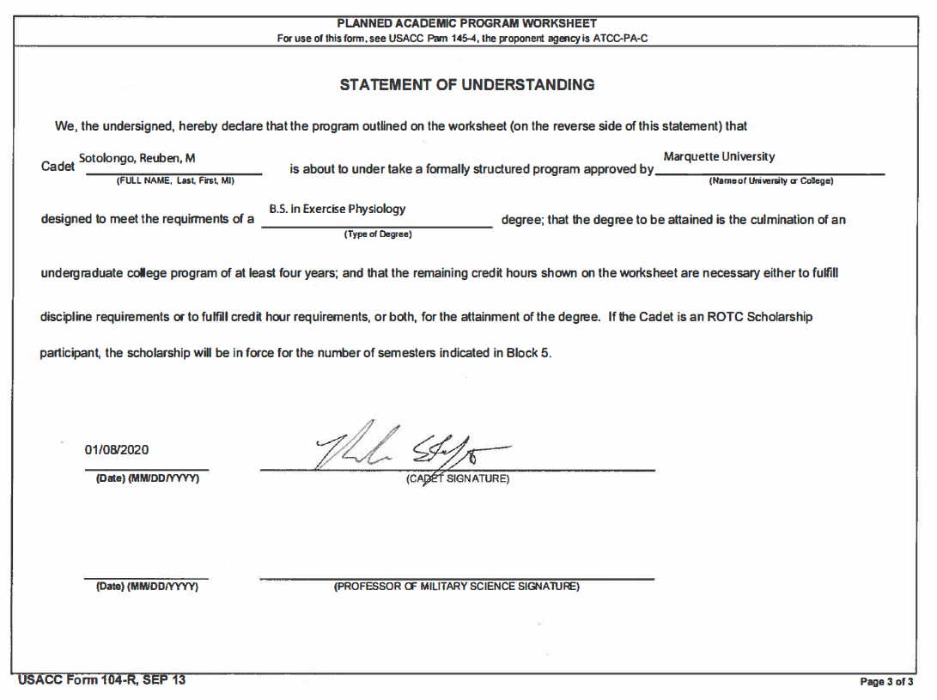

Slide 7
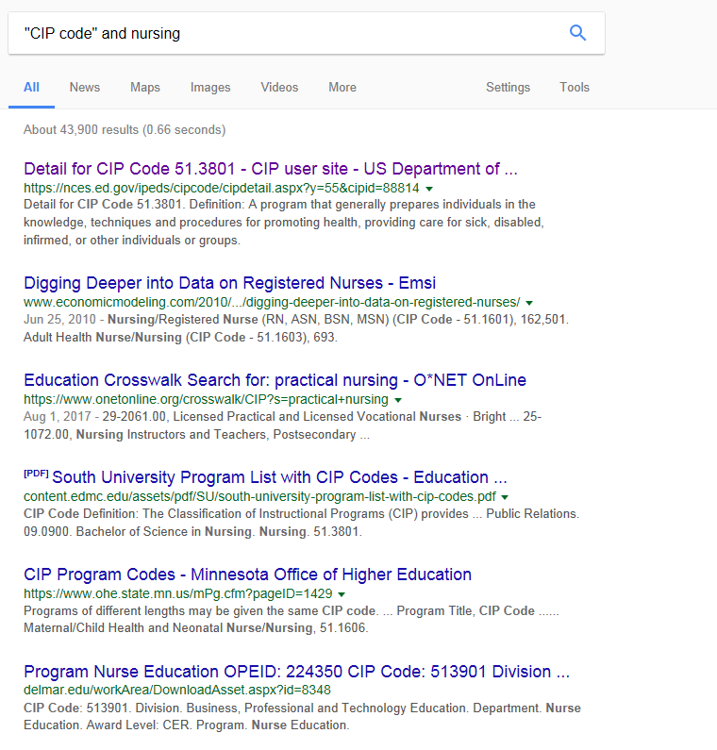
Classification of Instructional Programs (CIP) Code
Search “CIP code” and (major). Ensure you pick the CIP Code that displays for the https://nces.ed.gov website.
When typing CIP code type all 6-digits without placing the decimal.

Slide 8
Identification
MU = Host
UWM = Extension Center
MSOE = Cross-Enrolled
CUW = Cross-Enrolled
UWP = Cross-Enrolled
Federal Interagency Committee on Education (FICE)
MU = 003863

Slide 9
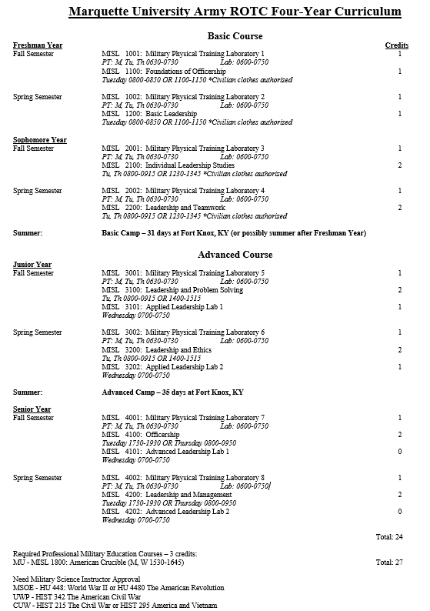
MU Professional Military Education (PME)

Slide 10
Marquette University Marquette Core Curriculum (MCC)
https://www.marquette.edu/core-curriculum/new-approved-courses.php https://bulletin.marquette.edu/undergrad/marquettecorecurriculum/#requirementstext

Slide 11
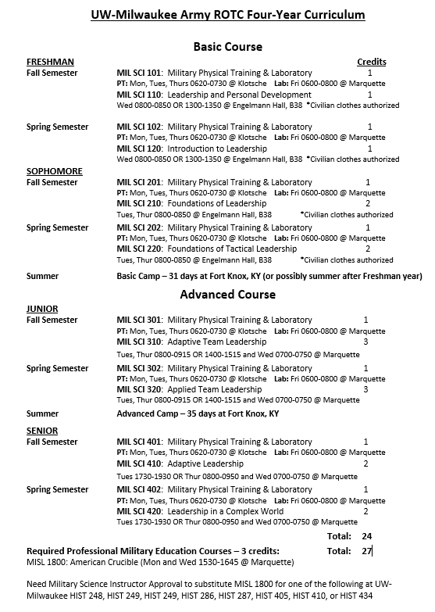
UWM Professional Military Education (PME)
Marquette University for Cross Enrollment
UW-Milwaukee for CC Form 104-R

Slide 12
UW-Milwaukee General Education Requirements
The General Education Requirements are intended to give structure to each student's education while providing the student the greatest possible freedom to design an individual academic program. These requirements include two major categories, competency and distribution.
The competency requirements are designed to assure basic proficiency in oral and written communication, quantitative literacy, and foreign language. The GER Quantitative Literacy Part A and Oral and Written Communications Part A requirements should be completed early in the academic career to ensure acquisition of critical skills for subsequent coursework. Many UWM schools/colleges require completion of Part A of those competencies prior to advancing to the professional portion of the major. Completion of the relevant Part A competency is also a prerequisite for some intermediate and advanced courses. The distribution requirements are designed to provide students with a broad body of knowledge in the areas of the arts, humanities, natural sciences, and social sciences as a foundation for specialization.
https://catalog.uwm.edu/policies/undergraduate-policies/#generaleducationtext
http://www4.uwm.edu/academics/undergraduatecatalog.cfm?u=index.html

Slide 13
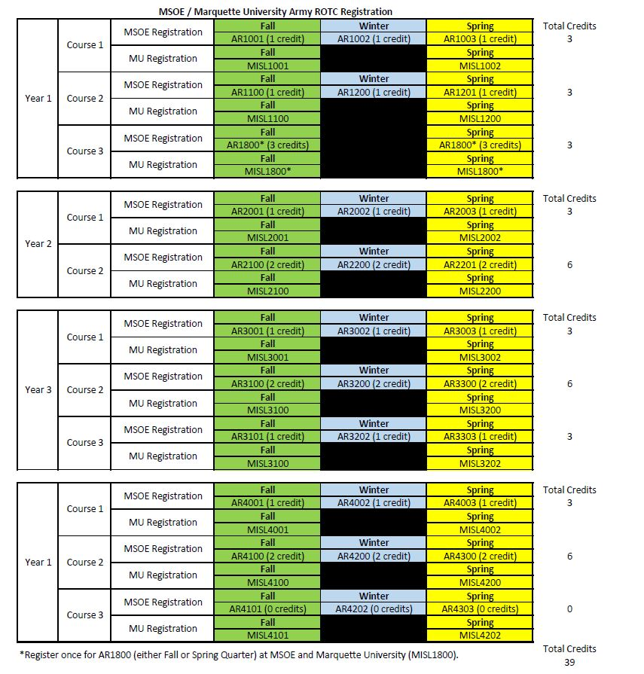
MSOE Professional Military Education (PME)
Marquette University for Cross Enrollment
MSOE Registration for CC Form 104-R

Slide 14
MSOE General Education Curriculum
MSOE requires all undergraduate students to take courses in disciplines outside their major. The general education curriculum will hone your mathematical and scientific reasoning, communication and information literacy skills, as well as provide a foundation in culture and cultural values, ethics and integrity.
In addition to the course requirements of your major, you’ll complete a minimum of 49 general education credits that include:
Mathematics and Science - 16 Credits Minimum
Freshman Studies - 12 Credits Minimum
Ethics - 3 Credits Minimum
Humanities and Social Science - 15 Credits Minimum
General Education Elective(s) - 3 Credits Minimum
Program Capstone Experience - Senior Design / Senior Project / Capstone Project - 3 Credits Minimum
https://www.msoe.edu/academics/how-we-teach/degree-structure/
https://catalog.msoe.edu/index.php
*Ensure you have the correct school year selected for the academic catalog.

Slide 15
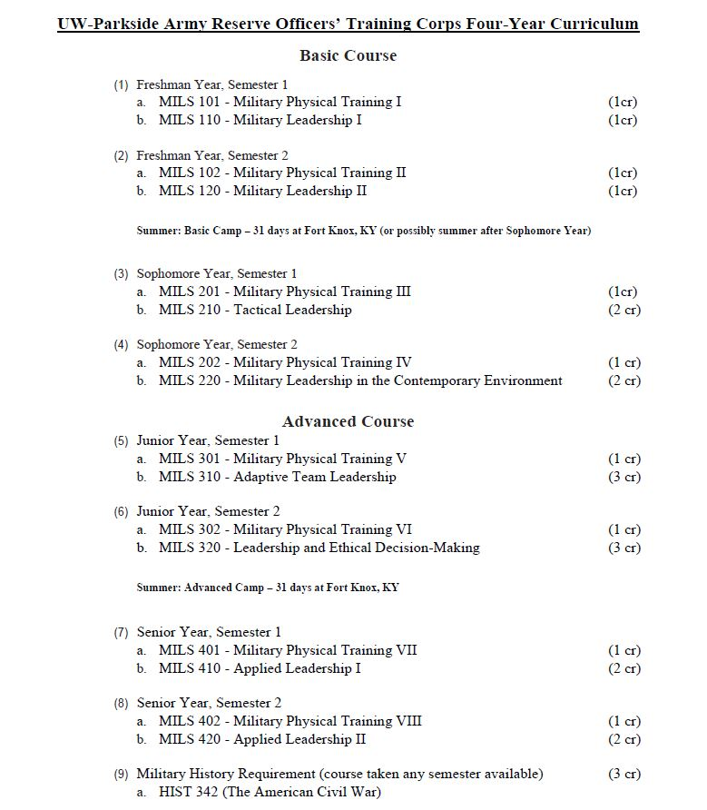
UWP Professional Military Education (PME)
Marquette University for Cross Enrollment
UW-Parkside for CC Form 104-R

Slide 16
UW-Parkside General Education
University Graduation Requirements
Math and English
You must complete a sequence of courses ending with ENGL 101 and MATH 102, Math 103 or MATH 111 before completing 60 credits. Where you start in the sequence is determined by the Wisconsin Placement Exam unless you have satisfactory transfer credit.
General Education
You must complete a minimum of 36 general education credits from the Humanities and the Arts, Social and Behavioral, and Natural Sciences.
Foreign Language
Two semesters of foreign language, or the equivalent of two semesters of one foreign language.
Ethnic Diversity
One 3-credit course dealing with issues of race and ethnicity within the United States is required. Courses that meet the ethnic diversity requirement may also fulfill a general education requirement.
Major Requirements
Specific requirements for your major is included in the course catalog.
https://www.uwp.edu/learn/academiccatalog/undergraduate.cfm

Slide 17
CUW Professional Military Education (PME)
Register for these courses at Marquette University for Cross Enrollment. Place these Courses on CC Form 104-R even though you do not register for them at CUW.

Slide 18
CUW Concordia Core
The Concordia Core embraces the distinctive Lutheran theology in the context of a dynamic educational experience that prepares you to achieve your God-given potential in 21st century career contexts.
The Core embraces six themes central to student intellectual inquiry and growth. Within these themes, you will enjoy choice and flexibility to maximize your interests and your learning goals by selecting courses that have a direct impact on your professional program or planned career major.
The Six Themes of the Concordia Core (Faith, Society and Culture, Human Creativity and Expression, The Natural World, Human Beings and Being Human, and Communication and Language).
The Concordia Core is divided into two parts: the Concordia Common Core (18 credits) and the Liberal Arts Dimensions (27 credits).
https://catalog.cuw.edu/undergraduate/university/acad-prog/trad/core/

Slide 19
Things to Remember
Visit your advisor once a semester.
Print the CC Form 104-R in three separate pages. That way minor changes (e.g. entering your grades and GPA) will not require your advisor to sign multiple times during one semester/quarter.
Remember where you saved it so you can make minor changes to update.
Apple versus Microsoft
Some classes are only taken once a year.
Do not miss prerequisite course(s).
If you change a course, ensure the new course meets the requirements that the original one satisfied or meets a requirement that you planned to satisfy in the future.
Contracted (or pending contracted) Cadets cannot change major unless approved by Professor of Military Science.

Slide 20
Resources
USACC Form 104-R dated September 2013, use the Microsoft Excel version before attempting to use the Adobe PDF version.
https://www.cadetcommand.army.mil/res/files/forms_policies/forms/104-R%20Planned%20Academic%20Worksheet%2009-25-13.pdf
Military History Alternatives with Military Instructor Approval

