Slide 1



Slide 2
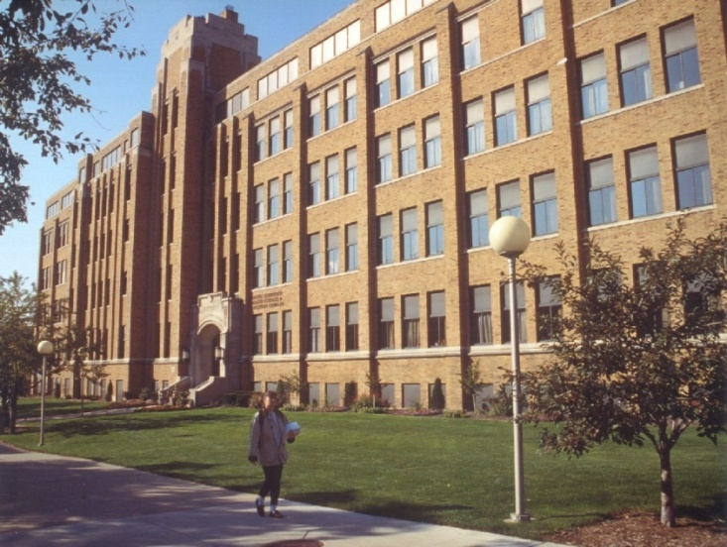
College of Health Sciences
We are here, stop in and say “hi”!
Schroeder Complex 244
Michelle Schuh, Assistant Dean
Dr. Kim Halula, Associate Dean
Dr. William Cullinan, Dean

Slide 3
From your check-in materials:
CHS Folder (blue) w/key resources
  Check the label on your CHS folder for correct major
      BISC = Biomedical Sciences
      CLLS = Clinical Laboratory Sciences
      EXPH = Exercise Physiology (includes direct-admit AT)
      SPPA = Speech Pathology and Audiology

Slide 4

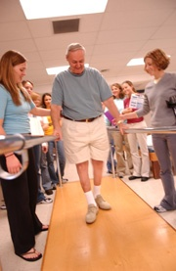
..also includes Special Admission Programs and athletics:
Direct PT
Direct AT
Pre-Dental Scholar
Honors
Athlete - Sport

Slide 5
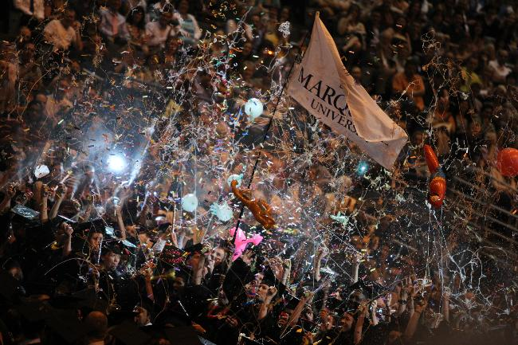
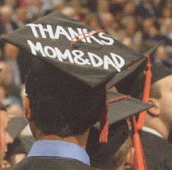
Bachelor of Science Degree
  B.S. Degree completion – by the numbers
    128 total credits (average 16 credits/semester)
    At least 60 credits completed at MU
    Final 30 credits must be completed at MU
    Complete all major courses with a C or better

Slide 6
B.S. Degree completion
Degree Completion (128 credits)
General Electives
MCC
(Marquette Core Curriculum)
Major
Cognates
Freshman Year

Slide 7
B.S. Degree completion
Degree Completion (128 credits)
General Electives
MCC
(Marquette Core Curriculum)
Major
Cognates
Freshman Year

Slide 8
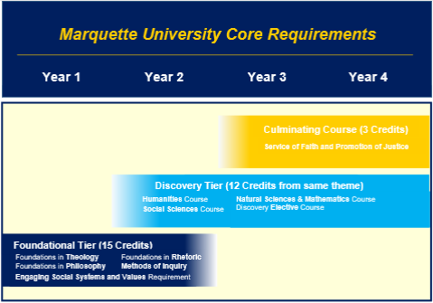

Slide 9
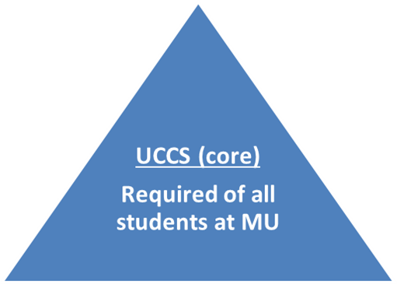
B.S. Degree completion Marquette Core Curriculum (MCC)
  First Year Focus
  Foundations Tier – 5 courses (15 cr.)
  ENGL 1001 Foundations in Rhetoric
  PHIL 1001 Foundations in Philosophy
  THEO 1001 Foundations in Theology
  CORE 1929 Methods of Inquiry
  Engaging Social Systems and Values 1
MCC (core)

Slide 10
B.S. Degree completion Marquette Core Curriculum (MCC)
  Discovery Tier – Take 4 courses within the same theme (12 cr.)
  1 Humanities course
  1 Social Science course
  1 Natural Science and Mathematics course
  1 Elective course (from any content area)
  Culminating Course – CORE 4929
MCC (core)
Note: Through the core or other degree requirements must also complete a class designated Writing Intensive (WRIT) and a class designated Engaging Social Systems and Values 2 (ESSV2)

Slide 11
B.S. Degree completion Cognates/Foundational Courses
  Vary by major and track (DRPT, DRAT, PRDS, etc.) – may include BIOL, CHEM, PHYS, MATH
MCC (core)
Cognates
Foundational courses for major i.e. CHEM, BIOL

Slide 12
B.S. Degree completion Major Requirements
  Major (and minor) courses must be completed with a C or better to complete requirement.
Major
33-54 credits depending on major (C or better)
MCC (core)
Cognates
Foundational courses for major i.e. CHEM, BIOL

Slide 13
B.S. Degree completion General Electives
  Minor???
  2nd major???
  Just for fun – dance???
General Electives
Any courses at MU
Major
33-54 credits depending on major (C or better)
MCC (core)
Cognates
Foundational courses for major

Slide 14
B.S. Degree completion
Degree Completion (128 credits)
General Electives
Any courses at MU
Major
33-54 credits depending on major (C or better)
MCC (core)
Cognates
Foundational courses for major
Freshman Year

Slide 15

Understanding your degree requirements
Online Undergraduate Bulletin at http://bulletin.marquette.edu/undergrad

Slide 16
Understanding your degree requirements
Go to the College of Health Sciences section of the Undergraduate Bulletin
  Select department of major, then click on:
    “Degree Requirements” tab
      Shows breakdown of 128 total credits for each degree requirement category
      Lists all foundational/cognate courses for major
    “Major Requirements” tab
      List required major courses and major electives
      Semester-by-semester curriculum plans
    “Courses” tab
      Course credits, descriptions, & prerequisites

Slide 17

Other UG BULLETIN content…
  Other majors or minors?
  Go to the bulletin section for the college that offers the minor
  Common minors for students in CHS:
    Psychology (Klingler College of Arts and Sciences)
    Spanish for the Professions (Klingler College of Arts and Sciences)
    Health Studies (College of Nursing)
    Business Administration (College of Business)

Slide 18
Other UG BULLETIN content….
University section - policies and procedures that are not college/major specific:
  Honors Program (under “Academic Programs”)
  Core Curriculum (MCC)
  Attendance Policy
  Grading Scale
  Academic Integrity
  AP/IB credit award chart

Slide 19
Fall Course Selection Considerations
Foreign language
Test credits
Transfer credits

Slide 20
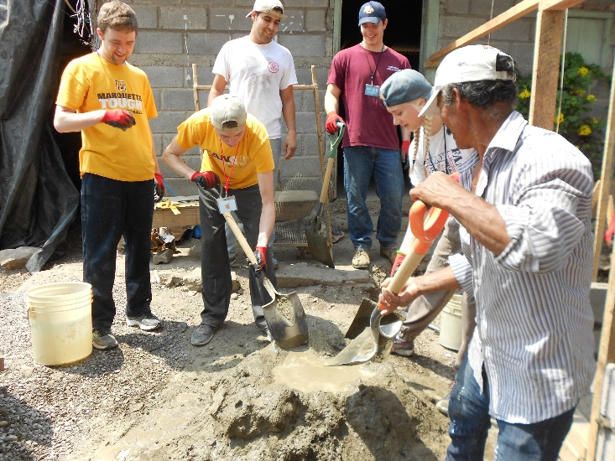
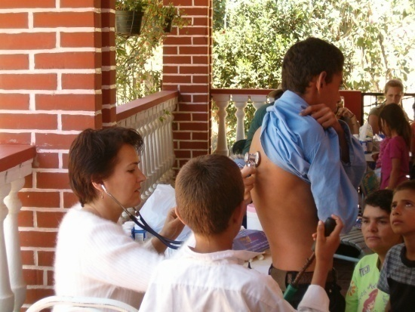
FAQ’s: Second Language
  Not required for any major in CHS, may fulfill MCC or general electives.
  Placement test required for students who took French, German or Spanish in high school
  3001 – first course that counts toward a major or minor

Slide 21
FAQ’s: Test Credits (AP or IB)
  AP/IB award chart in UG bulletin, click on “Admission and Readmission to the Undergraduate Colleges” then “Placement Exam/Credit”
  AP credits will be received as a download from College Board (if you reported MU when you took the exam)
  IB credits – must contact IB to have score report sent to MU
  Credits apply to your undergraduate degree, but may not fulfill requirements for some professional or graduate schools

Slide 22

FAQ’s: Test Credits (AP or IB)
  Rationale:
  AP credits are not graded, won’t be included in science gpa vs. earning A’s as college courses
  Schools that do accept science AP, typically require advanced courses in same content area
  Science content will be required for admission test for professional school (jr./sr. year at MU)
  Tuition is the same for 12 credits or more (full-time status) and professional schools like to see 15 credits or more a semester
Non-science and Math AP accepted by majority of professional schools
We recommend taking science prerequisites (BIOL, CHEM, and/or PHYS) for college credit

Slide 23

FAQ’s: Test Credits & Fall Registration
  ENGL 1001: if you might earn test or transfer credit for ENGL 1001, register for a different core course (PHIL 1001, THEO 1001, ESSV1 or CORE 1929)
  If you don’t earn the credit you would then take ENGL 1001 in the spring term
  Won’t be dependent on waiting for results and won’t have to change your fall schedule

Slide 24
FAQ’s: Test Credits (other than ENGL 1001)
  If you know you have earned credit (i.e., took exam prior to senior year) :
    Register for a different course if you want to keep the AP/IB credits
    Register for the same course if you want to take the class for a grade (test credits will be removed when successfully complete the course)
  If you don’t know your score:
    Register for the course
    MU receives the download of AP scores in the first part of July, then you will be able to view your credits in CheckMarq
    If you need to, you can adjust your schedule when registration re-opens July 17th

Slide 25
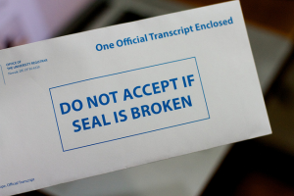
FAQ: Transfer (Dual) Credits
Transfer Credits
  College credits earned at another institution
  If course completed prior to the start of the fall semester, official college transcripts should be sent by the institution to:
    Marquette University
    Office of Undergraduate Admissions
    P.O. Box 1881
    Milwaukee, WI 53201-1881

Slide 26
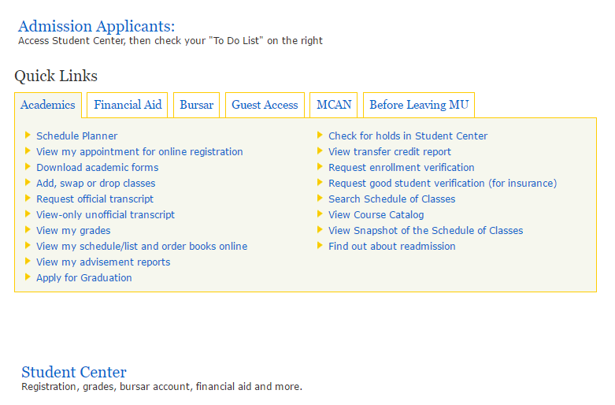
CheckMarq – viewing test/transfer credits

Slide 27
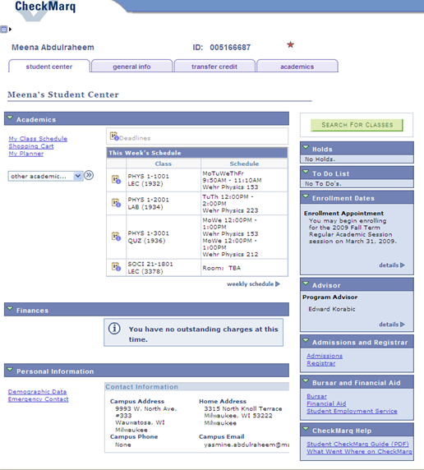

Slide 28
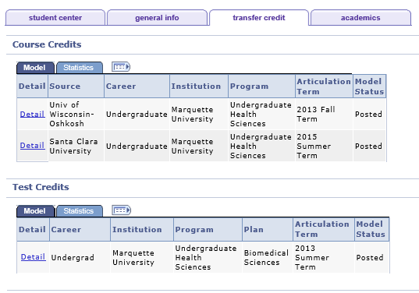

Slide 29
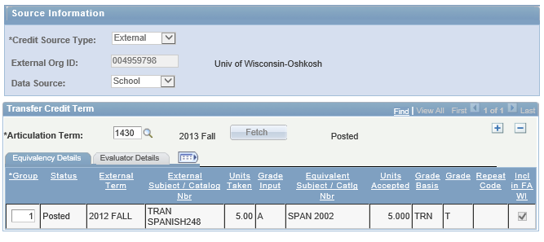
Detail Course Credits (Transfer Credits)

Slide 30
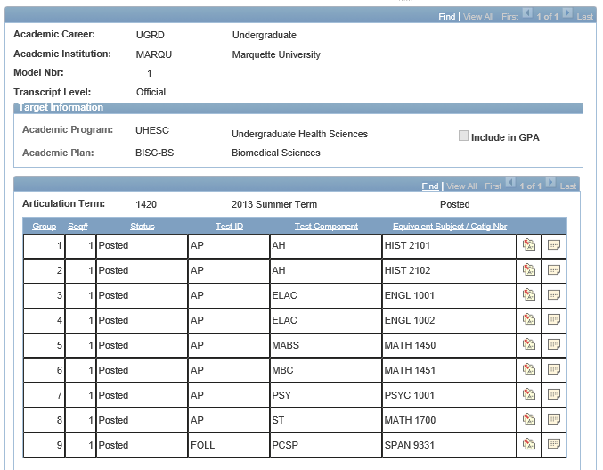
Detail Test Credits (AP/IB)

Slide 31

Course Scheduling Basics
3 credit course usually meets 2-3x’s/week
  MWF for 50 minutes or TTh for 75 minutes
10 minutes between classes is sufficient time to get to another class on campus
Develop a schedule that has:
  Downtime at least every third class (don’t schedule more than three classes back to back)
  Classes each day of the week

Slide 32
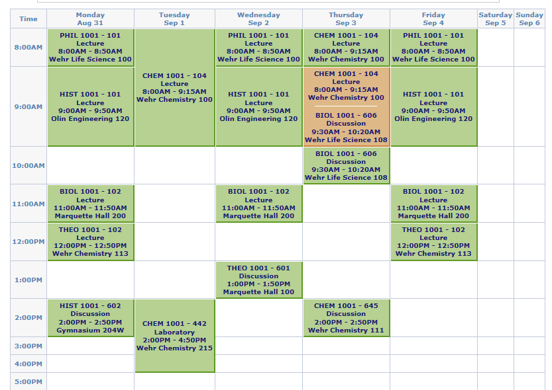
BIOL has lecture and discussion

Slide 33
CHEM has lecture, lab & discussion

Slide 34
Homework that will help your registration process tomorrow:
Worksheet on the left side of your folder
  Questions about long-term interests, test/transfer credit, second major, minor, etc.
  Place for questions you want to ask tomorrow
Bring the completed worksheet and folder with you tomorrow

Slide 35
Advising in CHS
Mandatory “advising week”
  After midterm break, must meet with your adviser to review your midterm grades and to determine classes for the next semester
  Unable to register for classes until advising form is complete
  Other meetings requested by student as needed
Other issues/questions – If you don’t know where to go with a question/issue, you can always contact the CHS office!!!!
Additional advisers: HCOR – Amelia Zurcher (amelia.zurcher@mu.edu); FFP, EOP, etc.

Slide 36
Advisor and contact information (details)

Slide 37
IMPORTANT DATES (yellow handout)
July 17: You will have access to change your fall schedule
August 23: New student orientation begins
August 27: Classes begin
September 3: Labor Day; no classes
September 4: Last day to make changes to your fall class schedule (before midnight)
October 18-21: Midterm Break
Oct. 29 – Nov. 3: Mandatory advising for spring 2018
December 15: Final exams end
Full academic calendar available online

Slide 38

Academic Information
Mid-term and Final grades are issued only via CheckMarq (you must log in to check grades)
FERPA – Family Educational Rights and Privacy Act
Set up guest access in CheckMarq so parents can see financials and/or grades

Slide 39
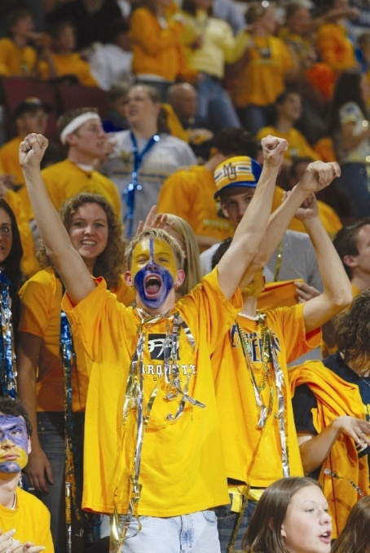
THANK YOU!!!!!
but you do have homework

