Slide 1
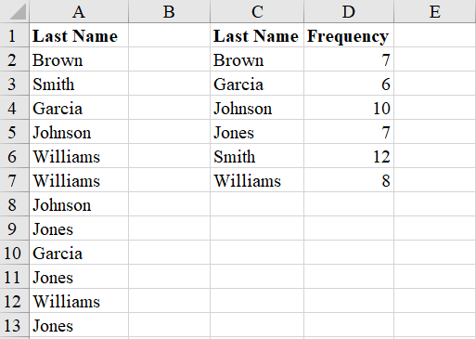
Bar Chart
The data (here using the text’s file Names2018 as in chapter 2, exercise 5) must be in Frequency Distribution form. If it is not, please see the Frequency Distribution (Categorical Data) presentation.

Slide 2
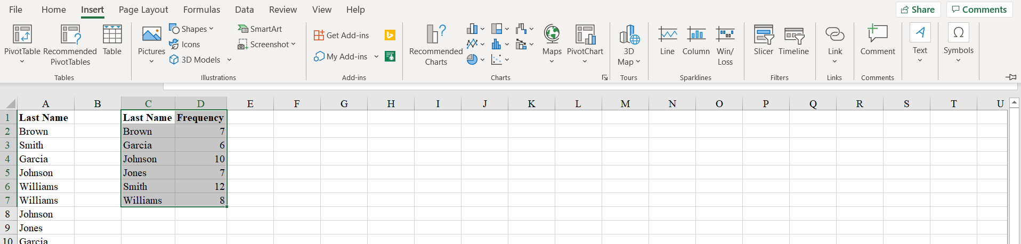
Bar Chart
Click on the Insert tab
Select cells C1:D7 (your Frequency Distribution)
Choose Recommended Charts or Insert Column or
Bar Chart

Slide 3
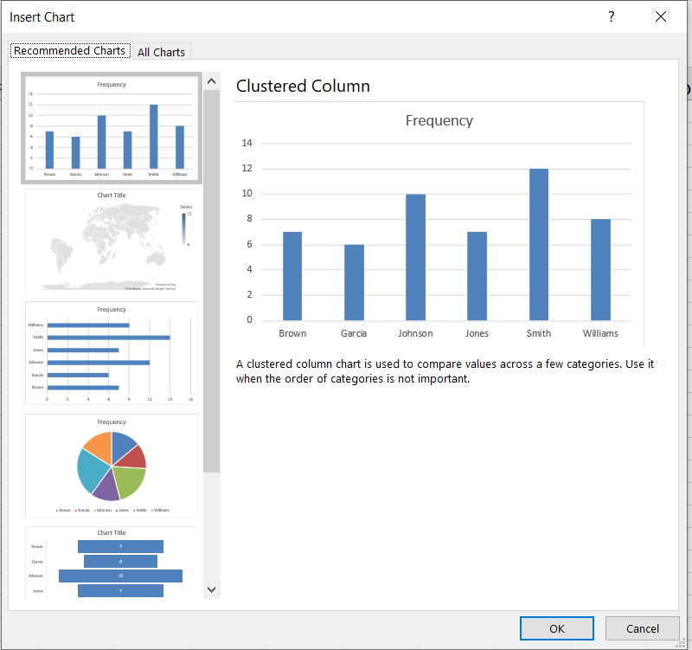
Bar Chart
Select the basic Clustered Column graph (but note the other possibilities for future reference)

Slide 4
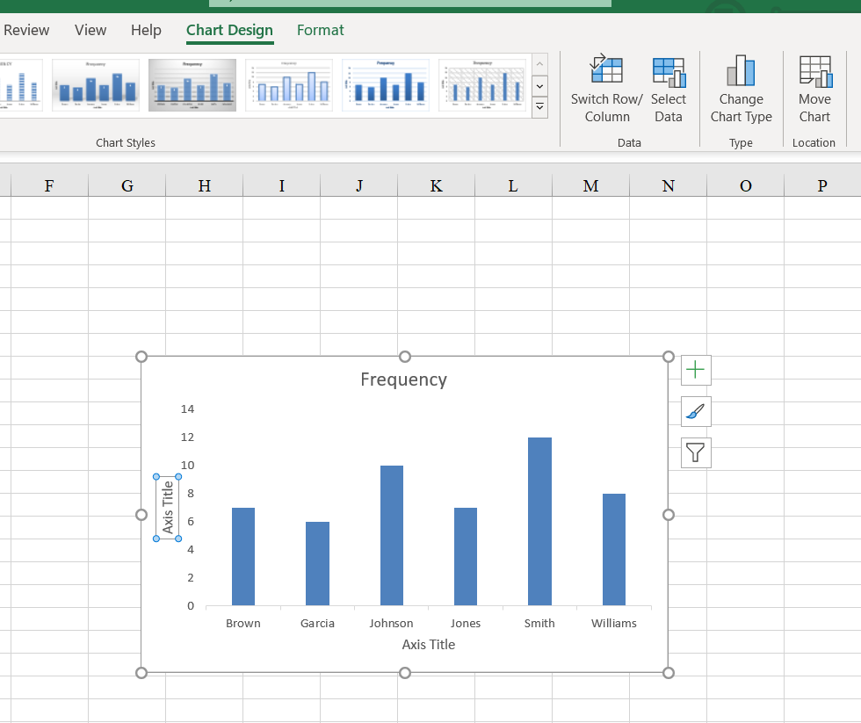
Bar Chart
You will get a pretty basic bar graph.
Use Chart Design and Chart Tools to make your graph prettier and give it the appropriate labels.

Slide 5
Bar Chart

