Slide 1
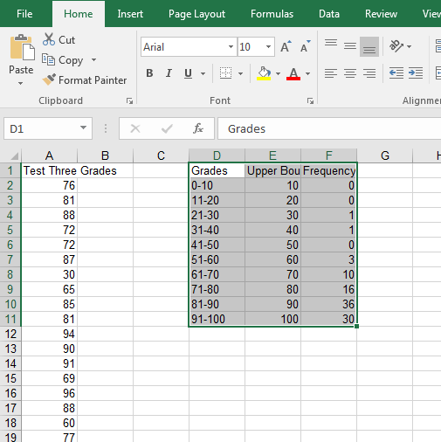
Histogram
The data must be in Frequency Distribution (see presentation if needed) form for Excel to draw a histogram
Make your Frequency Distribution active.

Slide 2
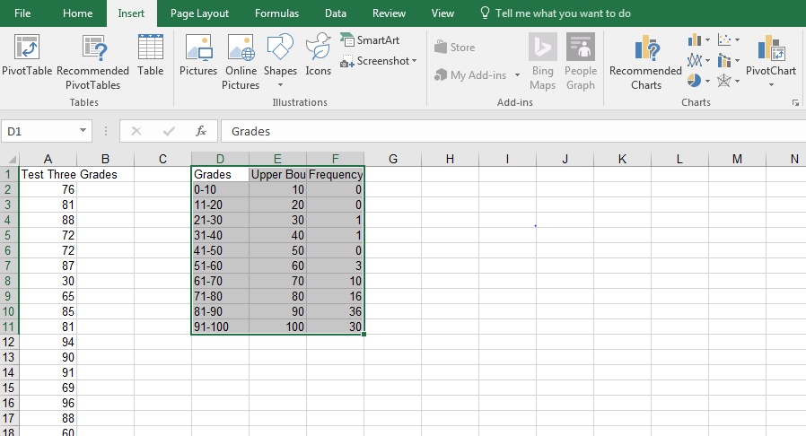
Histogram
Click on the Insert tab then Recommended Charts or Insert Column or Bar Chart

Slide 3
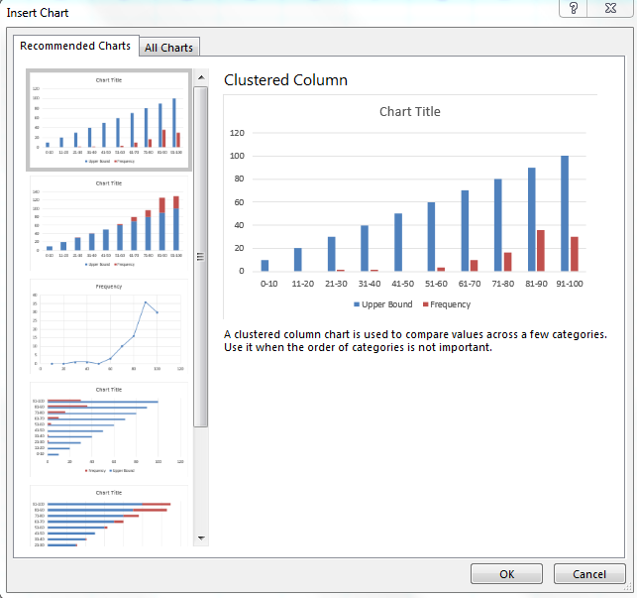
Histogram
Choose Clustered Column.

Slide 4
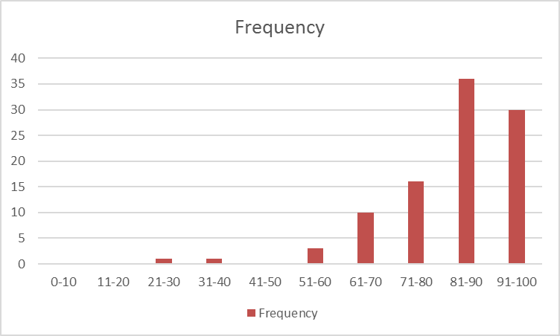
Histogram
Click on one of the Upper Bound bars and delete it.

Slide 5
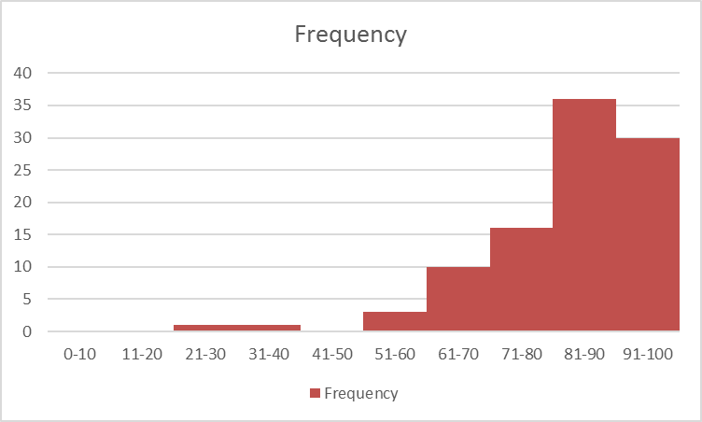
Histogram
Adjacent bars of your histogram should touch.
Right click on any of the frequency bars and choose Format Data Series…
Make the Gap Width 0%

Slide 6
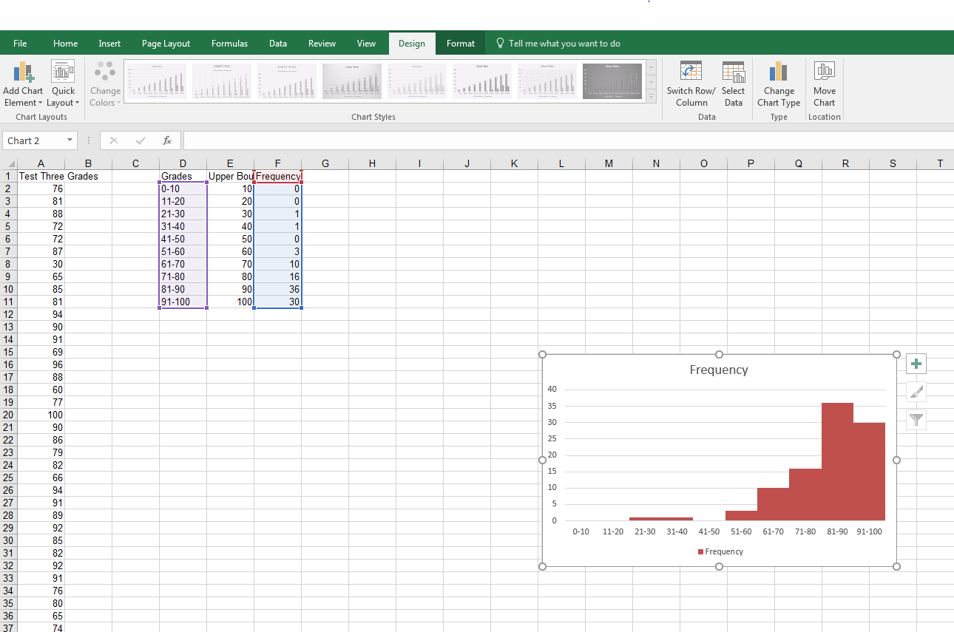
Histogram
Use Chart Tools (at the top of the page) and Chart Elements (the big green plus sign) to add titles, axis labels, etc.

Slide 7
Histogram

