Slide 1
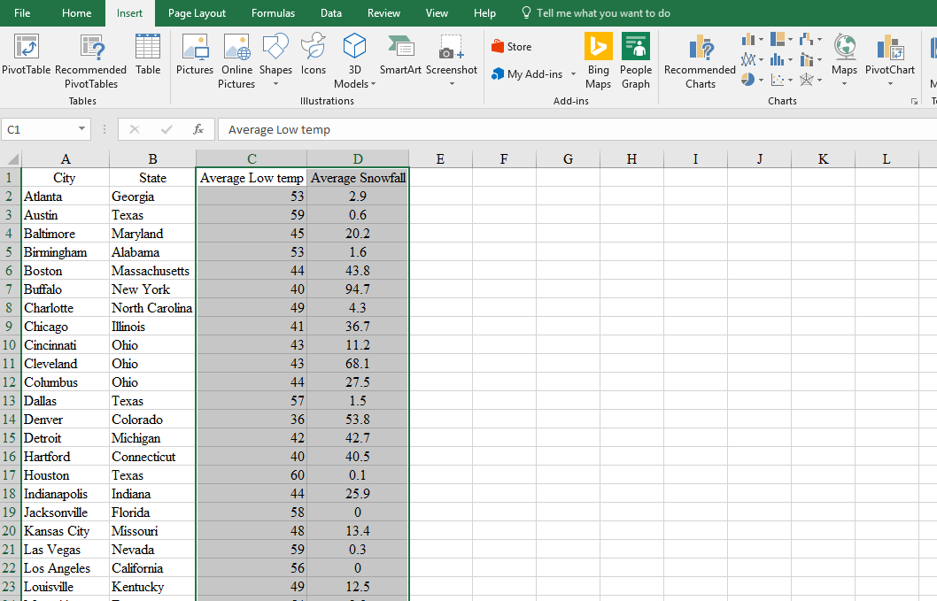
Scatter Diagram
The following gives you the scatter plot for exercise 40 in
chapter two of the text. Use the Snow data set.
Select Cells C1:D52
Click on the Insert tab, choose Recommended Charts or Insert
Scatter or Bubble Chart

Slide 2
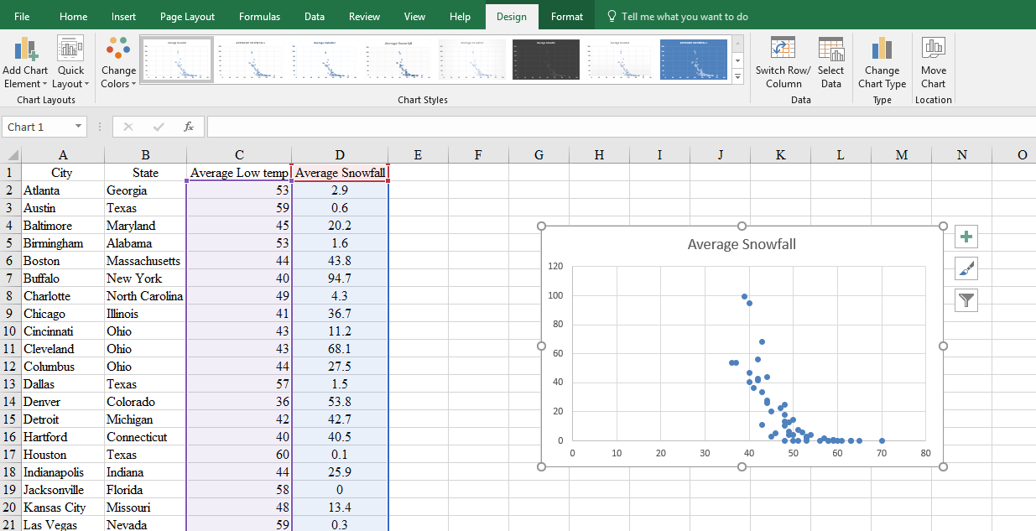
Scatter Diagram
Select the most basic scatter diagram (but note the other
possibilities for future reference)
Use the Chart Tools (at the top of the page) and Chart
Elements (the big green plus sign) to make
your graph prettier and give it the appropriate labels.

Slide 3
Scatter Diagram

