Slide 1
MS Bookings Workshop
Highlighted Topics:
Within Personal booking page*: Create or edit existing meeting that uses specific open days/times on your Outlook calendar.
Within Personal booking page:* Create or edit existing meeting that uses any open time within parameters on your Outlook calendar.
For repeat users: use the Shared bookings pages to edit a previous bookings page that you set exact days/times that is DISCONNECTED from your Outlook calendar.
* It’s preferred to use Bookings to pull from what’s open on your calendar.

Slide 2
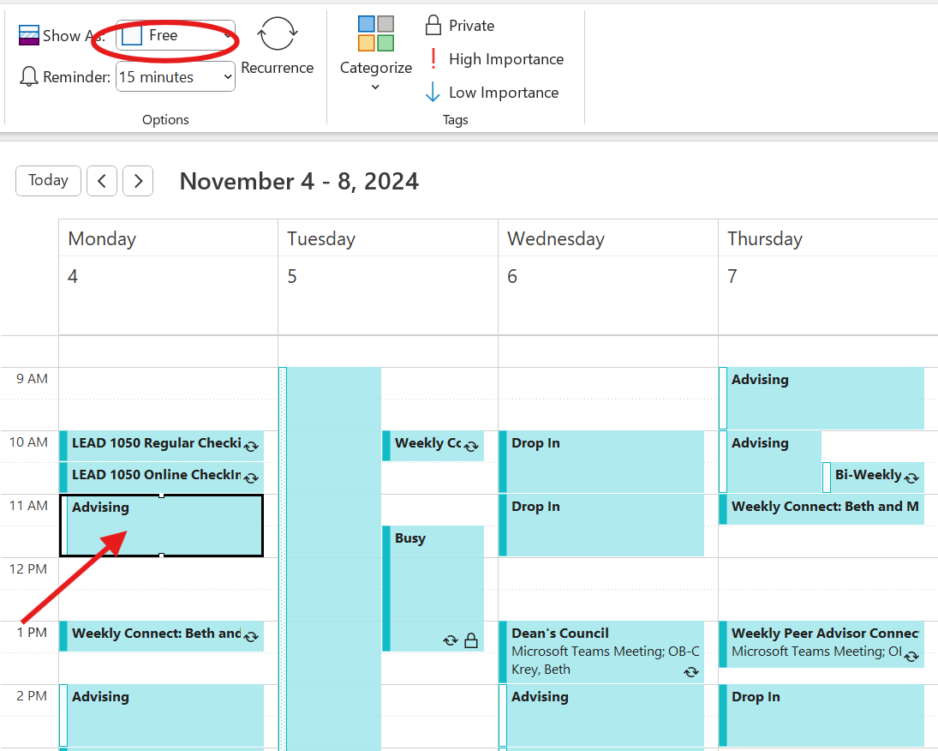
For Option 1: Within Personal booking page Create or edit existing meeting that uses specific open days/times on your Outlook calendar
It may be helpful to preset advising time on your calendar but schedule as “free”.
This ensures that I decline other non-advising meetings and am aware of the time set aside specific to advising.
Keep a list of the days/times that you are planning to have as Advising and use this to build your Bookings page.

Slide 3
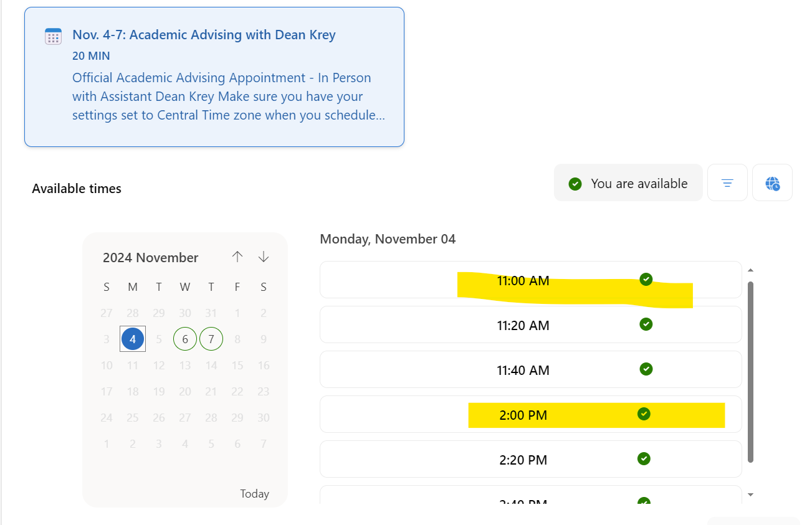
For Option 1: Within Personal booking page Create or edit existing meeting that uses specific open days/times on your Outlook calendar

Slide 4
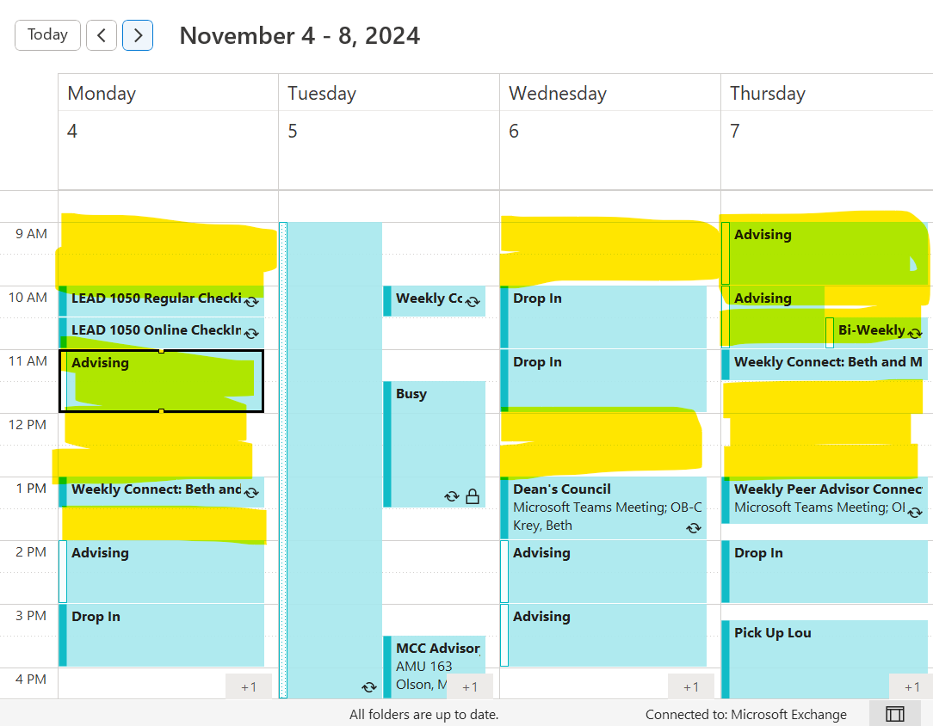
For OPTION 2: Within Personal booking page Create or edit existing meeting that uses open time within parameters on your Outlook calendar.
Create what parameters you will set for when you would advise when free. Example: Anytime free on Mondays between 9 AM-2 PM. Be sure to set time blocks for when you do not want to advise.
In this example – anytime I am “Free” between 9 AM-2PM, whether or not I set aside specific timings, the system will pull from the highlighted areas.

Slide 5
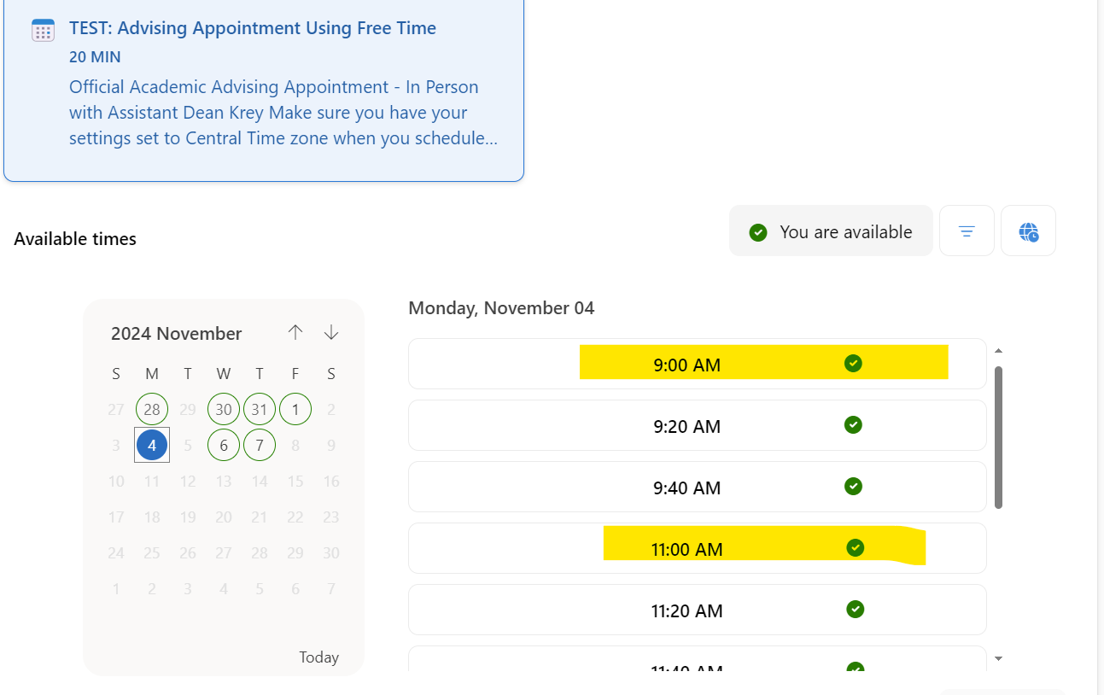
For OPTION 2: Within Personal booking page Create or edit existing meeting that uses open time within parameters on your Outlook calendar.

Slide 6
FOR OPTION 3: For repeat users Use the Shared bookings pages to edit a previous bookings page that you set exact days/times that is DISCONNECTED from your Outlook calendar.
You will only be able to go into a previous build and edit the days/times for the upcoming service.
Will likely need to talk with Drew and/or Beth about this.

Slide 7
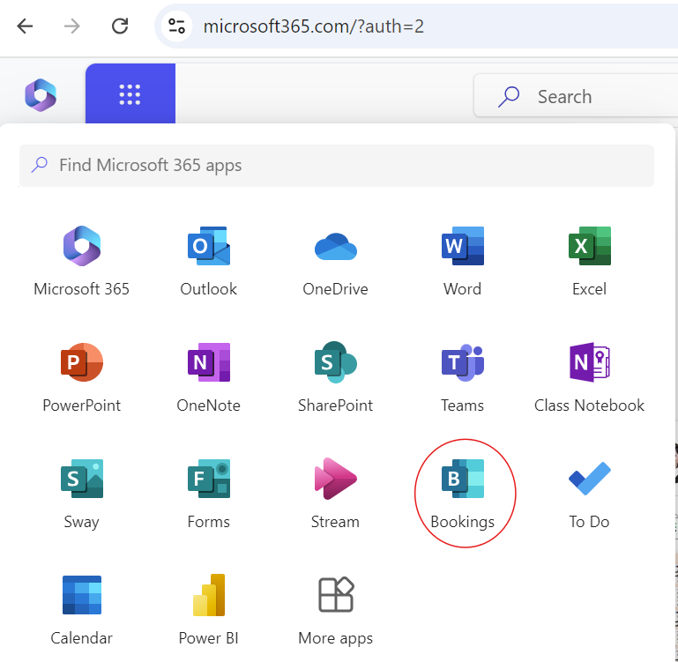
Let’s get started
For setup of OPTION 1 or 2 follow the handout of steps
Log into One Drive: Go to https://portal.office.com/
Navigate to the Bookings app:

Slide 8
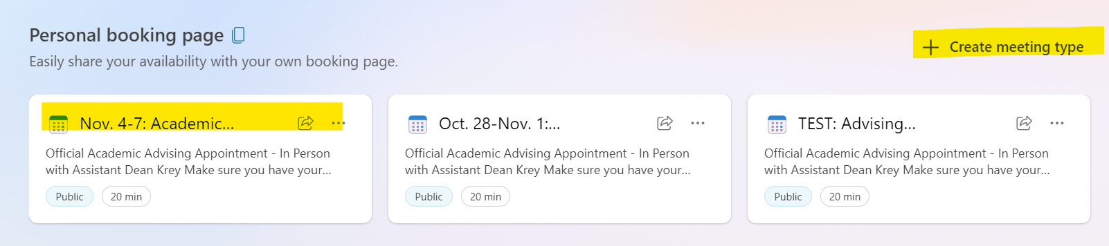
You will either edit an existing meeting, or create a new meeting type
My example has three events
OPTION 1: Using set days/times that are different each week – I have two meetings types, one for Week 1 and one for Week 2.
OPTION 2: “TEST” pulls from anything open during set days/times.

Slide 9
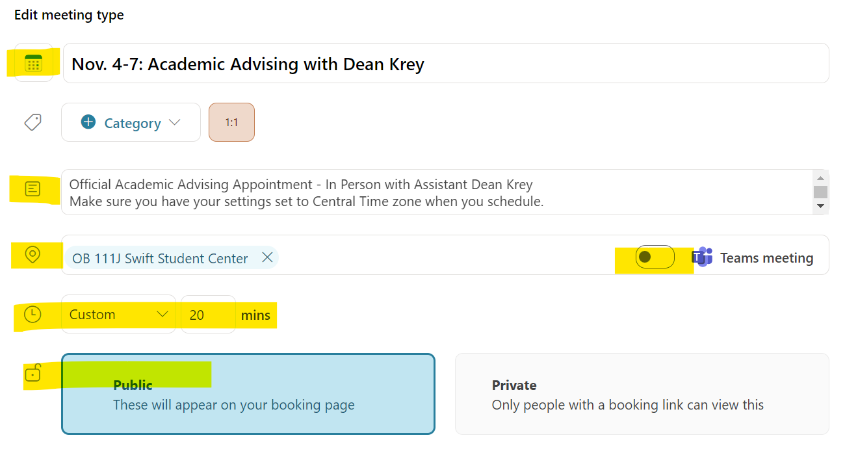
Fill in key areas:

Slide 10
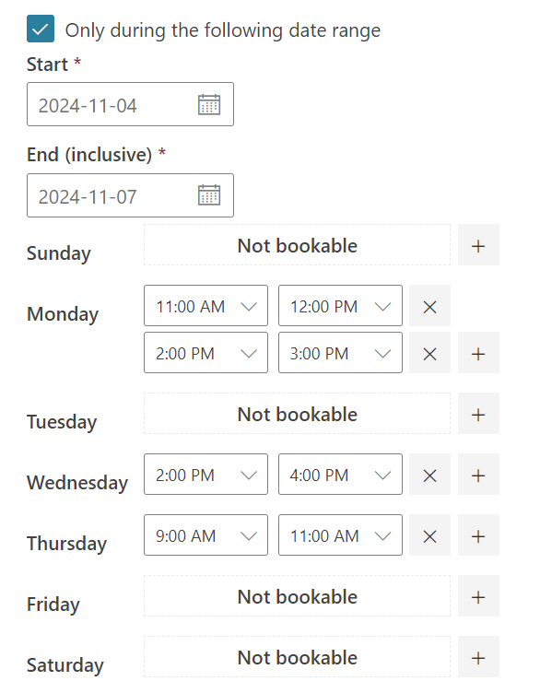
Set up appointment timing/blocks:

Slide 11
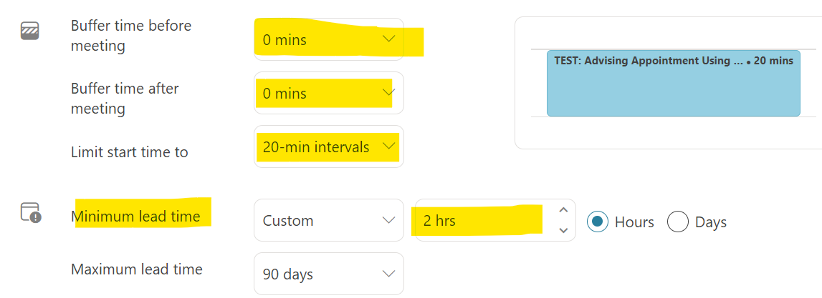
+ Advanced options

Slide 12
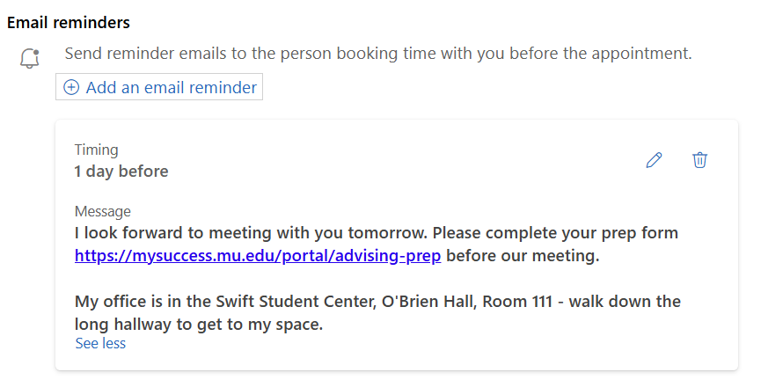
Email reminders

Slide 13
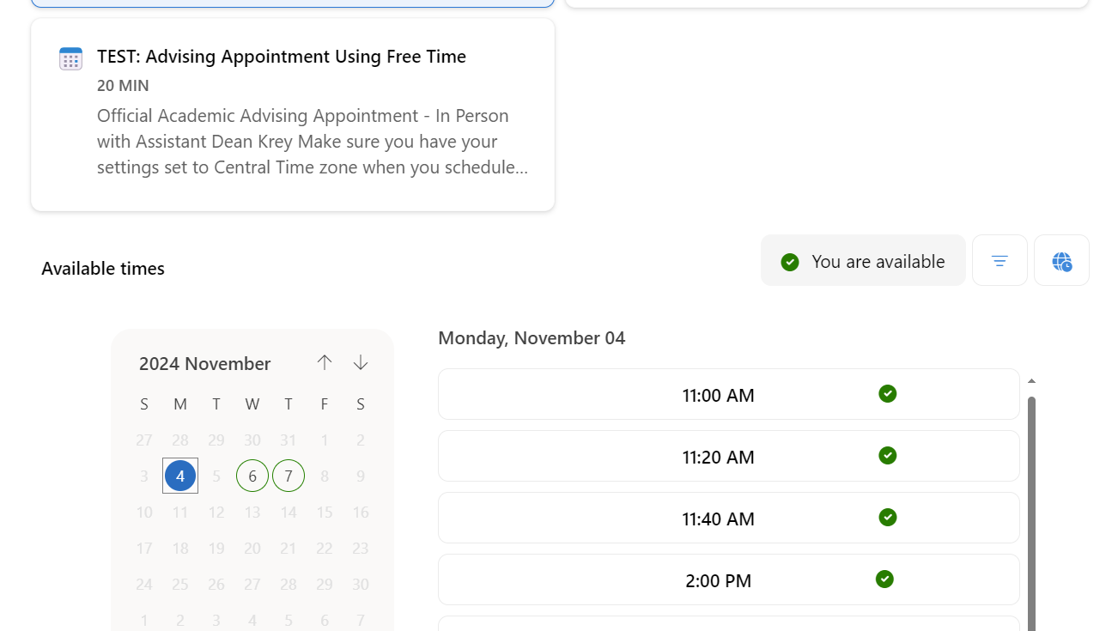
Save and check in a new browser window

Slide 14
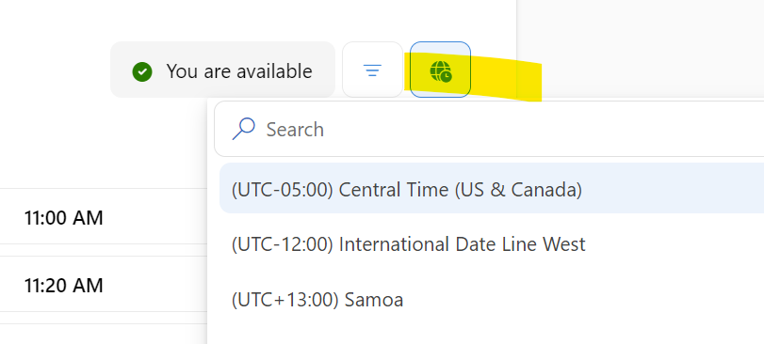
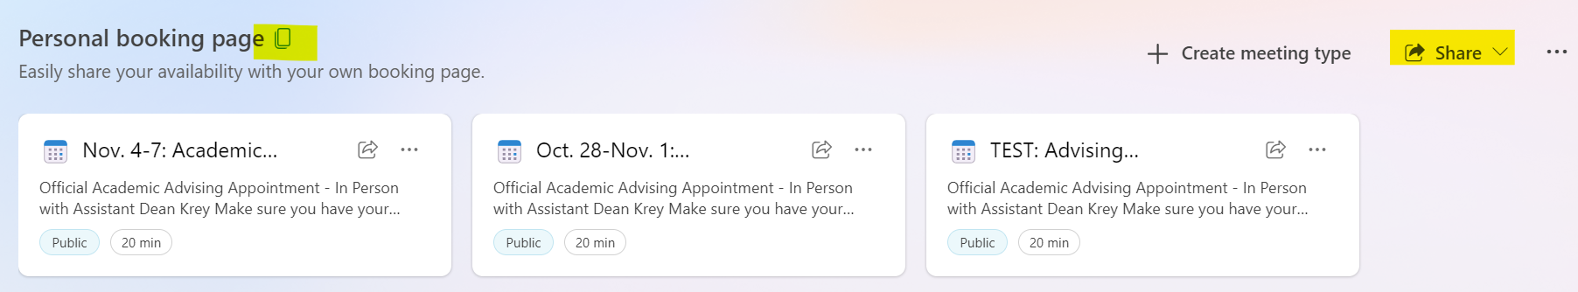
Don’t forget the time zone & send your link to Sara.Koenig@marquette.edu

