Slide 1

Glitter and Grit: Resilience among LGBTQ+ Individuals
Zane Ballard, M.S.
Marquette University Department of Psychology, MU LGBTQ+ Resource Center
Emma Wuetrich, M.S.
MU LGBTQ+ Resource Center

Slide 2
Presentation Contents
What is resilience?
  Discussion and definitions
Resilience to what?
  Structural stigma against LGBTQ+ community and its effects
Significance to LGBTQ+ folks
What does it look like?
  Self resources, coping, interpersonal relationships, community connectedness
  Institutional support
Discussion: What might resilience look like for LBGTQ+ folks in higher education?

Slide 3
Icebreaker Discussion:
What does it mean to be resilient?

Slide 4
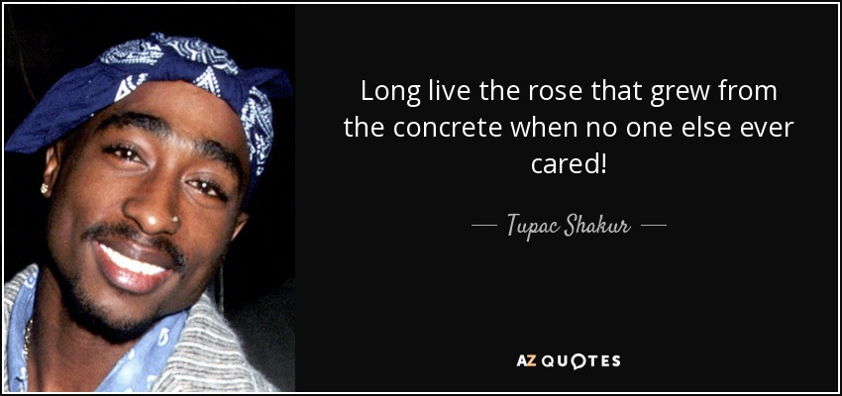
Resilience
What it means
“Good outcomes in spite of serious threats to adaptation or development” (Masten, 2001)
  “Resilience appears to be a common phenomenon that results in most cases from the operation of basic human adaptational systems. If those systems are protected and in good working order, development is robust even in the face of severe adversity…” (Ibid)
“Dynamic process encompassing positive adaptation within the context of significant adversity” (Luthar et al., 2000)

Slide 5
Resilience
What it DOESN’T mean
Invulnerability
That individuals/groups don’t need support
Something that people just do or don’t/can or can’t have
Just one thing—it’s contextual and changes over time!

Slide 6
Resilience to what?
LGBTQ+ individuals adapt to face stigma at multiple levels; not just individually, but structurally.

Slide 7
Stigma Exposure
Stigma relates individual characteristics/behaviors to negative stereotypes and prejudice directed at devalued groups (Major & O’Brien, 2005)
Structural stigma (Corrigan, 2005; Hatzenbuehler, 2014; Herek, Gillis, & Cogan, 2005): Political, social, cultural, religious messages that produce, support, and legitimize unequitable treatment
  Institutional: Formal policies, laws, regulations, etc. that produce unequitable treatment based on group membership
  Enacted: Disparate or harmful interpersonal treatment due to group identity
  Felt: Psychological impact of enacted stigma
  Internalized: Retaining negative beliefs regarding self/group identity

Slide 8
Stigma Exposure
Examples
  Structural (broadly): Public figures promoting anti-LGBTQ+ messages, pervasive stereotyping and misinformation, legitimization of violence against LGBTQ+ people, exclusion from access to material and social resources
  Institutional: Policies limiting access to public accommodations, lack of protections for marginalized sexual and gender groups or ideological exemptions, legal restrictions on LGBTQ+ topics
  Enacted: Exclusion/rejection, discrimination, harassment, victimization
  Felt: Emotional distress, perceived invalidation, isolation
    Acute versus chronic
  Internalized: Self-attribution, identity invalidation, negative stereotypes about other LGBTQ+ people

Slide 9
Effects of Stigma Exposure
Pervasive stigmatization impacts most domains of functioning.
Physical health
  Violence
  Access to healthcare and utilization
  Morbidity and mortality
Mental health
  Conditions precipitated and exacerbated by chronic stress
Material conditions
  Employment, housing, documentation

Slide 10
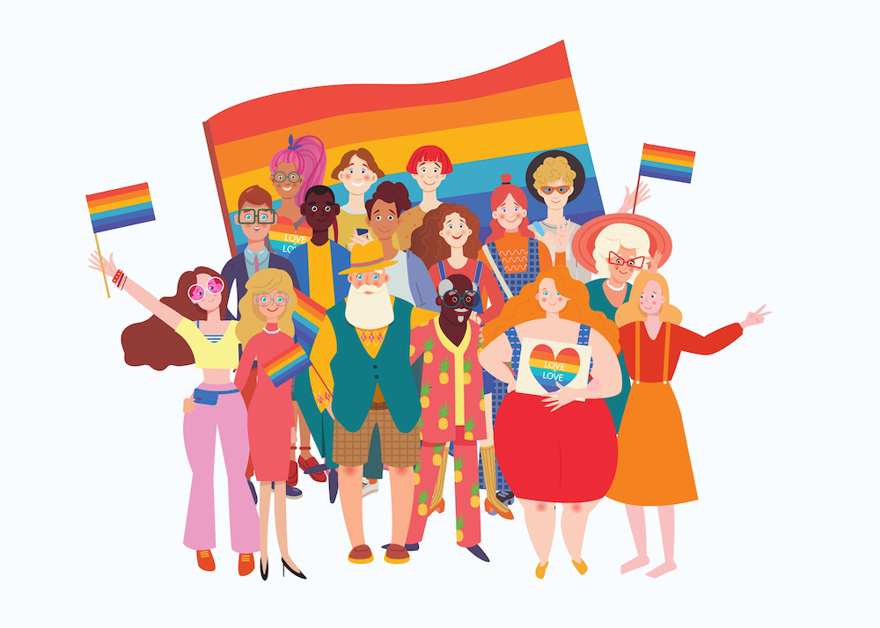
Significance for LGBTQ+ folks
Sexual, romantic, and gender identity are not subject to voluntary change, not always visible, must seek community
Resilience needed in the absence of full societal acceptance
Focus on resilience also shifts the conversation away from “what’s wrong with all those El-jee-bee-tees?” to “how are people subjected to lifelong exclusion and mistreatment still able to survive and thrive?”

Slide 11
What does resilience look like for LGBTQ+ folks?
Despite pervasive stress and inequality, the majority of LGBTQ+ individuals achieve high levels of functioning.
Combination of general and identity-specific factors
  Ex. Self-esteem AND regard for specific marginalized identities
  Identity is intersectional, so resilience is also (Follins et al., 2014)
    Entangled with gender norms, which are culturally-inflected
Different forms: protective, promotive, harm-reduction (Hill & Gunderson, 2015
Resilience is “ecological”—the product of many interacting spheres of life

Slide 12
Self Resources
Social motivation
  Desire to seek out social connection and support, positive expectations of support
Emotional openness
  Awareness and exploration of identity-related emotions
Hope and optimism
  Motivates active coping, more positive expectations of future and coping efficacy
Positive LGBTQ+ identity
  Awareness, understanding, and positive feelings regarding LGBTQ+ identity
  Confronting stereotypes
  Reduces likelihood of attributing mistreatment to self

Slide 13
Coping Behavior
Active, problem-focused coping
Emotion-focused coping
  Different from rumination, worry
  Reappraisal
Compartmentalizing
Meaning making
  Affirming interpretations of experiences and perceived climate, challenges as things to overcome

Slide 14
Interpersonal Relationships
Social support and connectedness
  Specifically perceived and invisible social support
  Size of social network and support utilization
Accepting relationships
  Family support strongly associated with resilience
  Supportive friends and “chosen family”
  Also includes teachers, coworkers
  Provides sense of belonging and personal validity
Includes its own coping behaviors, i.e., talking about difficult situations related to identity

Slide 15
Community Connectedness
Active participation in community
  Accessing LGBTQ+ specific spaces, attending events, online interaction
  Typically, must be sought out
Political involvement
  Supporting pro-LGBTQ+ causes
“Fictive kin” (Follins et al., 2014)
  General sense of affiliation with like others, present or not
Religious faith

Slide 16
Institutions Can Support Resilience
Institutional policies are associated with greater LGBTQ+ well-being, including in education
  Beyond individual relationships, policies related to general perceived climate
  What about Marquette?
Supportive laws promote well-being
  Repressive laws associated with decreased positive functioning

Slide 17
Wrap-up Discussion
What might resilience look like in higher education? How can we promote opportunities for queer joy?

Slide 18
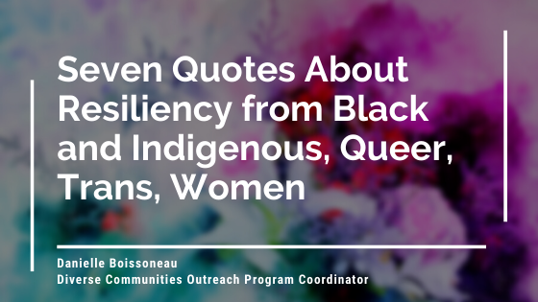
Parting Thoughts
“We are pow­er­ful because we have sur­vived, and that is what it is all about- sur­vival and growth.”
Audre Lorde
“It is in col­lec­tiv­i­ties that we find reser­voirs of hope and optimism.”
Angela Y. Davis
“Find free­dom in the con­text you inherit”
Lee Maracle (Stó:lō)
https://sacha.ca/blog/resiliency-quotes

