Slide 1

Woman
Life
Freedom
#MahsaAmini

Slide 2


Slide 3
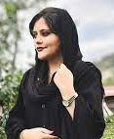

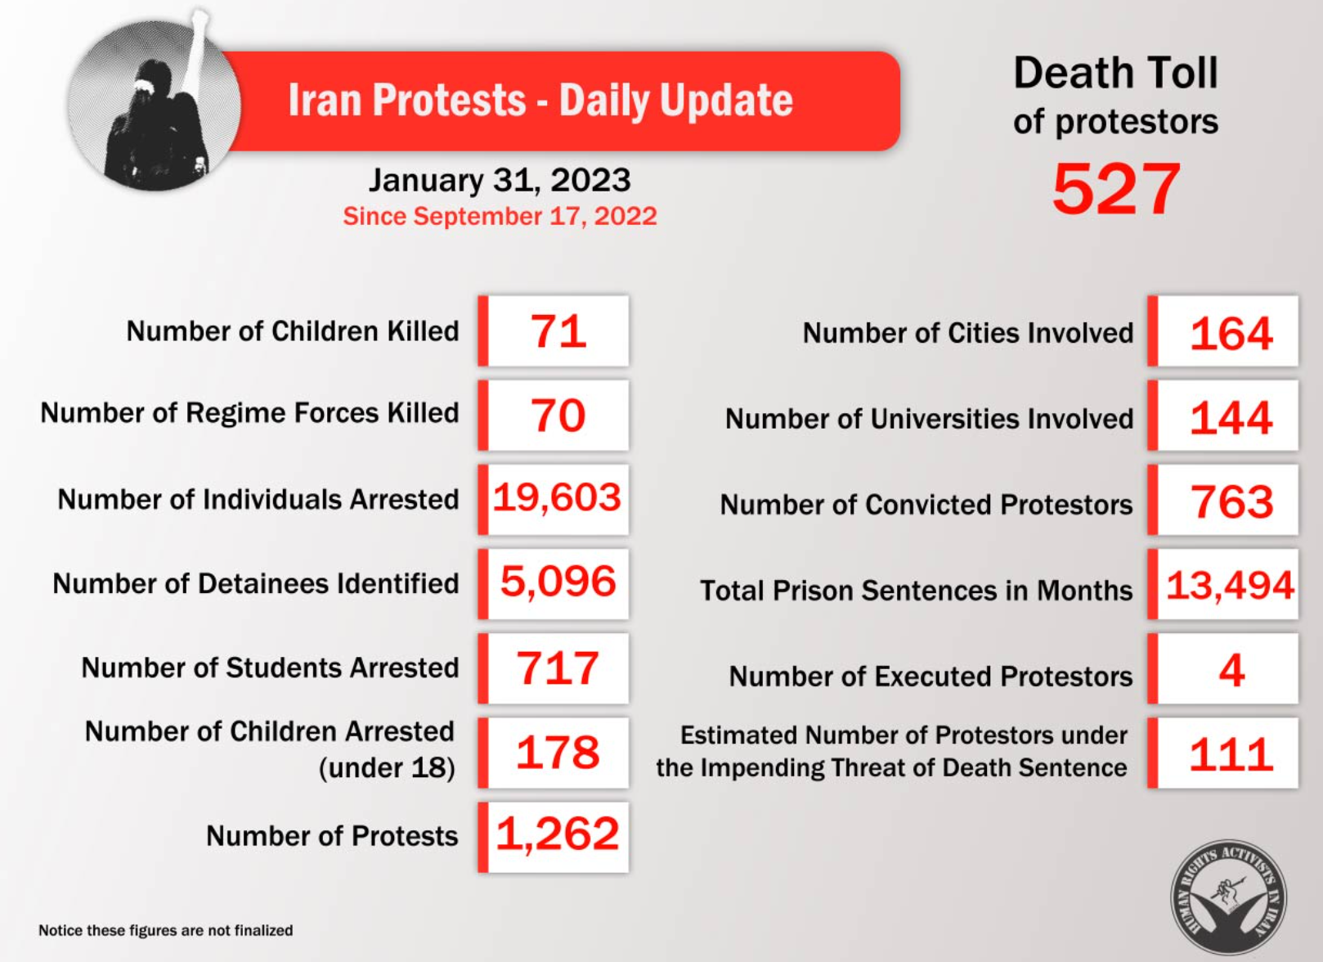
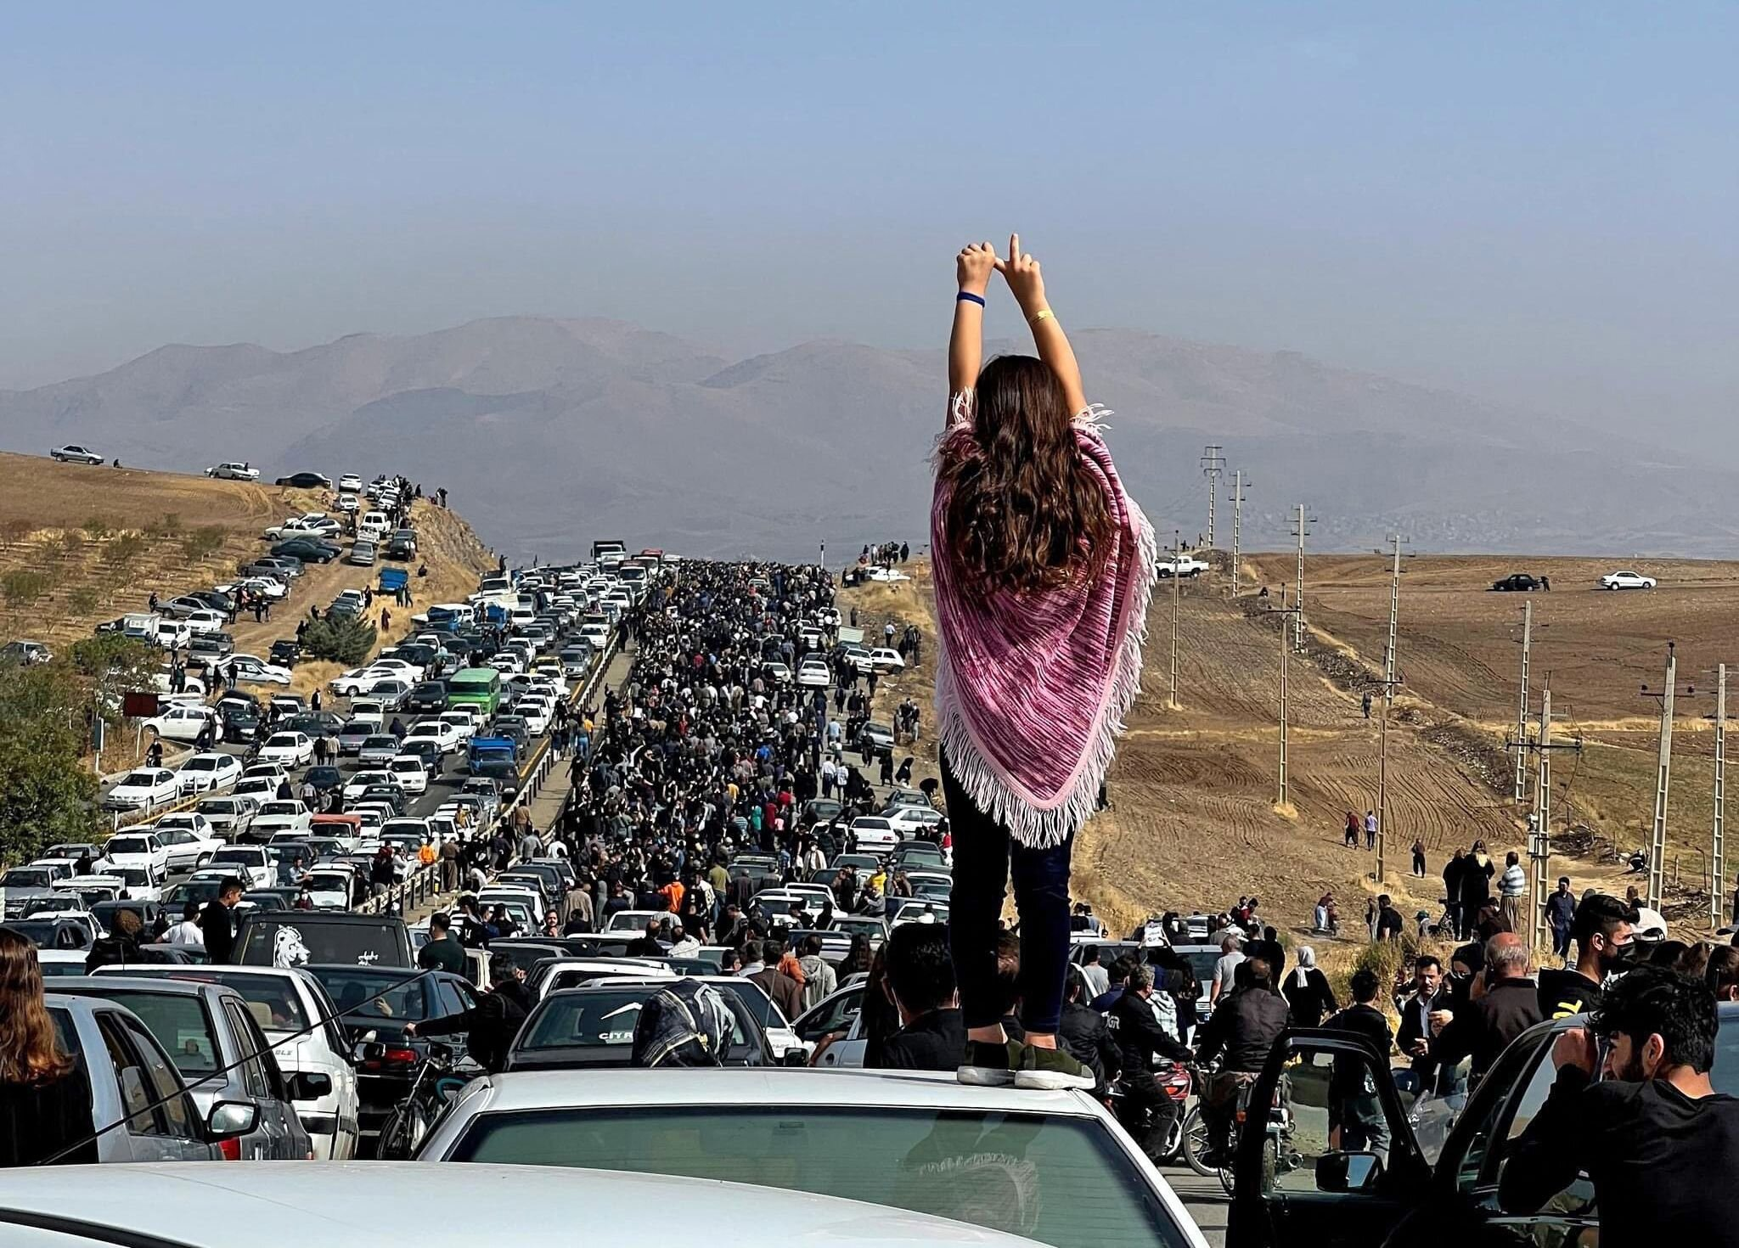
What is happening in Iran?
Woman
Life
Freedom
#MahsaAmini
Mahsa Amini, 22, an Iranian woman, was detained on September 13th for allegedly “not complying properly” with the compulsory hijab. She was brutally beaten by the so-called “morality police”, causing her to go into a coma. Sadly, she passed away on Sep 16th. On Sept 17th, 2022, the death of Mahsa sparked protests throughout Iran calling for justice and fundamental human rights.
Iranian men and women stand shoulder by shoulder against the Islamic Republic gender apartheid regime chanting “Woman Life Freedom” while demanding the fundamental rights that have been taken away from them for more than 40 years now:
Freedom of expression, association, and assembly; as well as fair trials and due process.
To suppress these protests, the Islamic Republic captured, tortured, and shot the protesters with war bullets in the streets, universities, and sadly schools.
Two myths about Iran:
  “Hijab is a part of Iranian culture” → FALSE!
  You do not need to subjugate people into observing cultural norms!
  “The Islamic Republic is reformable” → FALSE!
  43 years of consolidation of power by a dictator leader while putting up shows called “presidential elections” (while proven to be ineffective), showed that the Islamic Republic is a totalitarian regime that is NOT REFORMABLE!

Slide 4
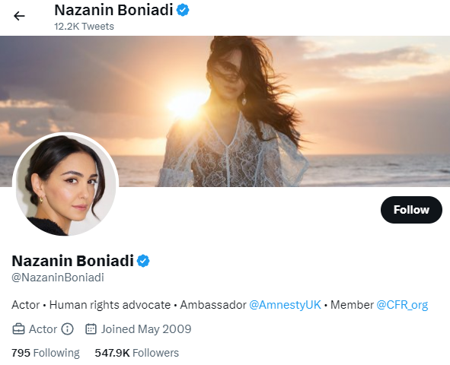
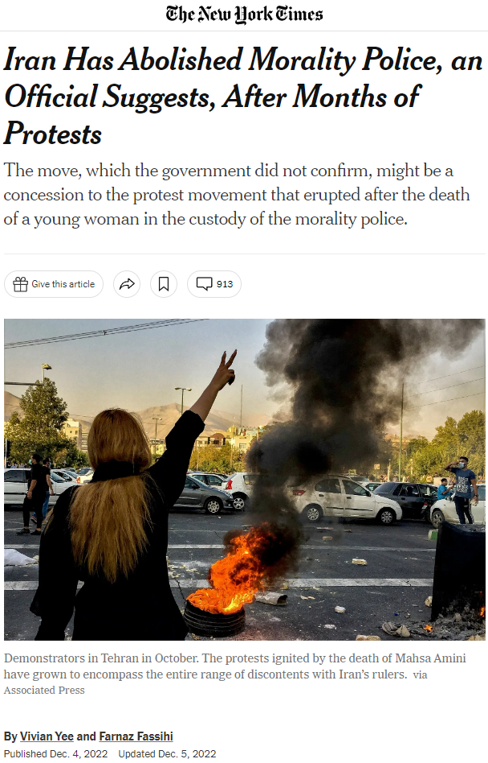
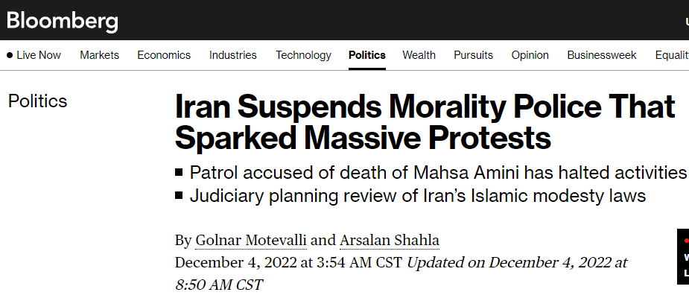


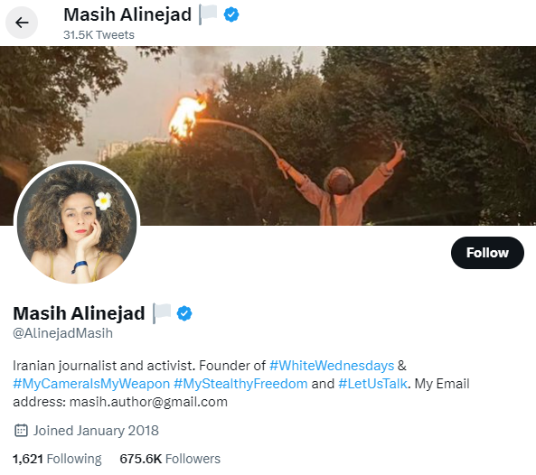
Your Impact
Woman
Life
Freedom
#MahsaAmini
Its all about spreading awareness.
Avoid listening to the misinformation/disinformation
“Injustice anywhere is a threat to justice everywhere. We are caught in an inescapable network of mutuality, tied in a single garment of destiny. Whatever affects one directly, affects all indirectly.”
Dr. Martin Luther King, 1963.

Slide 5
Woman
Life
Freedom
Thank You For Your Attention
#MahsaAmini

