Slide 1
The Use of Electronic Monitoring on Youth in Milwaukee County
By Kathryn Storm

Slide 2
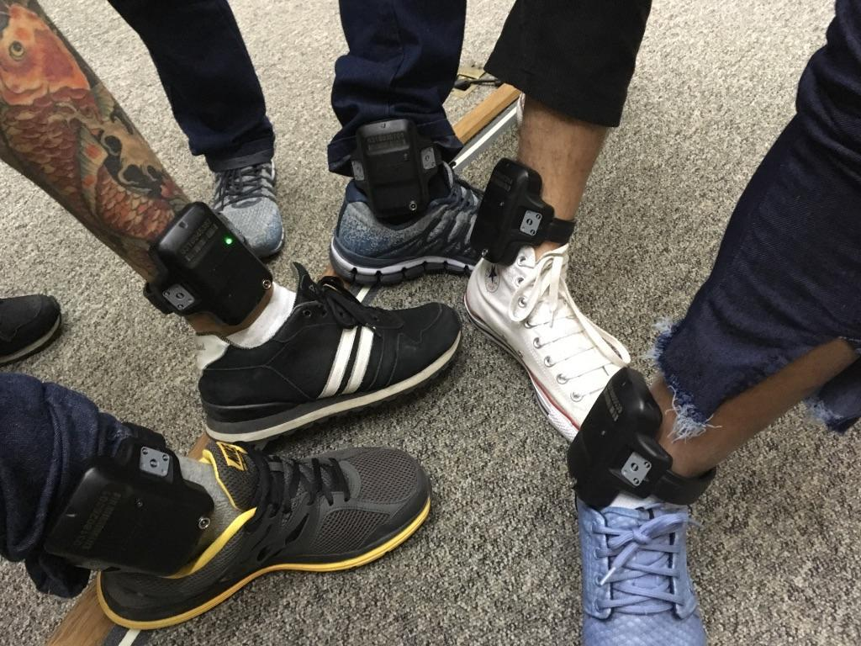
What is EM?
Electronic Monitoring are device is placed on the ankle of an individual through which a third party is able to track their location 24/7. The bracelet cannot be removed and some have the capabilities to monitor heart rate, blood alcohol content, and serve as a communication device.
Devices such as this are considered forms of E-carecreation. This is because the level of restriction put on the individual is heavy.
While originally EM was a tool used for the adult system, in the early 2000s Milwaukee County began using it on youth. This is concerning because there is not evidence to support the use of this tool on youth and its effectiveness as a rehabilitative tool.

Slide 3
CURTOs Mixed Methods Research Team
Qualitative Team
Conducts interviews with stakeholders
Developing Case Studies with youth
Quantitative Team
Working through county provided data
Exploring risk assessment tools
  The YASI

Slide 4
Road Map to Electronic Monitoring
There are several ways a youth can end up on EM when engaged in the juvenile legal system.
During their initial hearing the commissioner puts it on the youth as a pre-trial tool
A Judge can put the youth on EM
A Human Service Worker is given discretion by the judge to place youth on EM
EM is a tool heavily influenced by discretion.

Slide 5
Rules and Restrictions of EM
The guidelines youth need to adhere to while on EM are extremely rigorous.
Youth are under 24/7 surveillance and any movement needs to be preapproved at least 48 hours in advance.
When a youth breaks a rule on EM it is called a violation, but whether these impact the youths trajectory in the legal system is up to the discretion of the Human Service Worker and Judges.
While damaging the bracelet and trying to remove it is typically considered the most serious violation, it is up to the system stakeholders to decide whether the violation is detention worthy or if it will be addressed in a conversation.
Some youth are on a One Rule Violation condition, meaning if they violate the terms of EM for any reason they will be sent to secure detention. This condition is at the discretion of the commissioners and Judges.

Slide 6
The Impact of EM on Youth
Lack of Privacy
Alienation from their community
  Losing jobs, kicked off sports team
Highly stigmatized
Mental Health Ramifications
  Isolating, can compound on preexisting struggles with anxiety and depression
Contradicts rehabilitative goals of the juvenile legal system.

Slide 7
EM Ramping Up
While EM originally was used for serious juvenile offenders to make weekend visits home during their detention, it now is predominantly a pre-trial tool.
There have been examples offered of arguments made that a youth being successful on EM is justification to keep the device on as well, showcasing a prioritization of surveillance as opposed to rehabilitation.
Pushing back against EM in the courtroom is a difficult line to balance because of the fear that judges will default back to detention

Slide 8
The Future of EM
Alternatives to detention increased as a result of the COVID 19 pandemic. However, currently there is no nation wide data about how many people are on EM and the growth of its use.
Scholars such as James Kilgore, Chaz Arnett, and Katie Weisburd are taking up the task of expanding EM scholarship.
Influential Works:
Understanding E-Carceration by James Kilgore
Virtual Shackles by Chaz Arnett
No More Shackles, 10 Arguments against Pre-trial Electronic Monitoring by MediaJustice

