Slide 1

Soup With Substance: Trans Rights in the United States 2022
Zane Ballard M.S.
Emma Wuetrich, M.S.
LGBTQ+ Resource Center
Marquette University

Slide 2
Purpose and Goals
The purpose of the following presentation is to start a dialogue with provided general information regarding the legal landscape for rights and protections for trans Americans.
Not exhaustive, not legal advice
Goals:
  Provide a brief introduction to state of trans rights in the US in 2022
  Describe differences between federal and state laws
    Including legal protections and negative policies
  Examine relevant Wisconsin laws and policies
  Note Marquette’s current institutional stance

Slide 3
Historical Note
Of approximately 400 indigenous nations present pre-colonization, multiple (>2) genders recognized in 113-155 (estimates vary)
  Contemporary term: two-spirit
Gender diversity repressed and punished by early Spanish and French missionaries and settlers
Mid-19th Century to WWI: 46 cities criminalized dress incongruent with assigned sex at birth
  As recent as 1974 (San Francisco)

Slide 4
US Trans* Rights
Divided between federal and state laws
Frequently dependent upon state, federal, and Supreme Court rulings
May be impacted by both birth state and state of residence
  Ex. Birth certificates
This presentation will not primarily address state or federal agency policies
  Still important—ex. DHS 2022 policy change for TSA
Transgender identity not a federally protected class
Hundreds of anti-trans bills considered in state legislatures in 2022: https://www.aclu.org/legislation-affecting-lgbtq-rights-across-country

Slide 5
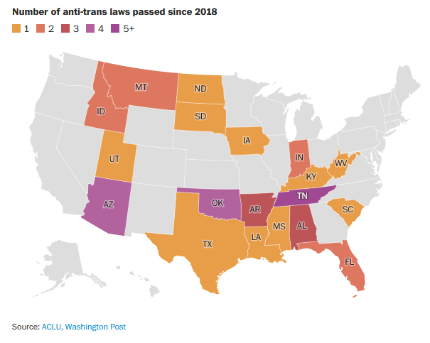
Image credit: Washington Post, 10/14/22

Slide 6

Legal Areas
Marriage & Family
Identity documents
Housing
Protections against violence
Protections against discrimination
  Employment
  Education
Healthcare
Additional areas

Slide 7

Marriage & Family
Right to marry: Obergefell v. Hodges (2015)
  SC ruling legalizing same-sex marriage
Parental rights
  Trans identity sometimes considered in custody and visitation proceedings
    Mayfield v. Mayfield (1996)
    Cisek v. Cisek (1982)
Reproductive rights
  Issue: if gender affirming surgery required for legal acknowledgment, then by extension infertility required.

Slide 8
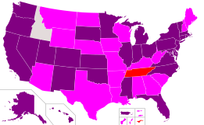
Identity Documents
Includes name change, birth certificate, driver’s license, passport
  May decrease discrimination
Legal name change
  May require court order, public legal notice, documentation by HCP
Birth certificate
Driver’s license
  Less stringent than birth certificate, but may require birth certificate change
Passport: federal; F/M/X
Purple: GAS not required, Fuchsia: GAS required, Red: does not alter BC, White: unclear due to legal conflict

Slide 9
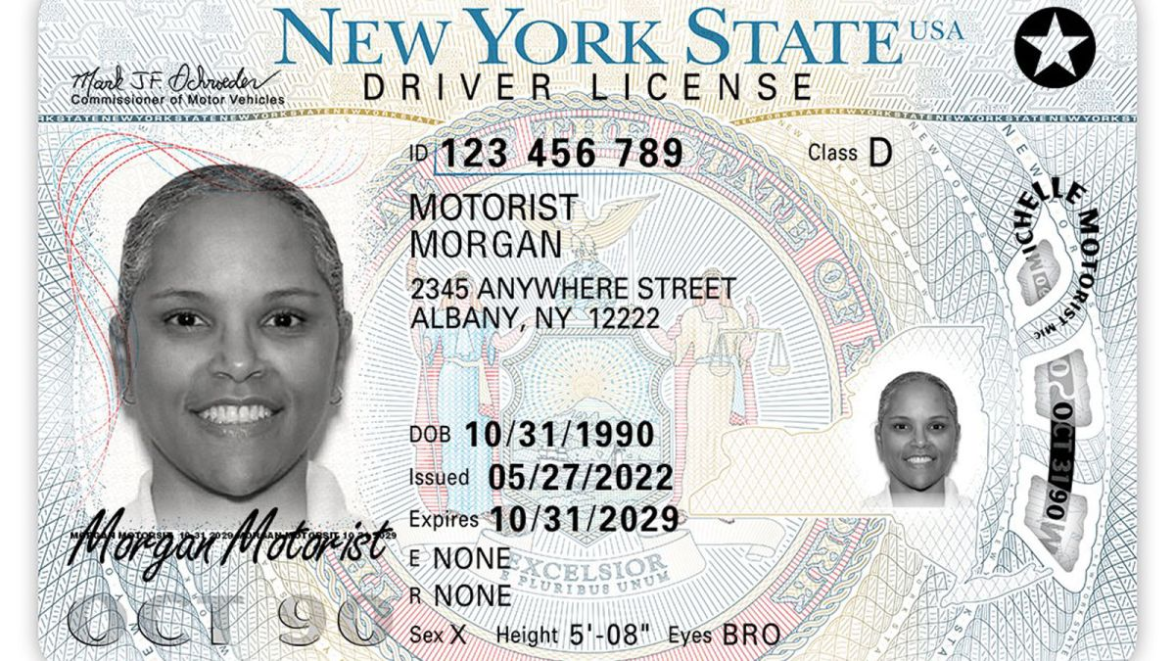
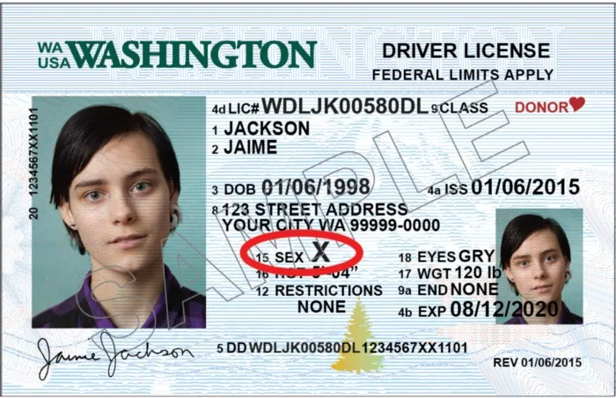
Third Gender Options: “X”
Birth certificate
  Colorado and New Mexico
Driver’s license/state ID: 25 states & D.C.
  Arkansas, California, Colorado, Connecticut, Delaware, Washington D.C., Hawai'i, Massachusetts, Maine, Maryland, Michigan, Minnesota, Nevada, New Hampshire, New Jersey, New York, Ohio, Oregon, Pennsylvania, Rhode Island, Utah, Virginia, Vermont, and Washington.
    Illinois in 2024

Slide 10

Housing
No federal protections against discrimination in housing for trans people
  Varies by state
  Dependent upon federal administration
    Access to homeless shelters
    2021 Biden EO and Housing and Urban Development (HUD) memo
Image credit: Movement Advancement Project

Slide 11
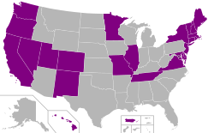
Protections Against Violence
LGBTQ+ people at greater risk of violence, trans people at 4x higher risk than cisgender
  Medical settings, police, incarceration
    2022 California AG office report: trans people 4x more likely to be stopped by police on “reasonable suspicion”
  Intimate partner violence
Limited federal hate crimes legislation
  Still primarily state-based

Slide 12
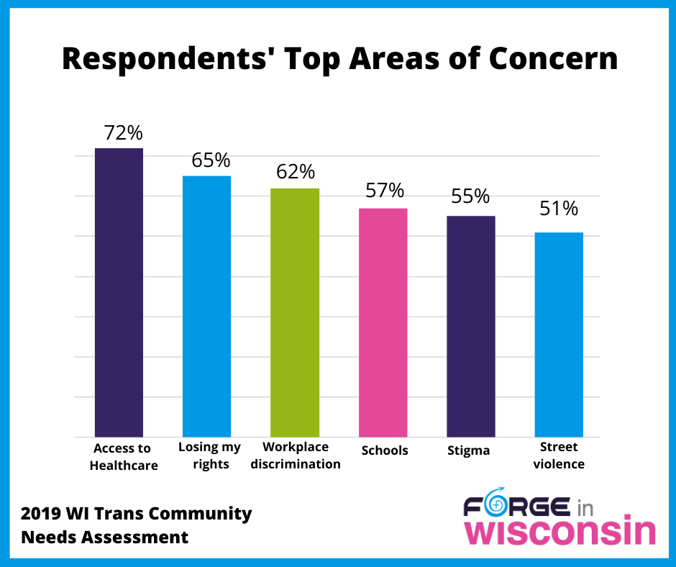
Protections Against Discrimination
Trans people are federally protected against employment discrimination as of 2020
  R.G. & G.R. Harris Funeral Homes Inc. v. EEOC (2020)
Housing: 22 states and 225 jurisdictions (including D.C.) currently prohibit discrimination in employment, housing, and public accommodations
  Except Utah: only employment & housing
Education: Obama-era policy, Title IX extends to trans students
  G.G. v. Cloucester County School Board (2016)

Slide 13
Adult Healthcare
States vary with regards to:
  Whether they require private insurers to cover gender affirming healthcare
  Whether state insurance covers gender affirming healthcare
Barriers: 2022 Florida requires approval from Florida Board of Medicine
Veteran Health Administration covers many gender affirming treatments
  Excluding genital surgeries and “cosmetic” procedures (electrolysis, facial/body contouring)
Affordable Care Act prohibits sex discrimination, upheld in Supreme Court ruling Bostock v. Clayton County (2020)
Many states and jurisdictions have banned practice of conversion therapy for sexual orientation and gender identity

Slide 14
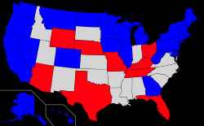
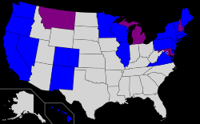
Blue: explicitly includes Medicaid coverage, Red: explicitly excludes, Grey: no policy
Blue: explicitly prohibits discrimination in coverage and exclusion of trans people, Purple: prohibits trans exclusions in health insurance, Grey: no protections

Slide 15
Additional Areas
Rights of the incarcerated
  Mixed rulings, USDOJ supports availability of gender affirming healthcare regardless of whether it began before incarceration
  Trans inmates are still regularly incarcerated according to ASAB, “V-coding”
In immigration
  Persecution for gender identity considered legitimate reason for asylum
  Can change gender marker on certificate of naturalization, certificate of citizenship, permanent resident card, and state issued-consular report of birth abroad
Military service
  Trans people are allowed to serve in the military without concealing gender identity
Sports
  States with laws requiring trans athletes to participate in sports based upon ASAB
    Texas, Arkansas, Florida, Alabama, Oklahoma, Kentucky, Mississippi, Tennessee, West Virginia, South Carolina, Utah, South Dakota, Montana, Iowa, Arizona, Idaho, Indiana, Louisiana, and Georgia

Slide 16

Wisconsin
Changes in documentation
  Altering sex on birth certificate requires court order or GAS
  Original birth certificate amended
  Driver’s license requires physician affidavit/letter or court order
No housing protections or specific hate crime legislation
Private health insurance required to include trans care, covered by Medicaid
Conversion therapy banned in La Crosse and Eau Claire school district

Slide 17

Marquette Policies
Title IX
Non-Discrimination policy includes gender identity and expression
Not included in Harassment Policy
Additional institutional policies
  Student name and email change
  Student ID picture change
  Documentation of pronouns
  Alternative diplomas

Slide 18
References
Darrow, Rob. “Teaching LGBTQ History: Two-Spirits.” https://www.lgbtqhistory.org/lesson/native-americans-gender-roles-and-two-spirit-people/
“Indigenous tribes embraced gender fluidity prior to colonization.” https://indianexpress.com/article/world/indigenous-tribes-embraced-gender-fluidity-prior-to-colonisation-but-europeans-enforced-specific-gender-roles/
“When cross-dressing was criminal.” https://news.sfsu.edu/archive/when-cross-dressing-was-criminal-book-documents-history-longtime-san-francisco-law.html
“Nondiscrimination laws.” https://www.lgbtmap.org/equality-maps/non_discrimination_laws
“HUD announces new approach to SOGI discrimination under the Fair Housing Act.” https://equalrightscenter.org/hud-lgbtq-fair-housing/
Owen, Greg. “Police four times more likely to stop transgender people for “reasonable suspicion.”” https://www.lgbtqnation.com/2022/08/police-four-times-likely-stop-transgender-people-reasonable-suspicion/

Slide 19
“Introduction to Transgender Rights in the United States.” https://library.law.howard.edu/civilrightshistory/transgender
Branigin, Anne and Kirkpatrick, N. “Anti-trans laws are on the rise.” https://www.washingtonpost.com/lifestyle/2022/10/14/anti-trans-bills/

