Slide 1
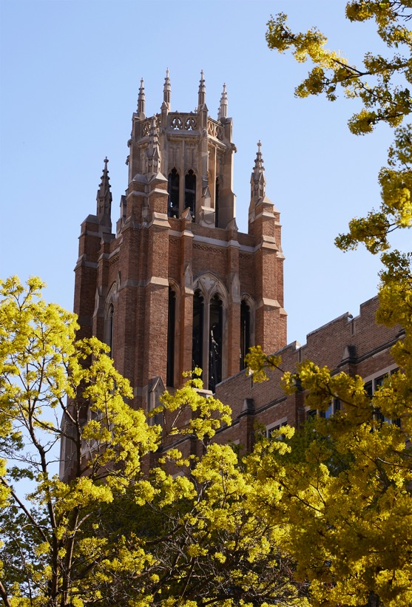
J. William and Mary Diederich
College of Communication

Slide 2
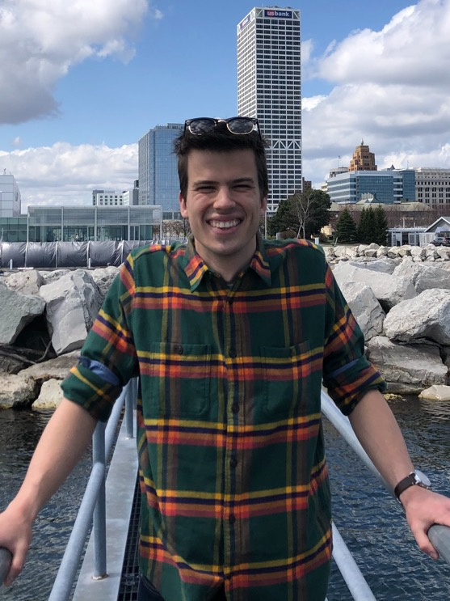
Joshua Anderson
J. William and Mary Diederich College of Communication
Honors Bachelor of Arts

Slide 3
Kelli Arseneau
J. William and Mary Diederich College of Communication
Honors Bachelor of Arts

Slide 4
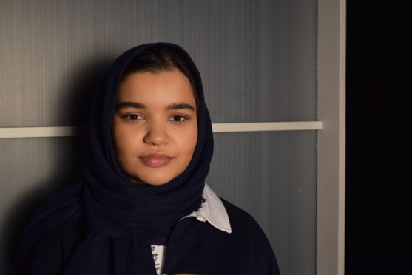
Aminah Beg
J. William and Mary Diederich College of Communication
Honors Bachelor of Arts

Slide 5
Kendra Bell
J. William and Mary Diederich College of Communication
Honors Bachelor of Arts

Slide 6
Margaret Cahill
J. William and Mary Diederich College of Communication
Honors Bachelor of Arts

Slide 7
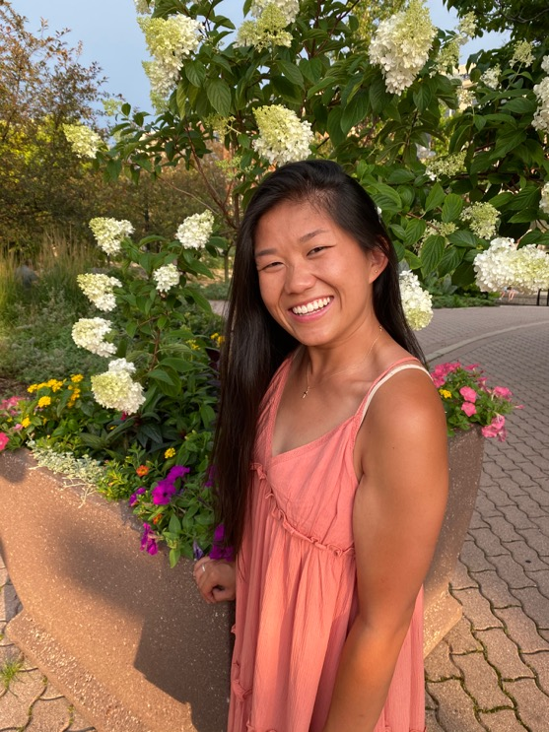
Isabel Comerford
J. William and Mary Diederich College of Communication
Honors Bachelor of Arts

Slide 8
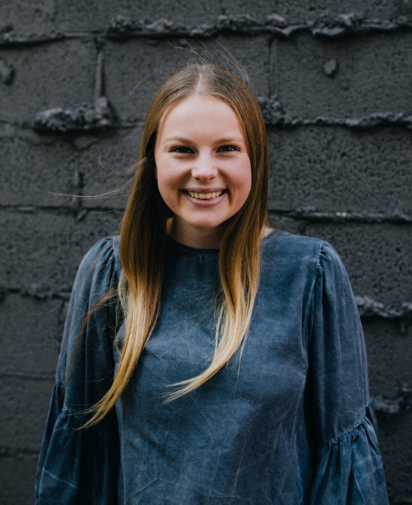
Noelle Douglass
J. William and Mary Diederich College of Communication
Honors Bachelor of Arts

Slide 9
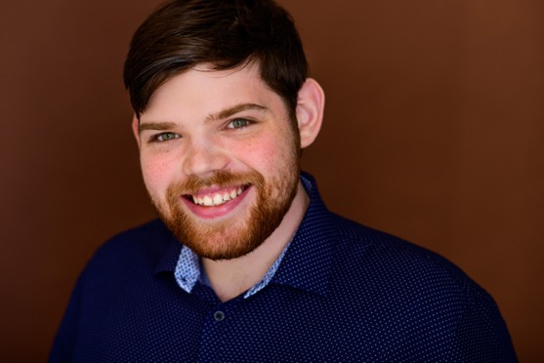
Jackson Hoemann
J. William and Mary Diederich College of Communication
Honors Bachelor of Arts

Slide 10
Katherine Holstein
J. William and Mary Diederich College of Communication
Honors Bachelor of Arts

Slide 11
Allison Manning
J. William and Mary Diederich College of Communication
Honors Bachelor of Arts

Slide 12
Mitchell Neunuebel
J. William and Mary Diederich College of Communication
Honors Bachelor of Arts

Slide 13
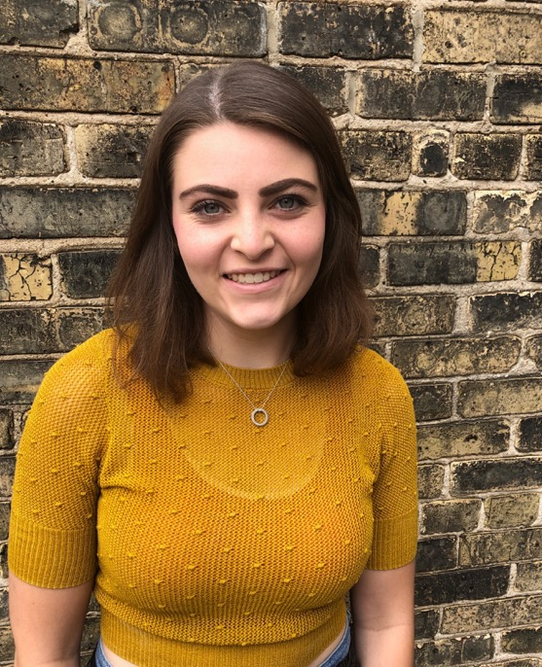
Amanda Parrish
J. William and Mary Diederich College of Communication
Honors Bachelor of Arts

Slide 14
William Scheuerman II
J. William and Mary Diederich College of Communication
Honors Bachelor of Arts

Slide 15
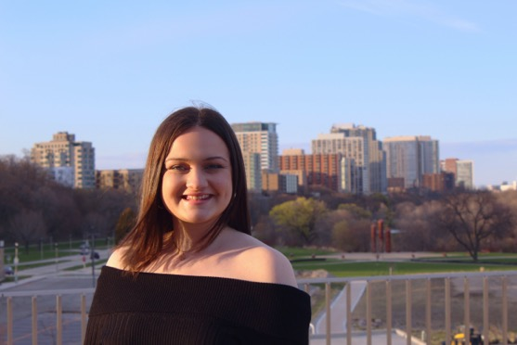
Hannah Van Der Karr
J. William and Mary Diederich College of Communication
Honors Bachelor of Arts

Slide 16
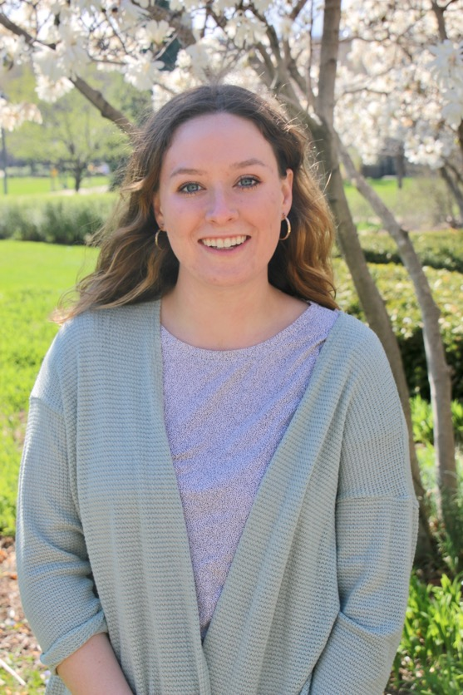
Mary Webb
J. William and Mary Diederich College of Communication
Honors Bachelor of Arts

Slide 17
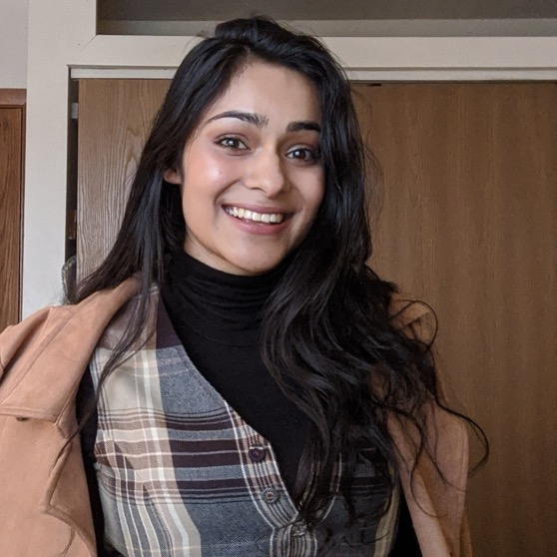
Sinthia Ahmed
J. William and Mary Diederich College of Communication
Bachelor of Arts

Slide 18
Christian Albelo
J. William and Mary Diederich College of Communication
Bachelor of Arts

Slide 19
Abdallah Alqaoud
J. William and Mary Diederich College of Communication
Bachelor of Arts

Slide 20
John Alvarez
J. William and Mary Diederich College of Communication
Bachelor of Arts

Slide 21
Errol Ashby III
J. William and Mary Diederich College of Communication
Bachelor of Arts

Slide 22
Sarah Baldwin
J. William and Mary Diederich College of Communication
Bachelor of Arts

Slide 23
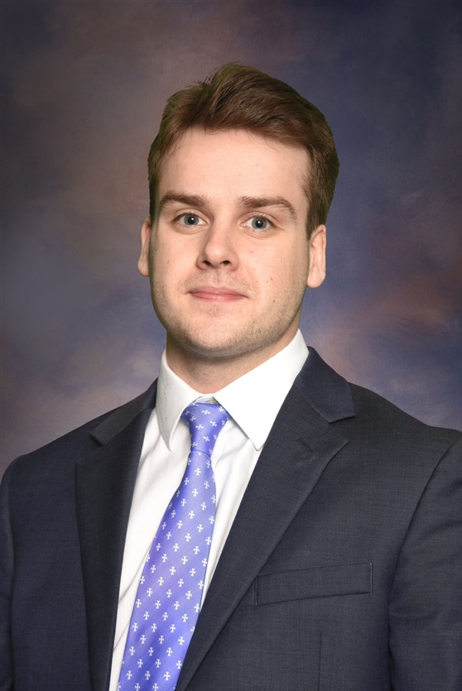
John Paul Bauer
J. William and Mary Diederich College of Communication
Bachelor of Arts

Slide 24
William Baughman
J. William and Mary Diederich College of Communication
Bachelor of Arts

Slide 25
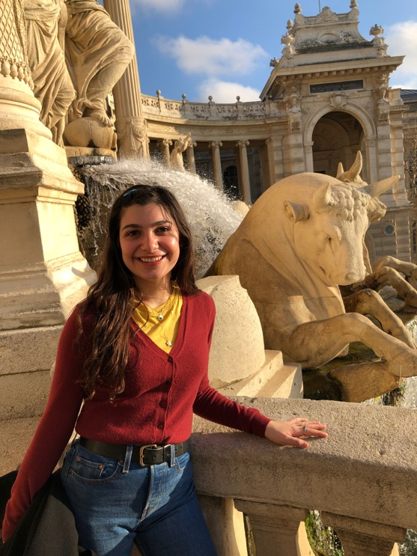
Isabella Bavone
J. William and Mary Diederich College of Communication
Bachelor of Arts

Slide 26

Sarah Belasco
J. William and Mary Diederich College of Communication
Bachelor of Arts

Slide 27
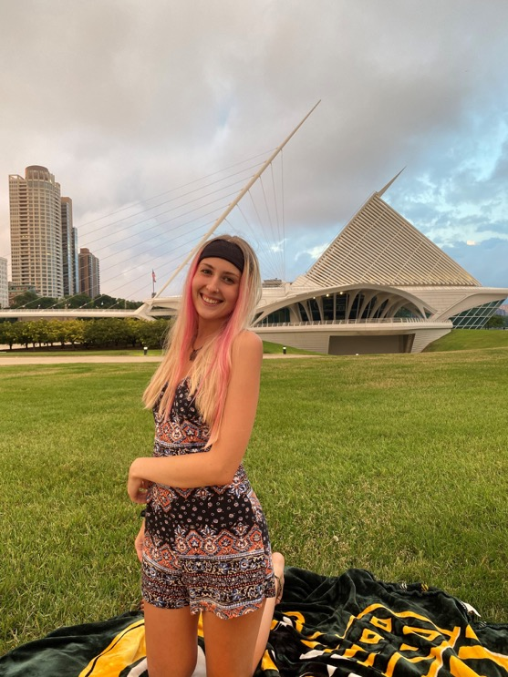
Haley Biggins
J. William and Mary Diederich College of Communication
Bachelor of Arts

Slide 28
Brendan Blockovich
J. William and Mary Diederich College of Communication
Bachelor of Arts

Slide 29
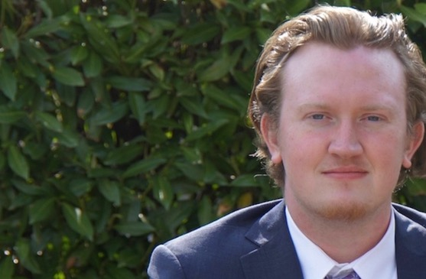
Shane Brady
J. William and Mary Diederich College of Communication
Bachelor of Arts

Slide 30
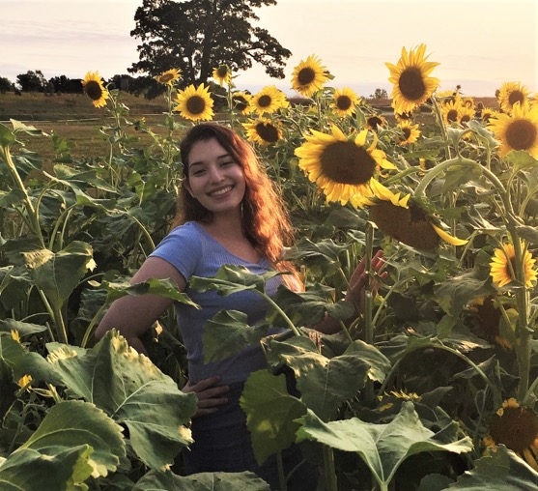
Elena Brambila
J. William and Mary Diederich College of Communication
Bachelor of Arts

Slide 31
Thomas Brannick
J. William and Mary Diederich College of Communication
Bachelor of Arts

Slide 32
Cole Brennan
J. William and Mary Diederich College of Communication
Bachelor of Arts

Slide 33
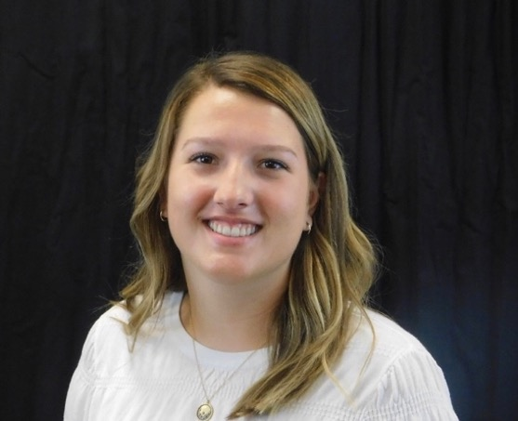
Sarah Brezonik
J. William and Mary Diederich College of Communication
Bachelor of Arts

Slide 34
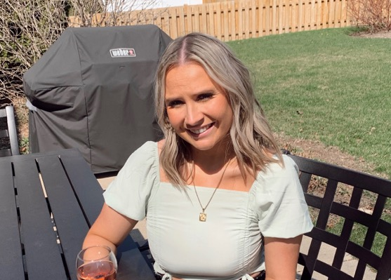
Sydney Bright
J. William and Mary Diederich College of Communication
Bachelor of Arts

Slide 35
Connor Broshar
J. William and Mary Diederich College of Communication
Bachelor of Arts

Slide 36
Owen Brown
J. William and Mary Diederich College of Communication
Bachelor of Arts

Slide 37
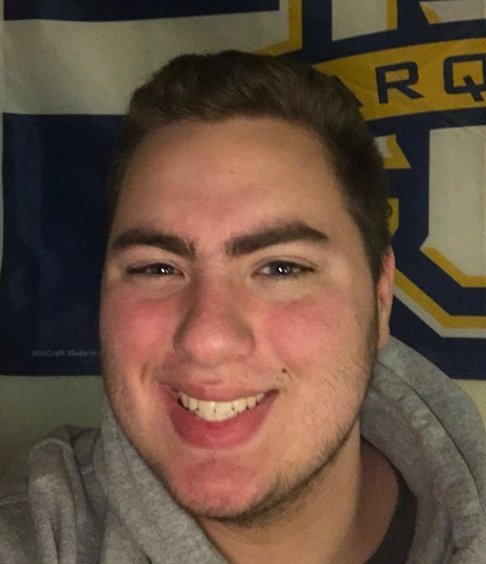
William Brownlow
J. William and Mary Diederich College of Communication
Bachelor of Arts

Slide 38
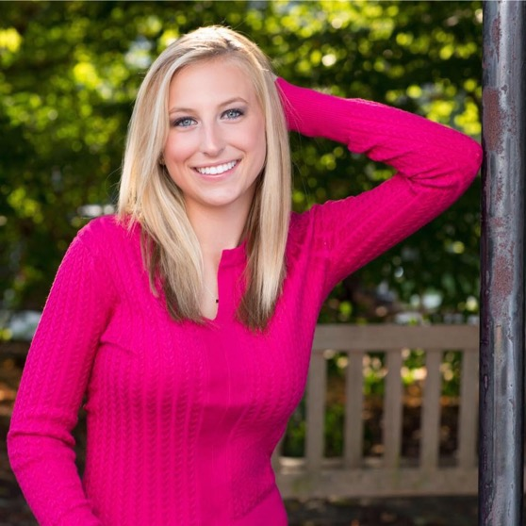
Lauren Buday
J. William and Mary Diederich College of Communication
Bachelor of Arts

Slide 39
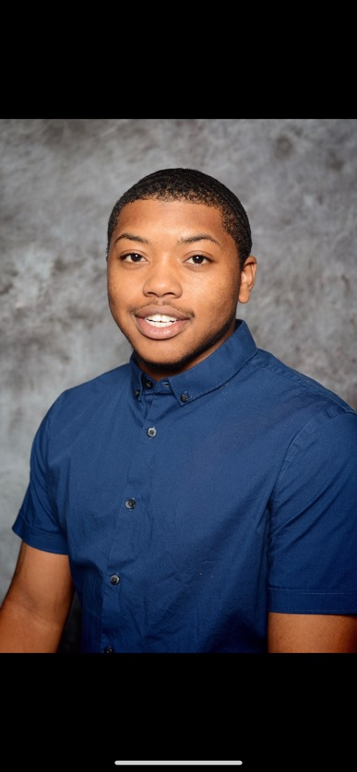
Eric Burks Jr.
J. William and Mary Diederich College of Communication
Bachelor of Arts

Slide 40
Isabella Buschette
J. William and Mary Diederich College of Communication
Bachelor of Arts

Slide 41
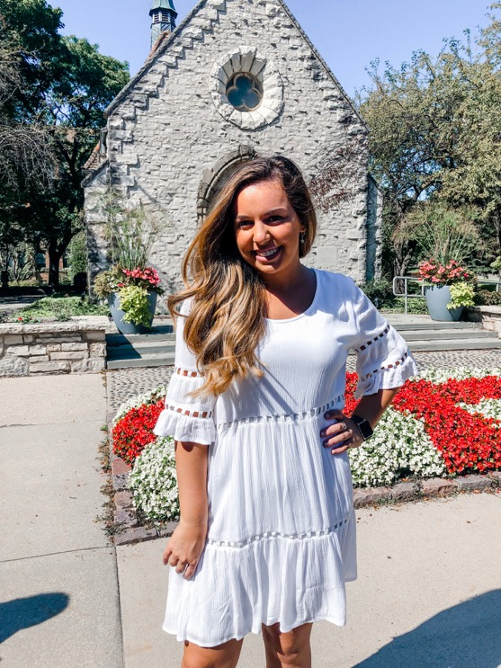
Sophia Cacioppo
J. William and Mary Diederich College of Communication
Bachelor of Arts

Slide 42
Hasen Cain
J. William and Mary Diederich College of Communication
Bachelor of Arts

Slide 43
Nathan Campbell
J. William and Mary Diederich College of Communication
Bachelor of Arts

Slide 44
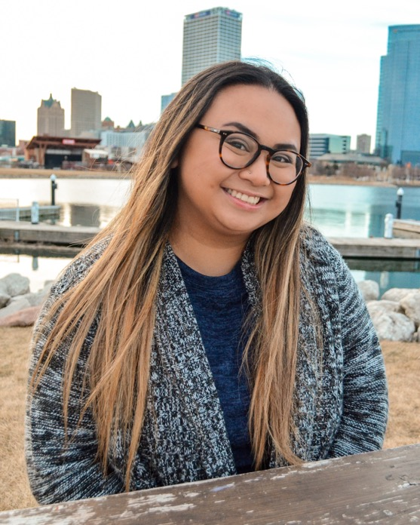
Krista Casuga
J. William and Mary Diederich College of Communication
Bachelor of Arts

Slide 45
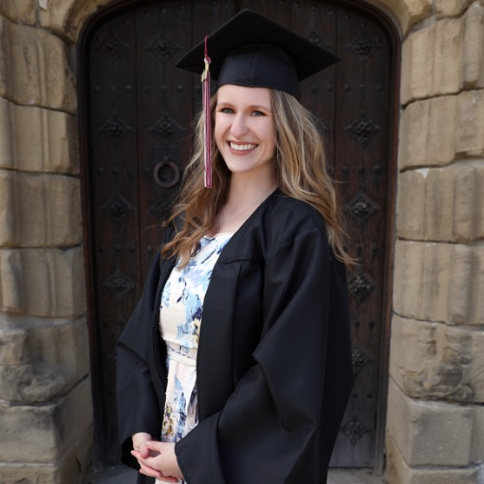
Meredith Cavaleri
J. William and Mary Diederich College of Communication
Bachelor of Arts

Slide 46
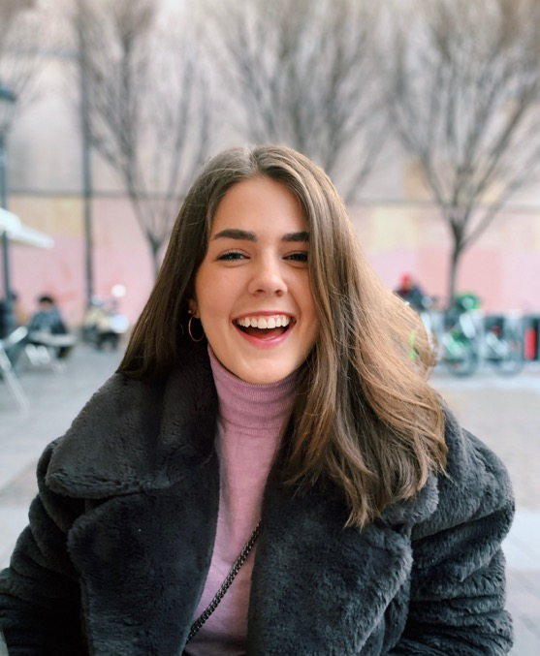
Sheila Cavanagh
J. William and Mary Diederich College of Communication
Bachelor of Arts

Slide 47
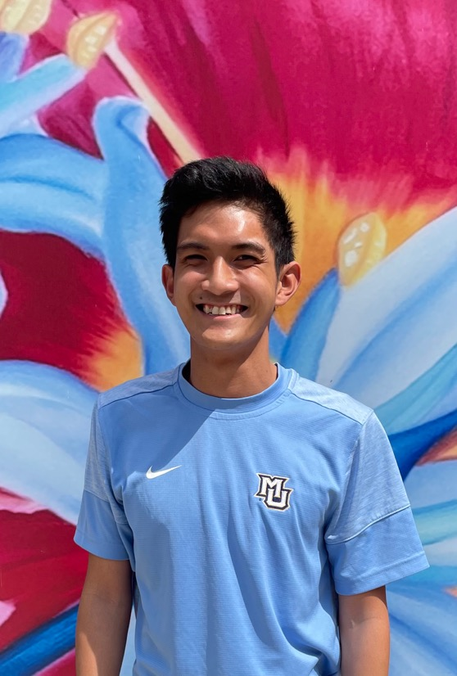
Alexander Celis
J. William and Mary Diederich College of Communication
Bachelor of Arts

Slide 48
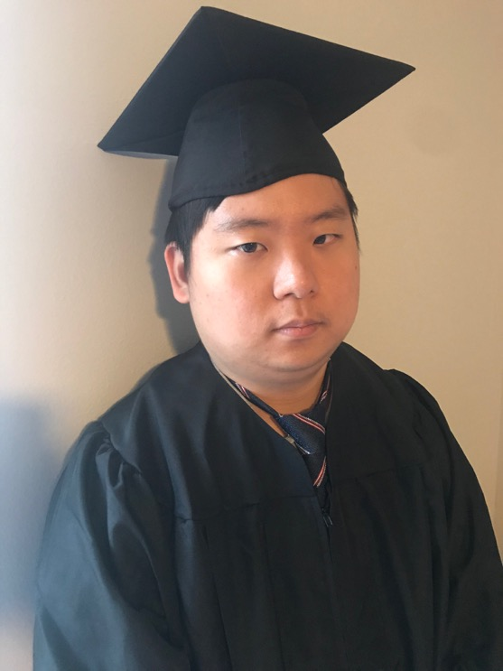
Yoonbin Cho
J. William and Mary Diederich College of Communication
Bachelor of Arts

Slide 49
Austin Chudy
J. William and Mary Diederich College of Communication
Bachelor of Arts

Slide 50
Niara Collins
J. William and Mary Diederich College of Communication
Bachelor of Arts

Slide 51
Victor Costa
J. William and Mary Diederich College of Communication
Bachelor of Arts

Slide 52
Anthony Courcelle
J. William and Mary Diederich College of Communication
Bachelor of Arts

Slide 53
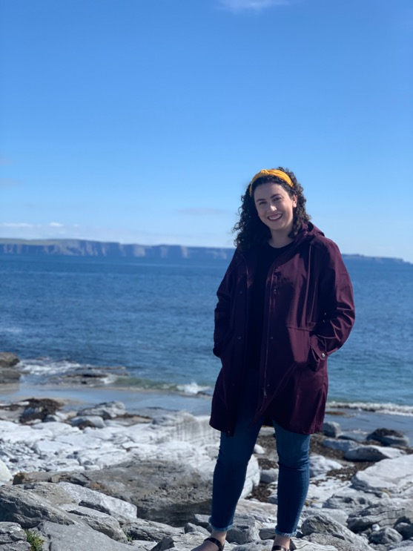
Elaina D'Ambrose
J. William and Mary Diederich College of Communication
Bachelor of Arts

Slide 54
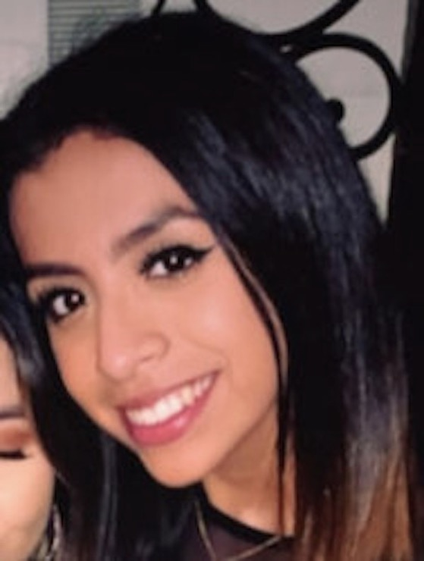
Johanna De Leon-Lopez
J. William and Mary Diederich College of Communication
Bachelor of Arts

Slide 55
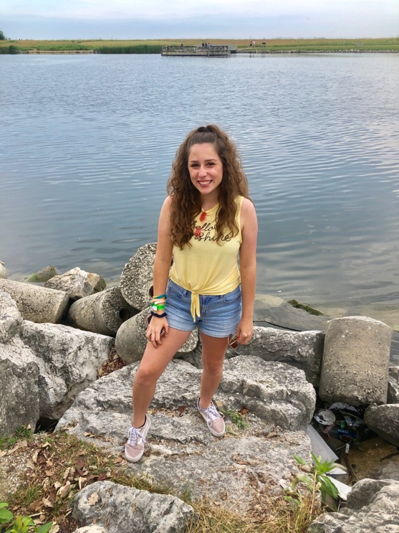
Angelique DeBellis
J. William and Mary Diederich College of Communication
Bachelor of Arts

Slide 56
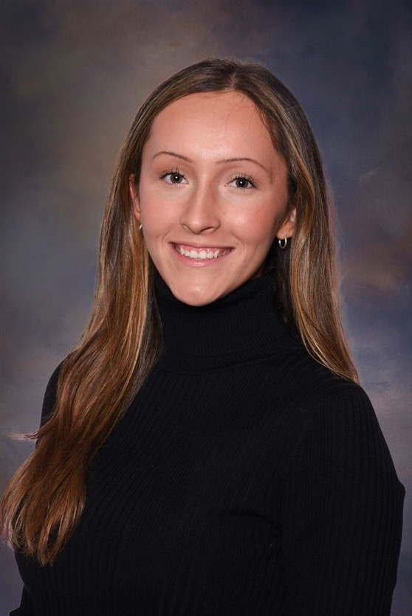
Madeleine Decker
J. William and Mary Diederich College of Communication
Bachelor of Arts

Slide 57
Alexander Delsman
J. William and Mary Diederich College of Communication
Bachelor of Arts

Slide 58
Lauren DeMille
J. William and Mary Diederich College of Communication
Bachelor of Arts

Slide 59
Gracie DeRosa
J. William and Mary Diederich College of Communication
Bachelor of Arts

Slide 60
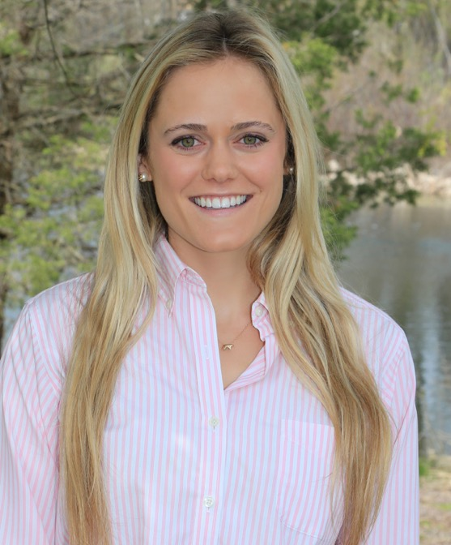
Charlotte Doering
J. William and Mary Diederich College of Communication
Bachelor of Arts

Slide 61
Jack Dore
J. William and Mary Diederich College of Communication
Bachelor of Arts

Slide 62
Kyle DuMez
J. William and Mary Diederich College of Communication
Bachelor of Arts

Slide 63
Felipe Duran-Ballen
J. William and Mary Diederich College of Communication
Bachelor of Arts

Slide 64
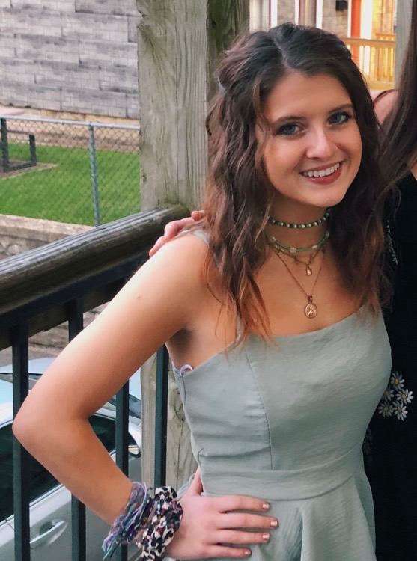
Dolores Ehrhardt
J. William and Mary Diederich College of Communication
Bachelor of Arts

Slide 65
Trevor Ellenberg
J. William and Mary Diederich College of Communication
Bachelor of Arts

Slide 66
Gregory Elliott III
J. William and Mary Diederich College of Communication
Bachelor of Arts

Slide 67
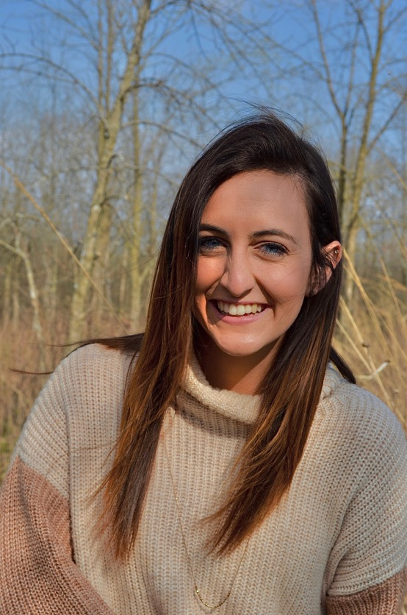
Hannah Engel
J. William and Mary Diederich College of Communication
Bachelor of Arts

Slide 68
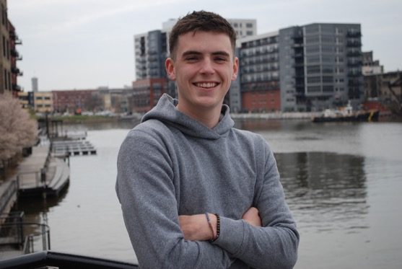
Quinlan Faeth
J. William and Mary Diederich College of Communication
Bachelor of Arts

Slide 69
Nathan Farias
J. William and Mary Diederich College of Communication
Bachelor of Arts

Slide 70
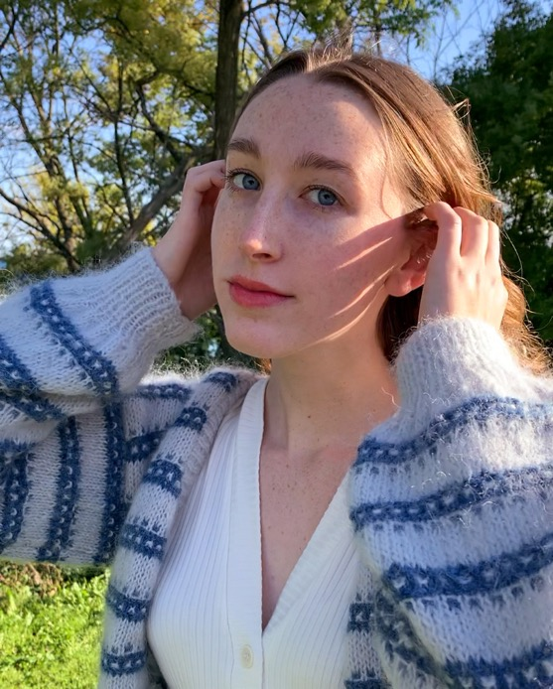
Chloe Fischer
J. William and Mary Diederich College of Communication
Bachelor of Arts

Slide 71
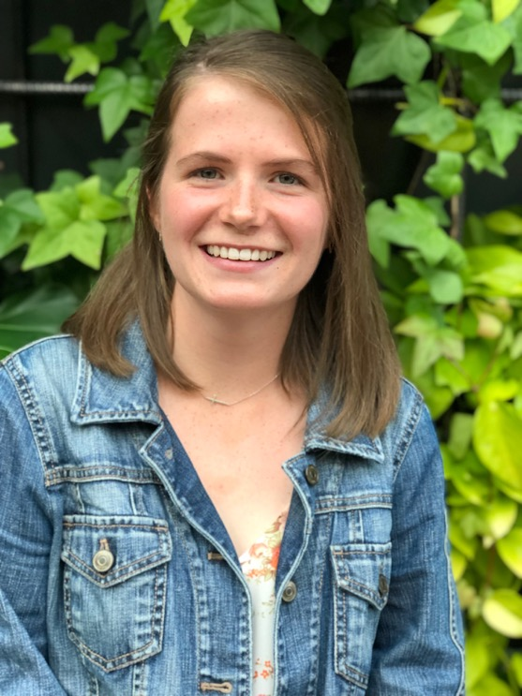
Erin Fitzgerald
J. William and Mary Diederich College of Communication
Bachelor of Arts

Slide 72
Ziyang Fu
J. William and Mary Diederich College of Communication
Bachelor of Arts

Slide 73
Joseph Gall
J. William and Mary Diederich College of Communication
Bachelor of Arts

Slide 74
Gabriela Gamboa
J. William and Mary Diederich College of Communication
Bachelor of Arts

Slide 75
Julio Garcia
J. William and Mary Diederich College of Communication
Bachelor of Arts

Slide 76
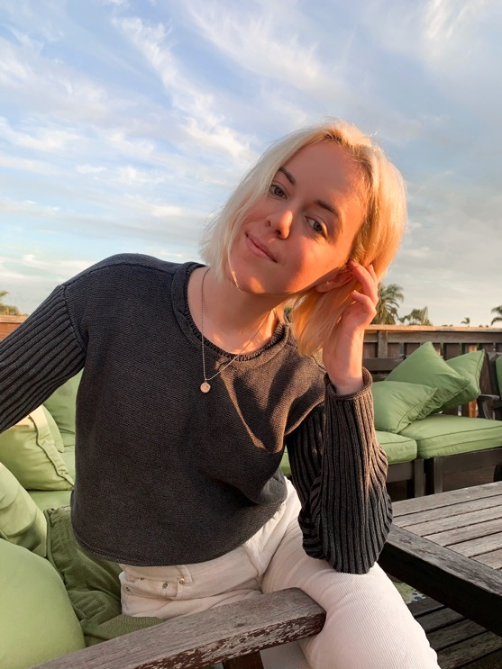
Delia Garland
J. William and Mary Diederich College of Communication
Bachelor of Arts

Slide 77
Patrick Gell
J. William and Mary Diederich College of Communication
Bachelor of Arts

Slide 78
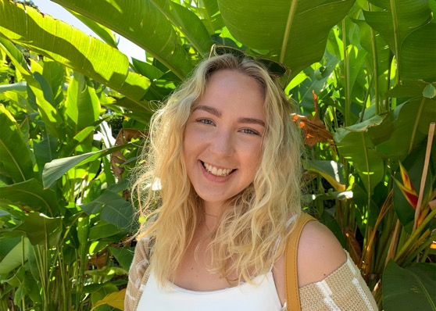
Margaret Gillette
J. William and Mary Diederich College of Communication
Bachelor of Arts

Slide 79
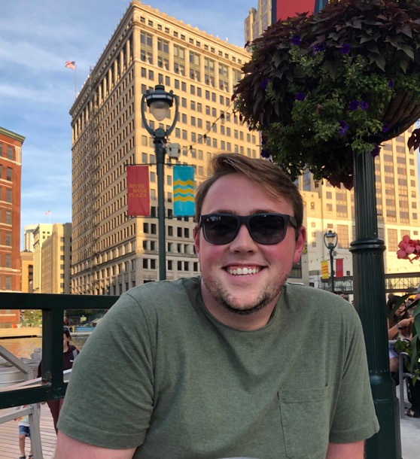
Jacob Gilman
J. William and Mary Diederich College of Communication
Bachelor of Arts

Slide 80
Cameron Gleeson
J. William and Mary Diederich College of Communication
Bachelor of Arts

Slide 81
Tania Gomez
J. William and Mary Diederich College of Communication
Bachelor of Arts

Slide 82
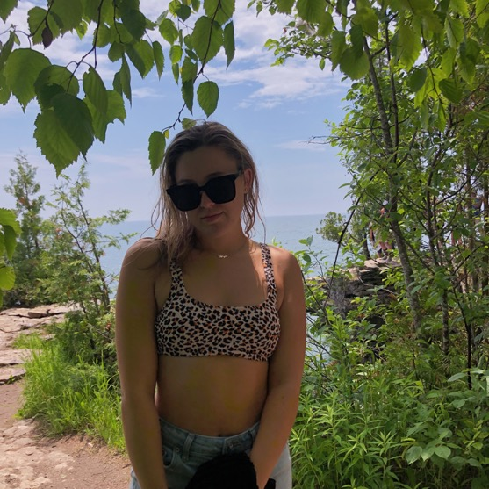
Meredith Graf
J. William and Mary Diederich College of Communication
Bachelor of Arts

Slide 83
Jalen Graves
J. William and Mary Diederich College of Communication
Bachelor of Arts

Slide 84
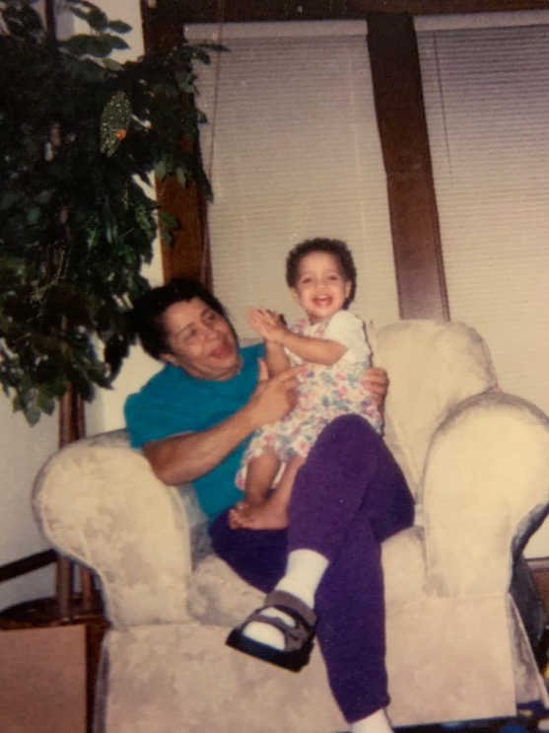
Raphael Gray Jr.
J. William and Mary Diederich College of Communication
Bachelor of Arts

Slide 85
Anne Gunn
J. William and Mary Diederich College of Communication
Bachelor of Arts

Slide 86
Brooke Hall
J. William and Mary Diederich College of Communication
Bachelor of Arts

Slide 87
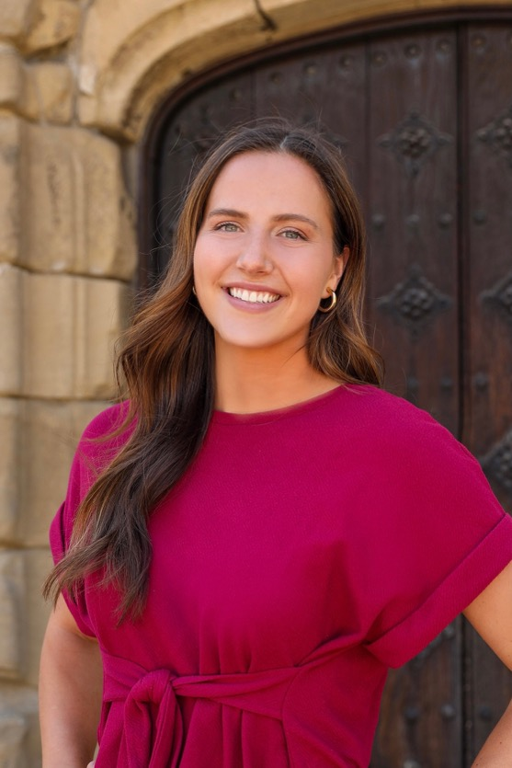
Claire Hamilton
J. William and Mary Diederich College of Communication
Bachelor of Arts

Slide 88
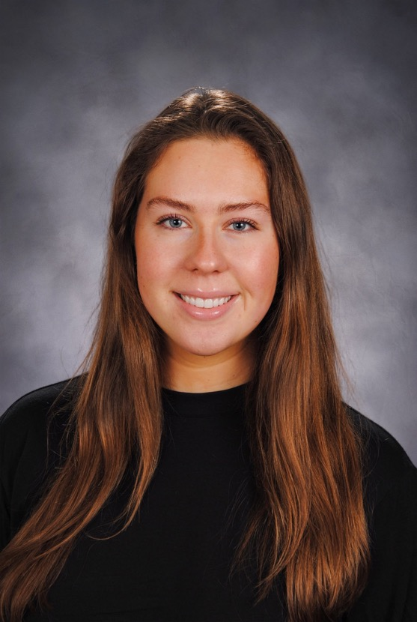
Mary Hanna
J. William and Mary Diederich College of Communication
Bachelor of Arts

Slide 89
James Hanson
J. William and Mary Diederich College of Communication
Bachelor of Arts

Slide 90
Libby Hays
J. William and Mary Diederich College of Communication
Bachelor of Arts

Slide 91
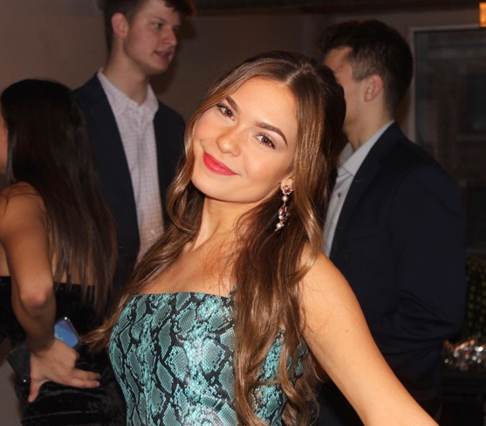
Ava Heiniger
J. William and Mary Diederich College of Communication
Bachelor of Arts

Slide 92
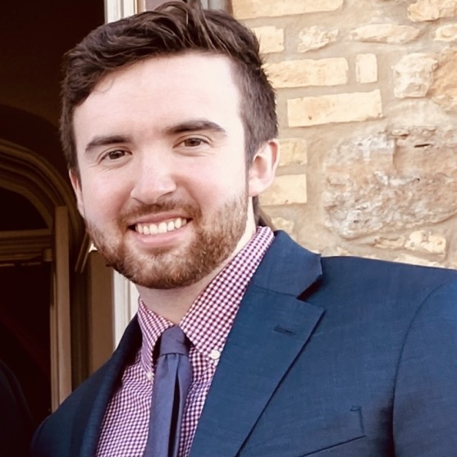
Joseph Hess
J. William and Mary Diederich College of Communication
Bachelor of Arts

Slide 93
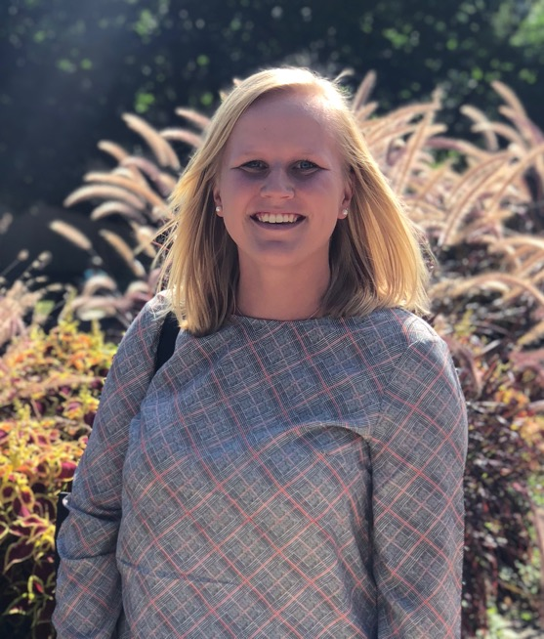
Kirsten Hewitt
J. William and Mary Diederich College of Communication
Bachelor of Arts

Slide 94
Lindsey Hill
J. William and Mary Diederich College of Communication
Bachelor of Arts

Slide 95
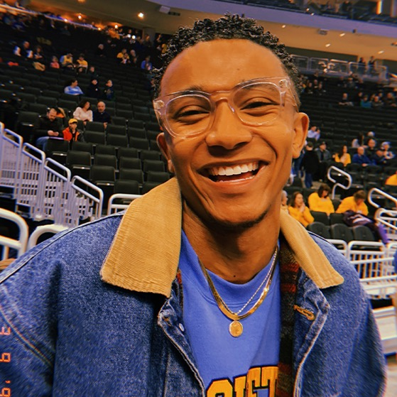
Cole Hines
J. William and Mary Diederich College of Communication
Bachelor of Arts

Slide 96
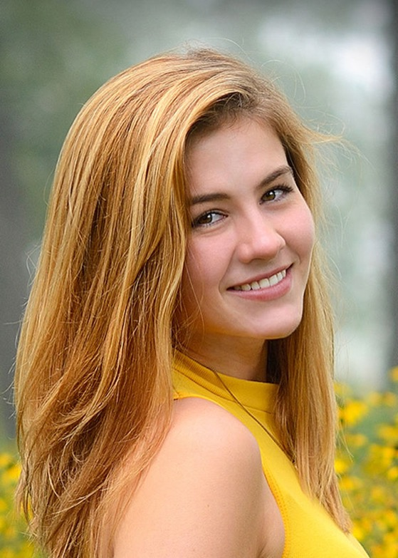
Autumn Hirchert
J. William and Mary Diederich College of Communication
Bachelor of Arts

Slide 97
James Hoban
J. William and Mary Diederich College of Communication
Bachelor of Arts

Slide 98
Alden Hodgdon
J. William and Mary Diederich College of Communication
Bachelor of Arts

Slide 99
Shane Hogan
J. William and Mary Diederich College of Communication
Bachelor of Arts

Slide 100
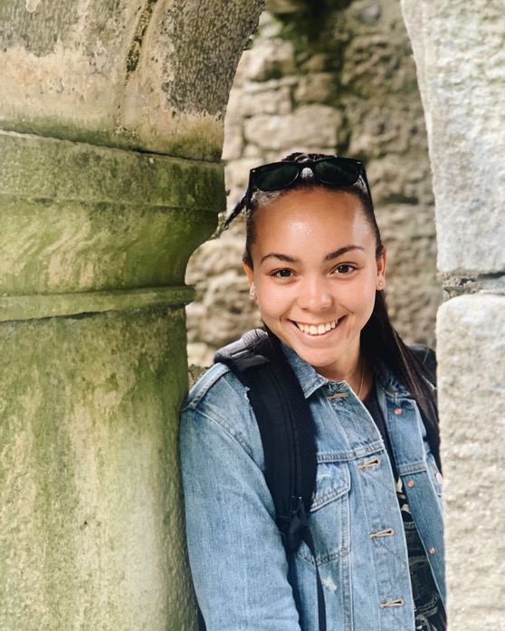
Olivia Huening
J. William and Mary Diederich College of Communication
Bachelor of Arts

Slide 101
Johnathon Hulsman
J. William and Mary Diederich College of Communication
Bachelor of Arts

Slide 102
Andres Isidoro Jr.
J. William and Mary Diederich College of Communication
Bachelor of Arts

Slide 103
Theodore John
J. William and Mary Diederich College of Communication
Bachelor of Arts

Slide 104
Megan Johnson
J. William and Mary Diederich College of Communication
Bachelor of Arts

Slide 105
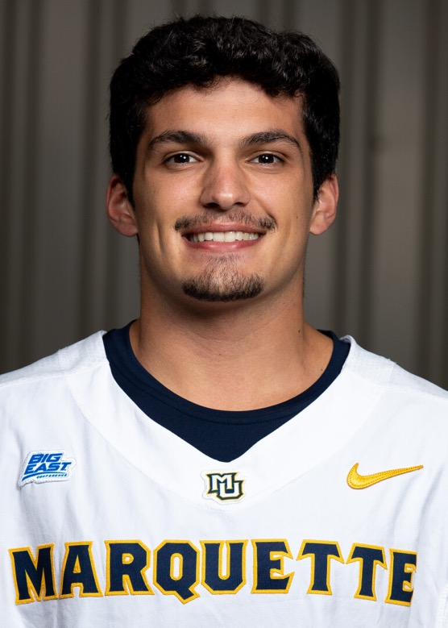
Aaron Joseph
J. William and Mary Diederich College of Communication
Bachelor of Arts

Slide 106
Jenna Jueco
J. William and Mary Diederich College of Communication
Bachelor of Arts

Slide 107

Kayla Kajita
J. William and Mary Diederich College of Communication
Bachelor of Arts

Slide 108

Madison Kane
J. William and Mary Diederich College of Communication
Bachelor of Arts

Slide 109
Daniel Kavula
J. William and Mary Diederich College of Communication
Bachelor of Arts

Slide 110

Joseph Kelly
J. William and Mary Diederich College of Communication
Bachelor of Arts

Slide 111

Cassidy Kemppainen
J. William and Mary Diederich College of Communication
Bachelor of Arts

Slide 112

Nora Kiernan
J. William and Mary Diederich College of Communication
Bachelor of Arts

Slide 113
Naledge Killins
J. William and Mary Diederich College of Communication
Bachelor of Arts

Slide 114

Kole Kloostra
J. William and Mary Diederich College of Communication
Bachelor of Arts

Slide 115
William Knox
J. William and Mary Diederich College of Communication
Bachelor of Arts

Slide 116
Joseph Kolano
J. William and Mary Diederich College of Communication
Bachelor of Arts

Slide 117
Caleb Konecki
J. William and Mary Diederich College of Communication
Bachelor of Arts

Slide 118

Aidan Korte
J. William and Mary Diederich College of Communication
Bachelor of Arts

Slide 119
Megan Kratoska
J. William and Mary Diederich College of Communication
Bachelor of Arts

Slide 120

Alejandro Laboy
J. William and Mary Diederich College of Communication
Bachelor of Arts

Slide 121

Isabella Lazarski
J. William and Mary Diederich College of Communication
Bachelor of Arts

Slide 122

Samuel Lee
J. William and Mary Diederich College of Communication
Bachelor of Arts

Slide 123
Sarah Lipo
J. William and Mary Diederich College of Communication
Bachelor of Arts

Slide 124

Elizabeth Lovdal
J. William and Mary Diederich College of Communication
Bachelor of Arts

Slide 125

Joanna Lozano
J. William and Mary Diederich College of Communication
Bachelor of Arts

Slide 126
Jaime Alexander Lugo
J. William and Mary Diederich College of Communication
Bachelor of Arts

Slide 127

Daniel Macias
J. William and Mary Diederich College of Communication
Bachelor of Arts

Slide 128
Olivia Mancheski-Thompson
J. William and Mary Diederich College of Communication
Bachelor of Arts

Slide 129
Sofia Manglano
J. William and Mary Diederich College of Communication
Bachelor of Arts

Slide 130
Natalie Maniscalco
J. William and Mary Diederich College of Communication
Bachelor of Arts

Slide 131
Alyna Manjee
J. William and Mary Diederich College of Communication
Bachelor of Arts

Slide 132

Luke Manning
J. William and Mary Diederich College of Communication
Bachelor of Arts

Slide 133
Madelyn Marquardt
J. William and Mary Diederich College of Communication
Bachelor of Arts

Slide 134

Julia Marshall
J. William and Mary Diederich College of Communication
Bachelor of Arts

Slide 135
Cristobal Martinez
J. William and Mary Diederich College of Communication
Bachelor of Arts

Slide 136

Michael Martinez
J. William and Mary Diederich College of Communication
Bachelor of Arts

Slide 137

Angela Mazzaferro
J. William and Mary Diederich College of Communication
Bachelor of Arts

Slide 138
Alexis McClain
J. William and Mary Diederich College of Communication
Bachelor of Arts

Slide 139

Connor McClelland
J. William and Mary Diederich College of Communication
Bachelor of Arts

Slide 140
Koby McEwen
J. William and Mary Diederich College of Communication
Bachelor of Arts

Slide 141

Meredith McGuire
J. William and Mary Diederich College of Communication
Bachelor of Arts

Slide 142

Rosie McNamee
J. William and Mary Diederich College of Communication
Bachelor of Arts

Slide 143

Mario Mendez Mendoza
J. William and Mary Diederich College of Communication
Bachelor of Arts

Slide 144
Alexander Milbrath
J. William and Mary Diederich College of Communication
Bachelor of Arts

Slide 145
Malaina Moore
J. William and Mary Diederich College of Communication
Bachelor of Arts

Slide 146
Justin Moralez
J. William and Mary Diederich College of Communication
Bachelor of Arts

Slide 147
Maria Jose Moran Avila
J. William and Mary Diederich College of Communication
Bachelor of Arts

Slide 148

Garrett Moya
J. William and Mary Diederich College of Communication
Bachelor of Arts

Slide 149

Kaleel Muhammad
J. William and Mary Diederich College of Communication
Bachelor of Arts

Slide 150
Meredith Nee
J. William and Mary Diederich College of Communication
Bachelor of Arts

Slide 151

Mark Nicholson
J. William and Mary Diederich College of Communication
Bachelor of Arts

Slide 152
William Nienstedt III
J. William and Mary Diederich College of Communication
Bachelor of Arts

Slide 153

Shannon O'Brien
J. William and Mary Diederich College of Communication
Bachelor of Arts

Slide 154
James Ogunbola
J. William and Mary Diederich College of Communication
Bachelor of Arts

Slide 155
Emily Ollendick
J. William and Mary Diederich College of Communication
Bachelor of Arts

Slide 156
Anthony Orsini
J. William and Mary Diederich College of Communication
Bachelor of Arts

Slide 157
Conor O'Sullivan
J. William and Mary Diederich College of Communication
Bachelor of Arts

Slide 158

David Pacewic
J. William and Mary Diederich College of Communication
Bachelor of Arts

Slide 159

Anjali Patel
J. William and Mary Diederich College of Communication
Bachelor of Arts

Slide 160
Madison Perkins
J. William and Mary Diederich College of Communication
Bachelor of Arts

Slide 161

Oskar Petzold
J. William and Mary Diederich College of Communication
Bachelor of Arts

Slide 162
Giulietta Phelan
J. William and Mary Diederich College of Communication
Bachelor of Arts

Slide 163

Jack Phillips
J. William and Mary Diederich College of Communication
Bachelor of Arts

Slide 164

Sophia Phillips
J. William and Mary Diederich College of Communication
Bachelor of Arts

Slide 165

Alexa Poidomani
J. William and Mary Diederich College of Communication
Bachelor of Arts

Slide 166

Margaret Pollard
J. William and Mary Diederich College of Communication
Bachelor of Arts

Slide 167
Natalija Popovic
J. William and Mary Diederich College of Communication
Bachelor of Arts

Slide 168
Héctor Quiñones Méndez
J. William and Mary Diederich College of Communication
Bachelor of Arts

Slide 169

Cynthia Ramirez
J. William and Mary Diederich College of Communication
Bachelor of Arts

Slide 170
Deija Richards
J. William and Mary Diederich College of Communication
Bachelor of Arts

Slide 171
Mary Margaret Riley
J. William and Mary Diederich College of Communication
Bachelor of Arts

Slide 172

Megan Rittler
J. William and Mary Diederich College of Communication
Bachelor of Arts

Slide 173

Katherine Robertson
J. William and Mary Diederich College of Communication
Bachelor of Arts

Slide 174
Ryan Rollag
J. William and Mary Diederich College of Communication
Bachelor of Arts

Slide 175

Jacob Rose
J. William and Mary Diederich College of Communication
Bachelor of Arts

Slide 176
Sarah Rose
J. William and Mary Diederich College of Communication
Bachelor of Arts

Slide 177

Lyra Ross
J. William and Mary Diederich College of Communication
Bachelor of Arts

Slide 178

Audrey Roth
J. William and Mary Diederich College of Communication
Bachelor of Arts

Slide 179
Taylor Rourke
J. William and Mary Diederich College of Communication
Bachelor of Arts

Slide 180

Jack Ryan
J. William and Mary Diederich College of Communication
Bachelor of Arts

Slide 181

M'Laya Sago
J. William and Mary Diederich College of Communication
Bachelor of Arts

Slide 182

Nawal Samara Segura
J. William and Mary Diederich College of Communication
Bachelor of Arts

Slide 183
Emma Samson
J. William and Mary Diederich College of Communication
Bachelor of Arts

Slide 184
Ernie Sanchez
J. William and Mary Diederich College of Communication
Bachelor of Arts

Slide 185

Sanya Sawlani
J. William and Mary Diederich College of Communication
Bachelor of Arts

Slide 186
Isabelle Shavlik
J. William and Mary Diederich College of Communication
Bachelor of Arts

Slide 187
Kyle Sheridan
J. William and Mary Diederich College of Communication
Bachelor of Arts

Slide 188
Megan Smikla
J. William and Mary Diederich College of Communication
Bachelor of Arts

Slide 189
Francesca Soto
J. William and Mary Diederich College of Communication
Bachelor of Arts

Slide 190

Natallie St. Onge
J. William and Mary Diederich College of Communication
Bachelor of Arts

Slide 191
Isabella Staton
J. William and Mary Diederich College of Communication
Bachelor of Arts

Slide 192
Gabe Stein
J. William and Mary Diederich College of Communication
Bachelor of Arts

Slide 193

Caroline Steller
J. William and Mary Diederich College of Communication
Bachelor of Arts

Slide 194
Patrick Sullivan
J. William and Mary Diederich College of Communication
Bachelor of Arts

Slide 195

Augustus Suneson
J. William and Mary Diederich College of Communication
Bachelor of Arts

Slide 196
Jennifer Swierczek
J. William and Mary Diederich College of Communication
Bachelor of Arts

Slide 197
Sean Taylor
J. William and Mary Diederich College of Communication
Bachelor of Arts

Slide 198
Grace Terry
J. William and Mary Diederich College of Communication
Bachelor of Arts

Slide 199

Jenna Thompson
J. William and Mary Diederich College of Communication
Bachelor of Arts

Slide 200
Kevin Thompson
J. William and Mary Diederich College of Communication
Bachelor of Arts

Slide 201

Brooke Tickler
J. William and Mary Diederich College of Communication
Bachelor of Arts

Slide 202
Reilly Tracy
J. William and Mary Diederich College of Communication
Bachelor of Arts

Slide 203
Joseph Valentyn
J. William and Mary Diederich College of Communication
Bachelor of Arts

Slide 204
Max Valerious
J. William and Mary Diederich College of Communication
Bachelor of Arts

Slide 205

Renu Venkatesh
J. William and Mary Diederich College of Communication
Bachelor of Arts

Slide 206

Mary Wade
J. William and Mary Diederich College of Communication
Bachelor of Arts

Slide 207
Margot Wage
J. William and Mary Diederich College of Communication
Bachelor of Arts

Slide 208

Jamario Walker
J. William and Mary Diederich College of Communication
Bachelor of Arts

Slide 209
Michael Walsh
J. William and Mary Diederich College of Communication
Bachelor of Arts

Slide 210

Grace Weir
J. William and Mary Diederich College of Communication
Bachelor of Arts

Slide 211

Hope Werch
J. William and Mary Diederich College of Communication
Bachelor of Arts

Slide 212
Caroline White
J. William and Mary Diederich College of Communication
Bachelor of Arts

Slide 213
Julia Wilson
J. William and Mary Diederich College of Communication
Bachelor of Arts

Slide 214
Zöe Zehren
J. William and Mary Diederich College of Communication
Bachelor of Arts

Slide 215
Damaris Zita
J. William and Mary Diederich College of Communication
Bachelor of Arts

