Slide 1
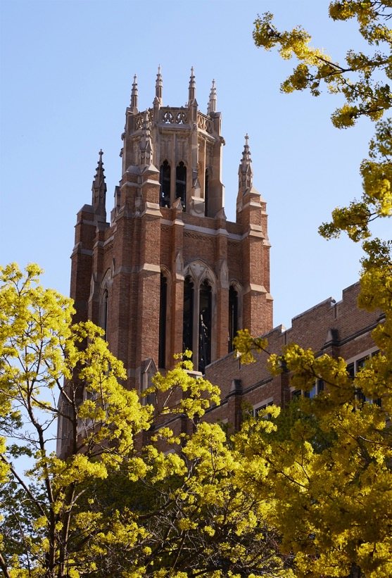
College of Education

Slide 2
Lily Regan
College of Education
Comprehensive Honors Bachelor of Science

Slide 3
Nathan Batty
College of Education
Honors Bachelor of Science

Slide 4
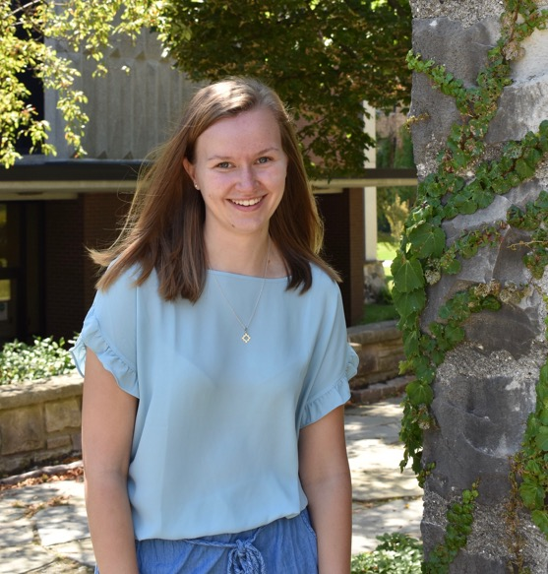
Carissa Burnes
College of Education
Honors Bachelor of Science

Slide 5
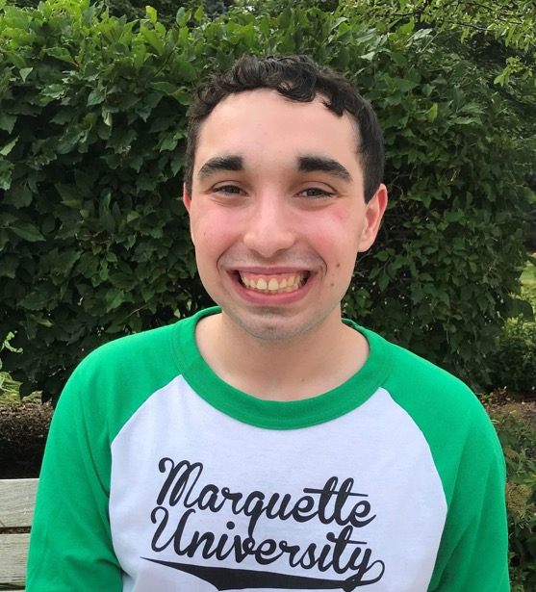
Andrew Hirsh
College of Education
Honors Bachelor of Science

Slide 6
Madeline Moster
College of Education
Honors Bachelor of Science

Slide 7
Joseph Passmore
College of Education
Honors Bachelor of Science

Slide 8
Alexis Aguirre
College of Education
Bachelor of Science

Slide 9
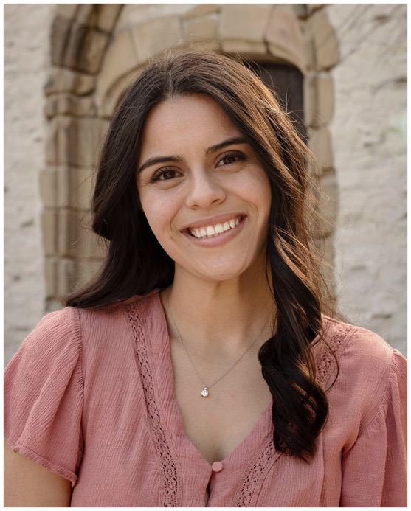
Kimberly Baeza
College of Education
Bachelor of Science

Slide 10
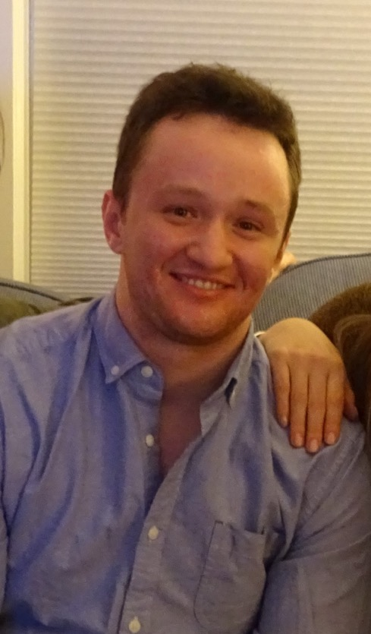
Roy Bowler
College of Education
Bachelor of Science

Slide 11
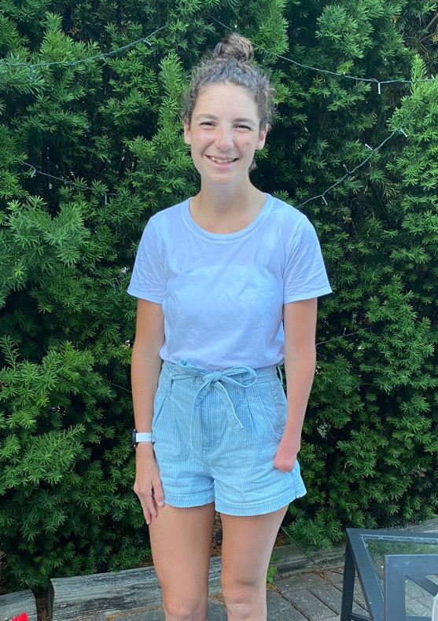
Meghan Bradshaw
College of Education
Bachelor of Science

Slide 12
Sarah Brennan
College of Education
Bachelor of Science

Slide 13
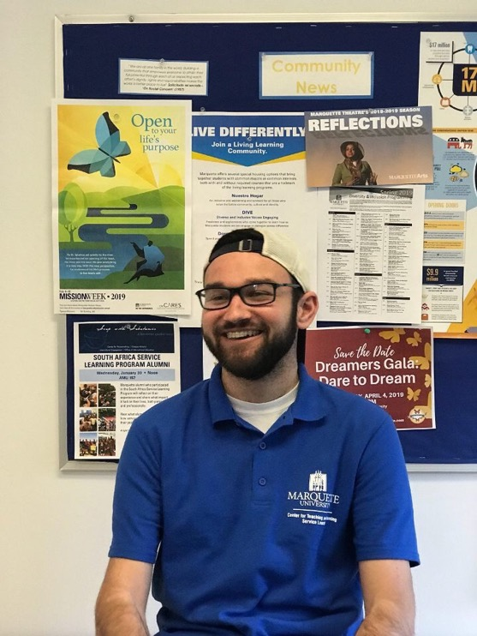
Angelo Bruscato
College of Education
Bachelor of Science

Slide 14
Emma Cranley
College of Education
Bachelor of Science

Slide 15
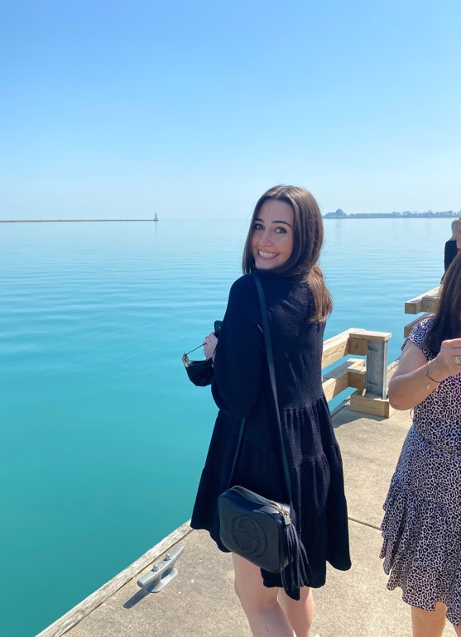
Isabella D'Agostino
College of Education
Bachelor of Science

Slide 16
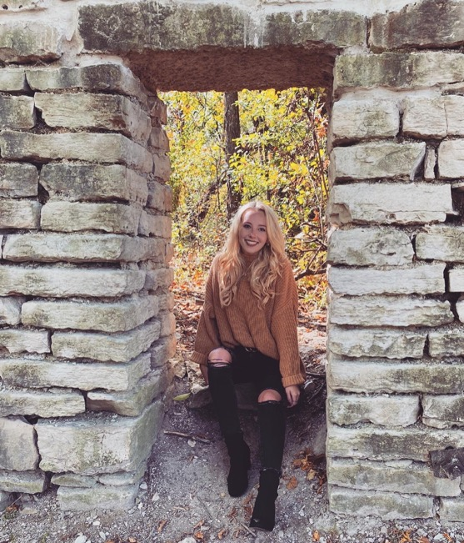
Madison Danduran
College of Education
Bachelor of Science

Slide 17
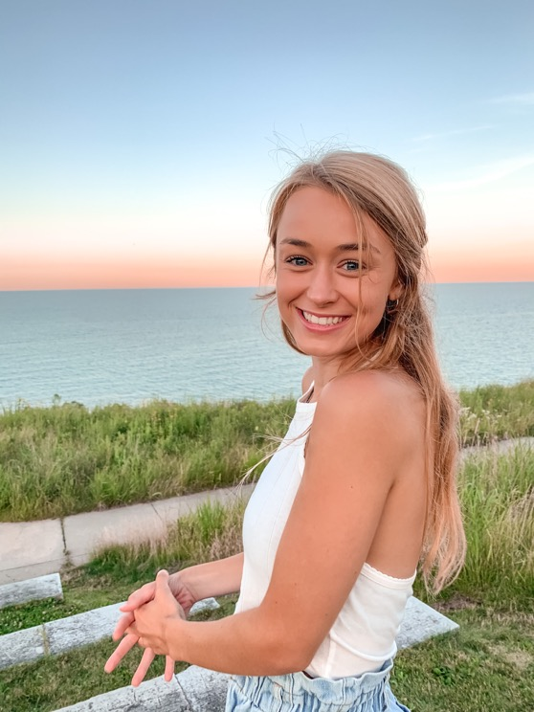
Ann Desing
College of Education
Bachelor of Science

Slide 18
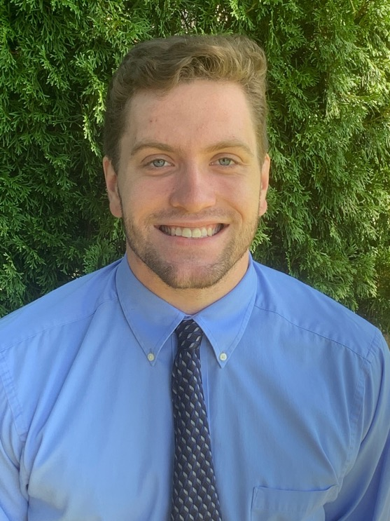
Kevin Dillenburg
College of Education
Bachelor of Science

Slide 19
Louise Ehrhardt
College of Education
Bachelor of Science

Slide 20
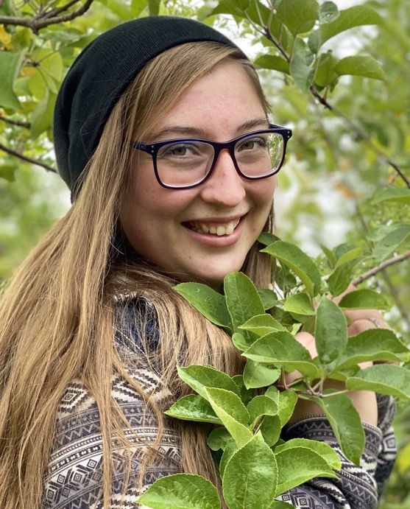
Morgan Frank
College of Education
Bachelor of Science

Slide 21
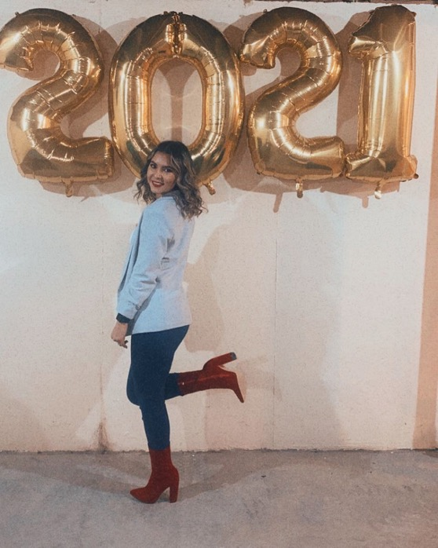
Claudia Frausto-Sandoval
College of Education
Bachelor of Science

Slide 22
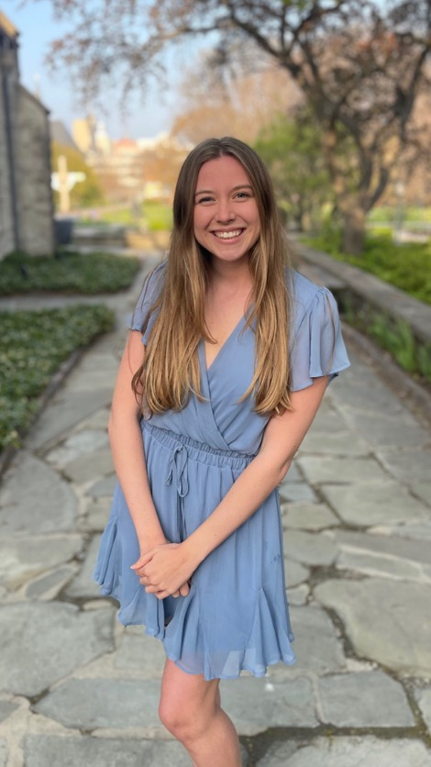
Taylor Gallop
College of Education
Bachelor of Science

Slide 23
Zachary Gleason
College of Education
Bachelor of Science

Slide 24
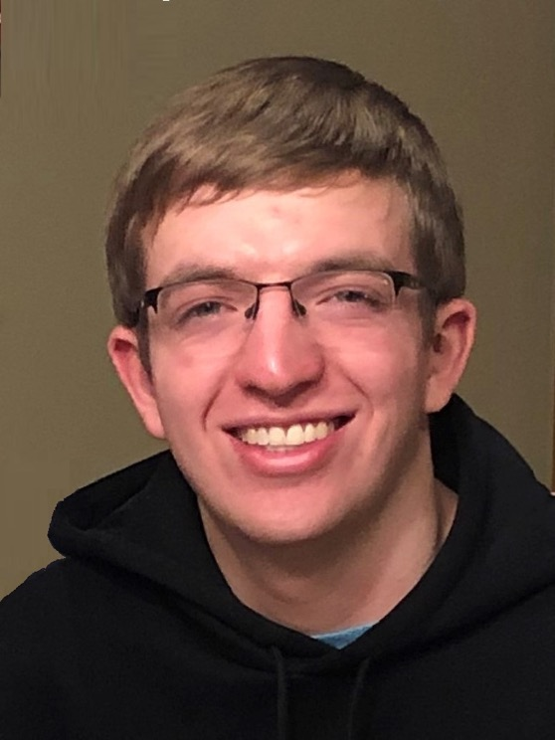
Joseph Goodman
College of Education
Bachelor of Science

Slide 25
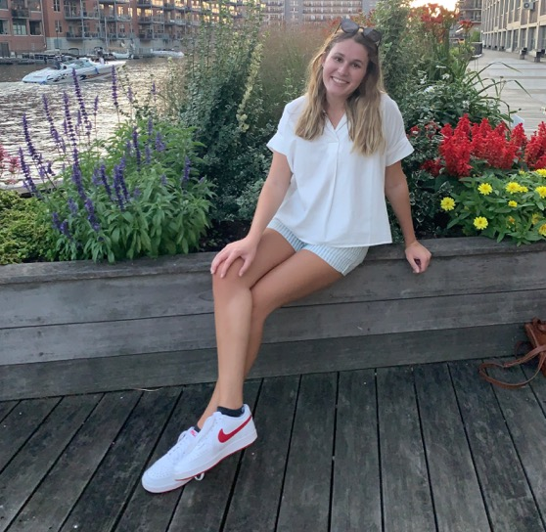
Sara Gramoll
College of Education
Bachelor of Science

Slide 26
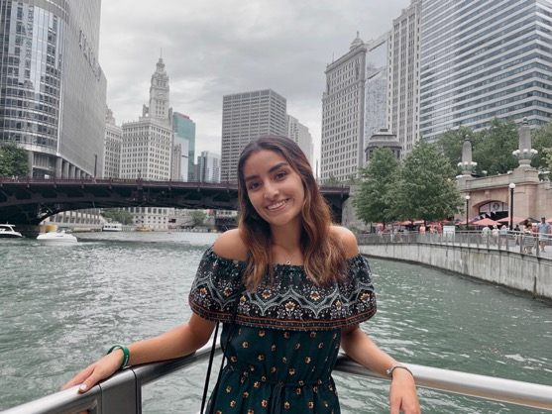
Madeline Guerrero
College of Education
Bachelor of Science

Slide 27
Daniel Ham
College of Education
Bachelor of Science

Slide 28
Gracia Hasebroock
College of Education
Bachelor of Science

Slide 29
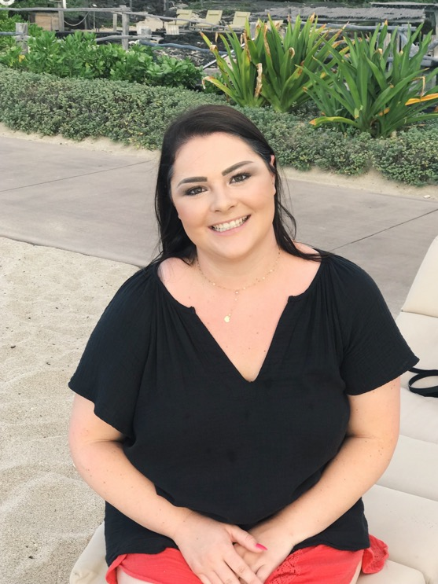
Emily Hawkins
College of Education
Bachelor of Science

Slide 30
Areli Herrera
College of Education
Bachelor of Science

Slide 31
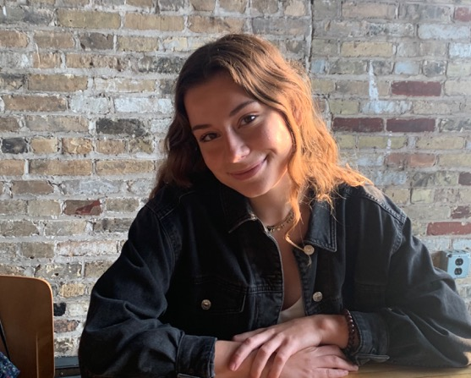
Mary Catherine Jezuit
College of Education
Bachelor of Science

Slide 32
Jonathon Jimenez
College of Education
Bachelor of Science

Slide 33
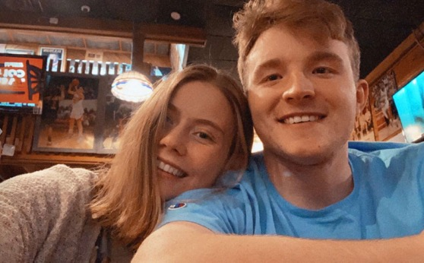
Keagan Lenz
College of Education
Bachelor of Science

Slide 34
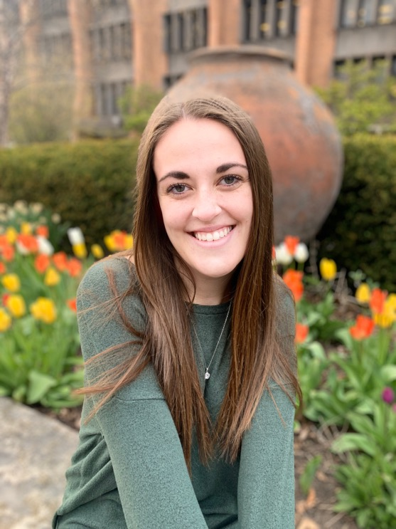
Makayla Loeffelholz
College of Education
Bachelor of Science

Slide 35
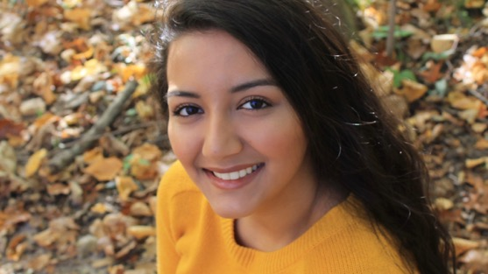
Alejandra Macias
College of Education
Bachelor of Science

Slide 36
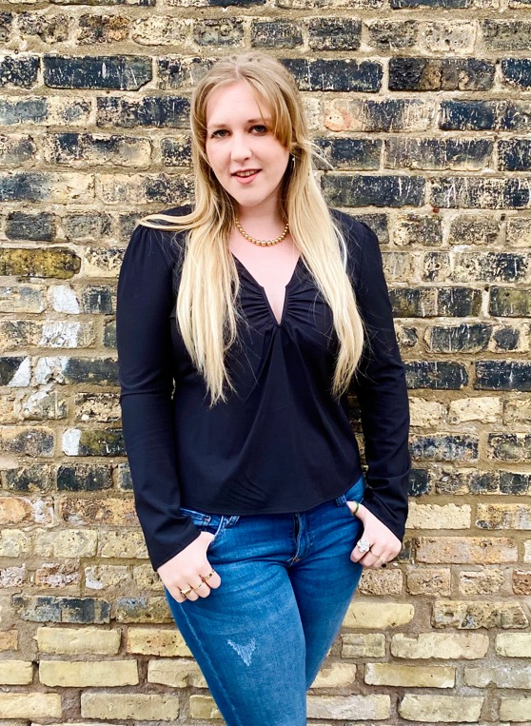
Emma Mass
College of Education
Bachelor of Science

Slide 37
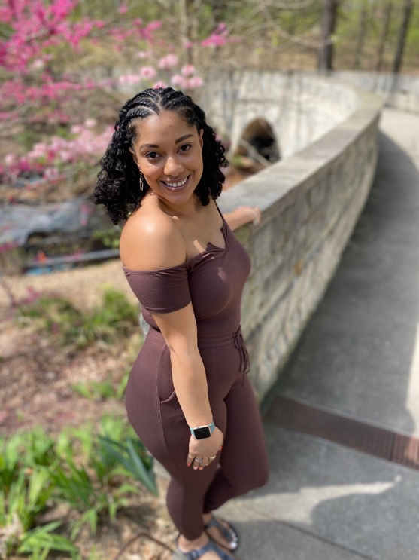
Dominique Maybank
College of Education
Bachelor of Science

Slide 38
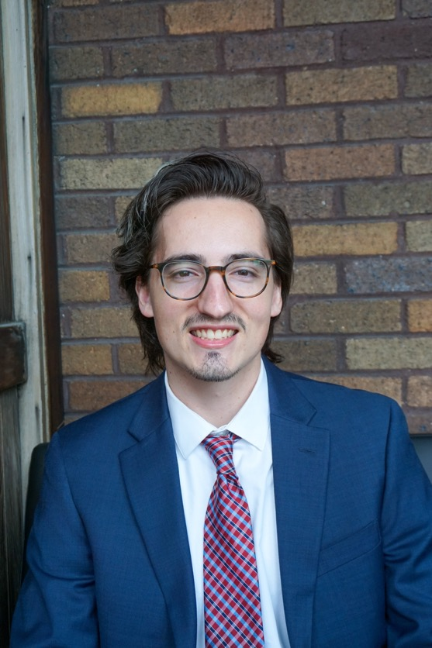
Andrew McCarthy
College of Education
Bachelor of Science

Slide 39
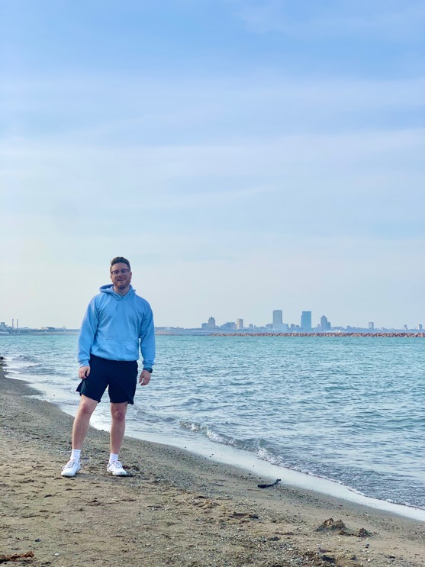
Dakota McFarren
College of Education
Bachelor of Science

Slide 40
Loren McMahon
College of Education
Bachelor of Science

Slide 41
Sandra Mohr
College of Education
Bachelor of Science

Slide 42
John Morrissey
College of Education
Bachelor of Science

Slide 43
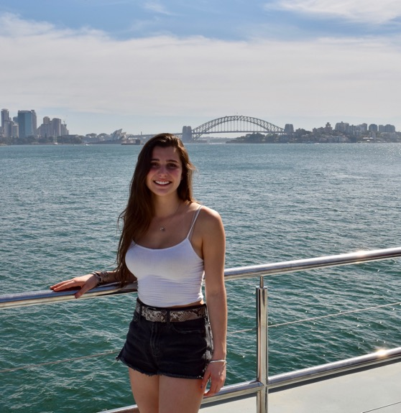
Isabella Olavarria
College of Education
Bachelor of Science

Slide 44
Tania Padilla
College of Education
Bachelor of Science

Slide 45
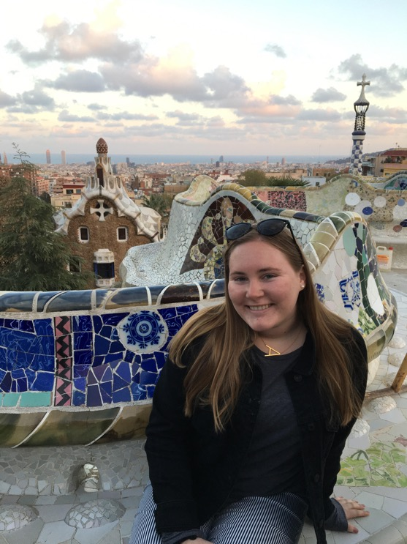
Alicia Piccininni
College of Education
Bachelor of Science

Slide 46
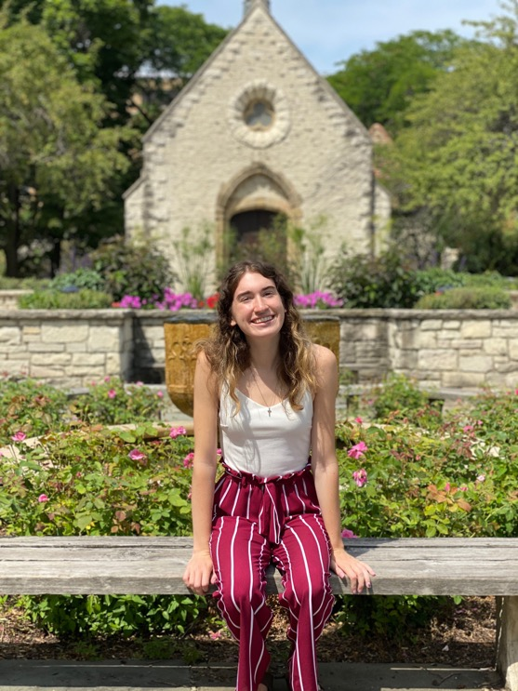
Rachel Pogodzinski
College of Education
Bachelor of Science

Slide 47
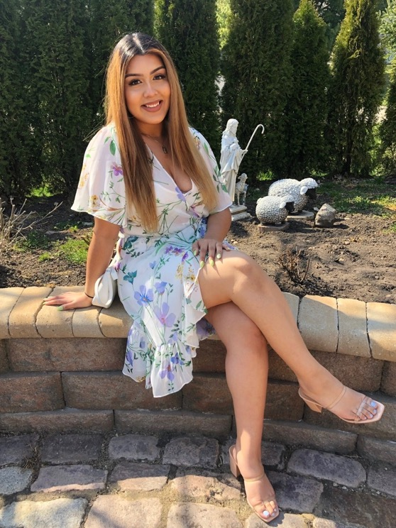
Evelyn Puga Ruiz
College of Education
Bachelor of Science

Slide 48
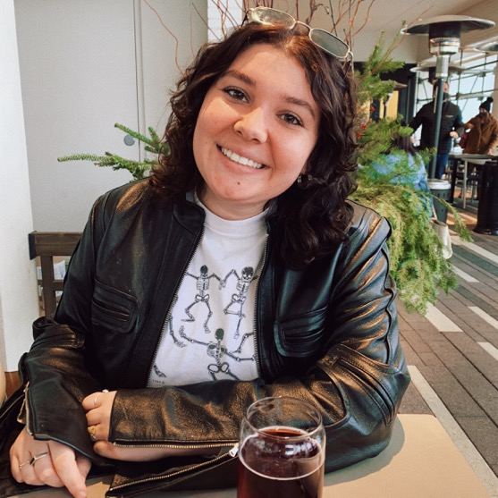
Hannah Puma
College of Education
Bachelor of Science

Slide 49
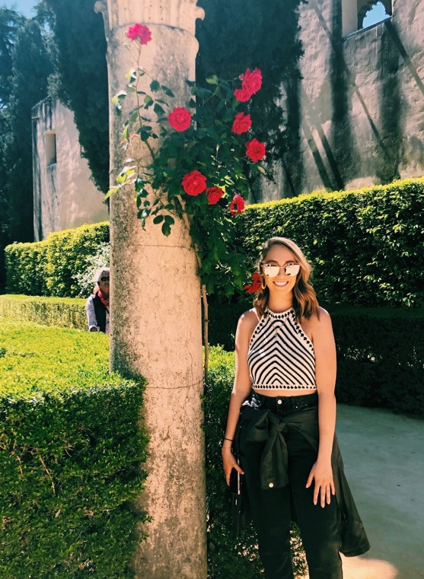
Cailee Riley
College of Education
Bachelor of Science

Slide 50
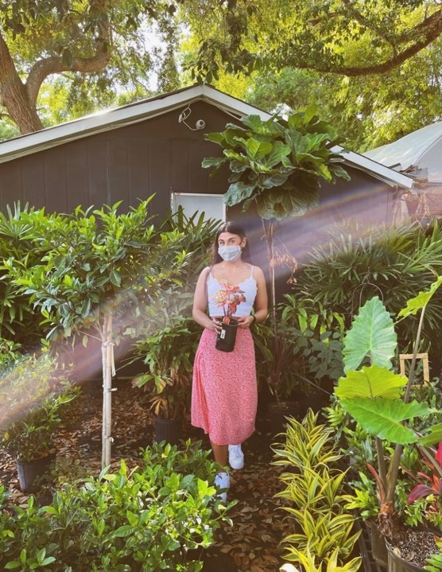
Payton Roque
College of Education
Bachelor of Science

Slide 51
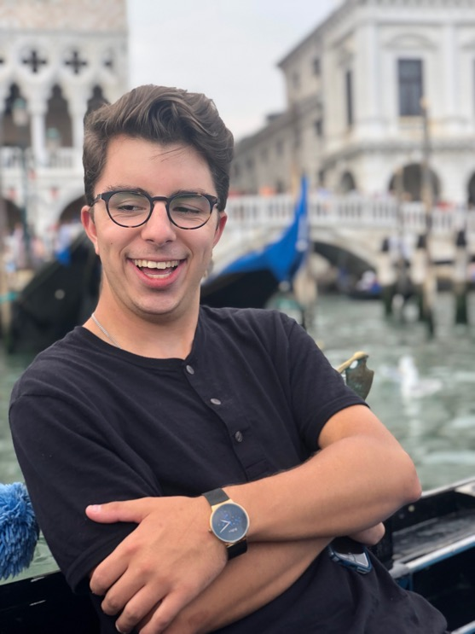
Arthur Scheller IV
College of Education
Bachelor of Science

Slide 52
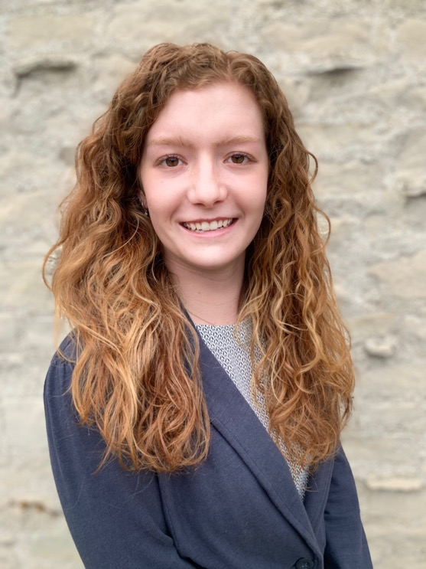
Kate Sheehan
College of Education
Bachelor of Science

Slide 53
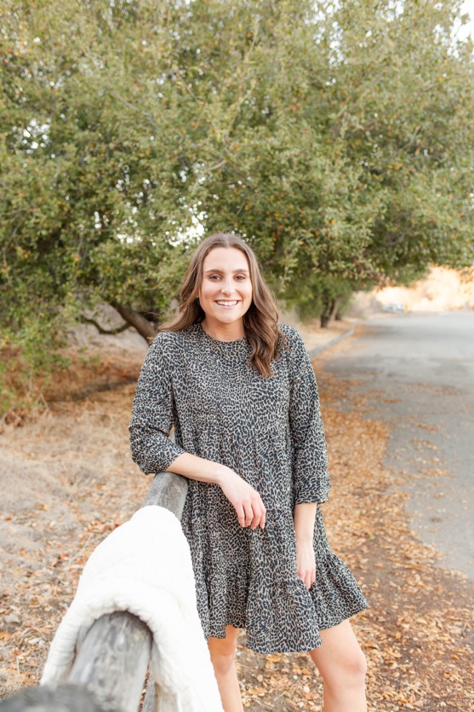
Johanna Stadtmueller
College of Education
Bachelor of Science

Slide 54
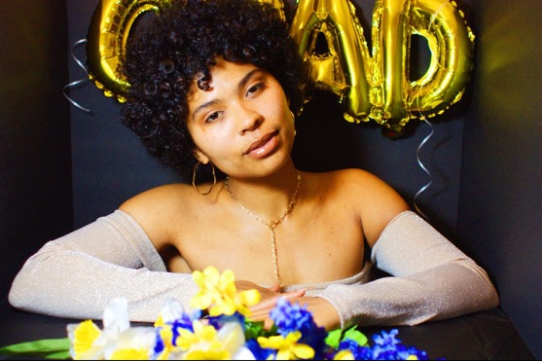
Essence Truth
College of Education
Bachelor of Science

Slide 55
Maria Van Thienen
College of Education
Bachelor of Science

Slide 56
Isabella Zanzucchi
College of Education
Bachelor of Science

