Slide 1
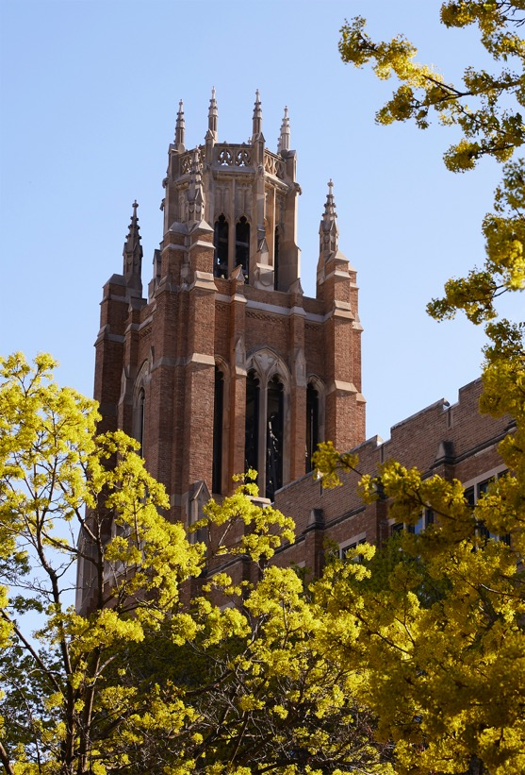
College of Health Sciences Professional

Slide 2
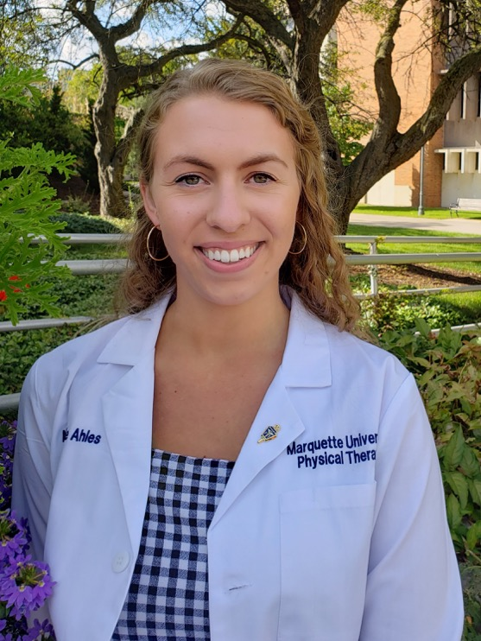
Nicole Ahles
College of Health Sciences Professional
Doctor of Physical Therapy

Slide 3
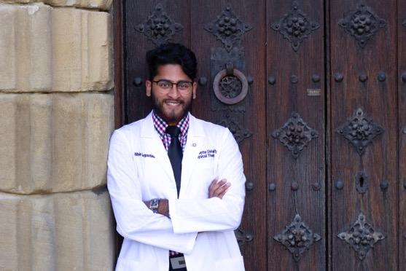
Bibin Augustine
College of Health Sciences Professional
Doctor of Physical Therapy

Slide 4
Molly Berigan
College of Health Sciences Professional
Doctor of Physical Therapy

Slide 5
Shannon Bettinger
College of Health Sciences Professional
Doctor of Physical Therapy

Slide 6
Lindsay Billig
College of Health Sciences Professional
Doctor of Physical Therapy

Slide 7
Bridget Bohan
College of Health Sciences Professional
Doctor of Physical Therapy

Slide 8
Mark Bouwmeester
College of Health Sciences Professional
Doctor of Physical Therapy

Slide 9
Drew Busch
College of Health Sciences Professional
Doctor of Physical Therapy

Slide 10
Sloane Carlson
College of Health Sciences Professional
Doctor of Physical Therapy

Slide 11
Leah Celarek
College of Health Sciences Professional
Doctor of Physical Therapy

Slide 12
Catherine Cunningham
College of Health Sciences Professional
Doctor of Physical Therapy

Slide 13
Sarah D'Astice
College of Health Sciences Professional
Doctor of Physical Therapy

Slide 14
Katherine De Lara
College of Health Sciences Professional
Doctor of Physical Therapy

Slide 15
Elizabeth DePauw
College of Health Sciences Professional
Doctor of Physical Therapy

Slide 16
Vincent Dray
College of Health Sciences Professional
Doctor of Physical Therapy

Slide 17
Allison Evans
College of Health Sciences Professional
Doctor of Physical Therapy

Slide 18
Karina Folliard
College of Health Sciences Professional
Doctor of Physical Therapy

Slide 19
Ashley Frey
College of Health Sciences Professional
Doctor of Physical Therapy

Slide 20
Sydney Gallop
College of Health Sciences Professional
Doctor of Physical Therapy

Slide 21
Amber Garcia
College of Health Sciences Professional
Doctor of Physical Therapy

Slide 22
Jacqueline Green
College of Health Sciences Professional
Doctor of Physical Therapy

Slide 23
Annika Haley
College of Health Sciences Professional
Doctor of Physical Therapy

Slide 24
Kimberly Harris
College of Health Sciences Professional
Doctor of Physical Therapy

Slide 25
Claire Heneghan
College of Health Sciences Professional
Doctor of Physical Therapy

Slide 26
Alaina Herron
College of Health Sciences Professional
Doctor of Physical Therapy

Slide 27
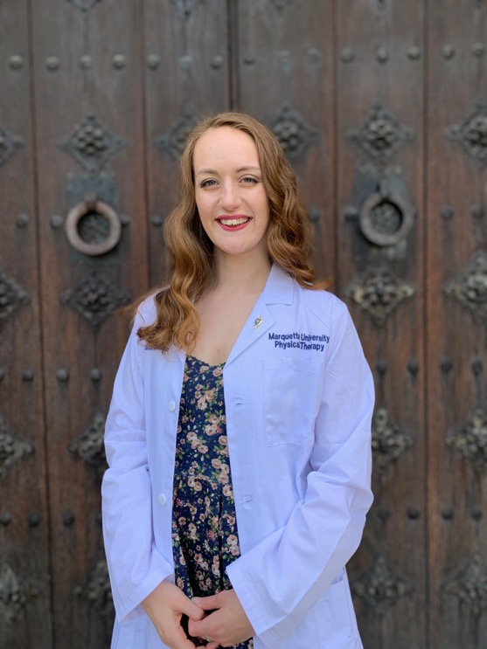
Christina Hochla
College of Health Sciences Professional
Doctor of Physical Therapy

Slide 28
Jill Hoffman
College of Health Sciences Professional
Doctor of Physical Therapy

Slide 29
Ming-Hung Hsieh
College of Health Sciences Professional
Doctor of Physical Therapy

Slide 30
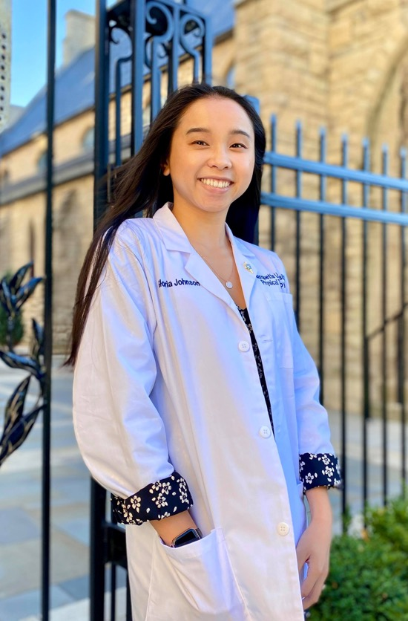
Gloria Johnson
College of Health Sciences Professional
Doctor of Physical Therapy

Slide 31
Megan Kaminski
College of Health Sciences Professional
Doctor of Physical Therapy

Slide 32
Jessica Kathe
College of Health Sciences Professional
Doctor of Physical Therapy

Slide 33
Nicolle Kaytsner
College of Health Sciences Professional
Doctor of Physical Therapy

Slide 34
Michael Knight
College of Health Sciences Professional
Doctor of Physical Therapy

Slide 35
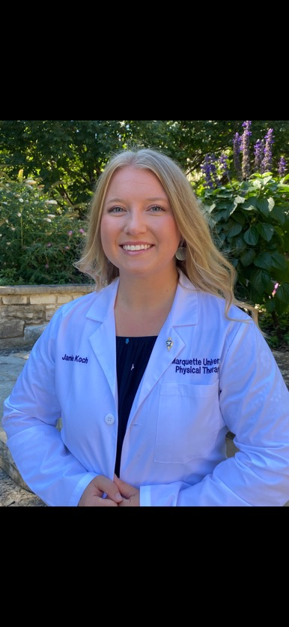
Jamie Koch
College of Health Sciences Professional
Doctor of Physical Therapy

Slide 36
Ashley Kriston
College of Health Sciences Professional
Doctor of Physical Therapy

Slide 37
Emily Krusenoski
College of Health Sciences Professional
Doctor of Physical Therapy

Slide 38
Erin Kurtz
College of Health Sciences Professional
Doctor of Physical Therapy

Slide 39
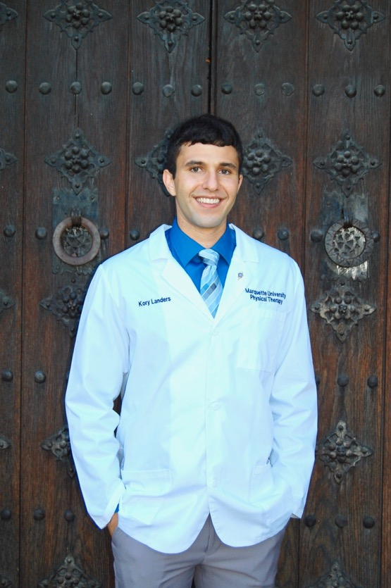
Kory Landers
College of Health Sciences Professional
Doctor of Physical Therapy

Slide 40
Jona Lee
College of Health Sciences Professional
Doctor of Physical Therapy

Slide 41
Martha Leuthner
College of Health Sciences Professional
Doctor of Physical Therapy

Slide 42
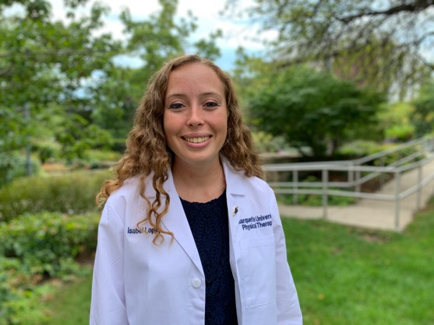
Maria Lopez
College of Health Sciences Professional
Doctor of Physical Therapy

Slide 43
Morgan McCarter
College of Health Sciences Professional
Doctor of Physical Therapy

Slide 44
Learon McGinn
College of Health Sciences Professional
Doctor of Physical Therapy

Slide 45
Paul McKeon
College of Health Sciences Professional
Doctor of Physical Therapy

Slide 46
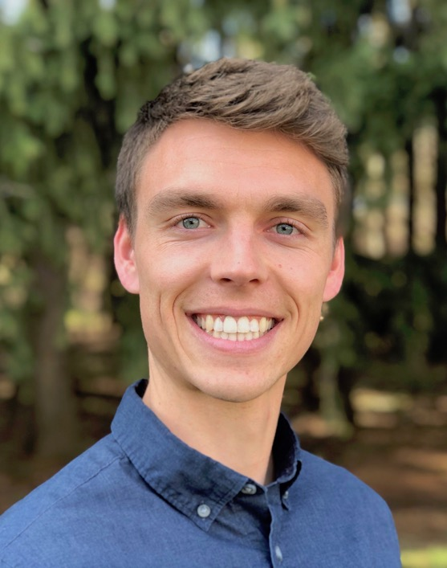
Carl Meyer
College of Health Sciences Professional
Doctor of Physical Therapy

Slide 47
Mariah Miller
College of Health Sciences Professional
Doctor of Physical Therapy

Slide 48
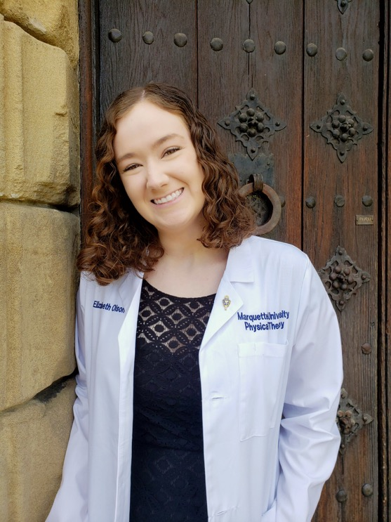
Elizabeth Olson
College of Health Sciences Professional
Doctor of Physical Therapy

Slide 49
Jasmine Ough
College of Health Sciences Professional
Doctor of Physical Therapy

Slide 50
Rey Dominick Paranal
College of Health Sciences Professional
Doctor of Physical Therapy

Slide 51
Megha Patel
College of Health Sciences Professional
Doctor of Physical Therapy

Slide 52
Neerali Patel
College of Health Sciences Professional
Doctor of Physical Therapy

Slide 53
Joaquin Pelayo
College of Health Sciences Professional
Doctor of Physical Therapy

Slide 54
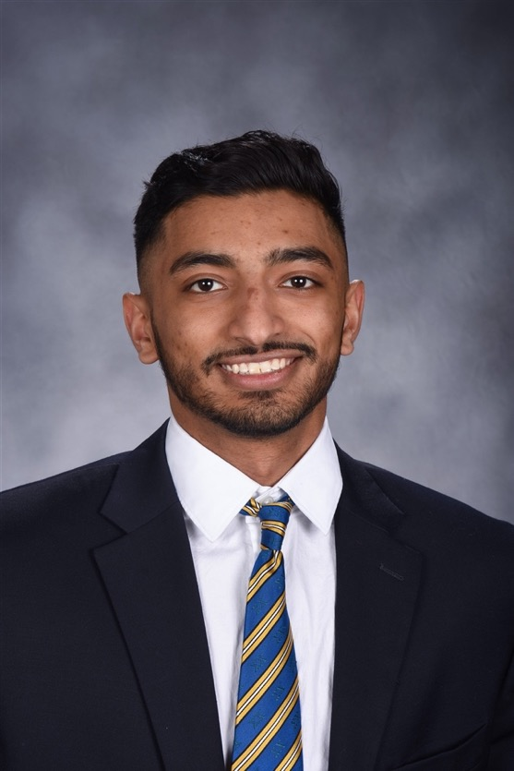
Jex Philip
College of Health Sciences Professional
Doctor of Physical Therapy

Slide 55
Madeleine Philipp
College of Health Sciences Professional
Doctor of Physical Therapy

Slide 56
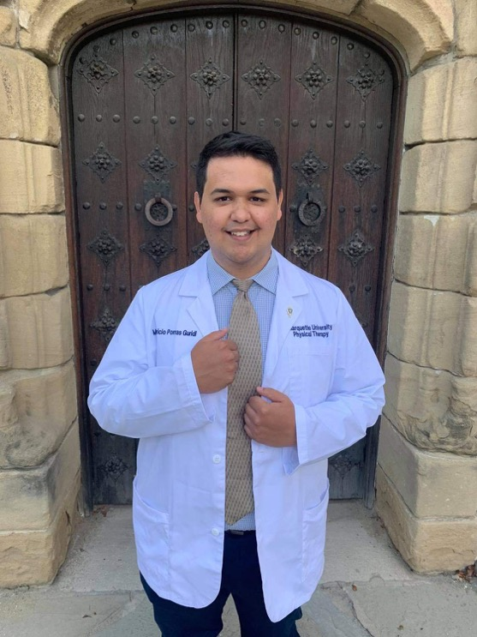
Mauricio Porras Guridi
College of Health Sciences Professional
Doctor of Physical Therapy

Slide 57
Jesus Prado
College of Health Sciences Professional
Doctor of Physical Therapy

Slide 58
Nikolas Psarros
College of Health Sciences Professional
Doctor of Physical Therapy

Slide 59
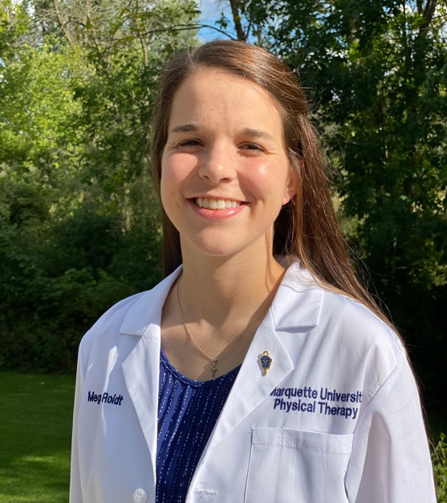
Megan Roidt
College of Health Sciences Professional
Doctor of Physical Therapy

Slide 60
Lucille Roudebush
College of Health Sciences Professional
Doctor of Physical Therapy

Slide 61
Gillian Scanlon
College of Health Sciences Professional
Doctor of Physical Therapy

Slide 62
Emily Schaefer
College of Health Sciences Professional
Doctor of Physical Therapy

Slide 63
Riley Schilling
College of Health Sciences Professional
Doctor of Physical Therapy

Slide 64
Amy Sedlak
College of Health Sciences Professional
Doctor of Physical Therapy

Slide 65
MacKenzie Skipper
College of Health Sciences Professional
Doctor of Physical Therapy

Slide 66
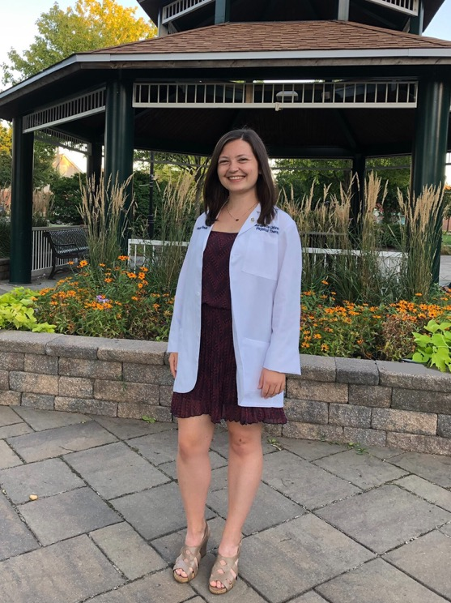
Karissa Smola
College of Health Sciences Professional
Doctor of Physical Therapy

Slide 67
Ryan Sung
College of Health Sciences Professional
Doctor of Physical Therapy

Slide 68
Kelly Walsh
College of Health Sciences Professional
Doctor of Physical Therapy

Slide 69
Erin Alagna
College of Health Sciences Professional
Master of Athletic Training

Slide 70
Alyssa Gorecki
College of Health Sciences Professional
Master of Athletic Training

Slide 71
Jeffrey Jackson
College of Health Sciences Professional
Master of Athletic Training

Slide 72
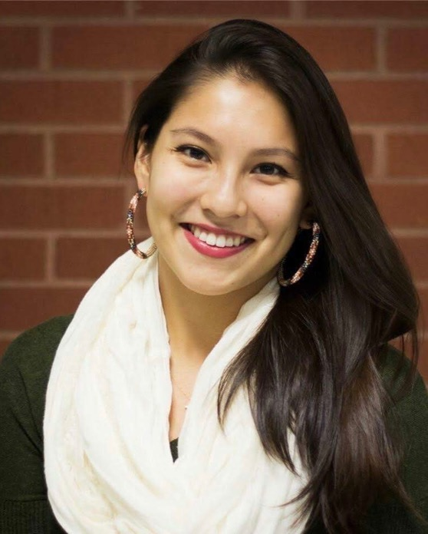
Caelan King
College of Health Sciences Professional
Master of Athletic Training

Slide 73
Cullen Murray
College of Health Sciences Professional
Master of Athletic Training

Slide 74
Joshua Rosales
College of Health Sciences Professional
Master of Athletic Training

Slide 75
Katherine Schmalz
College of Health Sciences Professional
Master of Athletic Training

Slide 76
Alefiyah Adam
College of Health Sciences Professional
Master of Physician Assistant Studies

Slide 77
Stephanie Adamczyk
College of Health Sciences Professional
Master of Physician Assistant Studies

Slide 78
Maureen Bailey
College of Health Sciences Professional
Master of Physician Assistant Studies

Slide 79
Kelli Benson
College of Health Sciences Professional
Master of Physician Assistant Studies

Slide 80
Hilary Benway
College of Health Sciences Professional
Master of Physician Assistant Studies

Slide 81
Alec Biese
College of Health Sciences Professional
Master of Physician Assistant Studies

Slide 82
Alexander Camp
College of Health Sciences Professional
Master of Physician Assistant Studies

Slide 83
Cody Cantrell
College of Health Sciences Professional
Master of Physician Assistant Studies

Slide 84
Kathleen Davis
College of Health Sciences Professional
Master of Physician Assistant Studies

Slide 85
Tara Duffy
College of Health Sciences Professional
Master of Physician Assistant Studies

Slide 86
Meghan Dugan
College of Health Sciences Professional
Master of Physician Assistant Studies

Slide 87
Madeleine Egan
College of Health Sciences Professional
Master of Physician Assistant Studies

Slide 88
Alexa Finger
College of Health Sciences Professional
Master of Physician Assistant Studies

Slide 89
Madeline Finn
College of Health Sciences Professional
Master of Physician Assistant Studies

Slide 90
Erin Fischer
College of Health Sciences Professional
Master of Physician Assistant Studies

Slide 91
Mitchell Fowler
College of Health Sciences Professional
Master of Physician Assistant Studies

Slide 92
Kaylyn Freeman
College of Health Sciences Professional
Master of Physician Assistant Studies

Slide 93
Michael Gernant
College of Health Sciences Professional
Master of Physician Assistant Studies

Slide 94
Jaclyn Goble
College of Health Sciences Professional
Master of Physician Assistant Studies

Slide 95
Kimberly Griesenauer
College of Health Sciences Professional
Master of Physician Assistant Studies

Slide 96
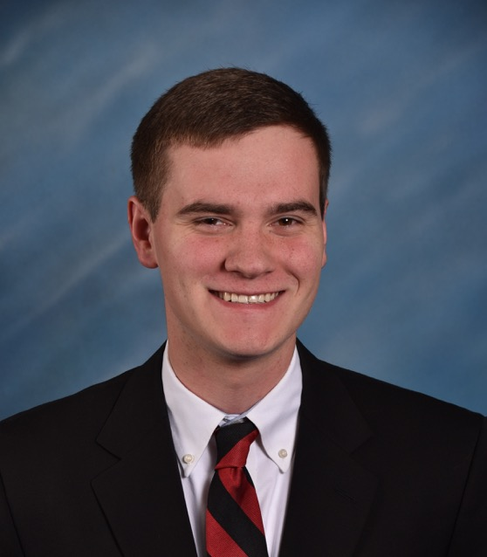
Drew Hetz
College of Health Sciences Professional
Master of Physician Assistant Studies

Slide 97
Sarah Hoffman
College of Health Sciences Professional
Master of Physician Assistant Studies

Slide 98
Courtney Hove
College of Health Sciences Professional
Master of Physician Assistant Studies

Slide 99
Adelaide Johanson
College of Health Sciences Professional
Master of Physician Assistant Studies

Slide 100
Amanda Kassner
College of Health Sciences Professional
Master of Physician Assistant Studies

Slide 101
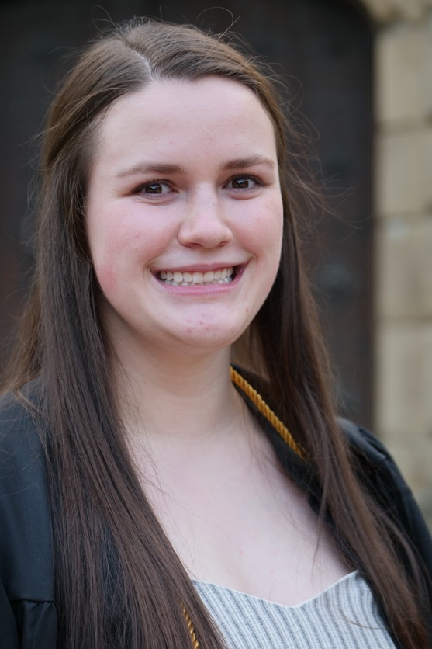
Colette Kelly
College of Health Sciences Professional
Master of Physician Assistant Studies

Slide 102
Carolyn Kinskey
College of Health Sciences Professional
Master of Physician Assistant Studies

Slide 103
Hana Koester
College of Health Sciences Professional
Master of Physician Assistant Studies

Slide 104
Anamarta Lamoutte
College of Health Sciences Professional
Master of Physician Assistant Studies

Slide 105
Rebecca LeGrett
College of Health Sciences Professional
Master of Physician Assistant Studies

Slide 106
Rachel Lillig
College of Health Sciences Professional
Master of Physician Assistant Studies

Slide 107
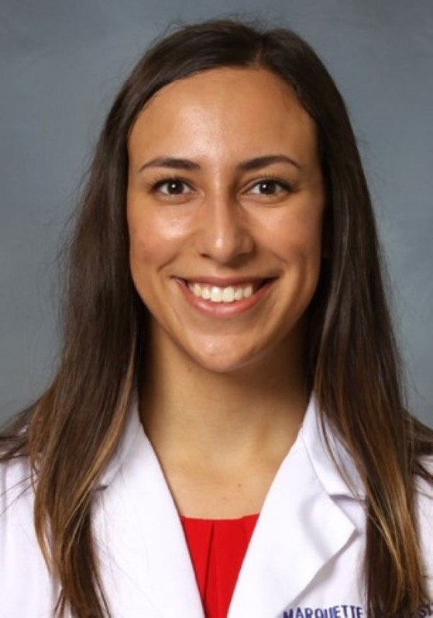
Alejandra Logan
College of Health Sciences Professional
Master of Physician Assistant Studies

Slide 108
Taylor Menard
College of Health Sciences Professional
Master of Physician Assistant Studies

Slide 109
Shana Michael
College of Health Sciences Professional
Master of Physician Assistant Studies

Slide 110
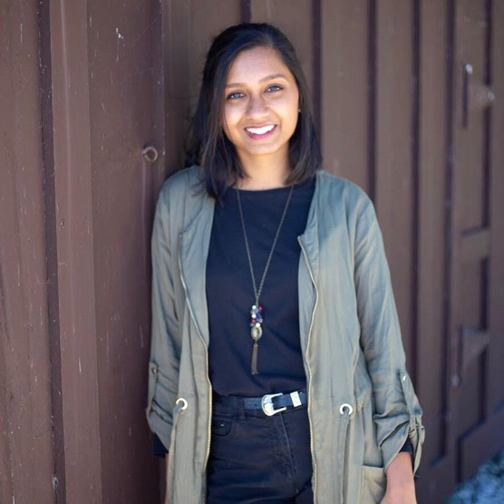
Pruthvi Patel
College of Health Sciences Professional
Master of Physician Assistant Studies

Slide 111
Alissa Pescheck
College of Health Sciences Professional
Master of Physician Assistant Studies

Slide 112
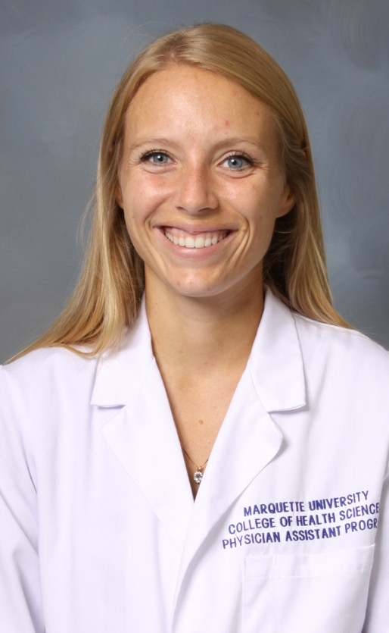
Rita Peterson
College of Health Sciences Professional
Master of Physician Assistant Studies

Slide 113
Elissa Porath
College of Health Sciences Professional
Master of Physician Assistant Studies

Slide 114
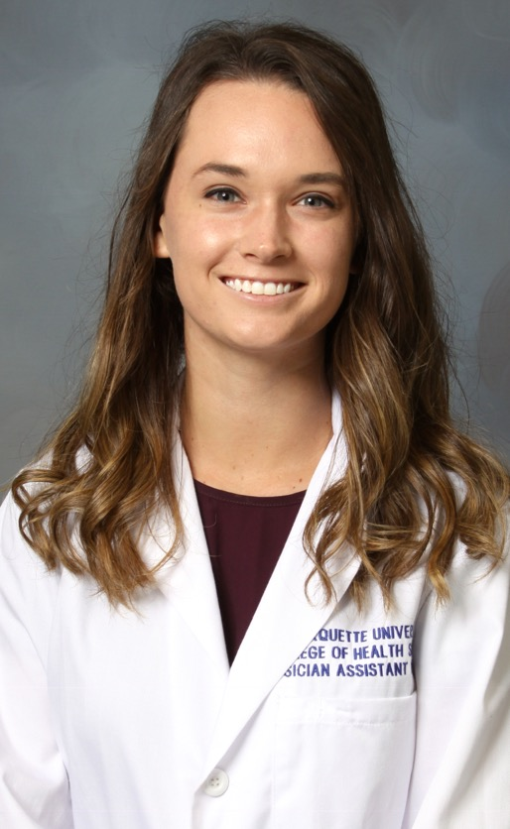
Hannah Quinette
College of Health Sciences Professional
Master of Physician Assistant Studies

Slide 115
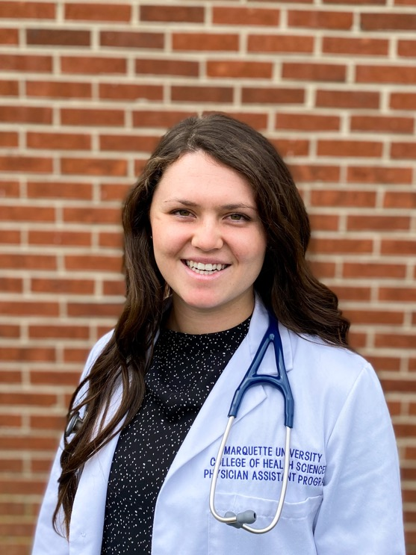
Victoria Rehfuss
College of Health Sciences Professional
Master of Physician Assistant Studies

Slide 116
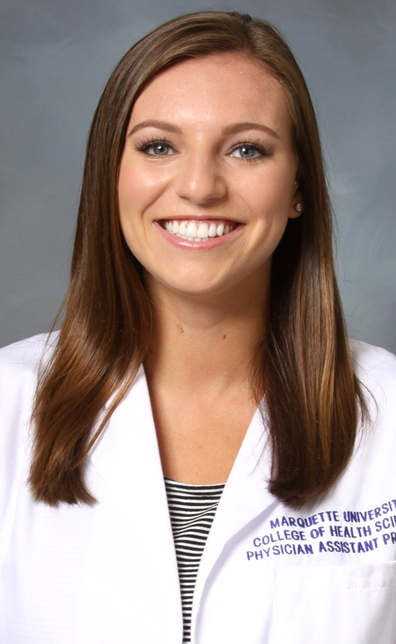
Paige Reynebeau
College of Health Sciences Professional
Master of Physician Assistant Studies

Slide 117
Timothy Sanner
College of Health Sciences Professional
Master of Physician Assistant Studies

Slide 118
Ryan Schellinger
College of Health Sciences Professional
Master of Physician Assistant Studies

Slide 119
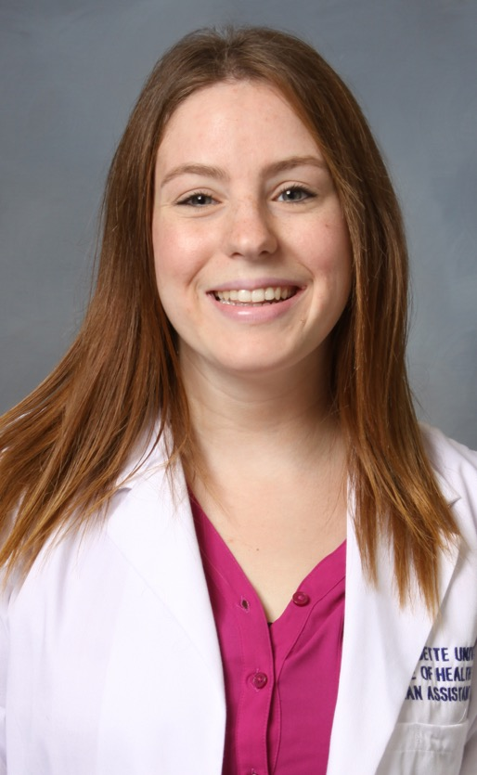
Rachel Shenfeld
College of Health Sciences Professional
Master of Physician Assistant Studies

Slide 120
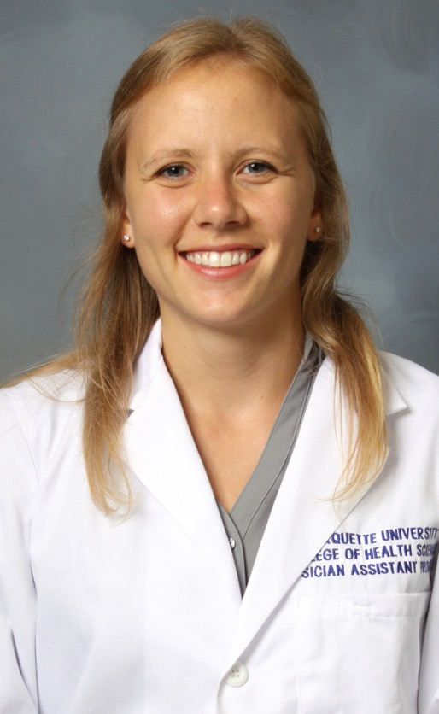
Elizabeth Smyth
College of Health Sciences Professional
Master of Physician Assistant Studies

Slide 121
Sarah Stinski
College of Health Sciences Professional
Master of Physician Assistant Studies

Slide 122
Abigail Tangney
College of Health Sciences Professional
Master of Physician Assistant Studies

Slide 123
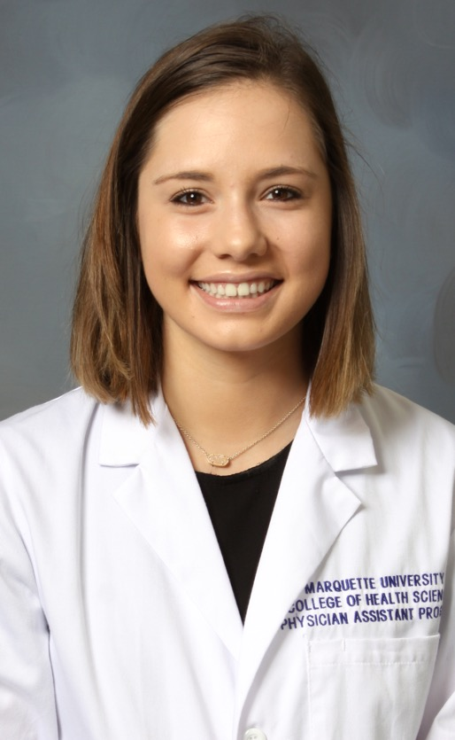
Madeline Titus
College of Health Sciences Professional
Master of Physician Assistant Studies

Slide 124
Elizabeth Toronto
College of Health Sciences Professional
Master of Physician Assistant Studies

Slide 125
Kayla Turco
College of Health Sciences Professional
Master of Physician Assistant Studies

Slide 126
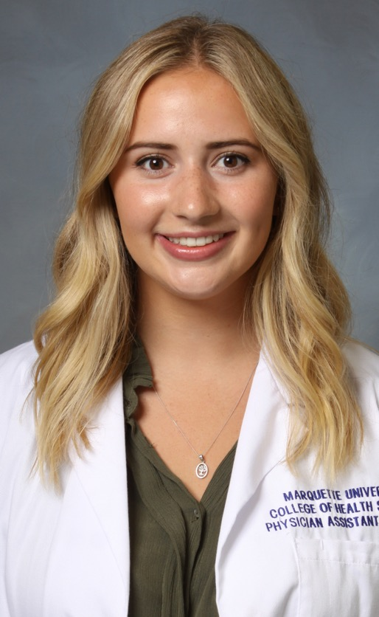
Allison Van Staalduinen
College of Health Sciences Professional
Master of Physician Assistant Studies

Slide 127
Amanda Wenger
College of Health Sciences Professional
Master of Physician Assistant Studies

Slide 128
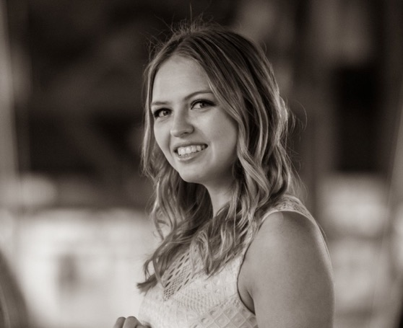
Paula Zdanowski
College of Health Sciences Professional
Master of Physician Assistant Studies

Slide 129
Brittany Cassel
College of Health Sciences Professional
Certificate in Clinical Laboratory Science

Slide 130
Jezabel Ninaja Villa
College of Health Sciences Professional
Certificate in Clinical Laboratory Science

Slide 131
Laura Perez Raya
College of Health Sciences Professional
Certificate in Clinical Laboratory Science

