Slide 1
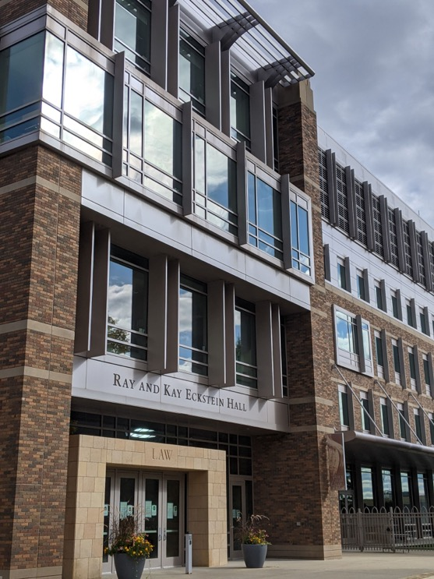
Marquette University Law School 2021 Graduates

Slide 2
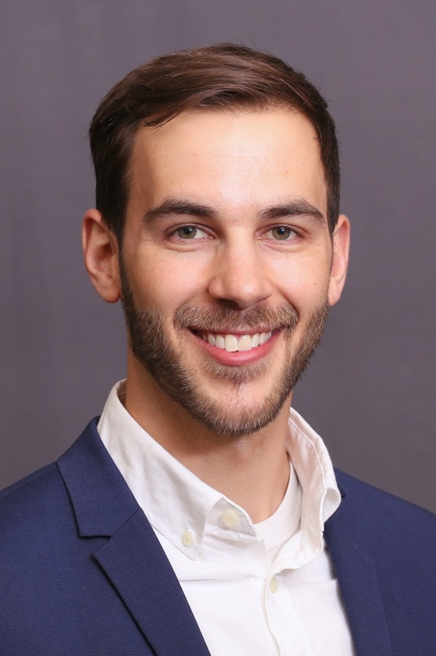
Jeremy Joseph Andereck
Law School
Juris Doctor

Slide 3
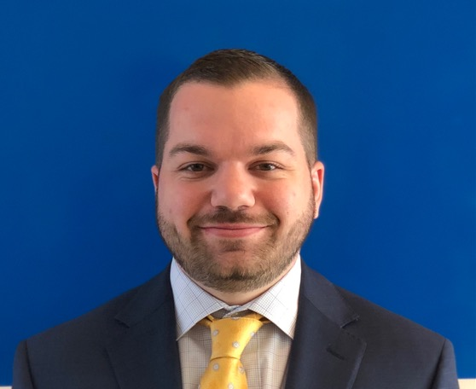
Matthew Scott Ashton
Law School
Juris Doctor

Slide 4
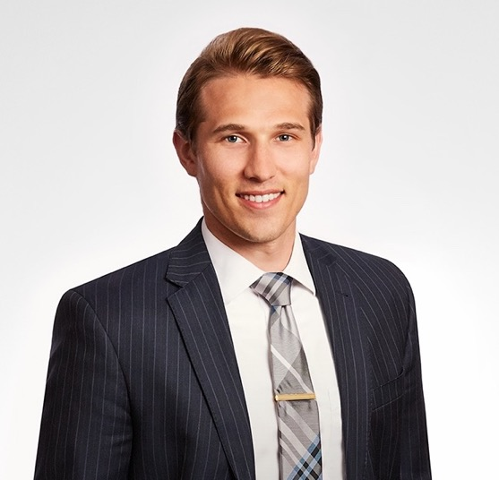
Brent E. Aussprung
Law School
Juris Doctor

Slide 5
Rachel Lauren Babinat
Law School
Juris Doctor

Slide 6
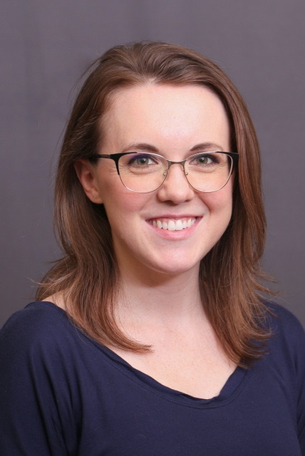
Claire E. Barth
Law School
Juris Doctor

Slide 7
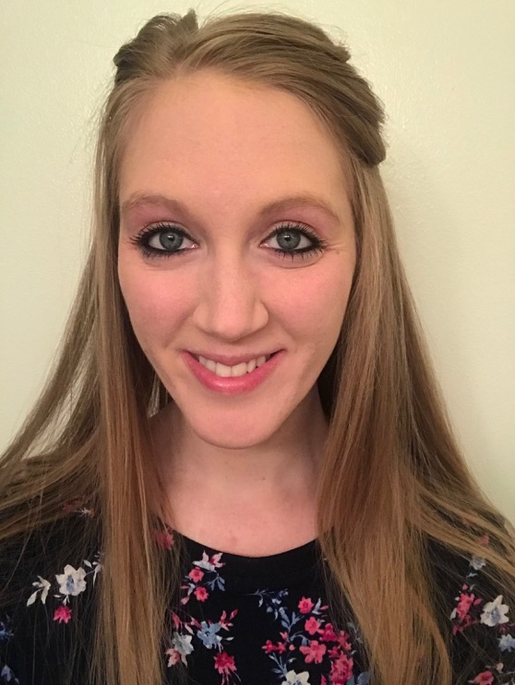
Mikayla E. Becherer
Law School
Juris Doctor

Slide 8
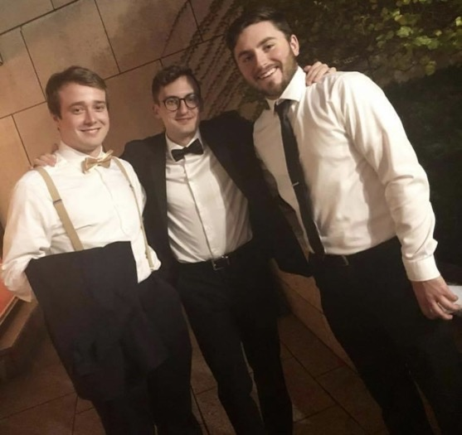
Michael J. Becker
Law School
Juris Doctor

Slide 9
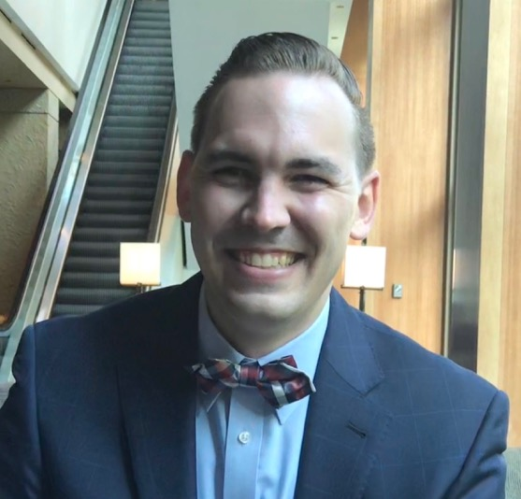
Kyle Brian Joseph Beczkiewicz
Law School
Juris Doctor

Slide 10
John E. Bennett Jr.
Law School
Juris Doctor

Slide 11
Adam J. Best
Law School
Juris Doctor

Slide 12
Amanda Louise Bethel
Law School
Juris Doctor

Slide 13
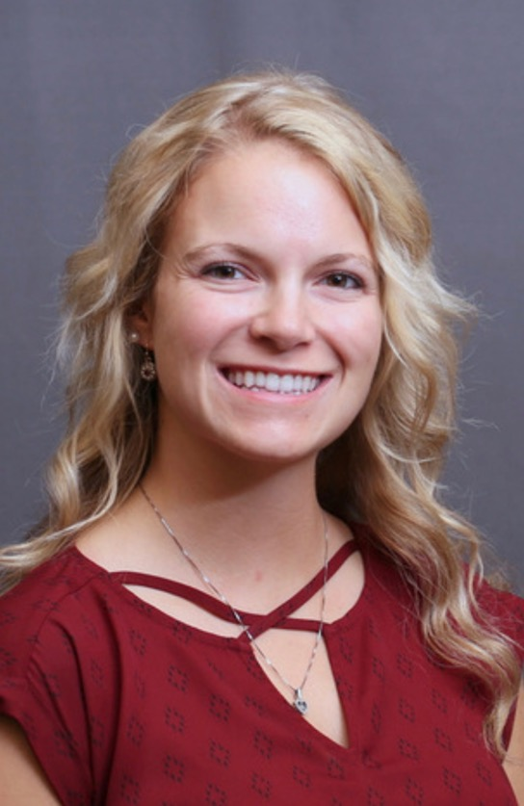
Leah Birch
Law School
Juris Doctor

Slide 14
Madeline C. Bitto
Law School
Juris Doctor

Slide 15
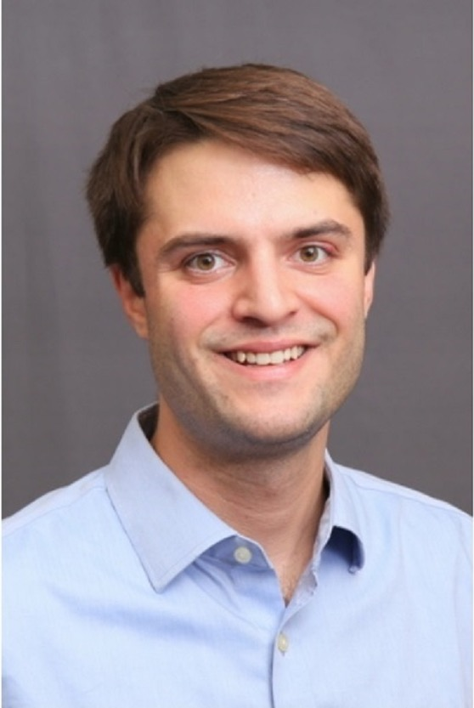
James Greer Black
Law School
Juris Doctor

Slide 16
Carly B. Boder
Law School
Juris Doctor

Slide 17
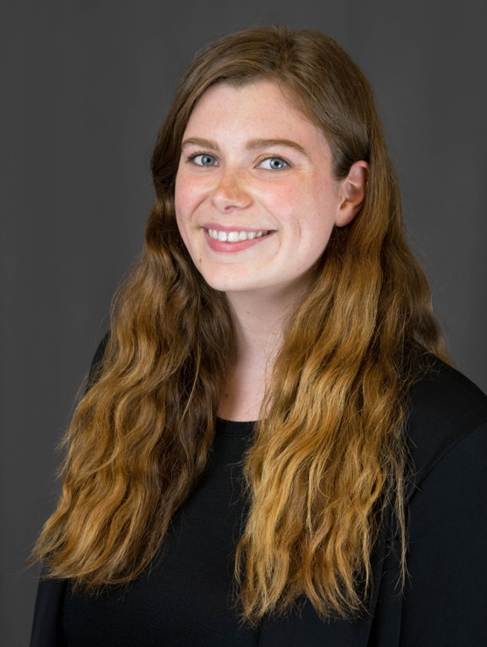
Emily C. Boylan
Law School
Juris Doctor

Slide 18
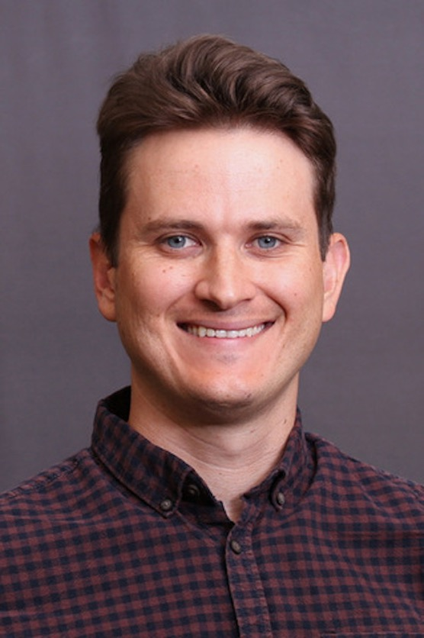
William A. Brookley
Law School
Juris Doctor

Slide 19

Jana N. Budet
Law School
Juris Doctor

Slide 20
Hannah R. Busch
Law School
Juris Doctor

Slide 21

Cherish Dell Laura Buss
Law School
Juris Doctor

Slide 22
Deborah Wyn Cain
Law School
Juris Doctor

Slide 23
Alexander Vincent Calpino
Law School
Juris Doctor

Slide 24
James J. Campbell
Law School
Juris Doctor

Slide 25
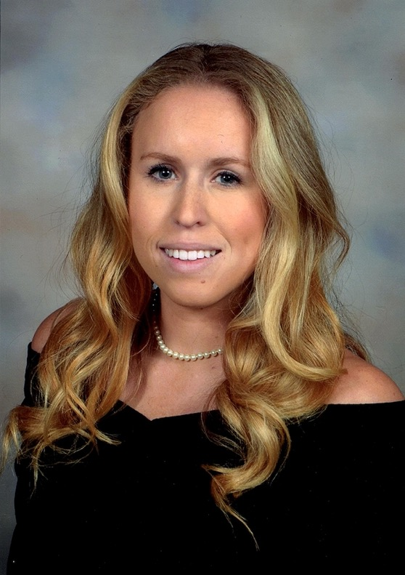
Casey Campos
Law School
Juris Doctor

Slide 26
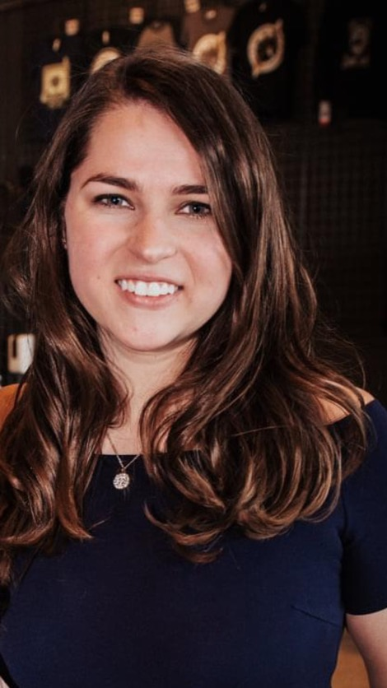
Maggie Marie Cash
Law School
Juris Doctor

Slide 27
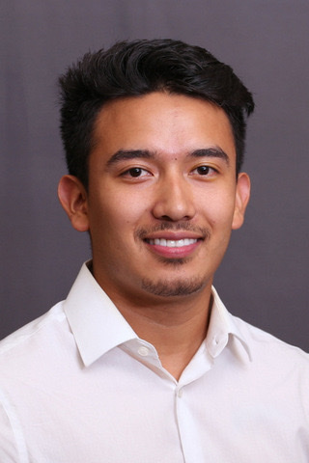
Edgar G. Ceniceros-Herrada
Law School
Juris Doctor

Slide 28
Denver Cherms
Law School
Juris Doctor

Slide 29
Kristen Danielle Cherry
Law School
Juris Doctor

Slide 30
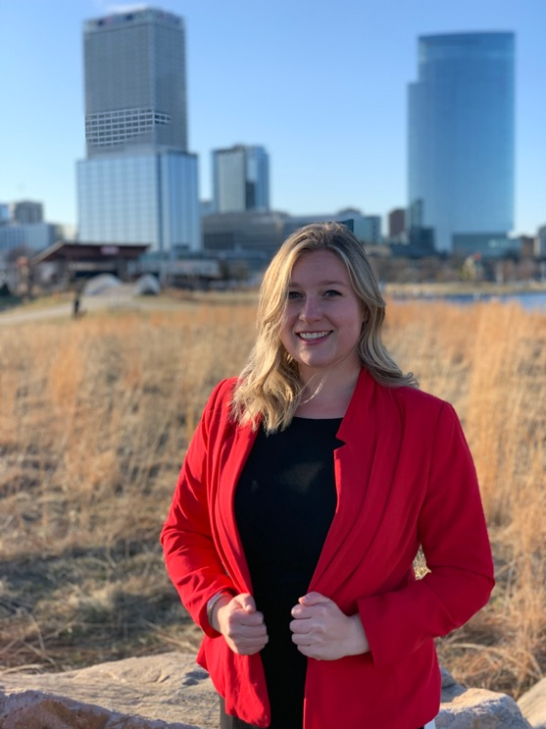
Sherre K. Chevalier
Law School
Juris Doctor

Slide 31
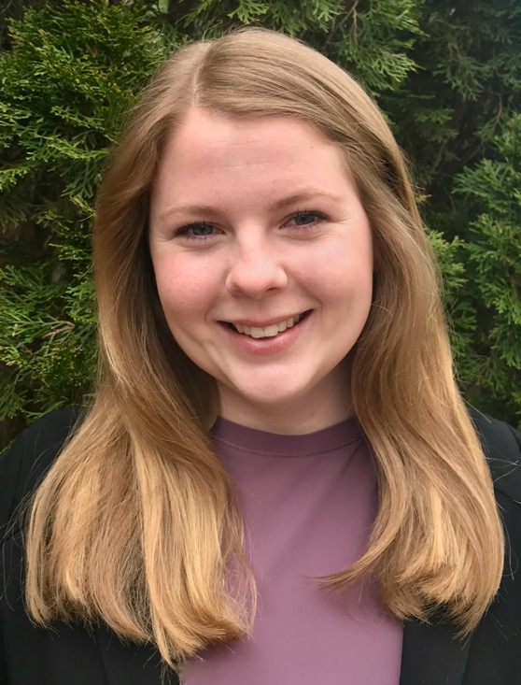
Olivia L. Clark
Law School
Juris Doctor

Slide 32
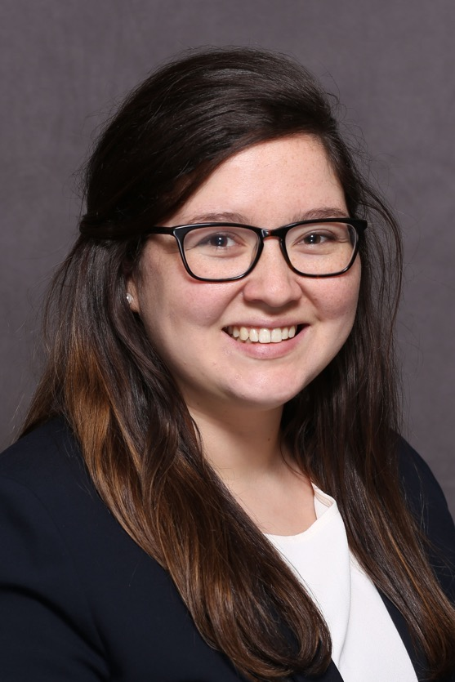
Amanda Elizabeth Brittain Collins
Law School
Juris Doctor

Slide 33
Austin Crist
Law School
Juris Doctor

Slide 34
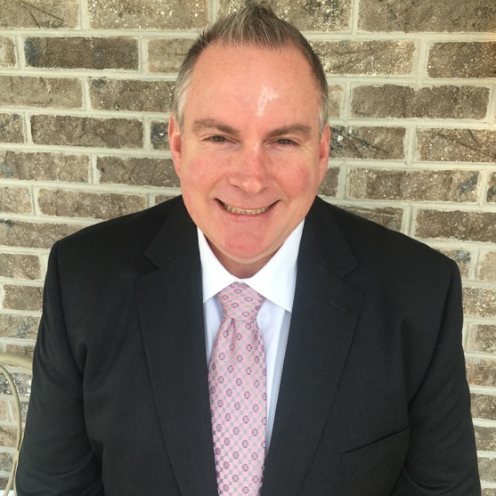
Nathaniel J. Cullen
Law School
Juris Doctor

Slide 35
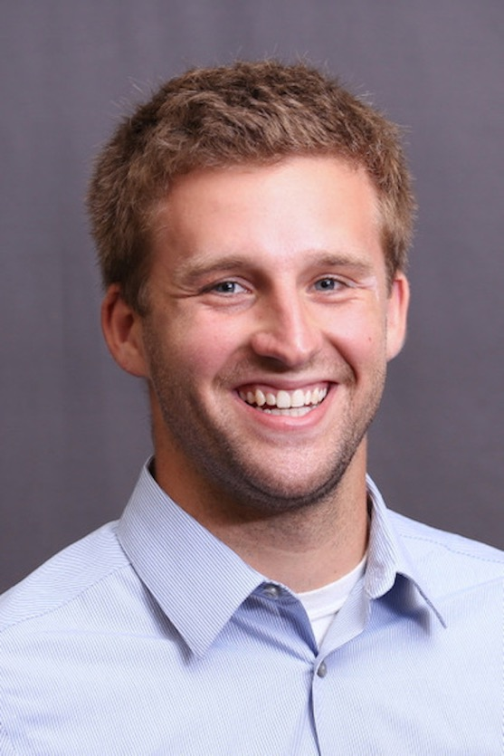
Andrew T. David
Law School
Juris Doctor

Slide 36
Ruby De Leon
Law School
Juris Doctor

Slide 37
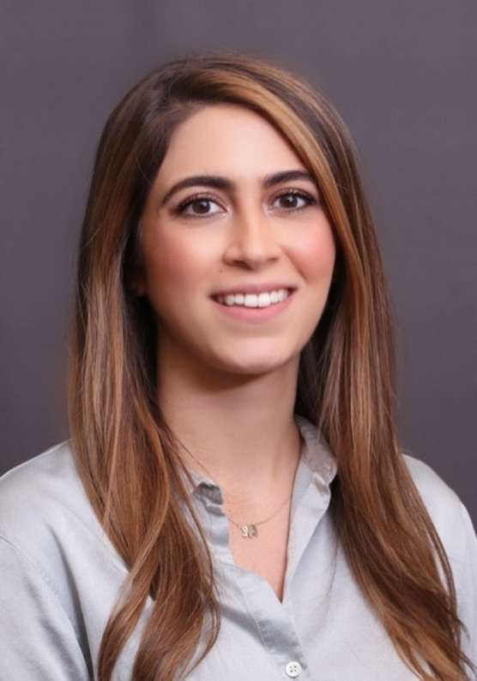
Luami Alexxandra Diaz Lopez
Law School
Juris Doctor

Slide 38
Ryan T. Dietrich
Law School
Juris Doctor

Slide 39
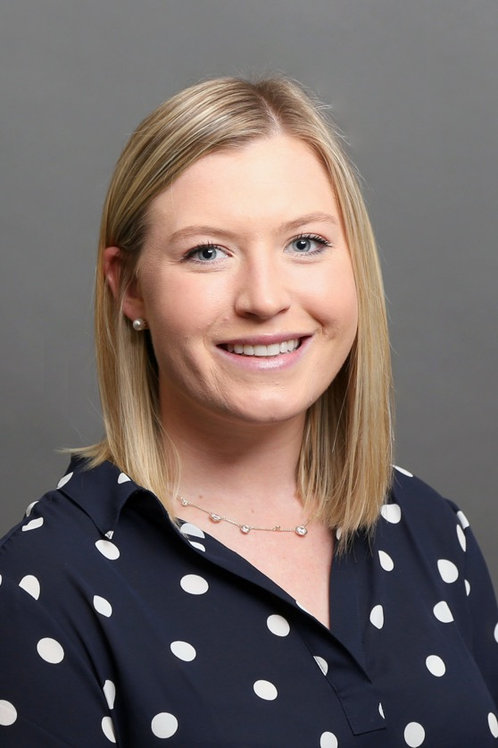
Lindsay T. Dodovich
Law School
Juris Doctor

Slide 40
Jennifer Frances Dombrowski
Law School
Juris Doctor

Slide 41
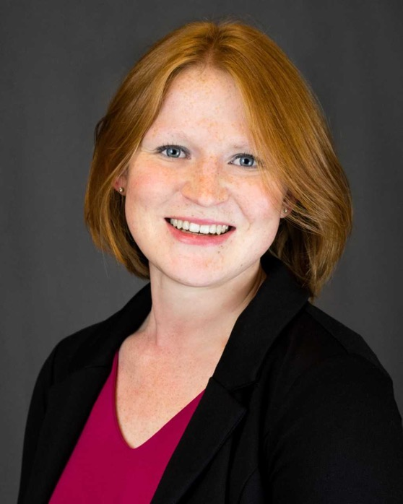
Caitlyn Blyth Doyle
Law School
Juris Doctor

Slide 42
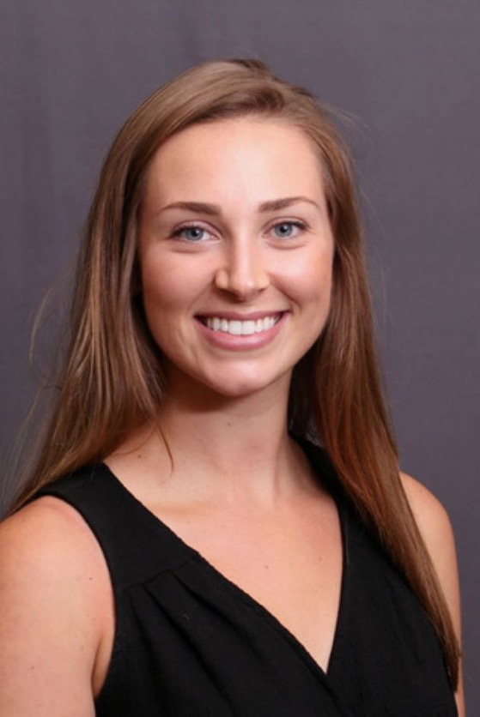
Megan L. Drury
Law School
Juris Doctor

Slide 43
Alec R. Durand
Law School
Juris Doctor

Slide 44
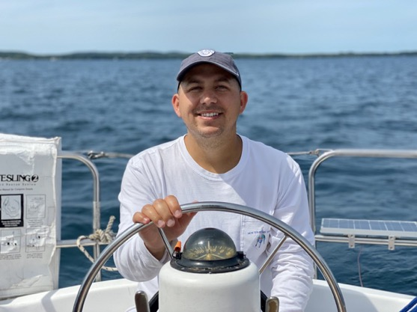
Curtis Alexander Edwards
Law School
Juris Doctor

Slide 45
Richard Esparza
Law School
Juris Doctor

Slide 46
Alina Rosalee Felber
Law School
Juris Doctor

Slide 47
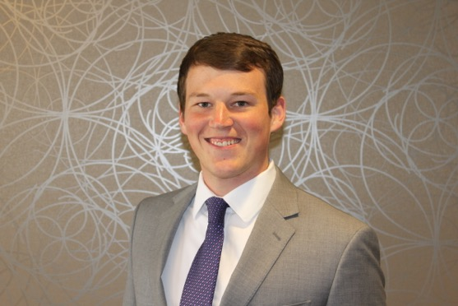
Randal D. Finger
Law School
Juris Doctor

Slide 48
Mario J. Fiumefreddo
Law School
Juris Doctor

Slide 49
Joshua Marc Frieser
Law School
Juris Doctor

Slide 50
John Fuller
Law School
Juris Doctor

Slide 51
Morgan E. Fuller
Law School
Juris Doctor

Slide 52
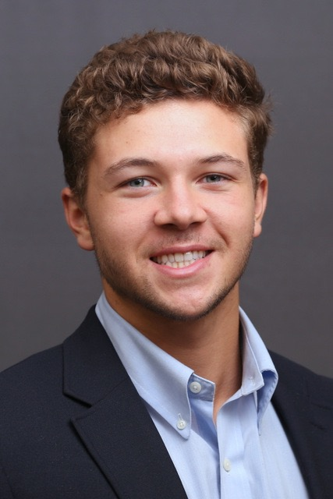
Pierson Miles Furnish
Law School
Juris Doctor

Slide 53
Jaime A. Garcia Montes
Law School
Juris Doctor

Slide 54
Robert Anthony Gentile
Law School
Juris Doctor

Slide 55
David E. Goldman
Law School
Juris Doctor

Slide 56
Alejandro Gonzales
Law School
Juris Doctor

Slide 57
José Andrés González López
Law School
Juris Doctor

Slide 58

Kaitlyn Moran Gould
Law School
Juris Doctor

Slide 59
Kaitlyn M. Gradecki
Law School
Juris Doctor

Slide 60

Gabriel Donald Grahek
Law School
Juris Doctor

Slide 61
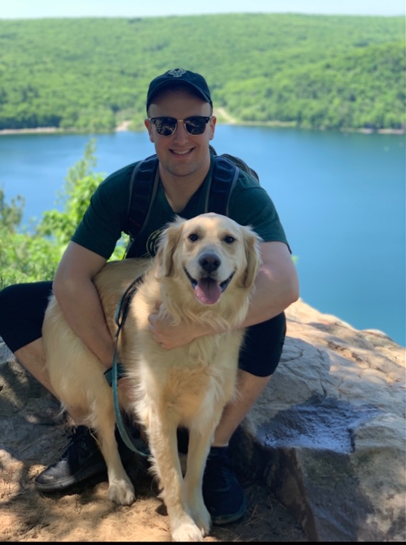
Derrick A. Gress
Law School
Juris Doctor

Slide 62
Kayla Marie Gribble
Law School
Juris Doctor

Slide 63
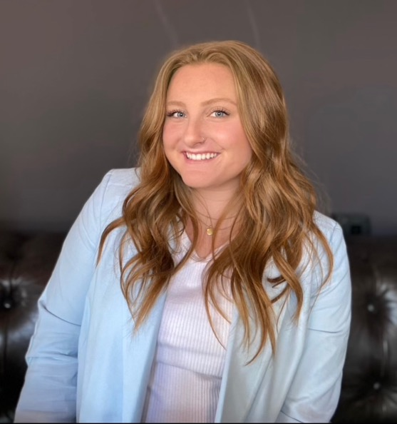
Emma L. Guthrie
Law School
Juris Doctor

Slide 64
Andrew V. Guzek
Law School
Juris Doctor

Slide 65
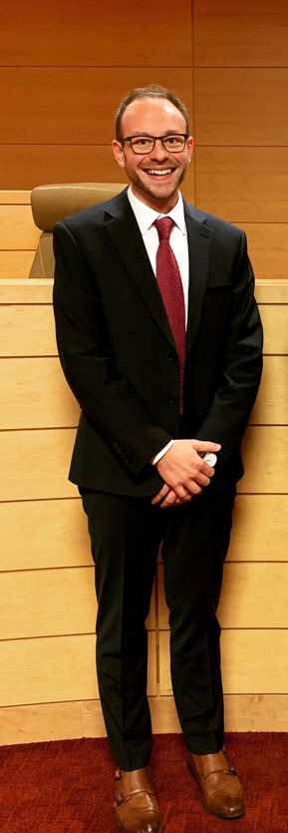
Robert Peter Hameister
Law School
Juris Doctor

Slide 66
Nicholas S. Harkness
Law School
Juris Doctor

Slide 67
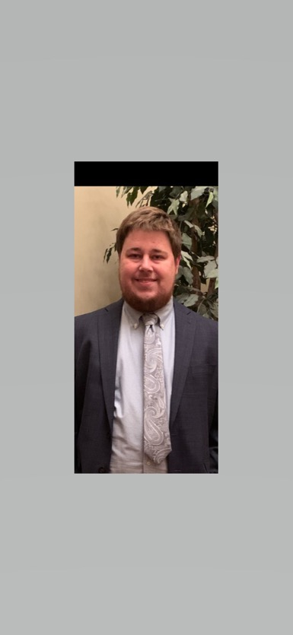
Zachary A. Hatfield
Law School
Juris Doctor

Slide 68
Madelyn Gene Hebbring
Law School
Juris Doctor

Slide 69
Derek William Hein
Law School
Juris Doctor

Slide 70
Brian Harris Hendricks
Law School
Juris Doctor

Slide 71
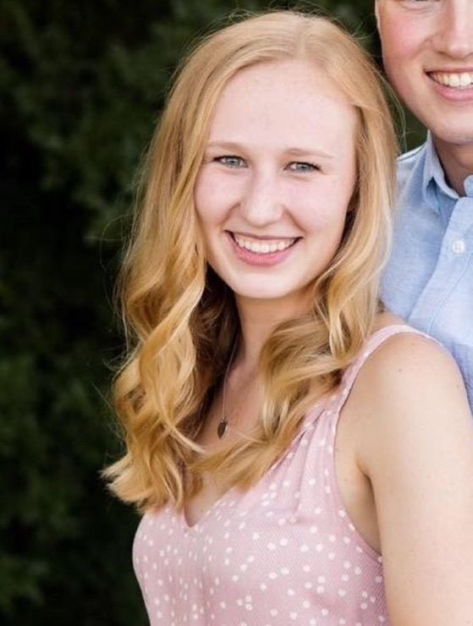
Michaela Aileen Hendricks
Law School
Juris Doctor

Slide 72
Michael F. Hickey
Law School
Juris Doctor

Slide 73
John F. Howard
Law School
Juris Doctor

Slide 74
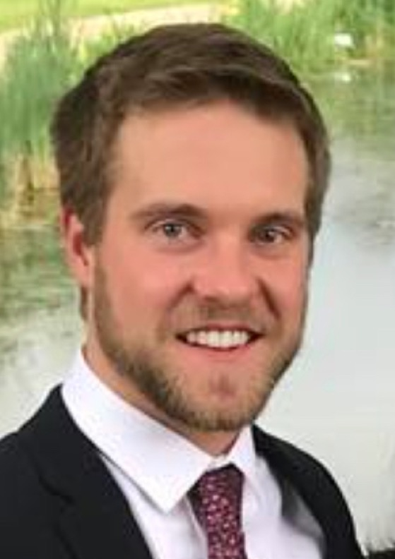
Nicholas Thomas Hunter
Law School
Juris Doctor

Slide 75
Bennett H. Jenkins
Law School
Juris Doctor

Slide 76
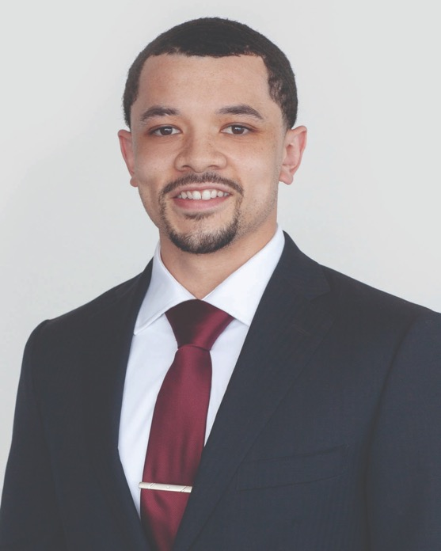
Xavier O. Jenkins
Law School
Juris Doctor

Slide 77
Jeffrey William Jensen Jr.
Law School
Juris Doctor

Slide 78
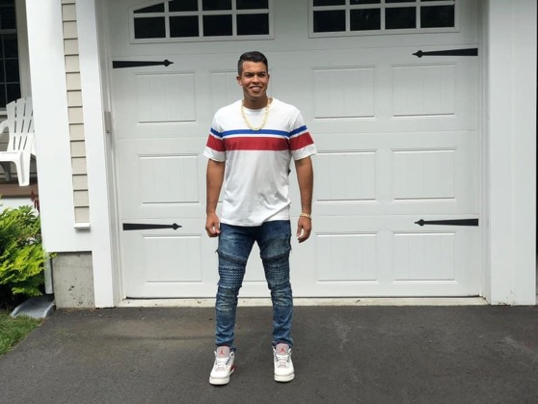
Alex Campos Jimenez
Law School
Juris Doctor

Slide 79
Gary C. Johnson
Law School
Juris Doctor

Slide 80
Jaren M. Johnson
Law School
Juris Doctor

Slide 81
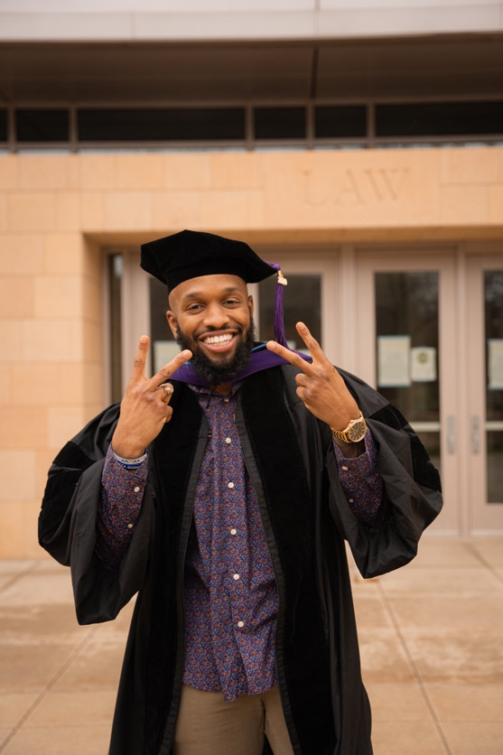
Miles A. Johnson
Law School
Juris Doctor

Slide 82
Nikolas Jordan Johnson
Law School
Juris Doctor

Slide 83
Austin P. Kamel
Law School
Juris Doctor

Slide 84
Matthew G. Kamine
Law School
Juris Doctor

Slide 85
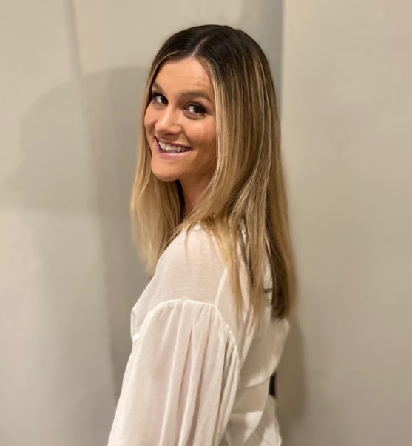
Kathryne Elder Keough
Law School
Juris Doctor

Slide 86

Cristin Carol Kin
Law School
Juris Doctor

Slide 87
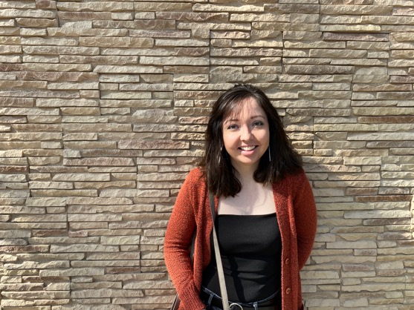
Rebecca A. Klongland
Law School
Juris Doctor

Slide 88
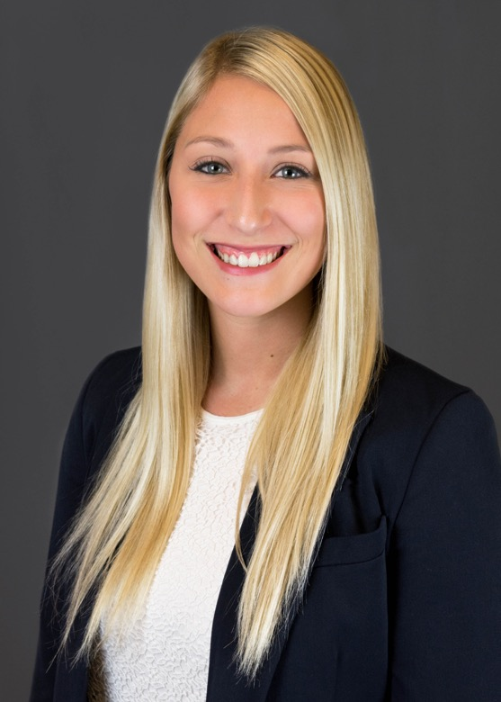
Michelle Marie Knapp
Law School
Juris Doctor

Slide 89
Mitchell I. Knief
Law School
Juris Doctor

Slide 90
Steven Michael Konitshek
Law School
Juris Doctor

Slide 91
Micah William Kordik
Law School
Juris Doctor

Slide 92
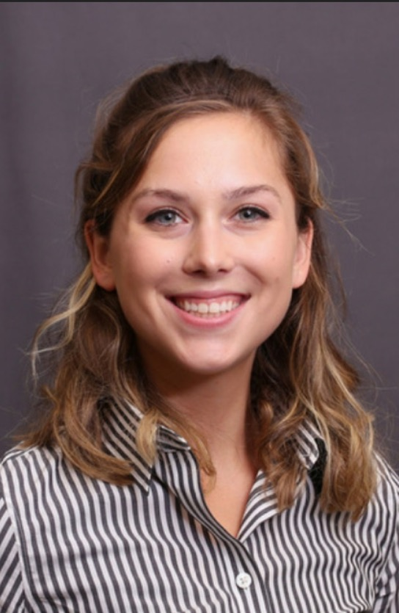
Ellen Rose Kosmatka
Law School
Juris Doctor

Slide 93
Victoria J. Kosobucki
Law School
Juris Doctor

Slide 94
Zachary Leonard Kuhfuss
Law School
Juris Doctor

Slide 95
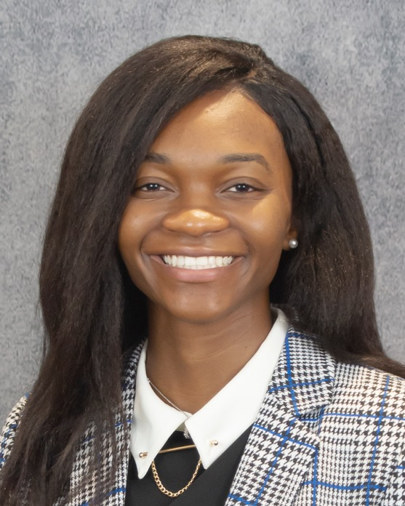
Naomie Kweyu
Law School
Juris Doctor

Slide 96
Matthew J. Lamb
Law School
Juris Doctor

Slide 97
Alexander M. Landy
Law School
Juris Doctor

Slide 98
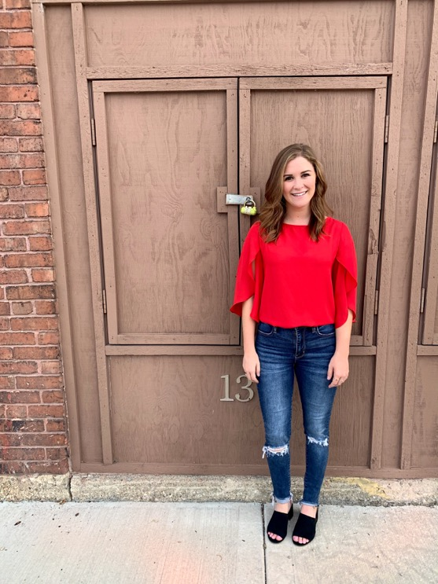
Gina Carol Leali
Law School
Juris Doctor

Slide 99
James P. Lenahan II
Law School
Juris Doctor

Slide 100
Jordan Alexander Liff
Law School
Juris Doctor

Slide 101
Lucas C. Logic
Law School
Juris Doctor

Slide 102
Annie Louk
Law School
Juris Doctor

Slide 103
Zachary J. Lowe
Law School
Juris Doctor

Slide 104
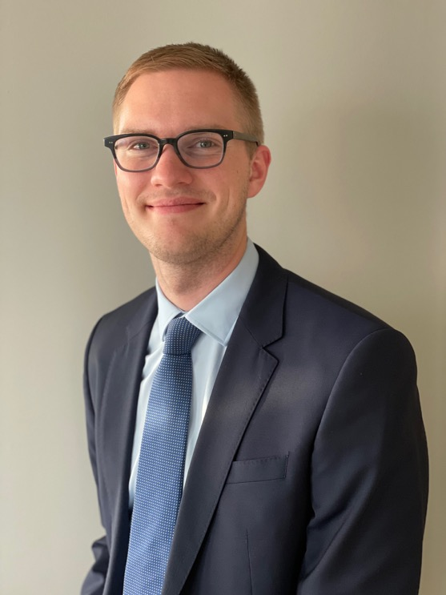
Nicholas M. Lubenow
Law School
Juris Doctor

Slide 105
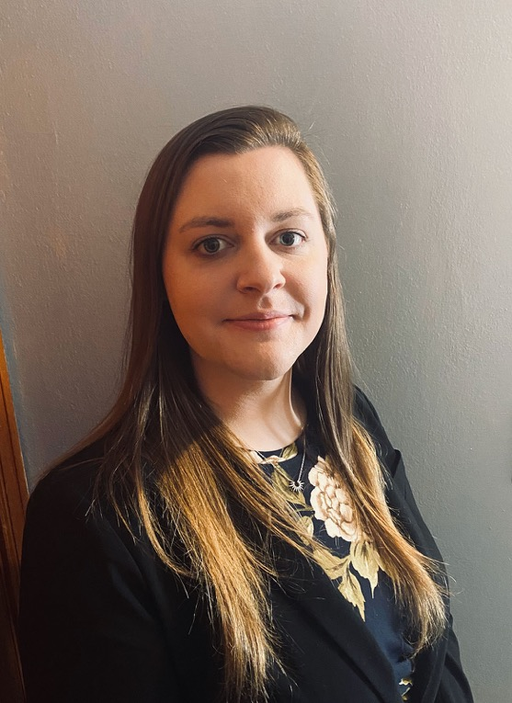
Jamie Lee Lumsden
Law School
Juris Doctor

Slide 106
Megan Alexa Mackay
Law School
Juris Doctor

Slide 107

Ashley Taylor Madsen
Law School
Juris Doctor

Slide 108
Jonathan Major
Law School
Juris Doctor

Slide 109
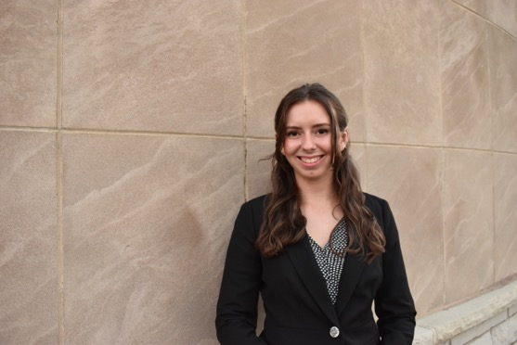
Colleen E. Mandell
Law School
Juris Doctor

Slide 110
Robert A. Maniak
Law School
Juris Doctor

Slide 111
Corinna Terese Martell
Law School
Juris Doctor

Slide 112
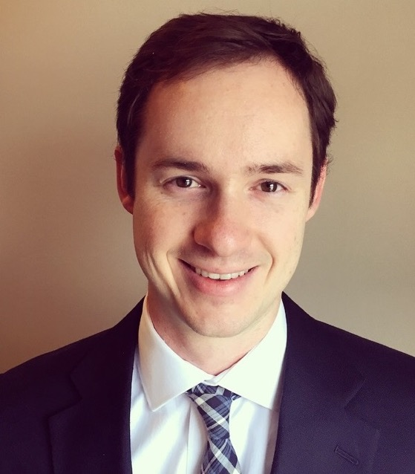
David Wolff McCormack
Law School
Juris Doctor

Slide 113
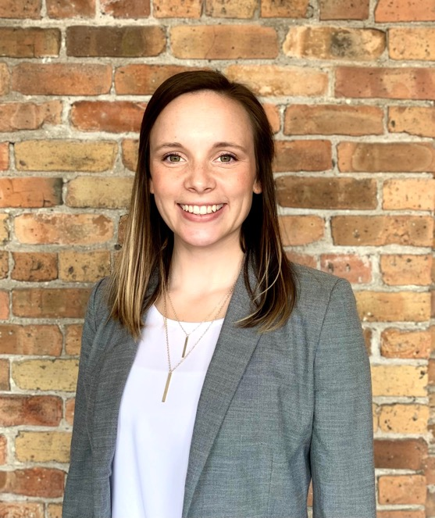
Sam M. McCoy
Law School
Juris Doctor

Slide 114
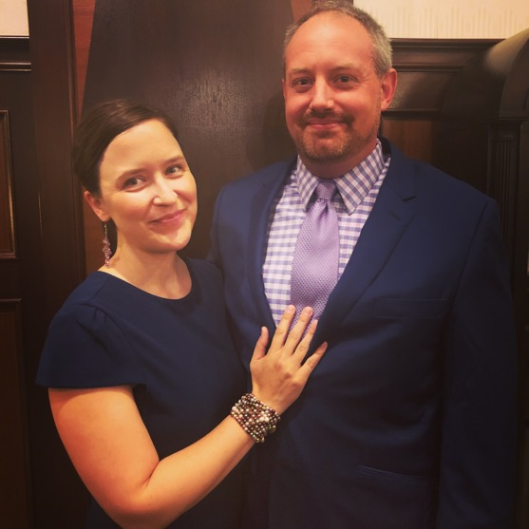
Jay M. McDivitt
Law School
Juris Doctor

Slide 115
Katlyn Q. McGarry
Law School
Juris Doctor

Slide 116
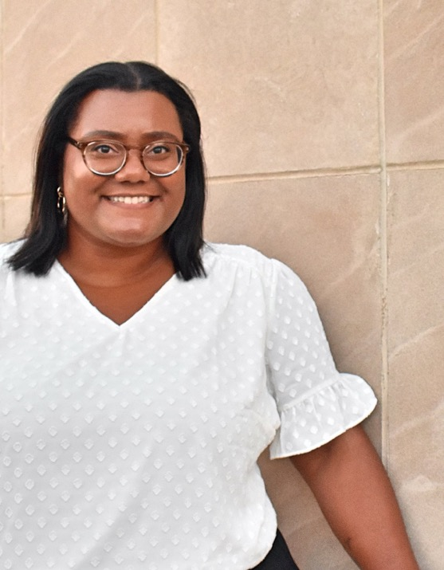
Aleina L. McGettrick
Law School
Juris Doctor

Slide 117
Thomas P. McGue
Law School
Juris Doctor

Slide 118
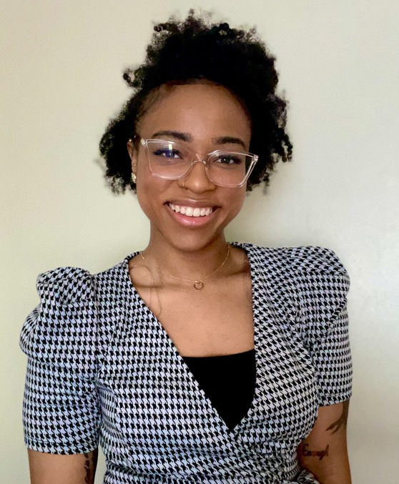
Wynetta Deborah McIntosh
Law School
Juris Doctor

Slide 119

Marilyn Olivia Anne McQuade
Law School
Juris Doctor

Slide 120

Julia M. Mikota
Law School
Juris Doctor

Slide 121
Claude-Allan Milhomme
Law School
Juris Doctor

Slide 122
Jordan Thomas Miller
Law School
Juris Doctor

Slide 123

Megan C. Mirka
Law School
Juris Doctor

Slide 124

Breanna Mai Moe
Law School
Juris Doctor

Slide 125

Katherine Muth
Law School
Juris Doctor

Slide 126
Nimrat Kaur Nannan
Law School
Juris Doctor

Slide 127

Tori A. Nanstad
Law School
Juris Doctor

Slide 128

Wilfredo Jose Navarro
Law School
Juris Doctor

Slide 129
Drake Thomas Nelson
Law School
Juris Doctor

Slide 130

Alexis Ruth Palmbach Nemecek
Law School
Juris Doctor

Slide 131
Matthew D. Nevaranta
Law School
Juris Doctor

Slide 132
Philip J. Ohrtmann
Law School
Juris Doctor

Slide 133
John William Orton
Law School
Juris Doctor

Slide 134

Felicia Lynn Owen
Law School
Juris Doctor

Slide 135

Marcellus N. Parker
Law School
Juris Doctor

Slide 136

Marissa J. Pawlinski
Law School
Juris Doctor

Slide 137
Keyana J. Payne
Law School
Juris Doctor

Slide 138
Kelsey Annette Pelegrin
Law School
Juris Doctor

Slide 139
Nicholas S. Pokey
Law School
Juris Doctor

Slide 140

Kolten W. Pope
Law School
Juris Doctor

Slide 141
Emily E. Pratt
Law School
Juris Doctor

Slide 142

Cooper S. Prindl
Law School
Juris Doctor

Slide 143

Jessica Lynn Puetz
Law School
Juris Doctor

Slide 144

Annalisa Nicole Pusick
Law School
Juris Doctor

Slide 145
Andrea M. Quade
Law School
Juris Doctor

Slide 146

Anne L. Radosevich
Law School
Juris Doctor

Slide 147

Jazmin Itzel Ramirez Bailon
Law School
Juris Doctor

Slide 148
Merrick Ramos
Law School
Juris Doctor

Slide 149
Samantha R. Raygo
Law School
Juris Doctor

Slide 150

Kylan Reilly
Law School
Juris Doctor

Slide 151
Elizabeth B. Reinowski
Law School
Juris Doctor

Slide 152

Mathias John Rekowski
Law School
Juris Doctor

Slide 153

Morgan L. Risseeuw
Law School
Juris Doctor

Slide 154
Kelley L. Roach
Law School
Juris Doctor

Slide 155

Rachel Eileen Roberge
Law School
Juris Doctor

Slide 156
Payton L. Roberts
Law School
Juris Doctor

Slide 157

Abby Louise Rockendorf
Law School
Juris Doctor

Slide 158

Alexa Rae Rodriguez
Law School
Juris Doctor

Slide 159

Ashley M. Rossman
Law School
Juris Doctor

Slide 160
Adam Rocque Roznowski
Law School
Juris Doctor

Slide 161

Kelly M. Ryan
Law School
Juris Doctor

Slide 162

Jason M. Sausser
Law School
Juris Doctor

Slide 163
Emma Nicole Schaefer
Law School
Juris Doctor

Slide 164

Lucas J. Schaetzel
Law School
Juris Doctor

Slide 165

Azene Seifoddini
Law School
Juris Doctor

Slide 166
Nicole Ann Shave
Law School
Juris Doctor

Slide 167

Andrew G. Slaven
Law School
Juris Doctor

Slide 168

Scott Allan Small
Law School
Juris Doctor

Slide 169

Bridget Mary Smith
Law School
Juris Doctor

Slide 170
Lauren J. Smith
Law School
Juris Doctor

Slide 171

Shakia Renee Smith
Law School
Juris Doctor

Slide 172
Natalie V. Sobierajski
Law School
Juris Doctor

Slide 173

Brendan J. Sofen
Law School
Juris Doctor

Slide 174
Janna L. Sorgatz
Law School
Juris Doctor

Slide 175

Holly L. Stenz
Law School
Juris Doctor

Slide 176

Thomas C. Sucevic
Law School
Juris Doctor

Slide 177

Tucker Thomas Tellefson
Law School
Juris Doctor

Slide 178
McKenzie E. Tibbetts
Law School
Juris Doctor

Slide 179
Miguel A. Torres
Law School
Juris Doctor

Slide 180
Rachel Renee Tovar
Law School
Juris Doctor

Slide 181

Charles W. Twohy
Law School
Juris Doctor

Slide 182

Alex R. Utrup
Law School
Juris Doctor

Slide 183
Foley J. Van Lieshout
Law School
Juris Doctor

Slide 184

Cooper Warner
Law School
Juris Doctor

Slide 185

Theodore Wegner
Law School
Juris Doctor

Slide 186
Haley Elizabeth Wentz
Law School
Juris Doctor

Slide 187

Monique Toshiko Faye Williams
Law School
Juris Doctor

Slide 188
Oniquca Ashley Wright
Law School
Juris Doctor

Slide 189

Alexandra Kathleen Zdunek
Law School
Juris Doctor

Slide 190
Lindsey P. Zucker
Law School
Juris Doctor

