Slide 1
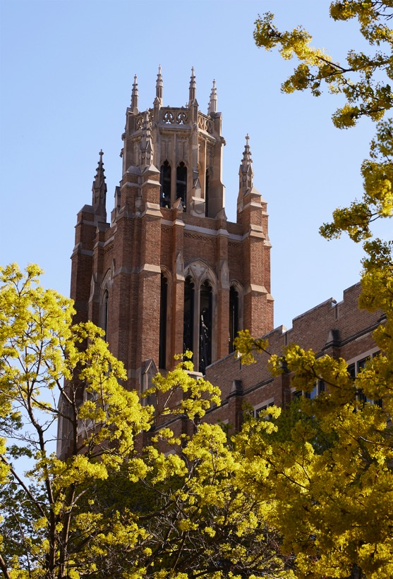
College of Nursing 2021 Graduates

Slide 2
Nina Enea
College of Nursing
Comprehensive Honors Bachelor of Science in Nursing

Slide 3
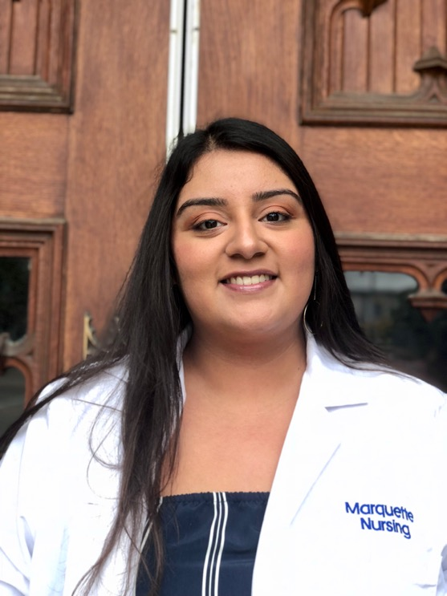
Evelia Guerrero
College of Nursing
Honors Bachelor of Science in Nursing

Slide 4
Samantha Alderson
College of Nursing
Bachelor of Science in Nursing

Slide 5
Catherine Alioto
College of Nursing
Bachelor of Science in Nursing

Slide 6
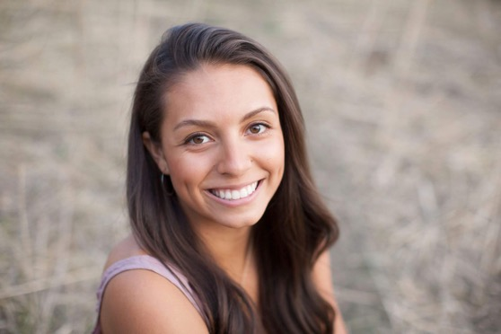
Mia Arthur
College of Nursing
Bachelor of Science in Nursing

Slide 7
Jamie Astigarraga
College of Nursing
Bachelor of Science in Nursing

Slide 8
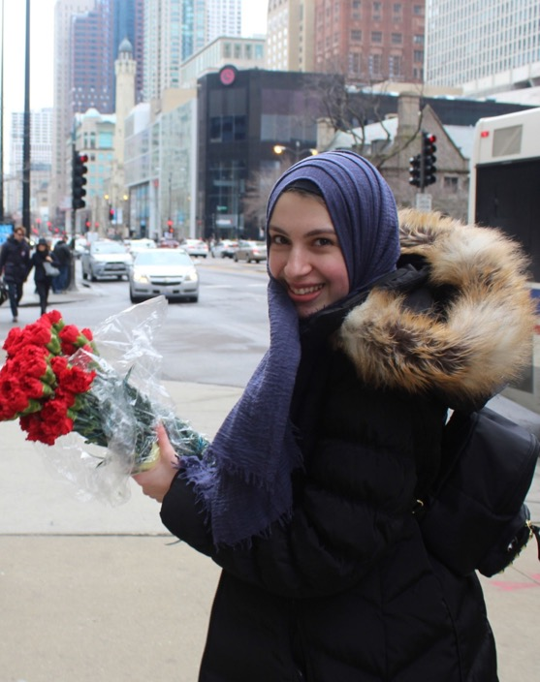
Yasmeen Atta
College of Nursing
Bachelor of Science in Nursing

Slide 9
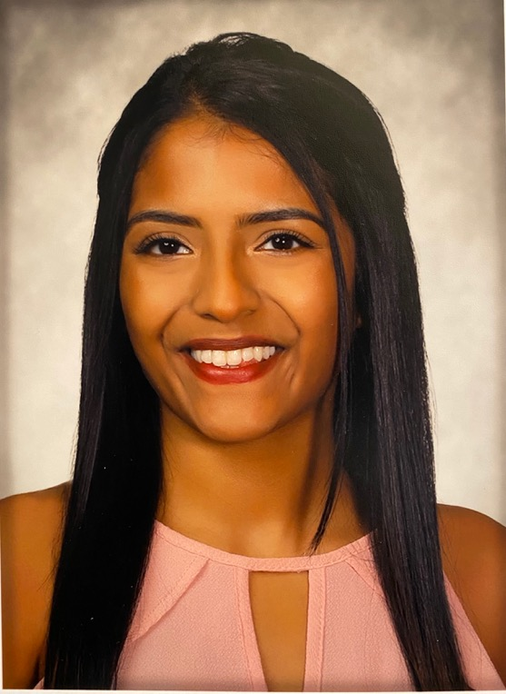
Sheryl Aykara
College of Nursing
Bachelor of Science in Nursing

Slide 10
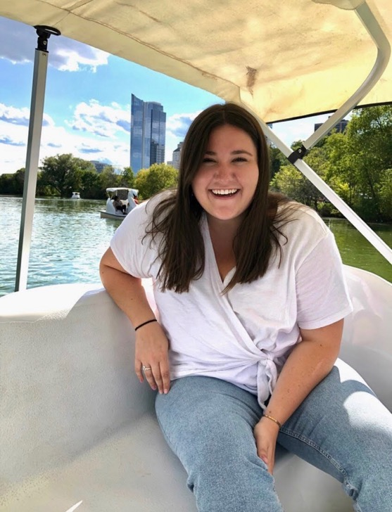
Madeline Babcock
College of Nursing
Bachelor of Science in Nursing

Slide 11

Claudia Bays
College of Nursing
Bachelor of Science in Nursing

Slide 12

Halle Berg
College of Nursing
Bachelor of Science in Nursing

Slide 13
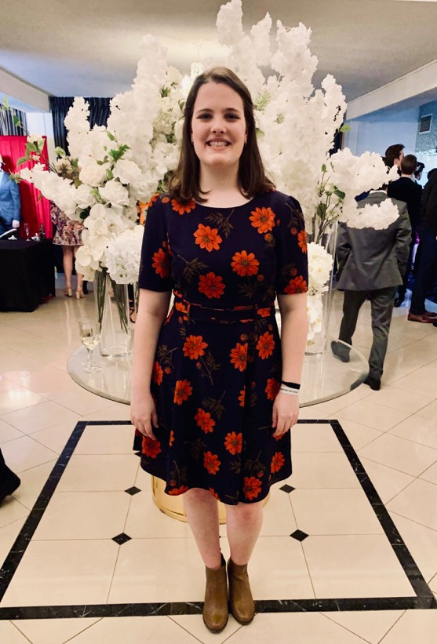
Anna Best
College of Nursing
Bachelor of Science in Nursing

Slide 14
Julie Biggins
College of Nursing
Bachelor of Science in Nursing

Slide 15
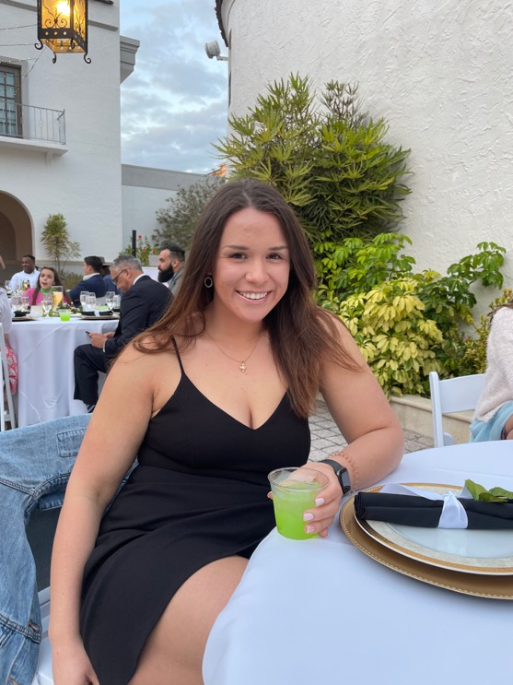
Bailey Birenbaum
College of Nursing
Bachelor of Science in Nursing

Slide 16
Mitchell Bradley
College of Nursing
Bachelor of Science in Nursing

Slide 17
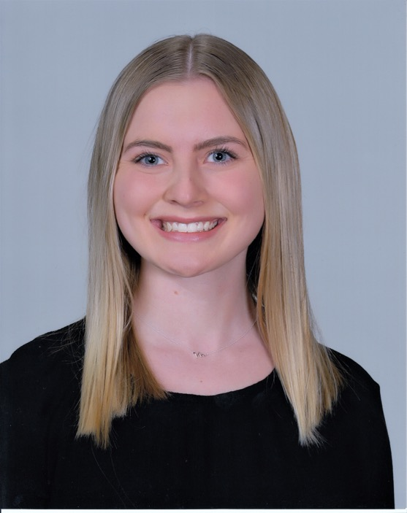
Emily Breines
College of Nursing
Bachelor of Science in Nursing

Slide 18

Samantha Bucklar
College of Nursing
Bachelor of Science in Nursing

Slide 19
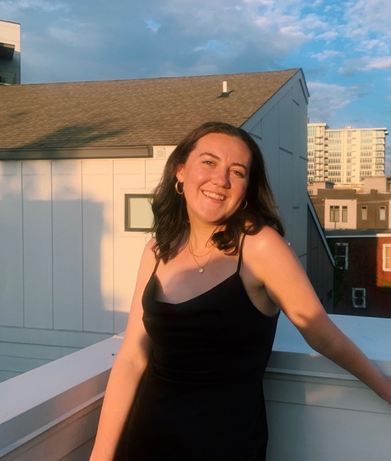
Maggie Burke
College of Nursing
Bachelor of Science in Nursing

Slide 20
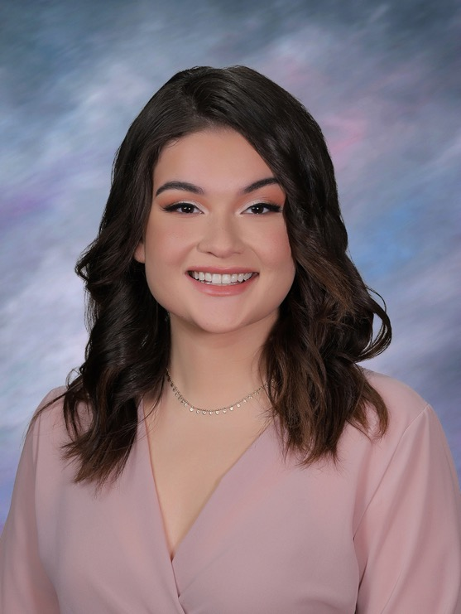
Veronica Colón
College of Nursing
Bachelor of Science in Nursing

Slide 21
Brendan Cooke
College of Nursing
Bachelor of Science in Nursing

Slide 22
Claire Coonan
College of Nursing
Bachelor of Science in Nursing

Slide 23
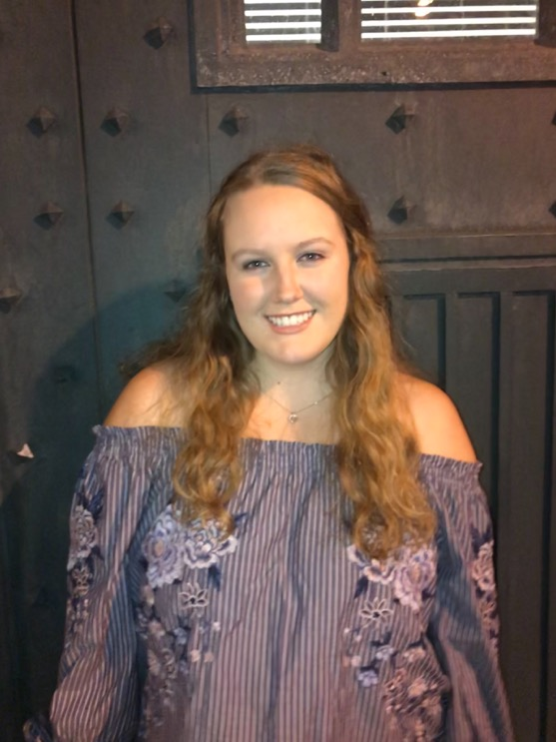
Emma Davis
College of Nursing
Bachelor of Science in Nursing

Slide 24
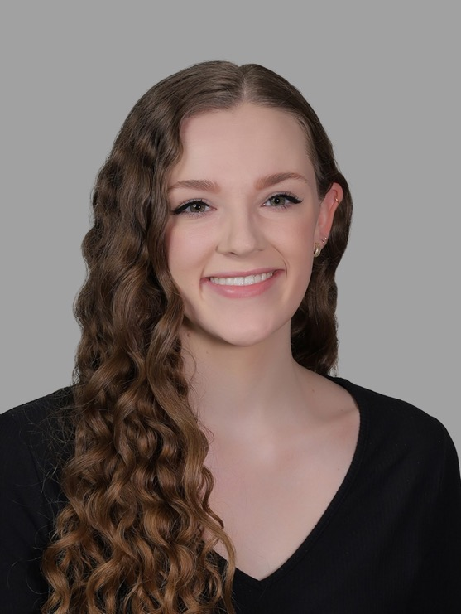
Elise Dickinson
College of Nursing
Bachelor of Science in Nursing

Slide 25
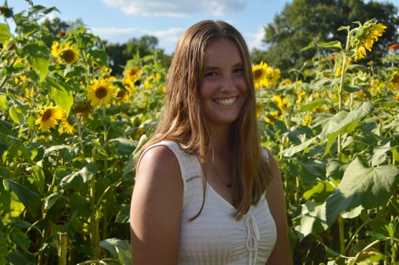
Keally Dombrowski
College of Nursing
Bachelor of Science in Nursing

Slide 26
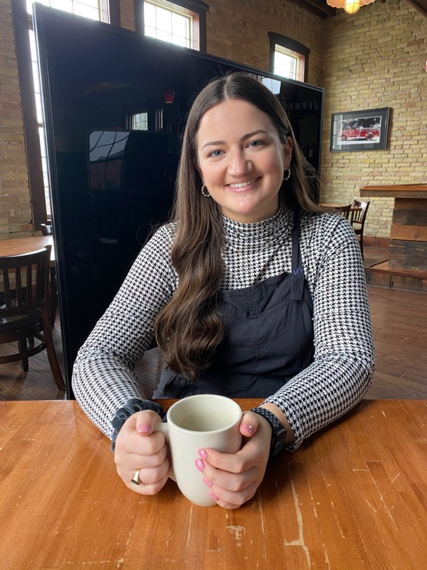
Margaret Dyszlewski
College of Nursing
Bachelor of Science in Nursing

Slide 27
Holly Earl
College of Nursing
Bachelor of Science in Nursing

Slide 28
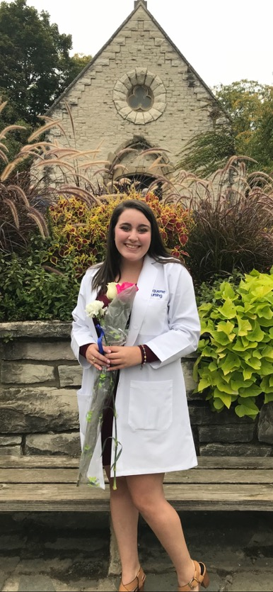
Caitlin Edgerton
College of Nursing
Bachelor of Science in Nursing

Slide 29
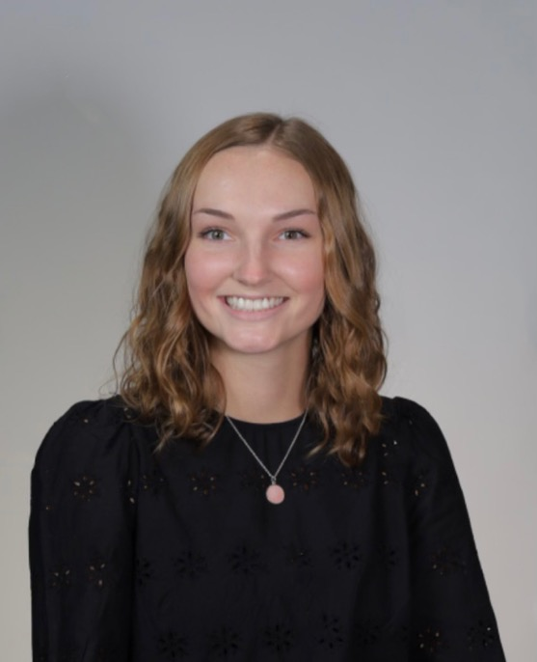
Kelly Ells
College of Nursing
Bachelor of Science in Nursing

Slide 30
Eric Escoto
College of Nursing
Bachelor of Science in Nursing

Slide 31
Julia Filmer
College of Nursing
Bachelor of Science in Nursing

Slide 32
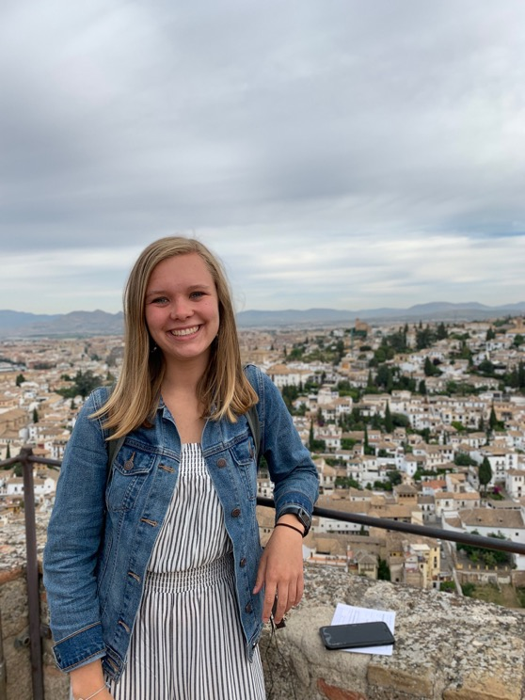
Elizabeth Fischer
College of Nursing
Bachelor of Science in Nursing

Slide 33
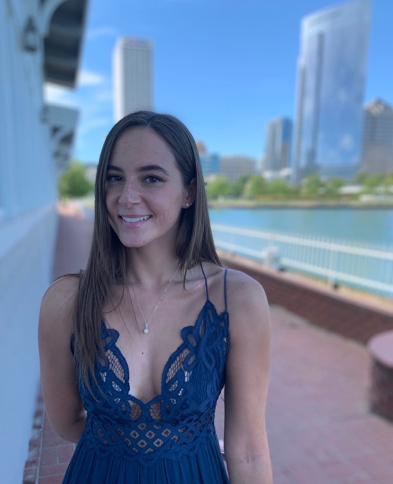
Clare Frumkin
College of Nursing
Bachelor of Science in Nursing

Slide 34

Sarah Furst
College of Nursing
Bachelor of Science in Nursing

Slide 35
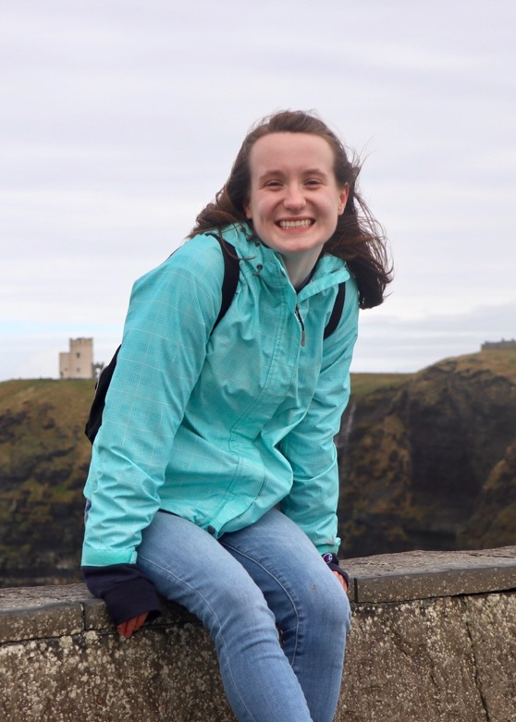
Kristen Gadbois
College of Nursing
Bachelor of Science in Nursing

Slide 36
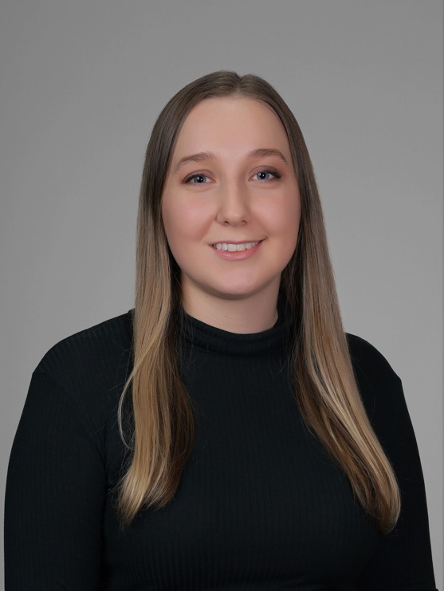
Jillian Gallo
College of Nursing
Bachelor of Science in Nursing

Slide 37
Anastasia Giese
College of Nursing
Bachelor of Science in Nursing

Slide 38
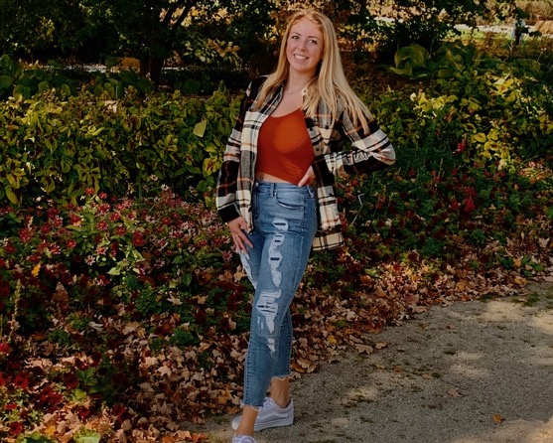
Morgan Gilmore
College of Nursing
Bachelor of Science in Nursing

Slide 39
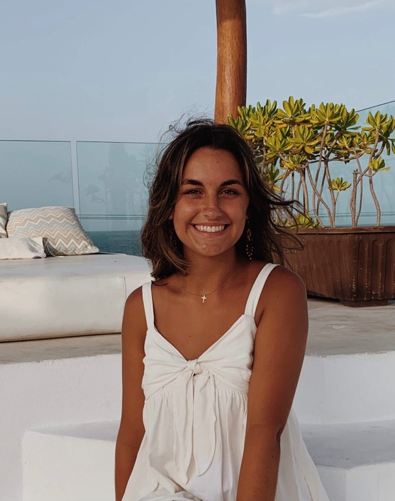
Grace Goebbert
College of Nursing
Bachelor of Science in Nursing

Slide 40
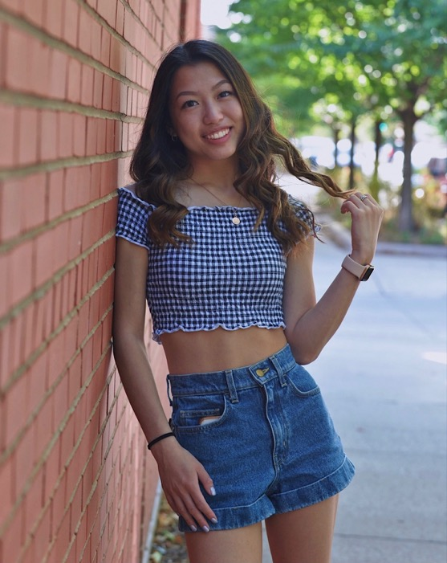
Kaitlyn Guan
College of Nursing
Bachelor of Science in Nursing

Slide 41
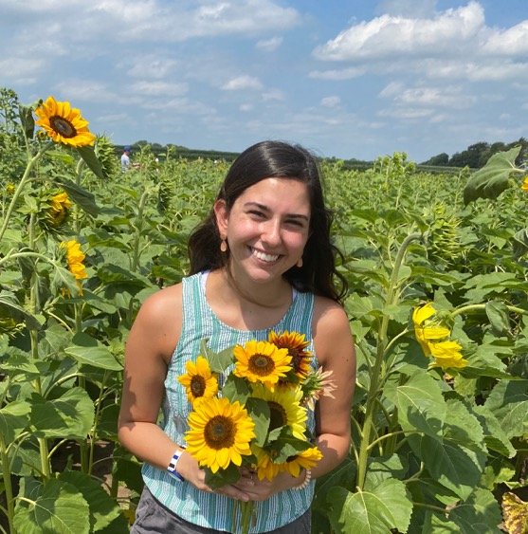
Madelyn Hartig
College of Nursing
Bachelor of Science in Nursing

Slide 42
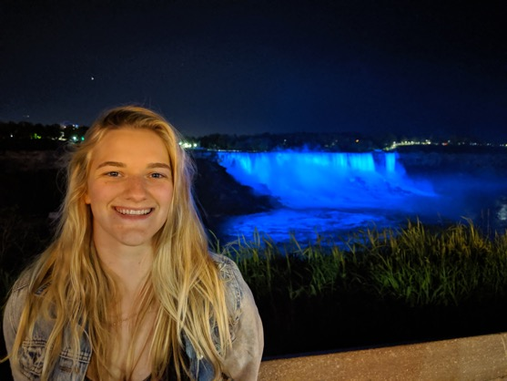
Jana Haschel
College of Nursing
Bachelor of Science in Nursing

Slide 43
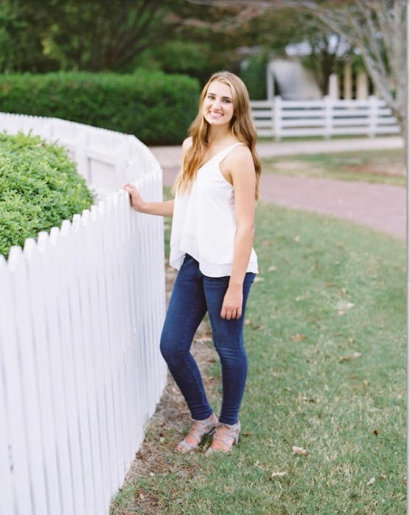
Colleen Haubold
College of Nursing
Bachelor of Science in Nursing

Slide 44
Jaime Hiller
College of Nursing
Bachelor of Science in Nursing

Slide 45

Jenna Hilton
College of Nursing
Bachelor of Science in Nursing

Slide 46
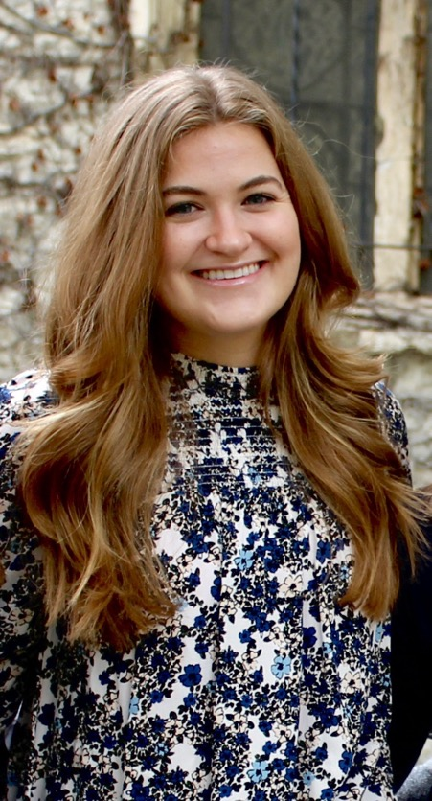
Brenna Hogan
College of Nursing
Bachelor of Science in Nursing

Slide 47
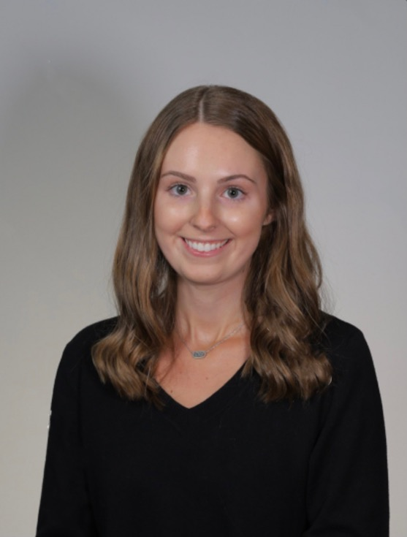
Madison Holt
College of Nursing
Bachelor of Science in Nursing

Slide 48
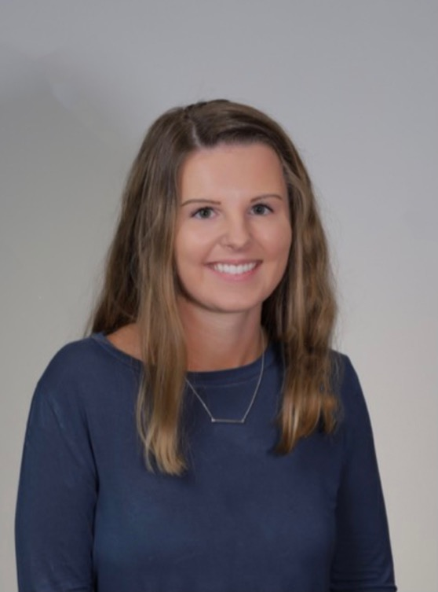
Morgan Holt
College of Nursing
Bachelor of Science in Nursing

Slide 49
Victoria Houle
College of Nursing
Bachelor of Science in Nursing

Slide 50
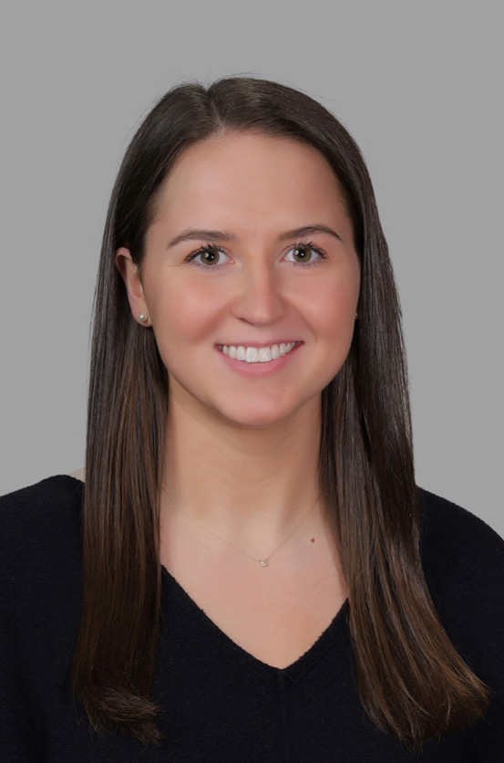
Sarah Iglar
College of Nursing
Bachelor of Science in Nursing

Slide 51
Halle Imm
College of Nursing
Bachelor of Science in Nursing

Slide 52
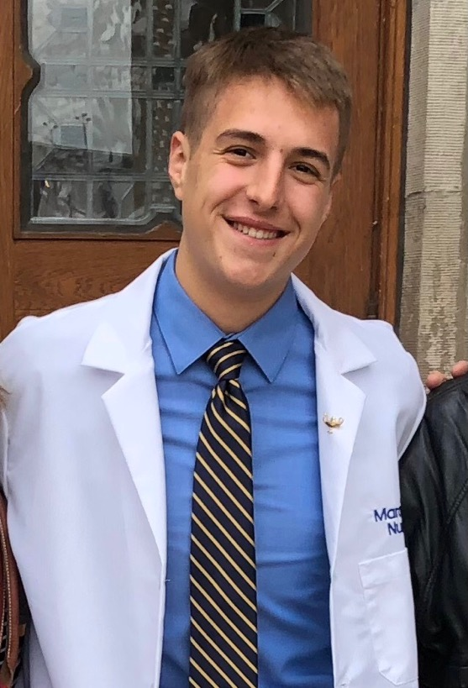
Joseph Jaruseski Jr.
College of Nursing
Bachelor of Science in Nursing

Slide 53
Brittany Jensen
College of Nursing
Bachelor of Science in Nursing

Slide 54
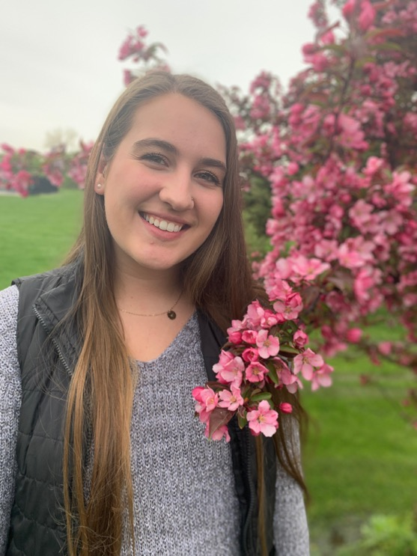
Emma Johnson
College of Nursing
Bachelor of Science in Nursing

Slide 55

Morgan Kallay
College of Nursing
Bachelor of Science in Nursing

Slide 56
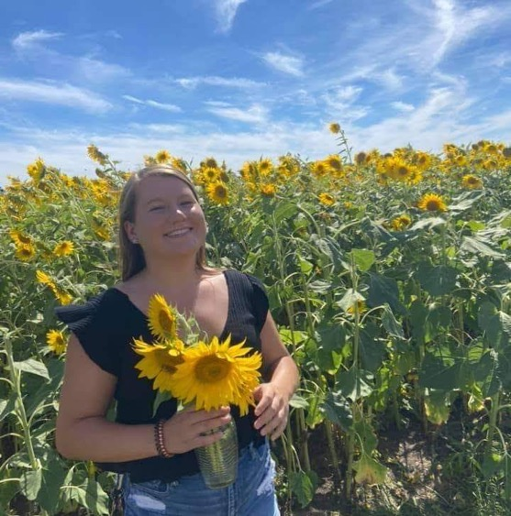
Lauren Klees
College of Nursing
Bachelor of Science in Nursing

Slide 57

Megan Kohmann
College of Nursing
Bachelor of Science in Nursing

Slide 58
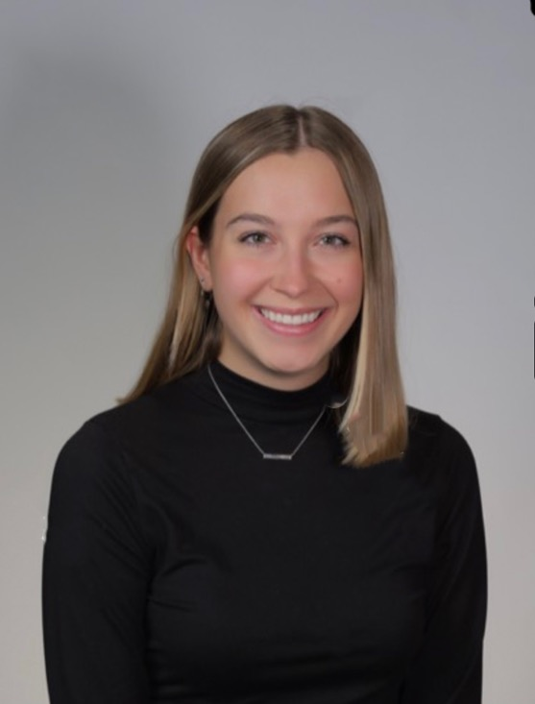
Alexandra Krzeczkowski
College of Nursing
Bachelor of Science in Nursing

Slide 59
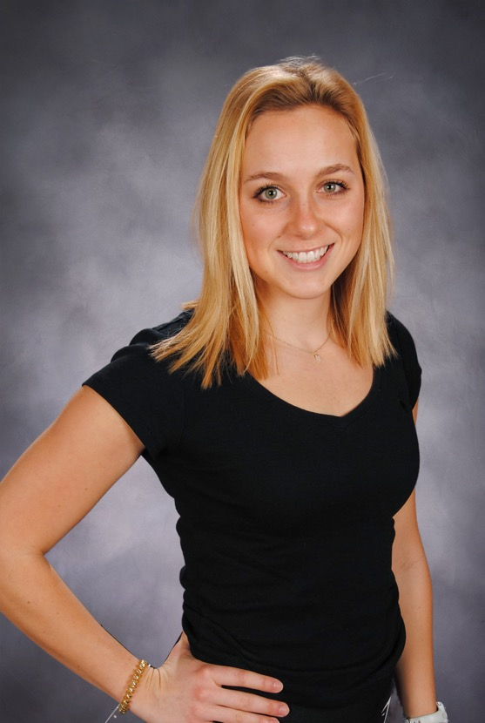
Elizabeth Kunkel
College of Nursing
Bachelor of Science in Nursing

Slide 60
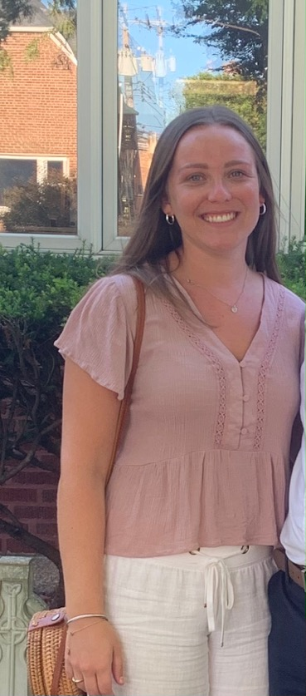
Laura Lambur
College of Nursing
Bachelor of Science in Nursing

Slide 61
Natalie Landgraf
College of Nursing
Bachelor of Science in Nursing

Slide 62
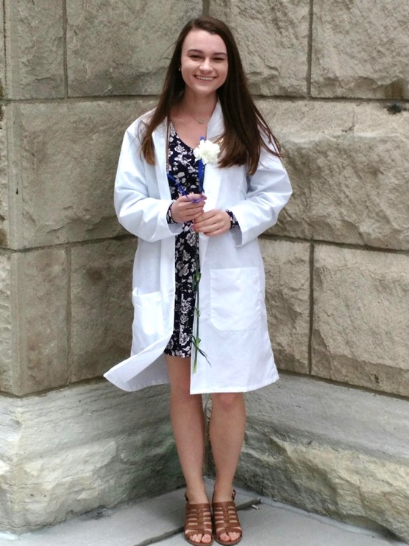
Rachel Laska
College of Nursing
Bachelor of Science in Nursing

Slide 63

Verenisse Ledesma
College of Nursing
Bachelor of Science in Nursing

Slide 64
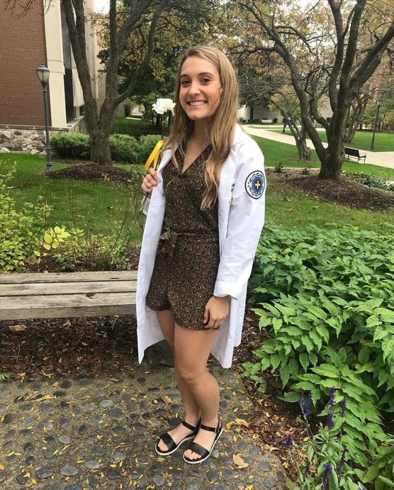
Brianna Ling
College of Nursing
Bachelor of Science in Nursing

Slide 65
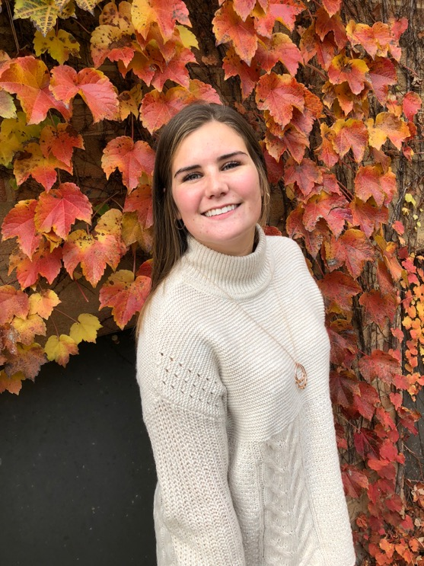
Danielle Loonsfoot
College of Nursing
Bachelor of Science in Nursing

Slide 66
Margaret Lyons
College of Nursing
Bachelor of Science in Nursing

Slide 67
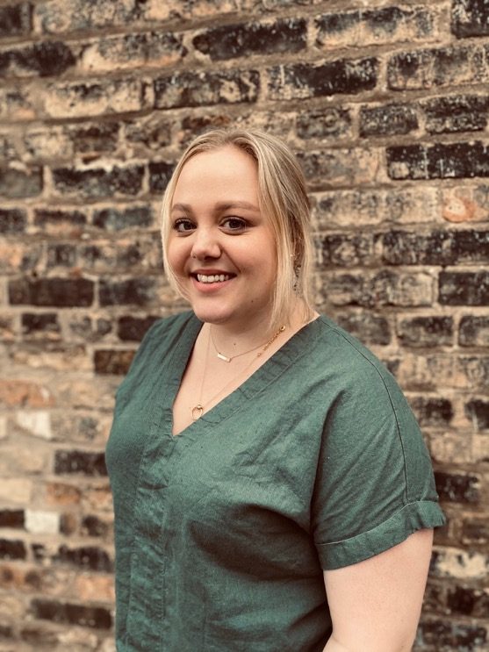
Megan Mahoney
College of Nursing
Bachelor of Science in Nursing

Slide 68
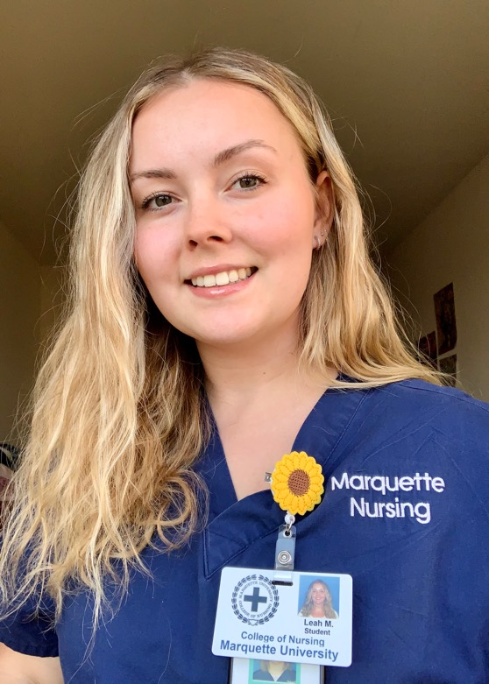
Leah McDonald
College of Nursing
Bachelor of Science in Nursing

Slide 69
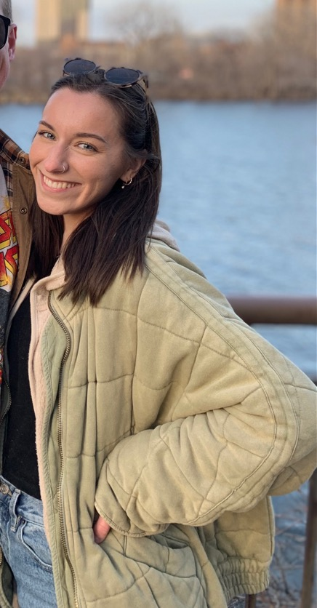
Brynne McGillis
College of Nursing
Bachelor of Science in Nursing

Slide 70
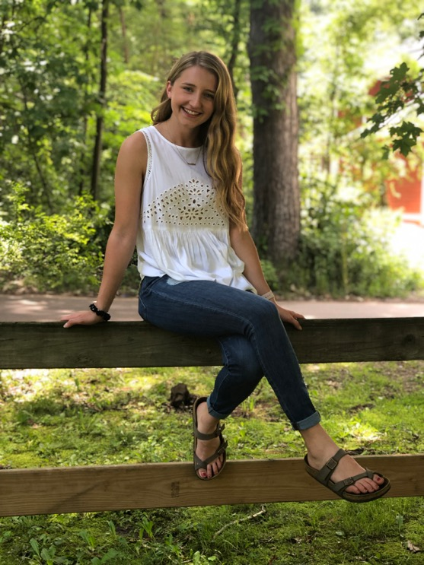
Madeline McMillin
College of Nursing
Bachelor of Science in Nursing

Slide 71
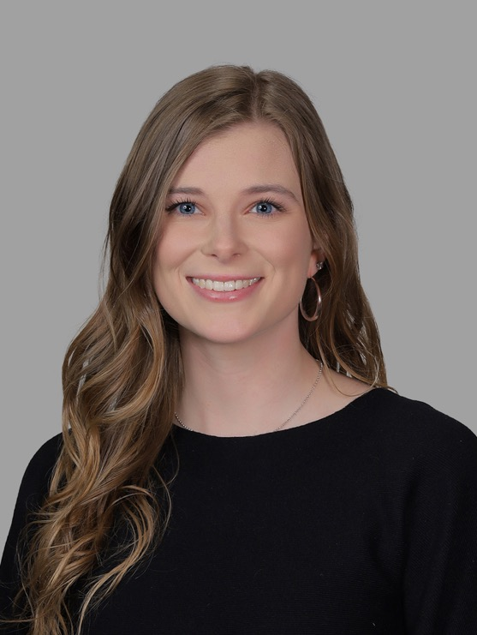
Kathleen McNicholas
College of Nursing
Bachelor of Science in Nursing

Slide 72
Jessica Mejorada
College of Nursing
Bachelor of Science in Nursing

Slide 73

Helen Moran
College of Nursing
Bachelor of Science in Nursing

Slide 74

Aislinn Mulvey
College of Nursing
Bachelor of Science in Nursing

Slide 75
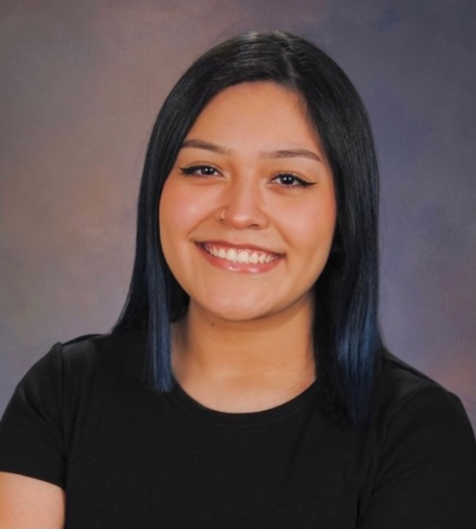
Elizabeth Murillo
College of Nursing
Bachelor of Science in Nursing

Slide 76
Sarah Oard
College of Nursing
Bachelor of Science in Nursing

Slide 77

Elizabeth O'Brien
College of Nursing
Bachelor of Science in Nursing

Slide 78
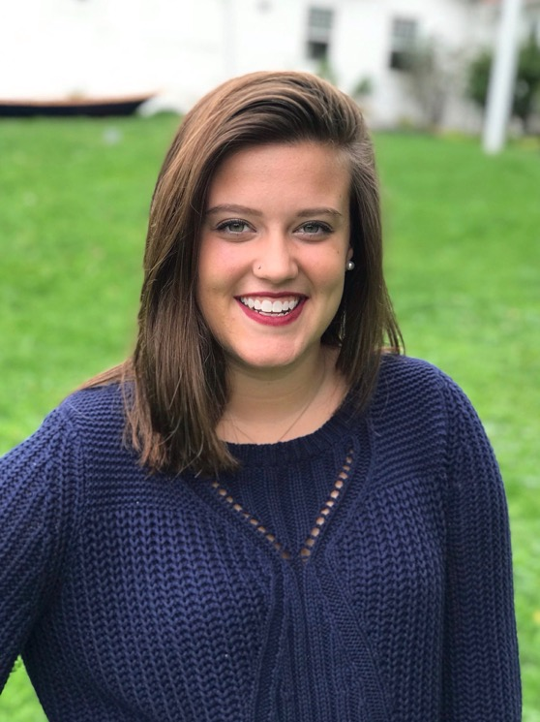
Katherine O'Brien
College of Nursing
Bachelor of Science in Nursing

Slide 79
Fiona O'Dea
College of Nursing
Bachelor of Science in Nursing

Slide 80
Jonathan Oeltjen
College of Nursing
Bachelor of Science in Nursing

Slide 81
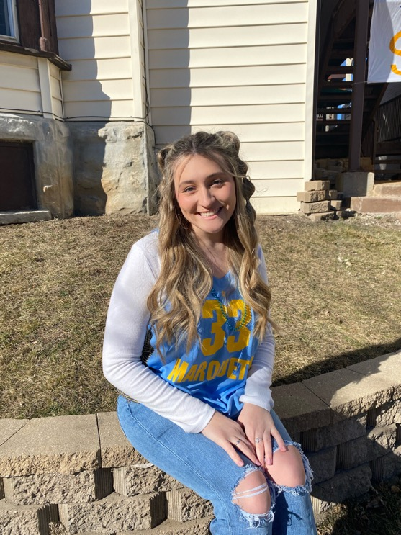
Kristin Osborne
College of Nursing
Bachelor of Science in Nursing

Slide 82
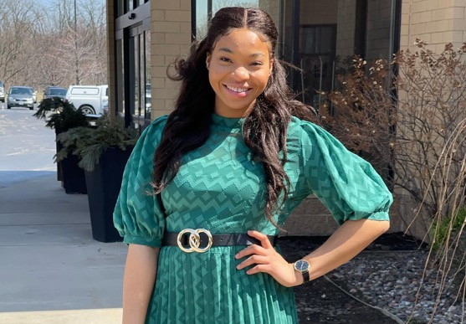
Olivia Osunkwo
College of Nursing
Bachelor of Science in Nursing

Slide 83
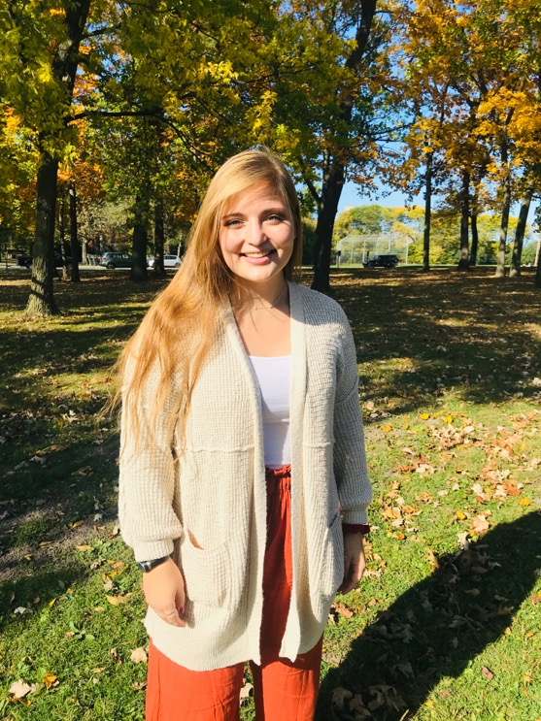
Abigail Oye
College of Nursing
Bachelor of Science in Nursing

Slide 84

Stephanie Perez
College of Nursing
Bachelor of Science in Nursing

Slide 85

Madeline Peters
College of Nursing
Bachelor of Science in Nursing

Slide 86
Daniel Peterson
College of Nursing
Bachelor of Science in Nursing

Slide 87
Olivia Provenzale
College of Nursing
Bachelor of Science in Nursing

Slide 88

Hannah Puff
College of Nursing
Bachelor of Science in Nursing

Slide 89

Kristine Ricafrente
College of Nursing
Bachelor of Science in Nursing

Slide 90
Steve Samuel
College of Nursing
Bachelor of Science in Nursing

Slide 91

Mary Schmidt
College of Nursing
Bachelor of Science in Nursing

Slide 92

Renee Gabrielle Seguban
College of Nursing
Bachelor of Science in Nursing

Slide 93

Skylar Senseny
College of Nursing
Bachelor of Science in Nursing

Slide 94

Alyssa Sharp
College of Nursing
Bachelor of Science in Nursing

Slide 95
Sarah Sheehan
College of Nursing
Bachelor of Science in Nursing

Slide 96

Mary Claire Simutis
College of Nursing
Bachelor of Science in Nursing

Slide 97

Peggy Smith
College of Nursing
Bachelor of Science in Nursing

Slide 98

Katharine Song
College of Nursing
Bachelor of Science in Nursing

Slide 99

Margaret Stillman
College of Nursing
Bachelor of Science in Nursing

Slide 100

Joanna Stollenwerk
College of Nursing
Bachelor of Science in Nursing

Slide 101

Claire Taiclet
College of Nursing
Bachelor of Science in Nursing

Slide 102

Theodosious Tavrides
College of Nursing
Bachelor of Science in Nursing

Slide 103

Claire Torrance
College of Nursing
Bachelor of Science in Nursing

Slide 104

Rhiannon Torres
College of Nursing
Bachelor of Science in Nursing

Slide 105

Natalie Valenzo
College of Nursing
Bachelor of Science in Nursing

Slide 106

Cecelia Van Gompel
College of Nursing
Bachelor of Science in Nursing

Slide 107

Sondra Vickstrom
College of Nursing
Bachelor of Science in Nursing

Slide 108

Juliana Vinci
College of Nursing
Bachelor of Science in Nursing

Slide 109

Makena Walsh
College of Nursing
Bachelor of Science in Nursing

Slide 110

Lindsay Walter
College of Nursing
Bachelor of Science in Nursing

Slide 111

Olivia Ward
College of Nursing
Bachelor of Science in Nursing

Slide 112

Mallory Wiest
College of Nursing
Bachelor of Science in Nursing

Slide 113

Katherine Willis
College of Nursing
Bachelor of Science in Nursing

Slide 114

Emily Woods
College of Nursing
Bachelor of Science in Nursing

Slide 115

Breanna Woyach
College of Nursing
Bachelor of Science in Nursing

Slide 116

Katherine Writz
College of Nursing
Bachelor of Science in Nursing

Slide 117

Danielle Zachman
College of Nursing
Bachelor of Science in Nursing

Slide 118

Hannah Zurcher
College of Nursing
Bachelor of Science in Nursing

