Slide 1
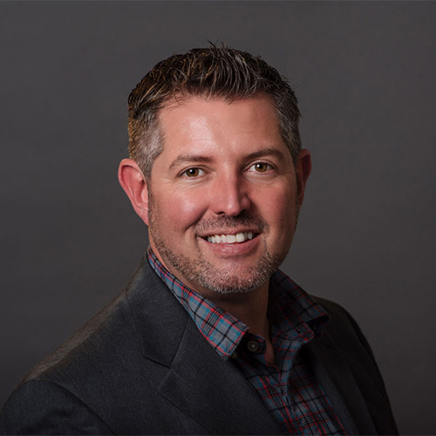
“Design, Analysis, and Demosaicing Consideration for Improved Snapshot Imaging Polarimeters"
Dr. Bradley M. Ratliff
Associate Professor,
Director Applied Sensing Laboratory,
Department of Electrical and Computer Engineering
University of Dayton
Tuesday, November 30th, 2021
2:00 – 3:00 p.m.
Olin 202​
Reception to follow Olin 204
3:00 – 3:30 pm

