Slide 1
Practice Space &
Show Policy training

Slide 2
Introductions

Slide 3
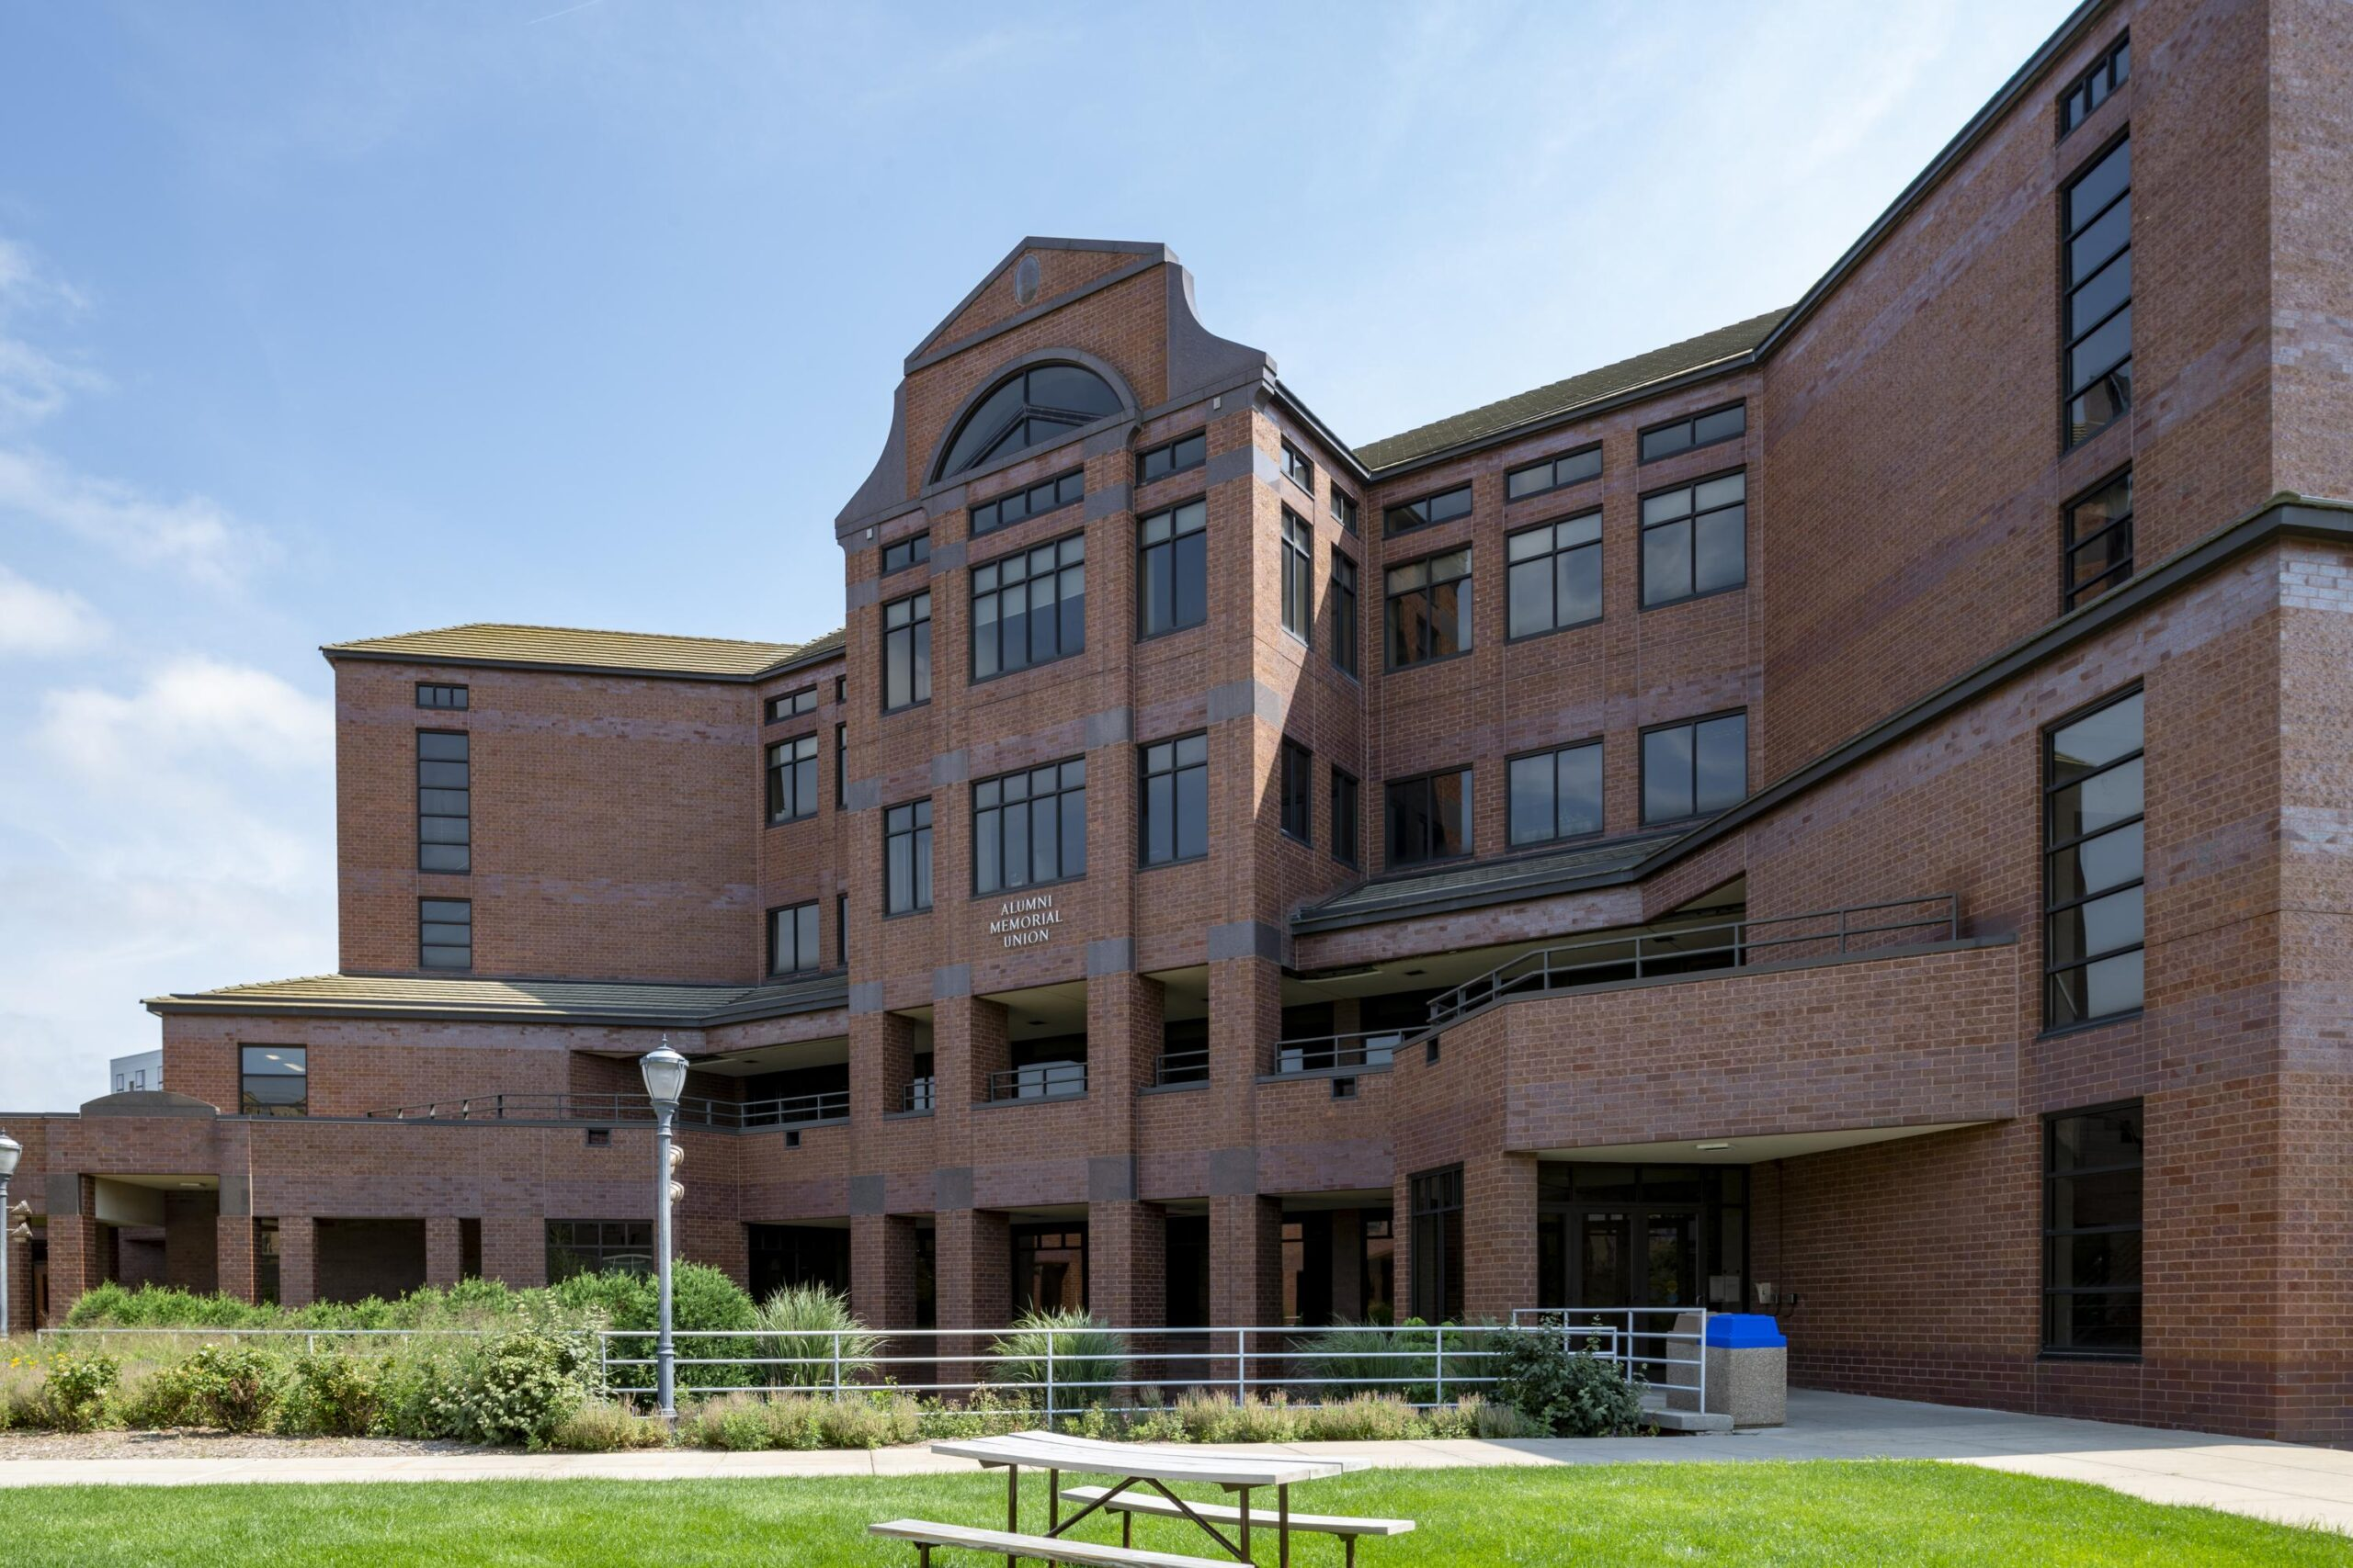
Student Engagement
Stephanie Dooge- Coordinator for Student Organizations and Campus Activities
EVENT SERVICES
Linda Lee: Assistant Director of AMU and Event Management
Natasha Gordon: Event Coordinator
Chanel Davis-Carter: Event Coordinator

Slide 4
Review:
Practice space policy

Slide 5
Defined as empty setup, no AV, up to 2 rolling mirrors
Maximum of 6 hours per week (up to 3 times per week)
Add up to 4 hours of practice time on Fridays for the following week
Spaces under this policy: AMU 157,163, 227, Weasler, Varsity, Marquette Place Practice Space, Humphrey Practice Space
Practices must end by 10:30pm at the latest
No sharing practice time with other organizations
3 Strike No-Show Policy

Slide 6
Show Policy

Slide 7
A show is defined as a major event with AV Tech that’s purpose is to draw an audience
This may include dance performances, musical concerts, major presentations, cultural shows, fashion shows, etc.
Shows must be scheduled by recognized student organizations
Student organizations will be allowed to book up to 2 shows per academic year
  Groups are allowed one (1) Primary Show with AMU Audio Visual Equipment (AVE) per Academic
  Groups can book one (1) Secondary Show, only if it does not require AMU Audio Visual Technicians to assist

Slide 8
Primary shows vs. secondary shows
Groups are allowed one (1) Primary Show with Audio Visual Equipment (AVE) per Academic Year
Examples of AVE include microphones, stage uplighting, music, laptop, screen, projector, etc.
This also includes AMU Tech Staff being present
Groups can book a Secondary Show, only if it does not require AMU Audio Visual Technicians to assist
This means that using AMU’s AVE will not be supported
You may have a show without renting any AVE from the AMU, or you can hire an outside vendor to produce the show

Slide 9
How to request a show

Slide 10
Fill out the Qualtrics “Show Request Form” from the website or your Primary Coordinator (email Natasha for the link)
  Submit your 5 preferred Primary Show dates
  (mixture of Fall & Spring dates)
You have until the end October 16, 2026 to submit your Primary Show Request form for this school year (if you have not done so already)
If you don’t submit your preferred dates before assignments are sent you can reserve a Primary Show but could be subject to having Event Services pick your show date based on AMU space availability
Your Primary Coordinator will notify you of your show assignment the Monday after Fall Break
Show date assignments will be made based on space availability, and by an org’s top preferences on the “Show Request From”
Start submitting preferred Primary Show dates on April 1, 2027 for the following Academic Year (2027-2028)

Slide 11
Tech rehearsals
10 hours to rehearse with an AMU Audio Visual Technician on top of your 6 hours of weekly practice time
Split your 10 hours of tech time between:
  Tech Rehearsal, scheduled separate from the Show date
  The Show date, including a pre-show Tech Rehearsal and the run time of the Show
Timeline of your day-of tech rehearsal will be coordinated between Event Services, AMU Technician(s), and the sponsoring organization
Tech rehearsal timeline will be based on the availability of the AMU Technician(s) scheduled to assist with your show
If you have a pre-show Tech Rehearsal, it must be consecutive with the start time of the show
Breaks between rehearsals day-of the show count as Tech Time!

Slide 12
EXAMPLE
Practice (for 6 hours):
  Monday 5-7pm (2 hours)
  Tuesday 6:30-9:30pm (3 hours)
  Wednesday 7-8pm (1 hour)
Tech Assistance (for 10 hours):
  Thursday: Tech Rehearsal from 5-9pm (4 hours)
  Saturday: Performance Day
    Pre-show Tech Rehearsal from 3-6:30pm (3.5 hours)
    Show run time (with Tech Assistance)
    from 7-9:30pm (2.5 hours)

Slide 13
Questions?

Slide 14
Contact:
Natasha.gordon@marquette.edu
Event services office
Amu 245
414-288-2263

