Slide 1
Grant Post Award Services Improvement Campus Town Hall Fall 2025

Slide 2
Setting the Stage
Challenges
~2X increase in research expenditures over 10 years
Increased complexity of grants and compliance requirements
Goals
Workflow and resources not designed to handle volume: manual processes and work-arounds, reliance on email, same people tapped to answer questions and fix errors, etc.
Create support system that will:
Handle peak work volumes
Reduce errors and need to fix later
Provide appropriate documentation and training
Clarify roles and responsibilities
Maintain compliance
Improve communication and tracking

Slide 3
Multiple Challenges and Perspectives
Institutional systems, policies, and practices
staff providing support
PIs
Campus-wide staff and faculty collaboration required to build capacity and improve the experience for all stakeholders.
Critical part of our research infrastructure.

Slide 4
Strategic Plan Priority: Process Improvement for Better Grant Management Support
Combination of:
Targeted efforts to improve processes that support grants (some may also support non-grant-related operations)
Example: DocuSign salary authorization process
MU POST: NSF-funded post-award improvement project
Develop advocate model to assist PIs and department staff (bridge to central offices)
Focus on improvement of selected processes → automation, efficiency, scalability, and transparency
Part of NSF cohort of GRANTED programs

Slide 5
Recap of Academic Year 2024-25 work
Grant dashboard launched, initial user training (Fall 2024)
MU POST grant funded by NSF (4-year project, ~$1.2M)
Grant-funded advocate position established, one university-funded advocate already in place
Currently searching for grant-funded advocate
Faculty and staff oversight committee established
Current and past members: Amy Albrinck Schroeder, Jodie Box, Steve Celichowski, Katherine Durben, Anita Guizar, Jeanne Hossenlopp, Allison Hyngstrom, Amber Jensen, Julie Knox, Anna Kranz, Anita Manogaran, Sherri Walker, Sa Yang, and project coordinator Sara Spragg

Slide 6
Recap of Academic Year 2024-25 work
DocuSign process rolled out for new account set-up
DocuSign process for academic area salary authorizations
Kuali data migrated into DataMarq, selected reports available
Automated annual grant budget rollover process
Documents created for: advocate engagement process, award kickoff and monthly checklists, and post-award roles and responsibilities (https://www.marquette.edu/research-sponsored-programs/mu-post/)
See https://www.marquette.edu/innovation/grant-management-process-improvement.php for May 2025 roadmap of projects and logic model for strategic plan priority

Slide 7
Recap of Summer 2025 work
Evaluated progress/completion of initial project priorities
Stakeholder survey and analysis by MU POST external evaluators; review by internal team
Began planning FY26 priorities

Slide 8
Pilot Academic Area Salary Authorization Project (FY25)
New process
Tracks progress
Works for high-volume times
Works for grant and non-grant cases
Declined submissions returned for corrections
Submit Request
College Office (with PI interaction for grants)
Approvals
ORSP (grants)
Transactions
HR
Payroll
Benefits
Provost
Compensation (HR)
Budget
Concern: Pay people on time and from the right accounts!

Slide 9
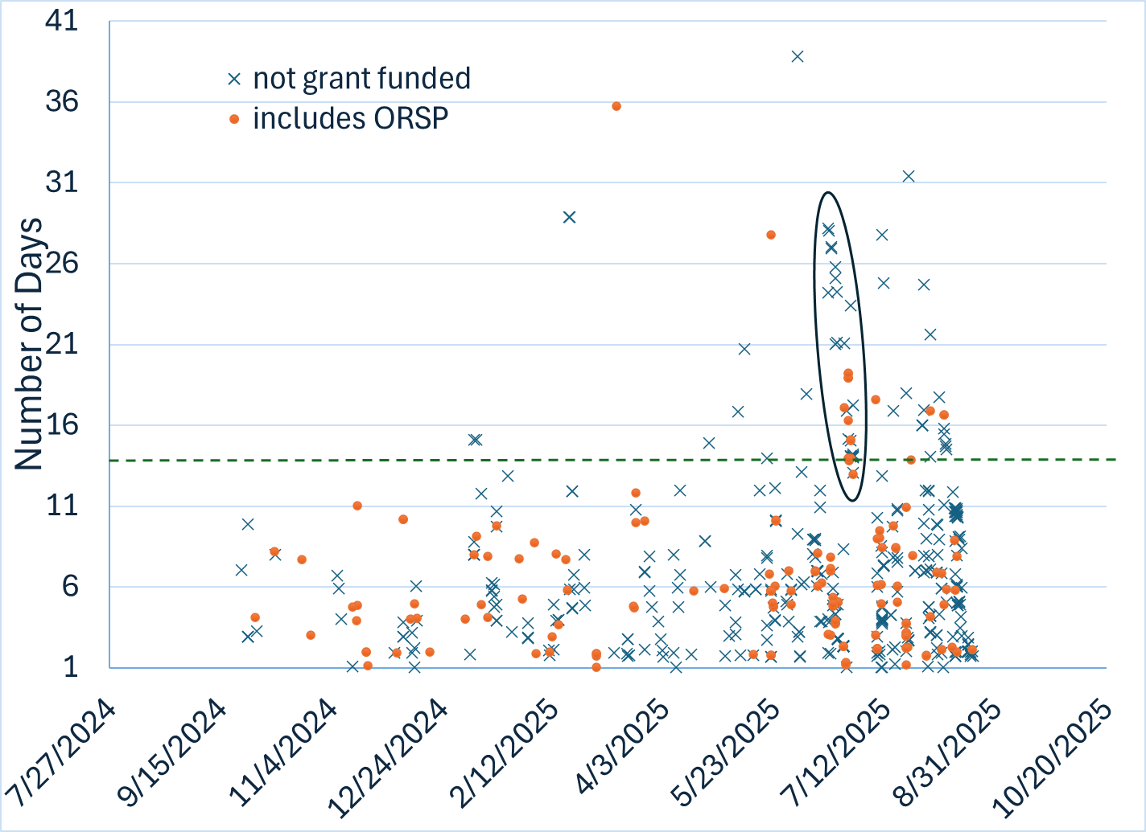
DocuSign SA Data
Outliers: need to focus next on reducing the number that are declined during approval
Submitted before GoT
←2 weeks

Slide 10
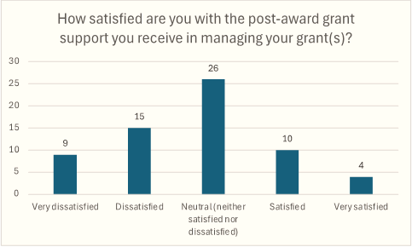
MU POST Stakeholder Survey
Respondents:
78 PIs,
15 business operations/department staff,
9 university central office staff,
7 academic leadership (dept chairs, associate deans for research)

Slide 11
External Evaluator Findings: Summary of Key Challenges
Role Clarity
Documentation and Transparency
Communication and Hand-offs
Forms and Report Use
Faculty-Staff Interface
Capacity and Resourcing
Stress and Empowerment

Slide 12
Another View of Survey Comments
Specific Issues
External Evaluator Themes
Delays in Award/Account Set-up
Communication and Hand-offs
Lack of Communication and Responsiveness
Communication and Hand-offs
Role Clarity
Capacity and Resourcing
Capacity and Resourcing
Accuracy and User Understanding of New Dashboard
Forms and Report Use
Documentation and Transparency

Slide 13
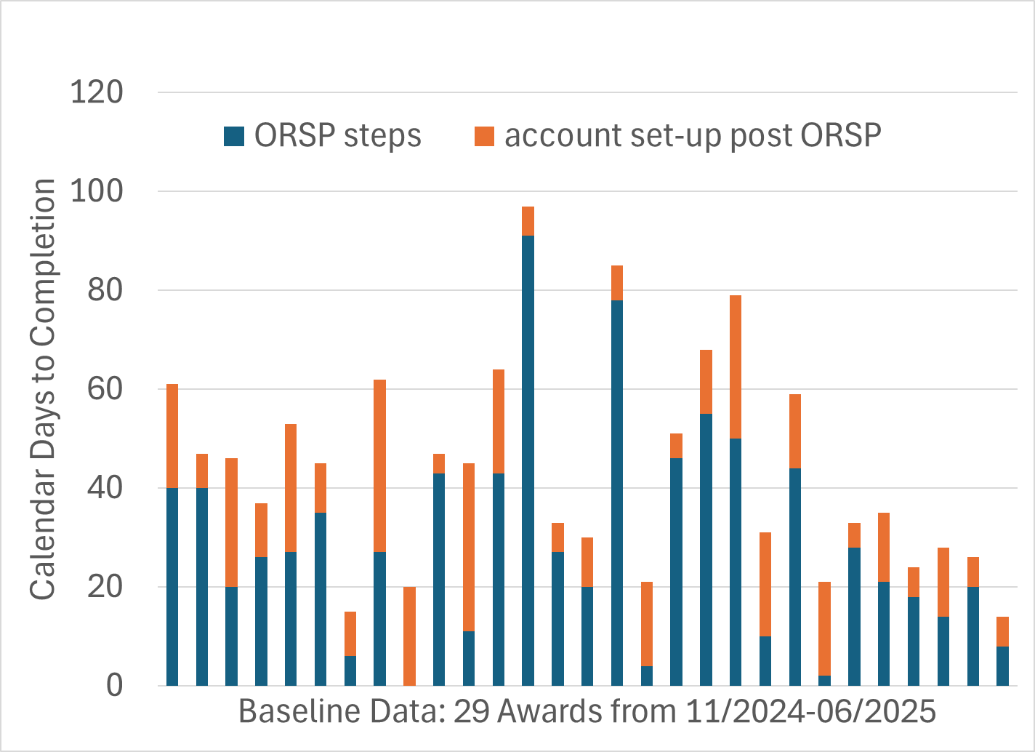
Notice of Award to Ready-to-Spend
May 2025 Roadmap Goal:
Annual report of key time-to-completion metrics for award/account set-up

Slide 14
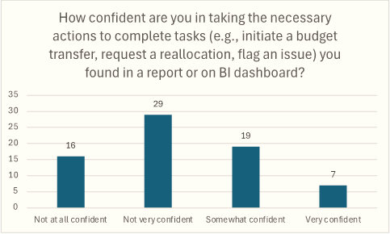
Why Focus on Reports and Forms?
Target outcomes:
PIs manage awards more effectively and maintain compliance.
Staff capacity for other critical tasks improved by:
Reduced inquiries (reports are useful to users)
Quicker identification and resolution of potential issues
Minimized rework/error correction

Slide 15
Reports: Comments on the New Dashboard
“Absolutely useless and isn't up to date”
“The Grant Budget Dashboard introduced recently is fantastic ”
“Concerns with the accuracy of information”
“The grants dashboard is the best tool. That is basically all that I use now.”
“Having to decipher between internal ORSP budget spreadsheets/PI initial budgets and where/what naturals the budget actually ends up in BI reports”
“The new grants dashboard is nice, but I think websites cannot replace human to human interaction”
“How much money is left right now?”

Slide 16
Responding to Dashboard Concerns
Grant advocate and ORSP have identified a few examples of the issues that PIs are encountering and are working with ITS and Finance to evaluate:
Where are there are gaps in user understanding of the information being presented?
Where may the reports be providing incorrect data and, if so, how can this be fixed?
And is there a simple way to report total available budget?
Plan to add in-person training sessions to assist users in FY26.

Slide 17
Help with Forms (Capacity Building Focus)
Reduce frequent errors and re-work in form submission
Improve visibility into form workflow and status
Provide clear guidance and training

Slide 18
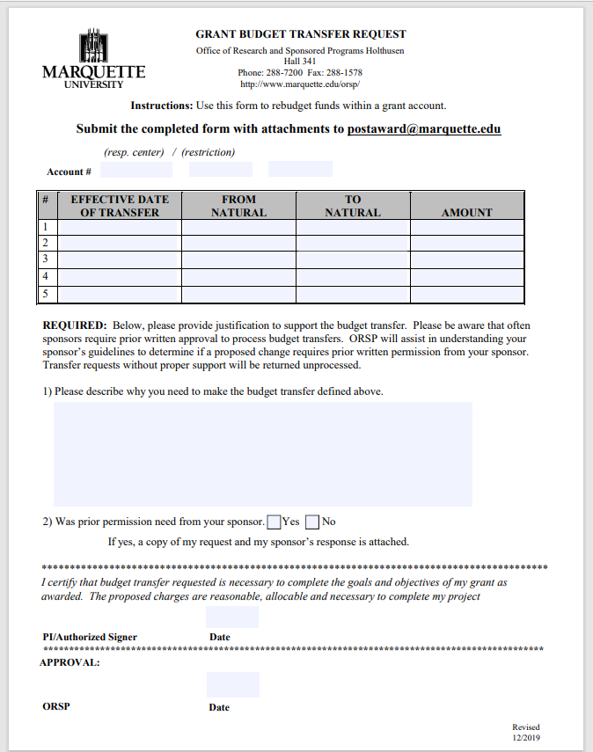
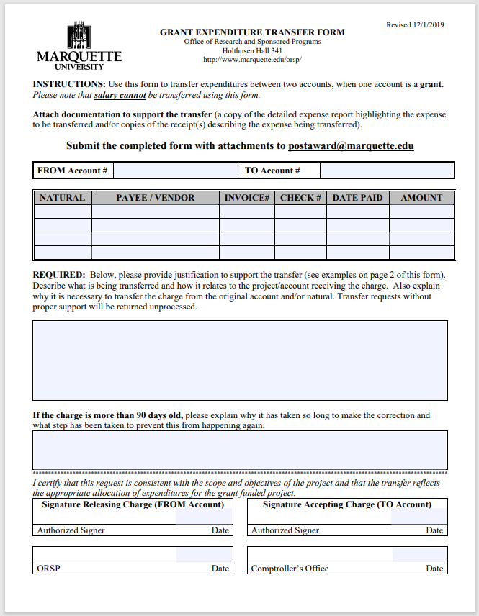
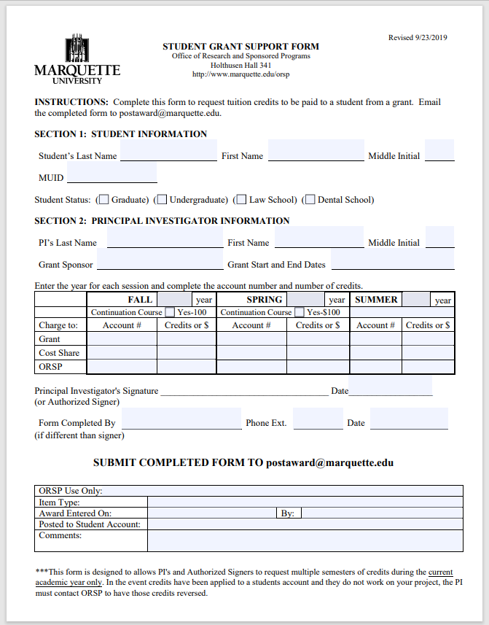
Forms Next Steps
Use Lean methodology to improve processes:
Rebudget funds within a grant account
Move expenses between accounts
Authorize tuition credits be paid from a grant
MU POST year 2 (FY26)
Notes:
1. Rebudget funds within a grant account
Common reasons for budget changes include:
Hiring changes (e.g., switching from graduate assistant to part-time employee)
Equipment needs (e.g., purchasing a computer)
Travel for dissemination of research
Reallocation of unused salary dollars
2. Move expenses between accounts
Examples include:
Transferring registration fees for conferences
Moving costs for lab animals or supplies
Correcting pre-award charges once the grant account is established

Slide 19
Communication and Responsiveness
Short-term:
Building tools/resources to help people find answers or direct questions to the right person
Pilot more in-person training (use of the dashboard, monthly sessions to help new awards get launched combined with office hours)
Longer-term:
Evaluate help-desk approach or other means of helping track inquiry responses (avoid things getting lost in email)

Slide 20
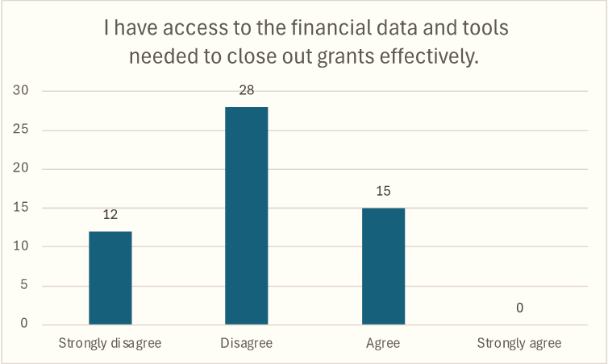
FY26 MU POST priority: account close-out
New checklist in progress with:
Timeline
Specific tasks
Who is responsible

Slide 21
Engaging the Campus in our Efforts
Campus Town Hall (suggest once per semester)
Office hours and other training activities – will gather “pulse survey” data to evaluate usefulness
Updating the online roadmap – September, December, and June
Online resources available as they are developed – how can we best point people to them?
Other suggestions?

Slide 22
Thanks!
Survey respondents
Colleagues who are helping with process improvement projects
Post award grants management improvement oversight committee
MU POST team and NSF GRANTED program (NSF award #2426787)

