Slide 1

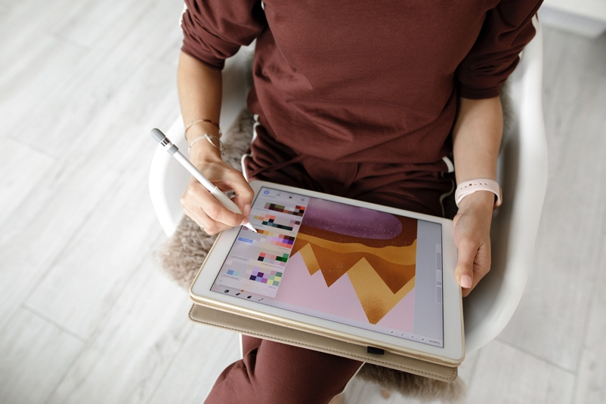

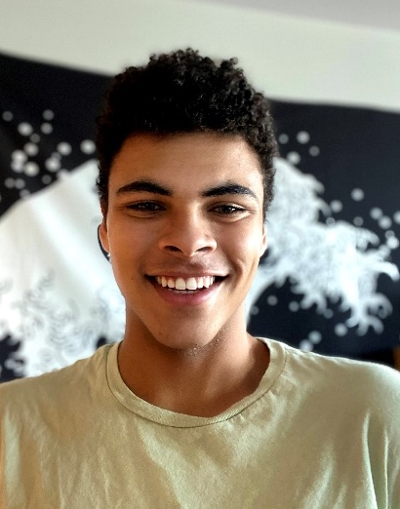

SPOTLIGHT ON SUMMER UNDERGRADUATE RESEARCH
Office of Research and Innovation
Cameron’s summer research focused on privacy violations as a result of faulty proctoring software implemented in schools. The team examined the socioeconomic and racial profiling of proctoring software systems and AI programs like them that are used in everyday life. Cameron discovered the impact “racist” AI can have in theory and in practice; although, there is no such thing as a “racist” computer. And Cameron’s favorite part of summer research was keeping the momentum going from the spring semester.
Cameron Fronczak

Slide 2
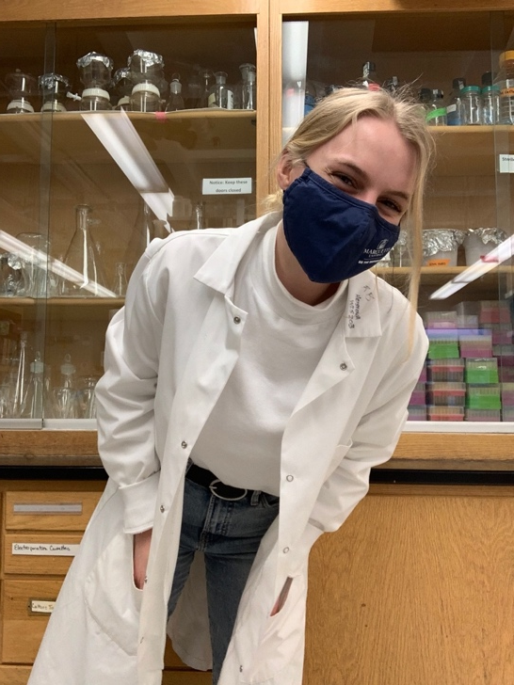
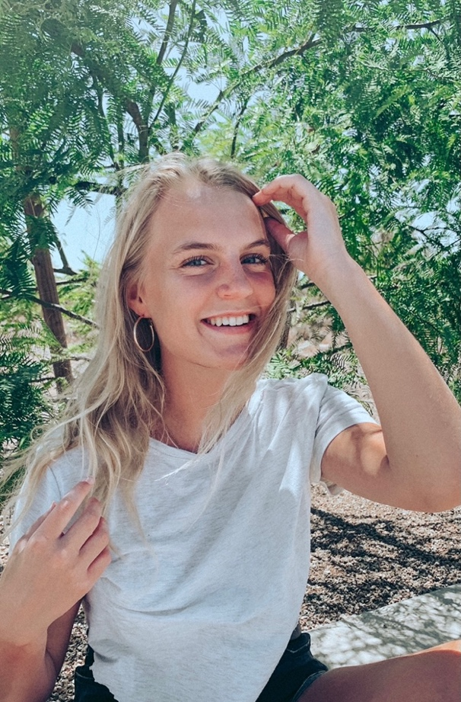
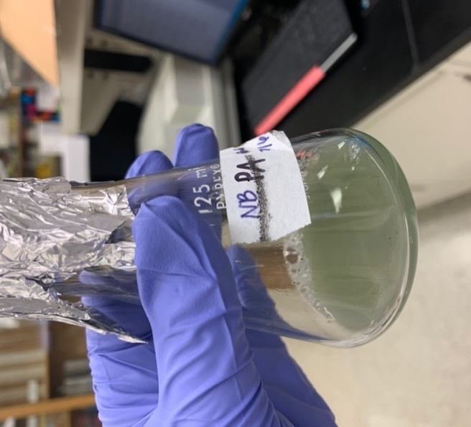
Grace’s summer research involved testing a commonly used disinfectant called Botanical Antimicrobial Cleaner, more commonly known as BAC to see how bacteria may have developed a resistance to the disinfectant over time.
She discovered that P. aeruginosa is incredibly resistant to the disinfectant BAC.
And her favorite part of her summer research was getting to spend so much time in the lab!
Office of Research and Innovation
Grace Schmaling
SPOTLIGHT ON SUMMER UNDERGRADUATE RESEARCH

Slide 3
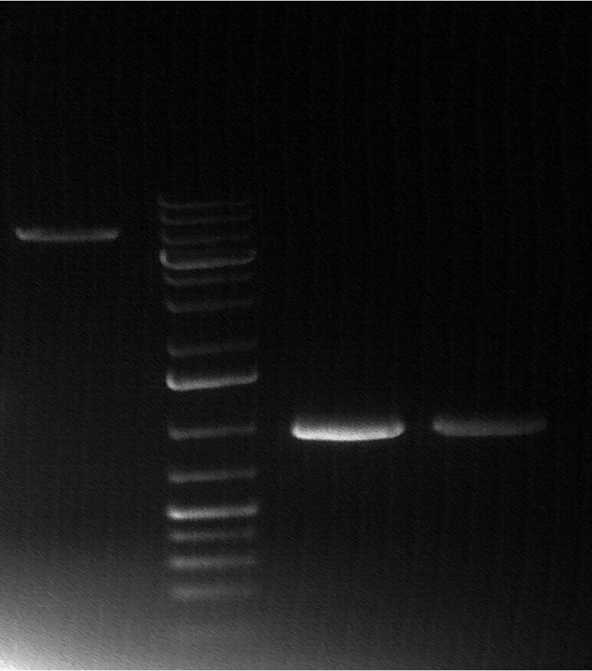
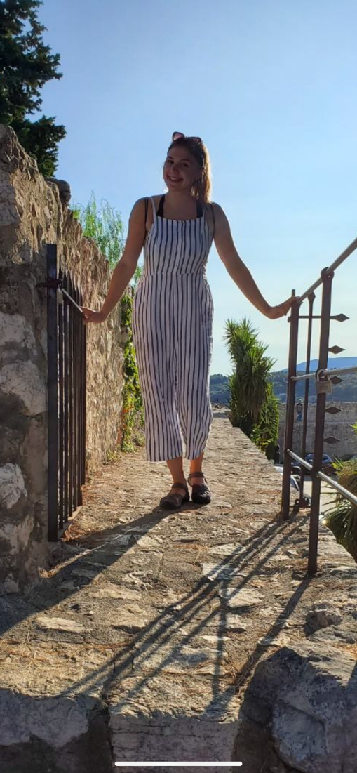
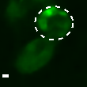
SPOTLIGHT ON SUMMER UNDERGRADUATE RESEARCH
Office of Research and Innovation
Leona’s summer research created a plasmid that expresses GFP-tagged Ab (Green Fluorescent Protein fluoresces when expressed so we can visualize misfolded Ab peptide) which has been implicated in Alzheimer’s disease.
Leona discovered that she loves research and that it is definitely going to be part of her future career path, but she is shifting to Psychology research after this summer.
And Leona’s favorite part of summer research was her mentors, Dr. Sontag and Sarah Rolli.
Leona Kondic

Slide 4
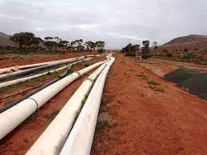
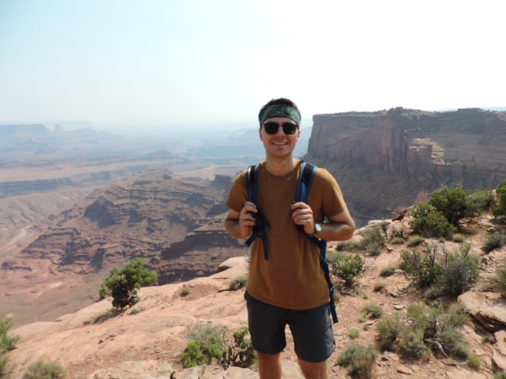

SPOTLIGHT ON SUMMER UNDERGRADUATE RESEARCH
Office of Research and Innovation
Adam’s summer research focused on trying to create a more accurate model of predicting failures in city pipelines with defects. “Using Abaqus, I modeled the pipelines and simulated them to try find the pressure that the pipe would fail.”
Adam discovered how to use the Abaqus software. “Whether it was modeling, simulating, or repairing errors, I gained a much deeper understanding on how the software works.” And Adam’s favorite part was meeting all the other students in the program. “Meeting them and getting to know them has been very informative on what other students are working on in the university.”
Adam Puchalski

Slide 5
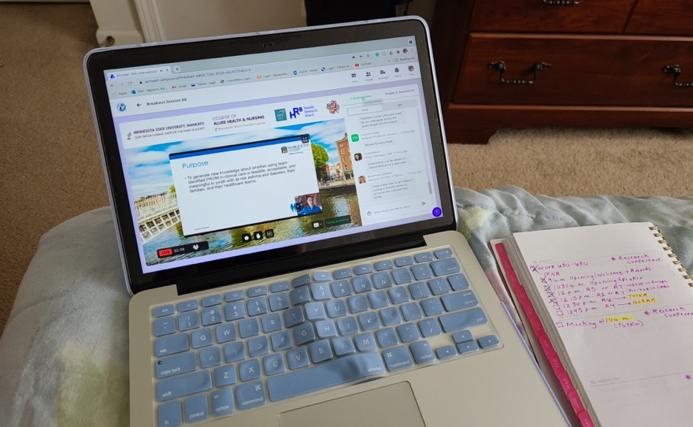
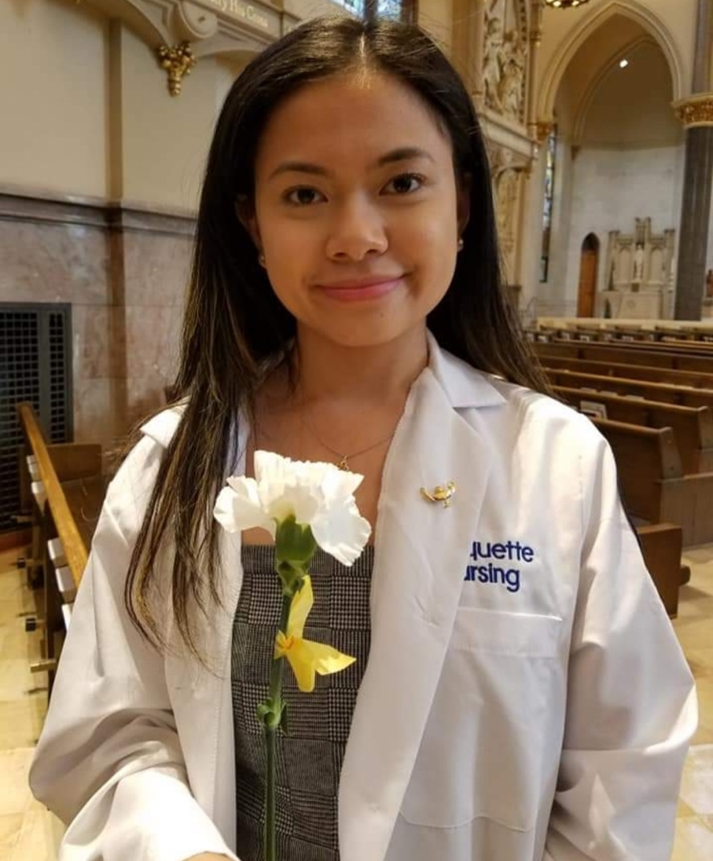
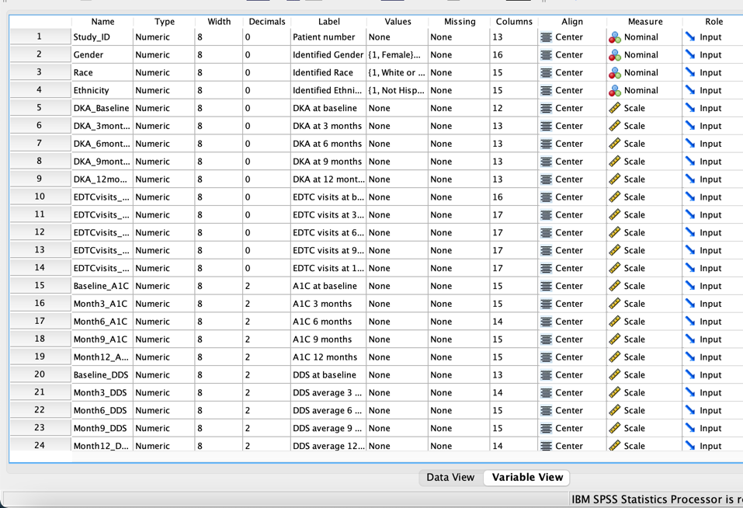
SPOTLIGHT ON SUMMER UNDERGRADUATE RESEARCH
Office of Research and Innovation
Kyla’s summer research involved gathering and analyzing data of patients with Type I and Type II diabetes – specifically the teen population. These Patient Reported Outcome Measures (PROM) aid in identifying which factors have a significant impact on the teens’ quality of life.
Kyla discovered that research is not a one-and-done process. It may take a couple months to a couple of years for research to progress.
And Kyla’s favorite part of summer research was attending a nursing conference virtually (the 15th International Family Nursing Conference).
Kyla Navarro

Slide 6
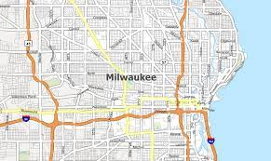
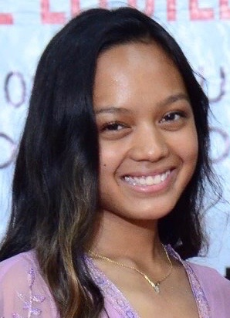
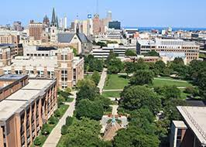
SPOTLIGHT ON SUMMER UNDERGRADUATE RESEARCH
Office of Research and Innovation
Lourdes’s summer research focused on working with the Center of Peacekeeping that partnered with Near West Side. They went around to different neighborhoods and gathered feedback in relation to NWS projects that have been implemented in their communities.
Lourdes discovered, “I liked talking to the residents while we were out giving surveys to the different neighborhoods. The residents gave a lot of feedback, and it helped me discover my own research topic that I’d like to focus on for this semester.”
And Lourdes’s favorite part of summer . research was connecting more with the
Milwaukee neighborhoods surrounding
Marquette University.
Lourdes Galido

Slide 7
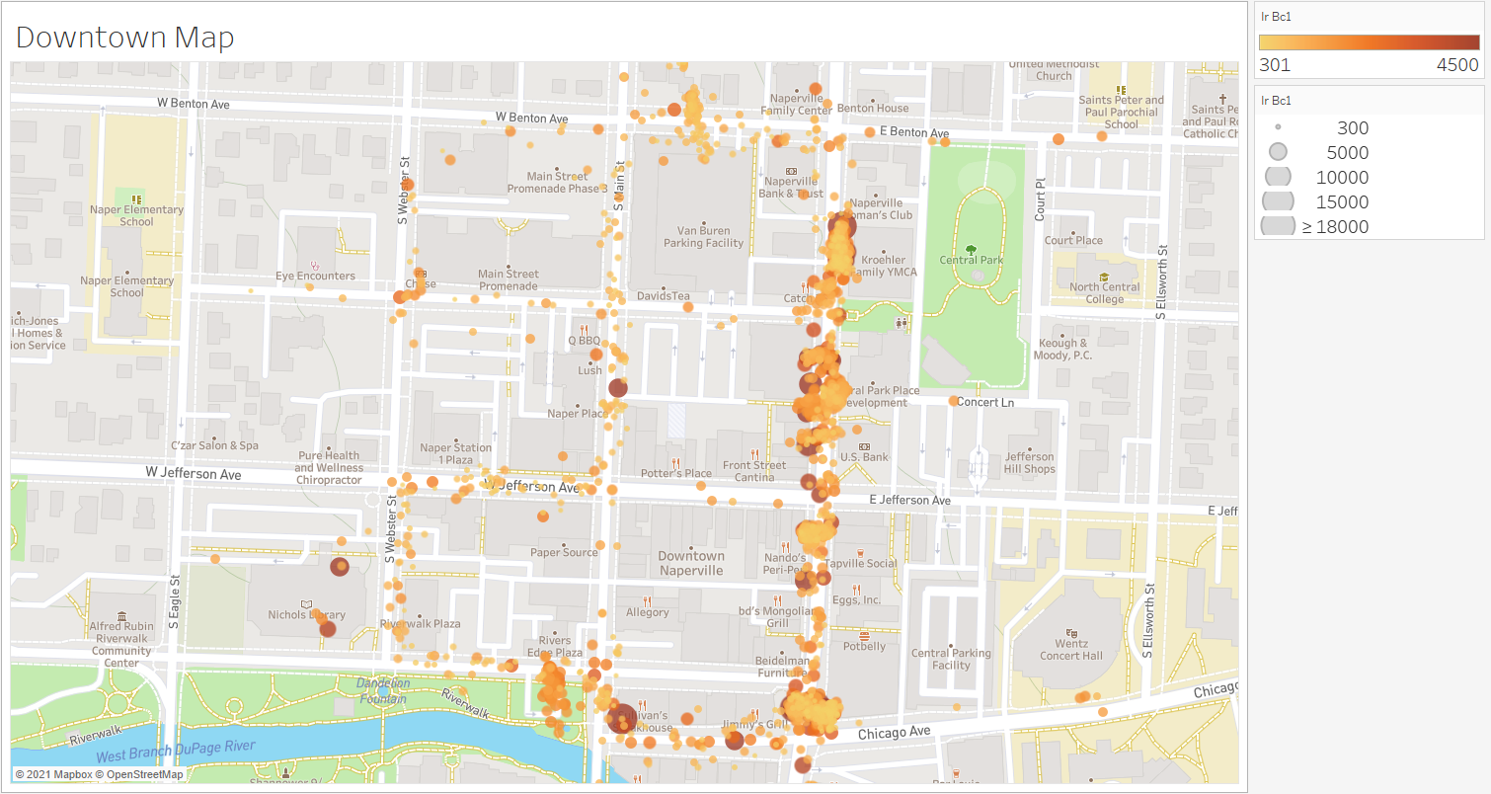
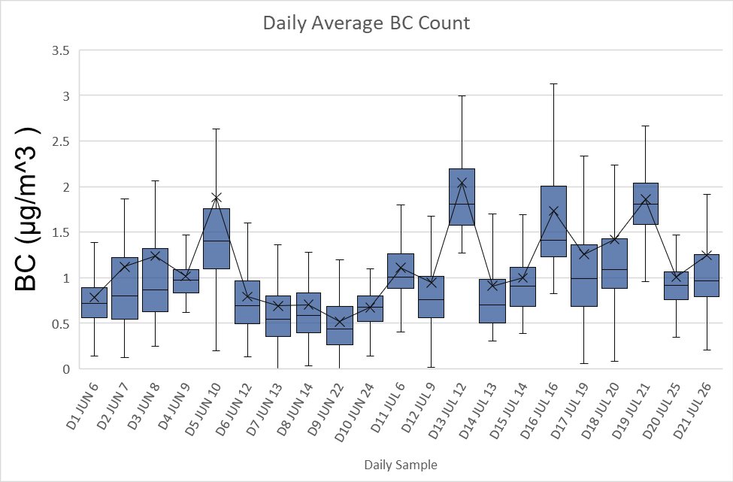
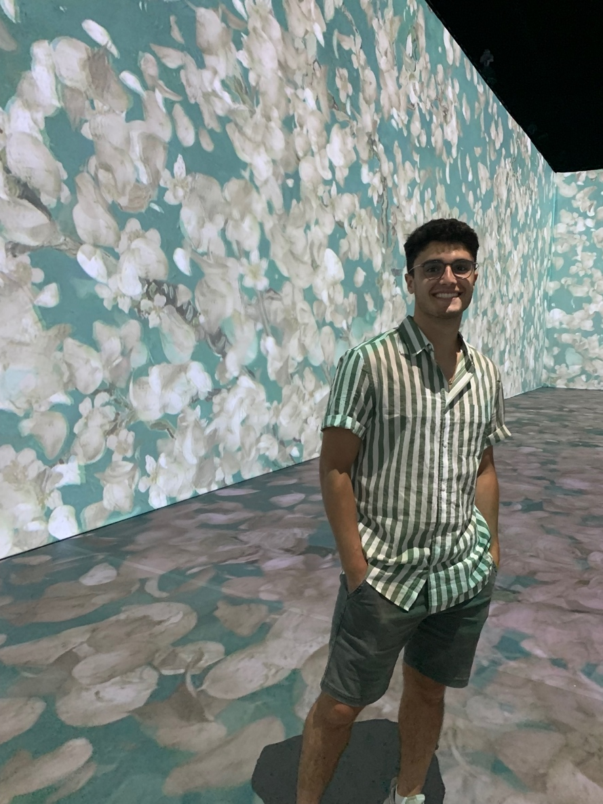
SPOTLIGHT ON SUMMER UNDERGRADUATE RESEARCH
Office of Research and Innovation
Christian’s summer research focused on monitoring pollutant aerosols, more specifically black carbon. The project was based on monitoring the affect of traffic on the increase of black carbon in areas with a high number of pedestrians and outdoor diners in the downtown of Naperville, IL.
Christian discovered a lot “about researching as a whole and myself. I found that it can be long and stressful though extremely gratifying and exciting."
And Christian’s favorite part was seeing how rewarding it can feel to make small progress in research and how it can feel as good as a large step.
Christian Romano

Slide 8
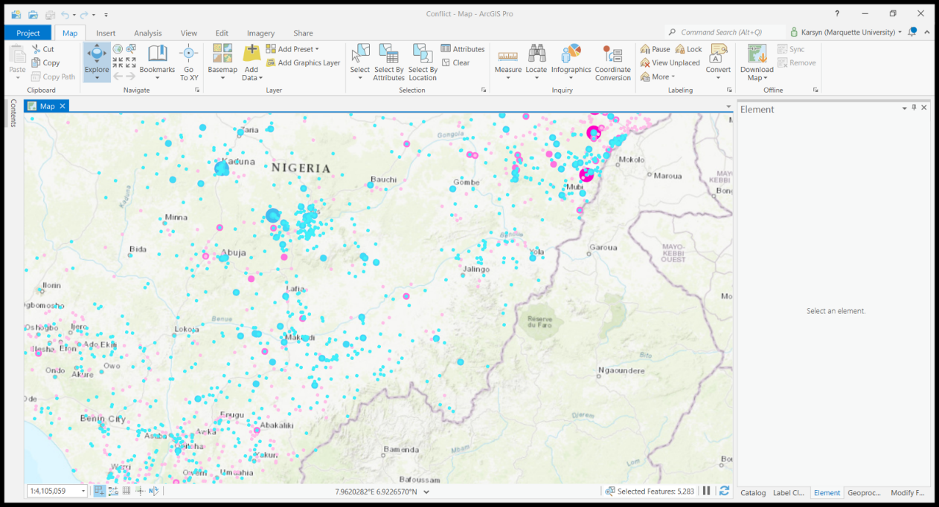
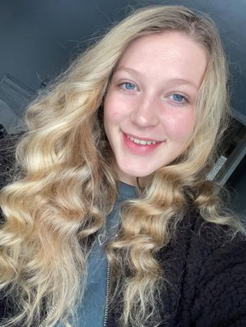
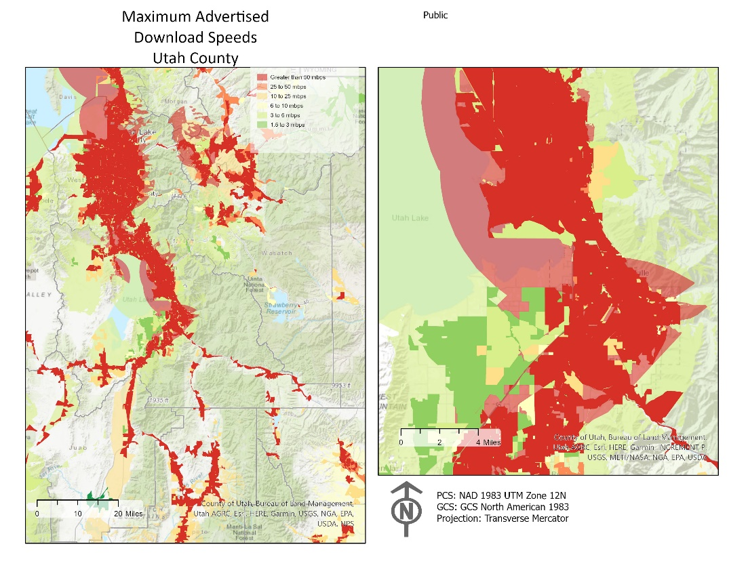
SPOTLIGHT ON SUMMER UNDERGRADUATE RESEARCH
Office of Research and Innovation
Karsyn’s summer research focused on assessing crime within the Milwaukee area. They specifically asked, what is the relationship between establishments that sell or have alcohol and crime rates?
Karsyn discovered that there really is no limitation on what can be researched. Karsyn says, “This was especially true after observing so much crime focused research.”
And Karsyn’s favorite part of summer research was working with Dr. Snowden and the other research student. “Dr. Snowden really made the research about our learning and our skill development.”
Karsyn Hartsfield

Slide 9
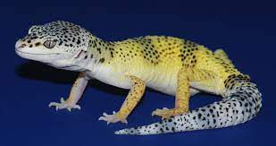
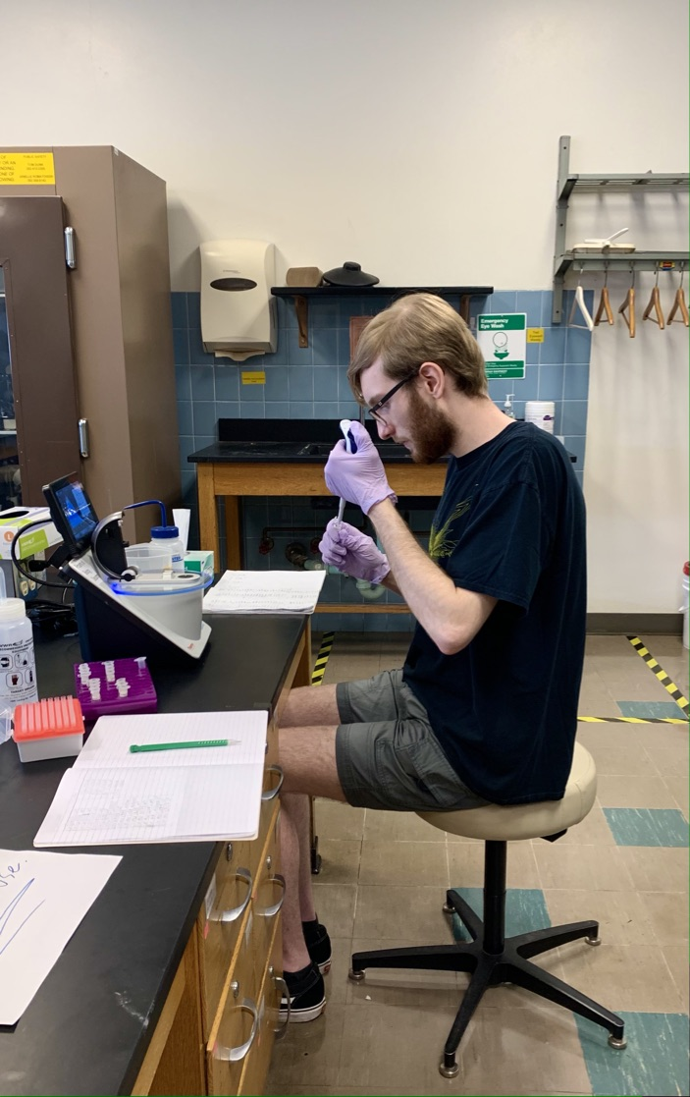
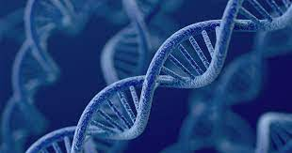
SPOTLIGHT ON SUMMER UNDERGRADUATE RESEARCH
Office of Research and Innovation
Blake’s summer research focused on a unique genetic variant of leopard gecko called a lemon frost morph. Lemon frost leopard geckos look different than normal leopard geckos and lemon frost geckos have an increased chance of experiencing cancer.
Blake discovered that the SPINT1 gene is not the lemon frost gene and that GCHFR (or a gene close to it) is the gene for lemon frost.
And Blake’s favorite part of summer research was having first-hand experience of working in a lab. “By working in a lab, I’m able to build experience that can help me in future jobs that involve lab work.”
Blake Gamble

Slide 10

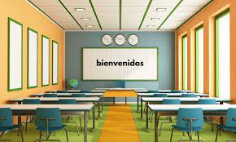
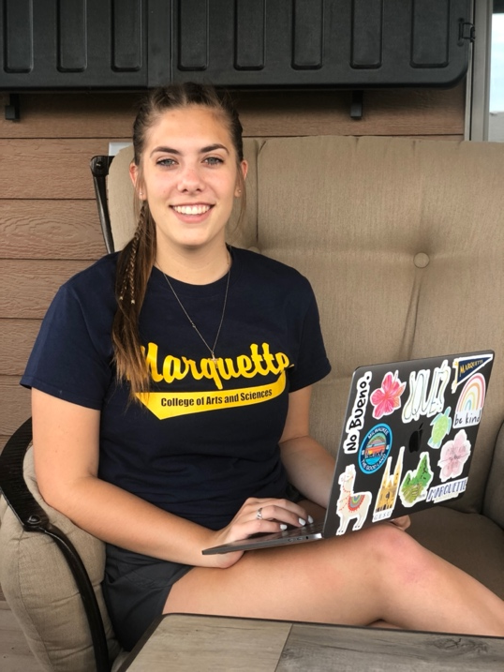
SPOTLIGHT ON SUMMER UNDERGRADUATE RESEARCH
Office of Research and Innovation
Maryn’s summer research looked at how university students perceive different varieties of Spanish they encounter in the classroom and what characteristics they associate with those speakers.
Maryn discovered that with a lot of hard work and an equal amount of curiosity you can do research no matter your skill level or degree process.
And Maryn’s favorite part of summer research was “the outlet that it gave me to still academically challenge myself during the summer months. The academic school year provides a structure that the summer lacks and I was happy to find that in this research program!"
Maryn Schaefbauer

Slide 11
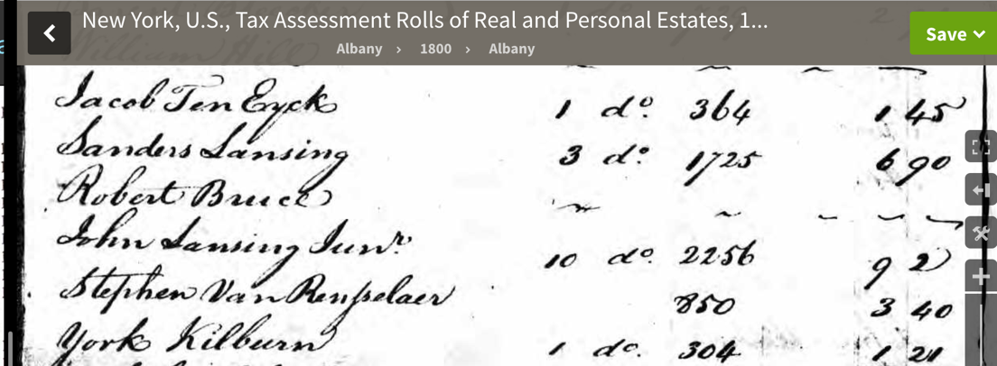
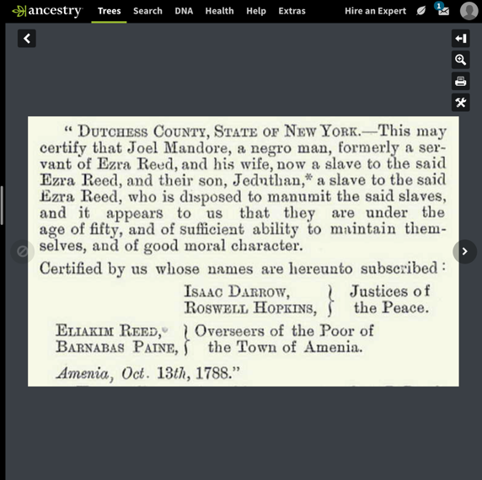
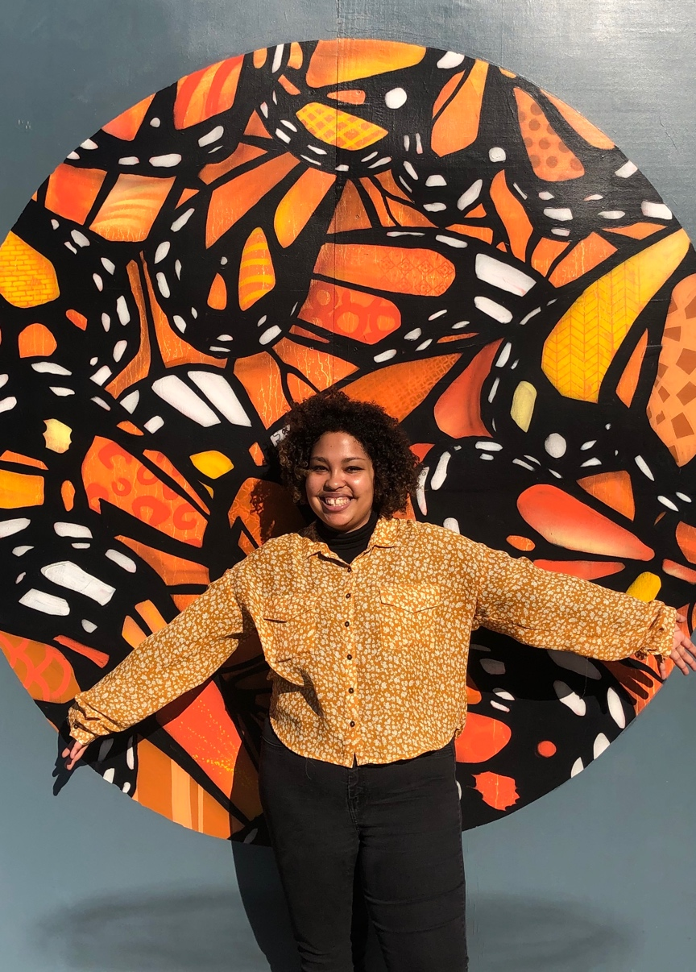
SPOTLIGHT ON SUMMER UNDERGRADUATE RESEARCH
Office of Research and Innovation
Laura’s summer research focused on the impact that the Haitian Revolution had on American ideas about race and equality. Laura explored the impact that these shifting ideas had on free black people between roughly 1776 and 1840.
Laura discovered, “I have a love of doing archival research. Looking through the various kinds of records, whether that be census, land, death, tax, etc. really awakened a part of me that I didn’t know existed that loves research.”
And Laura’s favorite part of summer research was uncovering the lives and. stories of free black heads of household whose stories have been lost to time.
Laura Wagner

Slide 12
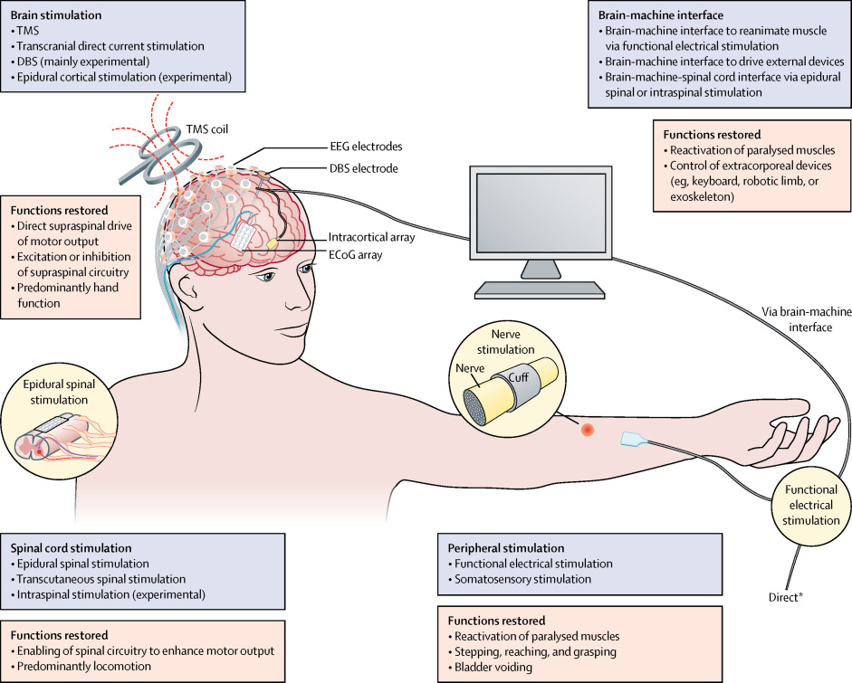
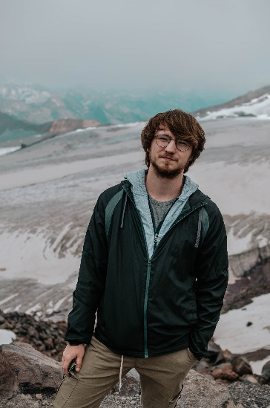
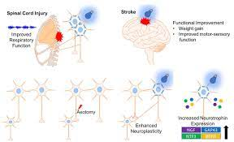
SPOTLIGHT ON SUMMER UNDERGRADUATE RESEARCH
Office of Research and Innovation
Arsenii’s summer research focused on developing peripheral optogenetic techniques to restore muscle function lost to spinal cord injury or diseases.
Arsenii discovered, “After this summer’s experience I for sure can say that I want to continue my education and get a PhD, so I could run a lab of my own and do my own research.”
And Arsenii’s favorite part of summer research was “getting to know some of my peers from this program who were involved in other types of research. It was nice seeing like-minded people from my school.”
Arsenii Pavlenko

Slide 13
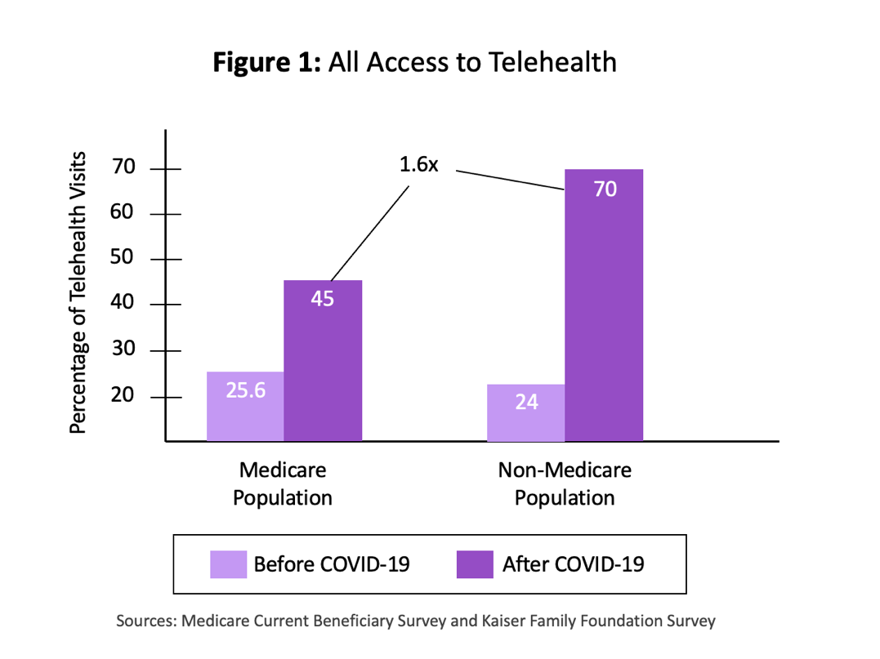
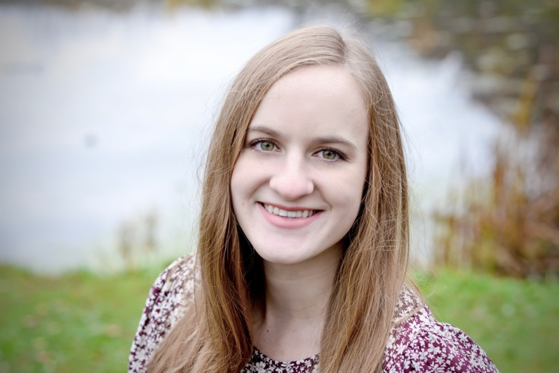
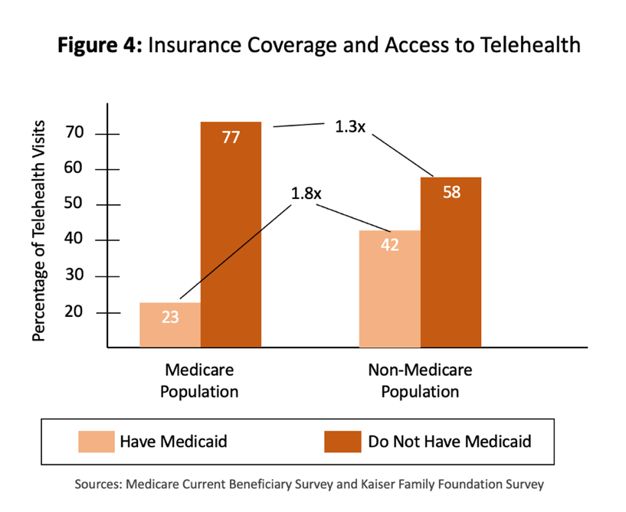
SPOTLIGHT ON SUMMER UNDERGRADUATE RESEARCH
Office of Research and Innovation
Cali’s summer was spent on nursing research related to a Medicare study regarding COVID-19 and access to telehealth services. The research focused on literature reviews in addition to data analysis comparing Medicare and non-Medicare beneficiaries’ responses to COVID-19 and health surveys.
Cali discovered that it’s important to research to complete literature reviews, find reputable sources, and organize important information.
And Cali’s favorite part of summer research was being able to continue the research they had been doing earlier in the. semester so as not to create a gap in study.
Cali Horder

Slide 14
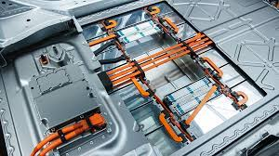
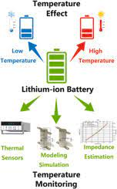
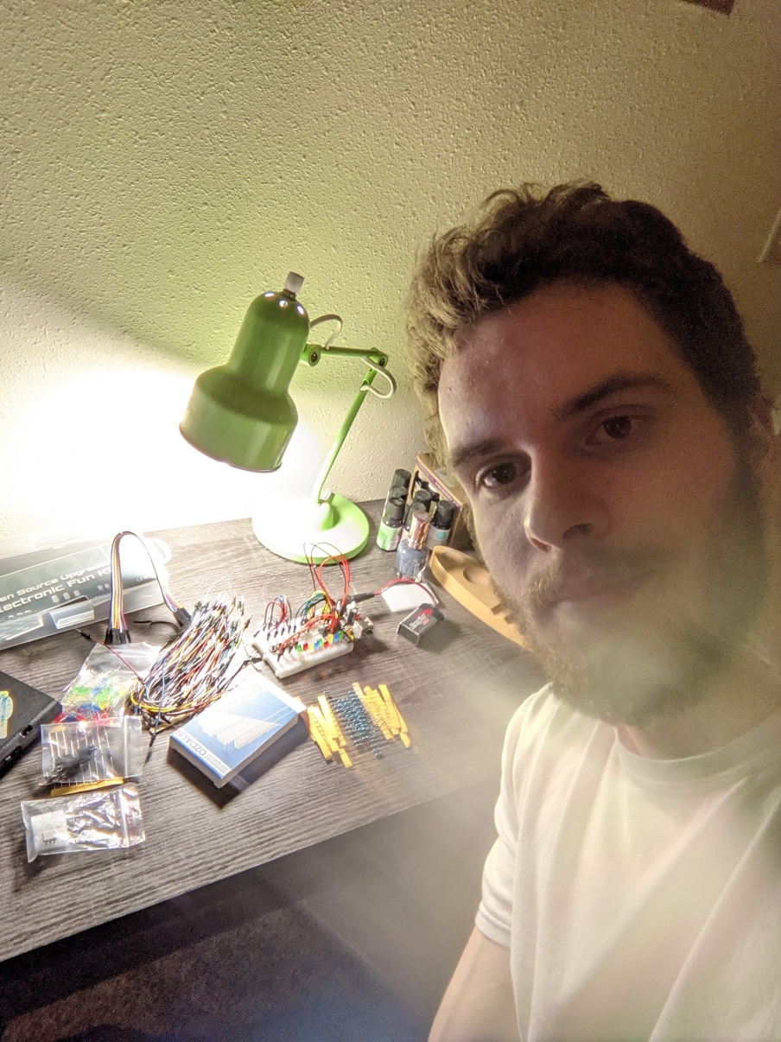
SPOTLIGHT ON SUMMER UNDERGRADUATE RESEARCH
Office of Research and Innovation
Rade’s summer research was about Lithium-Ion batteries and how their charging and discharging is affected by temperature. “Vehicles use a Battery Management System (BMS) in order to get a good estimation of how much charge is left in the battery, and then it is able to utilize the most potential from said batteries.”
Rade learned about mathematical modeling. “I used topics I learned in classes that I did not think would have as many applications as there turns out to be.”
And Rade’s favorite part of summer research was “the opportunity to work on an interesting topic and working alongside a few Marquette graduate students.”
Rade Latinovich

Slide 15
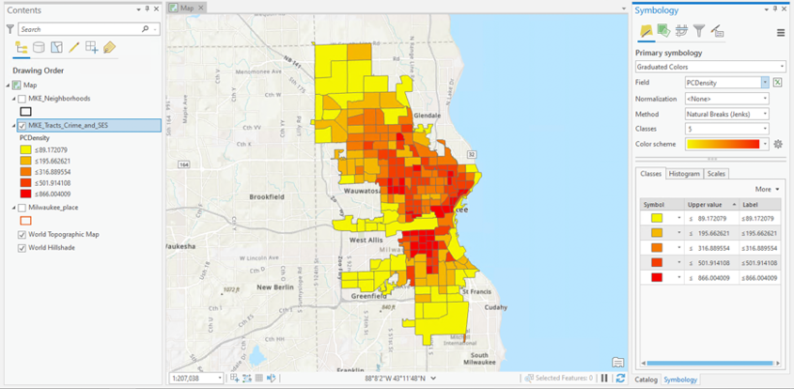
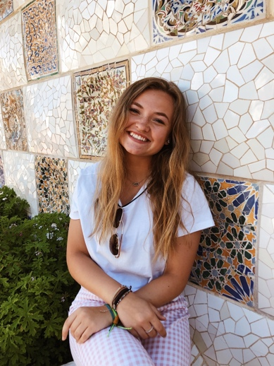
SPOTLIGHT ON SUMMER UNDERGRADUATE RESEARCH
Office of Research and Innovation
Emma’s summer research was “using ArcGIS Pro, a geographical information system we were able to look more in depth in the ways different demographics, such as single parent homes or net income, influence crime [of the west side of Milwaukee].”
Emma learned about how “demographics are so crucial to crime rates and density…[and] crime is what a lot of these people are forced into or is their only option, and if there were actual systemic and economic change, then many places facing these high rates of crime would be a whole lot safer.”
And Emma’s favorite part was “learning how to use the geographic information system.”
Emma Armbrust

Slide 16
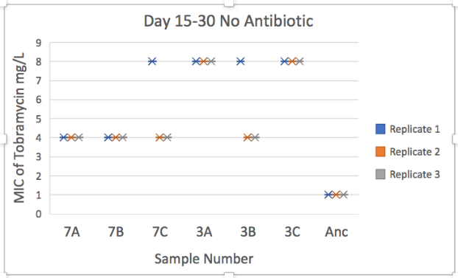
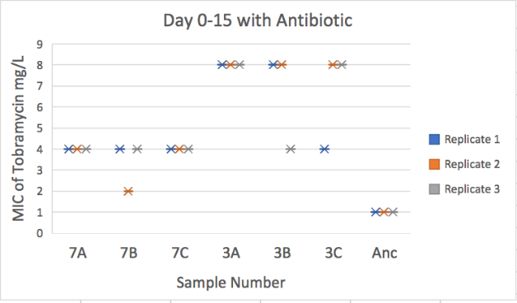
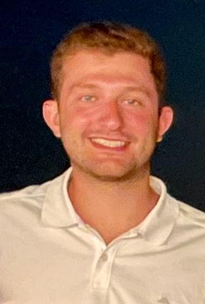
SPOTLIGHT ON SUMMER UNDERGRADUATE RESEARCH
Office of Research and Innovation
Michael’s summer research was ”learning more about compensatory mutations and antibiotic resistance in Pseudomonas aeruginosa. We wanted to see if taking away antibiotics after the bacteria had been previously exposed to them would affect the fitness and/or the resistance strength of the bacteria.”
Michael learned about how ”after taking away antibiotics from Pseudomonas, the bacteria were still antibiotic resistant and fit. This could be potentially dangerous.”
And Michael’s favorite part: ”I was really lucky to have a great group of people who worked in the lab with me.”
Michael Bahu

Slide 17
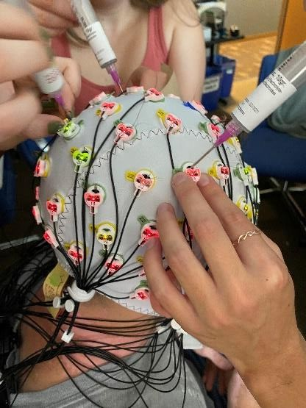
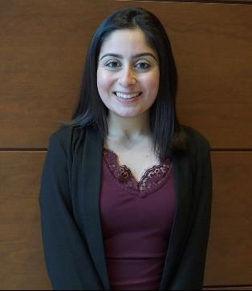
SPOTLIGHT ON SUMMER UNDERGRADUATE RESEARCH
Office of Research and Innovation
Riya’s summer research was ”to learn how to use neuropsychology tests and EEG data from an individual to be able to predict whether they will face cognitive deficits and when.”
Riya learned about how ”different clinical research techniques through the neuropsychology testing procedures has allowed me to understand how useful research is to our community.”
And Riya’s favorite part: “to be able to work with and learn from individuals that share my passion for research and neuropsychology.”
Riya Bhasin

Slide 18
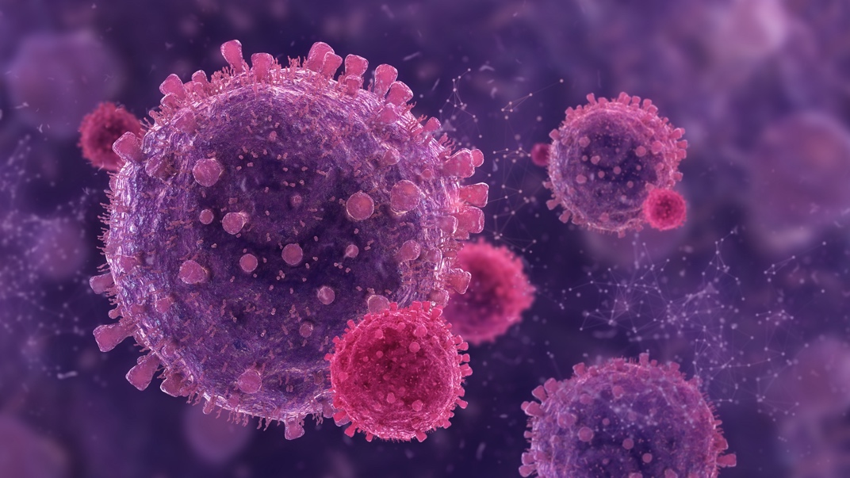
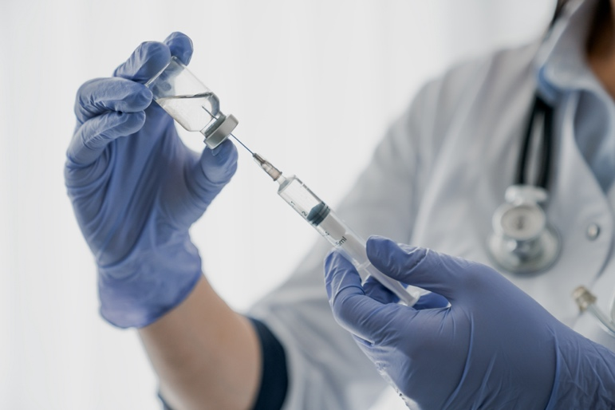
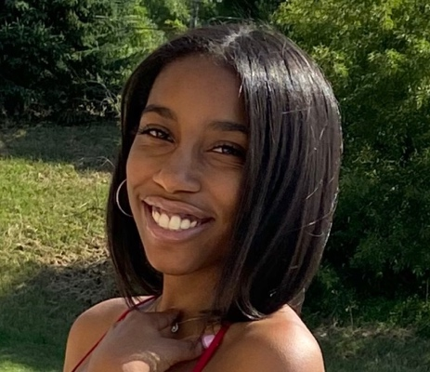
SPOTLIGHT ON SUMMER UNDERGRADUATE RESEARCH
Office of Research and Innovation
Sydney’s summer research was “to improve the transition from pediatric to adult medical care for young adults affected by sickle cell disease. In an effort to improve this transition I collected and analyzed research regarding previous programs that made similar efforts.”
Sydney learned about ”what it means to be a sickle cell warrior and areas in the medical field that require improvement in order for them to receive holistic care.”
And Sydney’s favorite part: “to be able to work with and learn from individuals that share my passion for research and neuropsychology.”
Sydney Chambliss

Slide 19
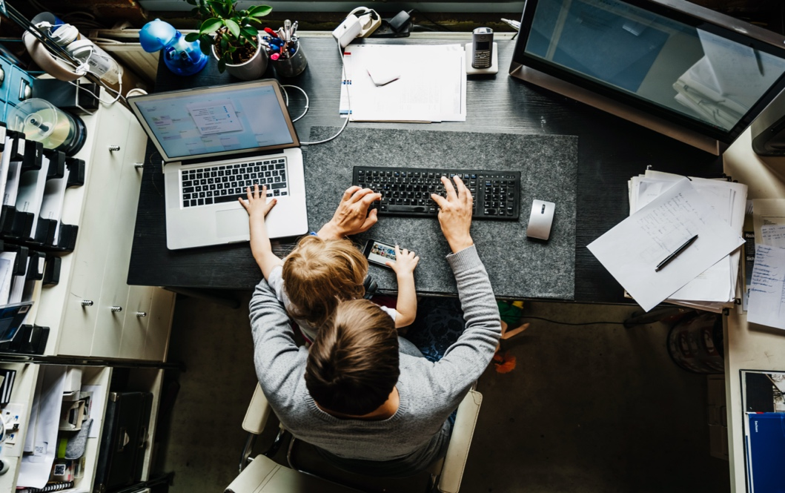


SPOTLIGHT ON SUMMER UNDERGRADUATE RESEARCH
Office of Research and Innovation
Jimmy’s summer research was ”on the topic of employee data privacy with being monitored and tracked by their employers, particularly during the time of the COVID-19 pandemic.”
Jimmy learned about ”how to effectively obtain notable information in order to summarize my findings from the article in draft paragraphs that are to be used for future articles and publications.”
And Jimmy’s favorite part of ”research were weekly online meetings with my advisor and the research itself.”
Jimmy Chen

Slide 20



SPOTLIGHT ON SUMMER UNDERGRADUATE RESEARCH
Office of Research and Innovation
Emily’s summer research “engaged with residents of Milwaukee’s Near West Side to identify community-driven priorities for action and relevant health assets in the community.”
Emily learned about ”how to effectively gather data while being able to analyze the results. I also learned how to communicate well with other researchers, faculty, and the Milwaukee community.”
And Emily’s favorite part “was meeting and interacting with the Milwaukee community in various neighborhoods. I was able to hear the able to hear the improvements they thought their neighborhood needed.”
Emily Ethington

Slide 21



SPOTLIGHT ON SUMMER UNDERGRADUATE RESEARCH
Office of Research and Innovation
Jamal’s summer research was “to examine land, tax, census, and probate records [and other] forms of documentation… for their empirical, geographical, and social relevance…[and] to piece together a clearer narrative of free black lives.”
Jamal learned “…that doing research takes intrinsic desire and discipline…[and] that the construction of race can be altered by external physical and intangible attributes beyond one’s perceived degree of melanin.”
And Jamal’s favorite part “was that on Fridays we would discuss our research in the afternoon... [My professor] gave me the space to learn about this time in history and grow through newfound understanding.”
Jamal L. Hanson

Slide 22


SPOTLIGHT ON SUMMER UNDERGRADUATE RESEARCH
Office of Research and Innovation
Addy’s summer research was [searching] for the number of people living in their household, where exactly in the state they lived, and the value of any property they owned. …[and] how the value of the property could lead to their ability to be politically active or participate in the democracy.”
Addy learned that ”there were Black heads of households in the 1790s who held property that was passed on for multiple generations.”
And Addy’s favorite part was ”sharing my research findings with the other students… It was super interesting to compare the lives of Black heads of households living in the same time period but different geographic regions.”
Addy Havens

Slide 23



SPOTLIGHT ON SUMMER UNDERGRADUATE RESEARCH
Office of Research and Innovation
Colton’s summer research was on waste treatment and disposal in agriculture. He discovered that “microalgae can be applied for additional treatment of the digestate and can upgrade the biogas for improved renewable energy generation.”
Colton learned ”a tremendous amount. From analyzing nearly all wastewater quality indicators to microbial system operation, my summer experience was not only enriching, but eye-opening.”
And Colton’s favorite part was “[meeting] such great mentors and friends in my lab and to learn about the research process, leading to my desire to continue on to graduate school.”
Colton Herbert

Slide 24



SPOTLIGHT ON SUMMER UNDERGRADUATE RESEARCH
Office of Research and Innovation
Cali’s summer research was ”on a Medicare study regarding COVID-19 and access to telehealth services. [I] focused on literature reviews in addition to my data analysis comparing Medicare and non-Medicare beneficiaries’ responses to COVID-19 and health surveys.”
Cali learned ”about completing literature reviews, finding reputable sources, and organizing important information that pertains to my telehealth research.”
And Cali’s favorite part was ”gaining more experience in practicing nursing research and continuing my ongoing study to determine major factors that relate to telehealth disparities among Medicare beneficiaries.”
Cali Horder

Slide 25



SPOTLIGHT ON SUMMER UNDERGRADUATE RESEARCH
Office of Research and Innovation
Julia’s summer research was “understanding the education that EMS providers receive on how to write their reports, and what specific details the emergency medicine physicians are looking for in the narrative, that can then lead to a higher quality of patient care.”
Julia learned about “the “stories told in medicine, as well as a passion for medical narratives and improving the technical writing curriculum for medical professionals.”
And Julia’s favorite part was ”[working] with Dr. Angeli and further develop skills like problem solving as a team and effective communication, which will be useful in both my interest in research and future career path.”
Julia Jezykowski

Slide 26


SPOTLIGHT ON SUMMER UNDERGRADUATE RESEARCH
Office of Research and Innovation
Navneet’s summer research was “detection of Plasmodium falciparum malaria parasite via Loopamp Malaria PAN/Pf kit from a single coinfected urine sample collected from the vulnerable group of pregnant women from the two districts in Ghana.”
Navneet learned about “the Plasmodium spp. via Looamp Malaria PAN from the DNA extracted from filtered urine samples of pregnant women. I have discovered my interest in research and have decided to continue working in Dr. Lodh’s lab.”
And Navneet’s favorite parts were ”the Socials on Tuesdays, the ice-cream social, picnic, or the final presentation day. Getting together and meeting new people during this summer was very nice.”
Navneet Kaur

Slide 27


SPOTLIGHT ON SUMMER UNDERGRADUATE RESEARCH
Office of Research and Innovation
Henry’s summer research was “about neuropsych testing and got trained to administer these tests once the semester starts. …[and] about how to prepare and put on EEG caps, which are used to measure brain functions.”
Henry learned “that I want to keep cognitive functioning involved in whatever I end up doing. Previously I was just doing this lab for experience, but in learning so much I have found that I am really interested in the topic.”
And Henry’s favorite part was “getting to know my lab members in person better because all of last year we were meeting and working virtually.”
Henry Licht

Slide 28


SPOTLIGHT ON SUMMER UNDERGRADUATE RESEARCH
Office of Research and Innovation
Koreena’s summer research was ”finding an accurate way to diagnose Schistosomiasis thorough filtered urine from Tanzania, Arica. …It is considered a disease of poverty, due to the lack of adequate infrastructure in the endemic countries.”
Koreena learned that ”the high prevalence of co-infection, meaning both species were found in the DNA sample, in the Tanzanian samples we analyzed. There needs to be a cheaper method to discover these infections efficiently to treat these patients properly.”
And Koreena’s favorite part was ”realizing the need for small projects like ours to continue because of the importance of helping these impacted populations.”
Koreena Miller

Slide 29

SPOTLIGHT ON SUMMER UNDERGRADUATE RESEARCH
Office of Research and Innovation
Isabel’s summer research was studying Sickle Cell Disease primarily in the adolescent Milwaukee population.
Isabel learned about ”the workload and requirements needed to begin a seminar from start to finish.” And Isabel’s favorite part: ”that this summer allowed me to continue progressing the research I had already been doing with Dr. Clayton-Jones throughout the school year into the summer.”
Isabel Silvar

Slide 30



SPOTLIGHT ON SUMMER UNDERGRADUATE RESEARCH
Office of Research and Innovation
Kyara’s summer research was on ”how the social environment of the Apis mellifera, which are western honeybees, mediates fanning, a thermoregulation response to rising temperatures. …Do honeybees interact with their antennas and use it as a form of communication on when to initiate their fanning response to temperatures above 36℃?”
Kyara learned about “honeybees that are able to use their antennas are more likely to fan than honeybees that aren’t able to use their antennas due to their ability to communicate more efficiently with attenuation.” And Kyara’s favorite part: “being taught the ins and outs of research! I got to design the experiment and that was a really exciting process.”
Kyara Vazquez

