Slide 1
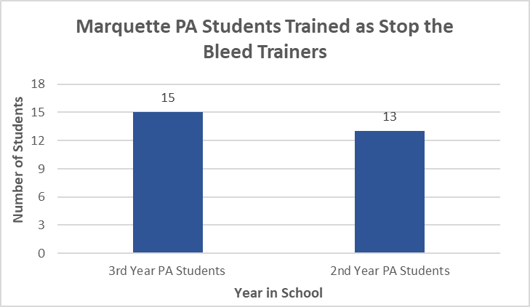
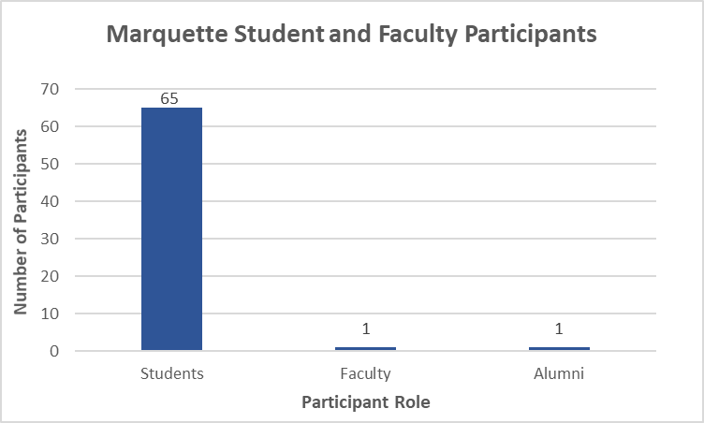
Educating Marquette University Students Through the Stop the Bleed Campaign
A. Beaudry¹, M. Emlaw ¹, J. Fischer¹
Marquette University, Milwaukee WI
Introduction
In the past 2 years, the average life expectancy of the United States population has decreased for the first time in decades.¹ The cause is multifactorial; however, traumatic injury has gained recognition as a contributing factor to these early deaths. One form of traumatic death that has become more prevalent in the past 20 years is mass casualty shootings.² However, even with the undeniable rise in the number of active shooter events, it is more likely that death from trauma would occur due to an accident or injury such as falls or, motor vehicle accidents.^{1,3}
Most trauma-related deaths occur in the prehospital phase prior to emergency medical services arrival.³ Of traumatic deaths, hemorrhagic shock is the second leading cause regardless of the mechanism of injury, and was found to be the most common cause of preventable traumatic death.^{3,4} Lives could be saved by bystander intervention through simple, non-invasive techniques such as tourniquet application, wound packing and applying pressure to the wound. However, when bystanders were present at the scene, intervention rates were as low as 25%-30%.⁵
The Stop the Bleed campaign was created with the goal to train bystanders and immediate first-responders on the initial steps of bleeding control and provide access to materials needed to do so in the hopes of reducing preventable traumatic deaths.
AIM
The purpose of this project is to encourage pre-hospital trauma intervention and contribute to the public education of bleeding control by training Marquette University students and faculty using the Stop the Bleed campaign.
METHODS
To conduct this study, the authors were educated as Stop the Bleed trainers and purchased two Stop the Bleed training kits with funding provided by Marquette University College of Health Sciences to be used in trainings. The study population was divided into two groups: Marquette University PA students and other Marquette University students and faculty.
A Stop the Bleed campaign-centered committee comprised of second year PA students was created under the Marquette University Student Association of the American Association of Physician Assistants (MUSAAAPA), with the intent to continue Stop the Bleed trainings through the Marquette University PA program following this project’s completion. Additionally, third-year and second-year Marquette University PA students were educated as Stop the Bleed trainers to prepare them to initiate their own training sessions following graduation and board certification.
Seven training sessions for general Marquette University students and faculty were conducted on campus over two weekends, divided into one hour time slots. Prior to the training, each participant was anonymously surveyed to determine their level of comfort in recognizing and responding to a life-threatening bleed. The survey was scored on a scale of 1-5, ranging from not comfortable to very comfortable, respectively. Participants were then asked to complete a post-training survey containing the same questions.
PARTICIPANT SURVEY RESULTS
Results
In the PA student group, a total of 13 second-year and 15 third-year PA students were trained. A verbal poll of both groups of PA students confirmed that all participants would be willing to continue Stop the Bleed trainings in their communities following graduation and national board certification.
In the second study population, 65 Marquette University students, one alumnus and one faculty member completed the Stop the Bleed program training. The group’s level of comfort in recognizing and responding in life-threatening bleed situations prior to completing the training ranged from 1-4, averaging at 2.42. Upon completion of the Stop the Bleed training session, the group reported a level of comfort ranging from 4-5 with an average of 4.82 on the 1-5 scale. Regardless of their initial level of comfort, all members in the general Marquette University student group reported improved level of comfort for recognition of and response to a life-threatening bleed.
Conclusions
Trauma-related deaths due to hemorrhage remain a primary source of preventable death. The Stop the Bleed campaign is an educational platform aimed at empowering the public to respond to bleeding emergencies by giving them the knowledge and tools to act quickly and efficiently. Although many challenges including limited finances, difficulty in participant recruitment and time constraints were encountered throughout the study, the main objectives were achieved.
As a whole, the group of non-PA students that were trained reported a significant increase in their confidence level to recognize and respond to life-threatening bleeds. Thus, the Stop the Bleed campaign is supported as an effective educational platform for the public that may help to improve pre-hospital trauma care and prevent further unnecessary deaths.
A Stop the Bleed MUSAAAPA committee was created to be overseen by a group of second year PA students who were trained to be Stop the Bleed trainers. This committee, in combination with the training kits purchased through the College of Health Sciences, allows Stop the Bleed educational sessions to continue at Marquette University for students and faculty in the future.
Lastly, the third year PA students trained as Stop the Bleed trainers during this study provide an opportunity for the expansion of the Stop the Bleed campaign outside of Marquette University and allows other communities to be empowered to respond to bleeding emergencies.
Acknowledgements
We would like to thank Marquette College of Health Sciences for supporting and funding our research. We would also like to thank Jean Fischer for facilitating training sessions.
References
Xu J, Murphy SL, Kochanek KD, Bastian B, Arias E. Deaths: Final data for 2016. Natl Vital Stat Rep. 2018;67(5):1-73. https://www.cdc.gov/nchs/data/nvsr/nvsr66/nvsr66_06.pdf. July 26, 2018. Accessed December 2, 2018.
Mass casualty shootings. OVC Archive. https://www.ncjrs.gov/ovc_archives/ncvrw/2017/fact_sheet.html. Published 2017. Accessed May 1, 2018.
Kauvar DS, Lefering R, Wade CE. Impact of hemorrhage on trauma outcome: An overview of epidemiology, clinical presentations, and therapeutic considerations. J Trauma. 2006;60(6):S3-S11. https://pdfs.semanticscholar.org/6c38/a92d9e64b22aa7db7d7d73a2f8cc7d89a50f.pdf. Published November 28, 2005. Accessed April 29, 2018
Maegele M, Schochl H, Cohen MJ. An update on the coagulopathy of trauma. Shock. 2014;40()21-25. https://journals.lww.com/shockjournal/fulltext/2014/05001/An_Update_on_the_Coagulopathy_of_Trauma.4.aspx Published May, 2014. Accessed July 17, 2018.
Oliver GJ, Walter DP, Redmond AD. Prehospital deaths from trauma; Are injuries survivable and do bystanders help? Injury. 2017;48(5):985-991. https://www.sciencedirect.com/science/article/pii/S0020138317300979. Published May, 2017. Accessed July 24, 2018.
Contact Information: ashley.beaudry@marquette.edu, madeline.emlaw@marquette.edu, jean.fischer@marquette.edu Disclosures: We have no disclosures.

