Slide 1
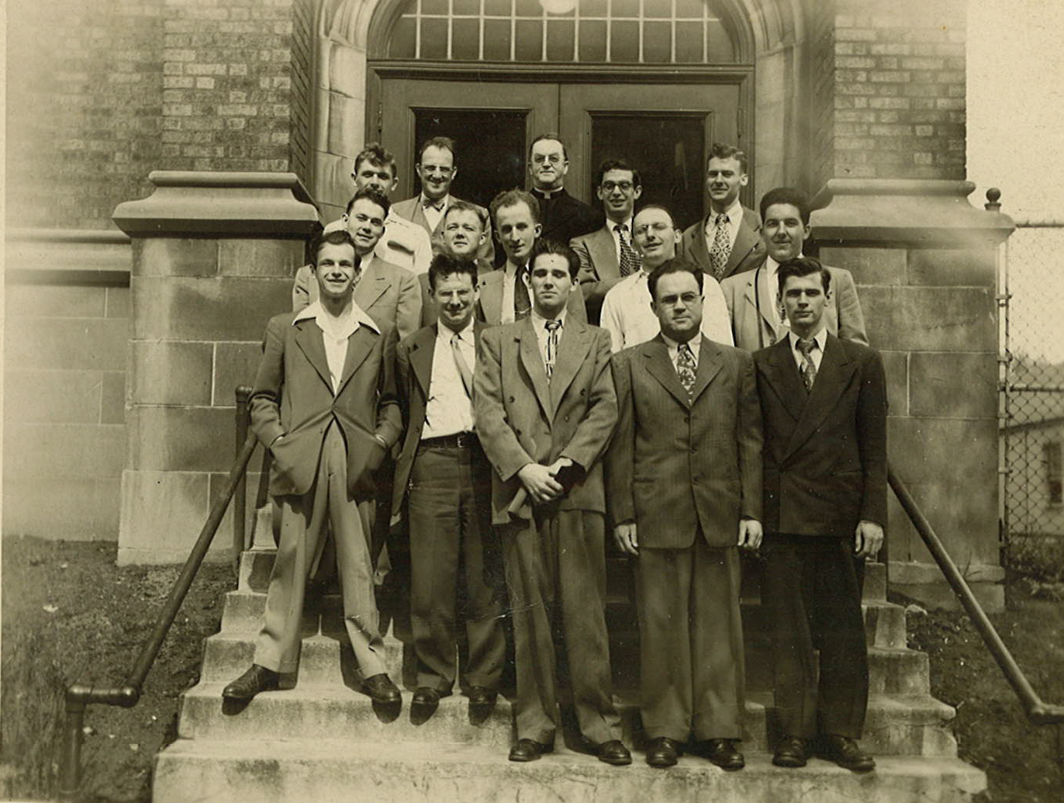
MU Physics Department ~1950

Slide 2
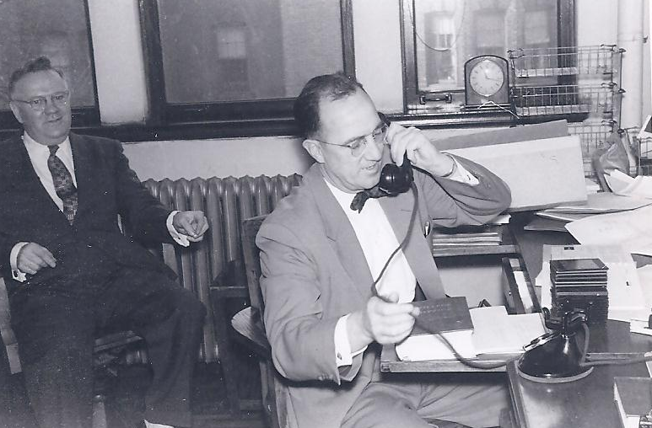
1954
Arthur G. Barkow

Slide 3
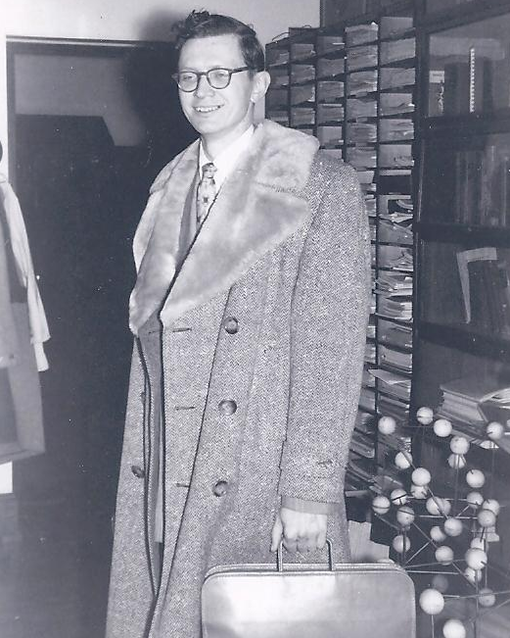
1954
Walter Kluck

Slide 4
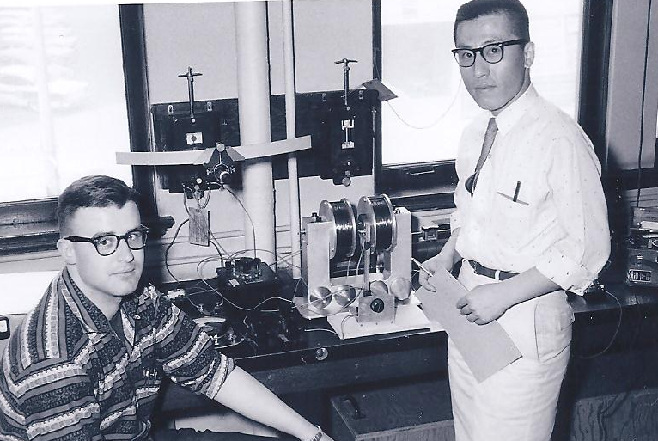
1959
Friedrich Weber and Benjamin Oh

Slide 5
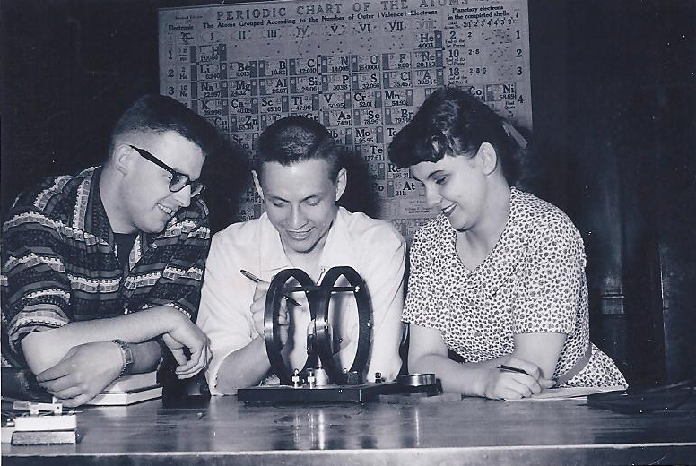
1959
Friedrich Weber, Gregory Kulas, Carol Squire

Slide 6
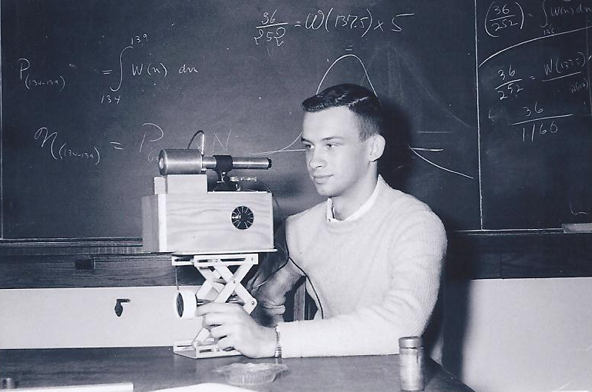
1959
Jim Sovey

Slide 7
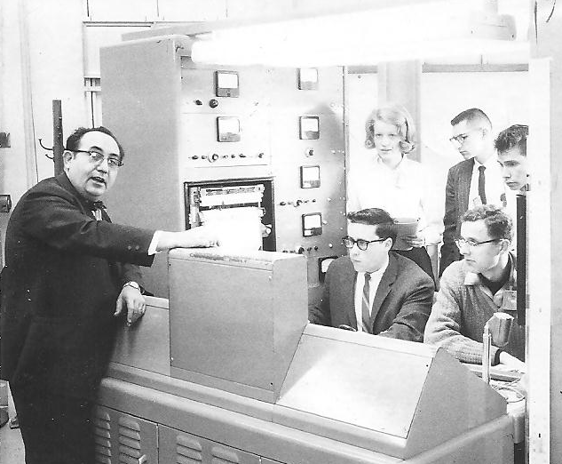

Slide 8
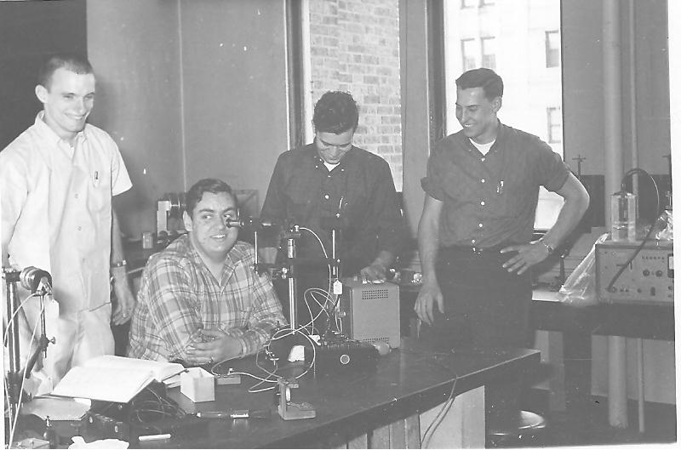
1962
Alan Toepfer, David Cutchin, Joseph Haertle, Peter Chard

Slide 9
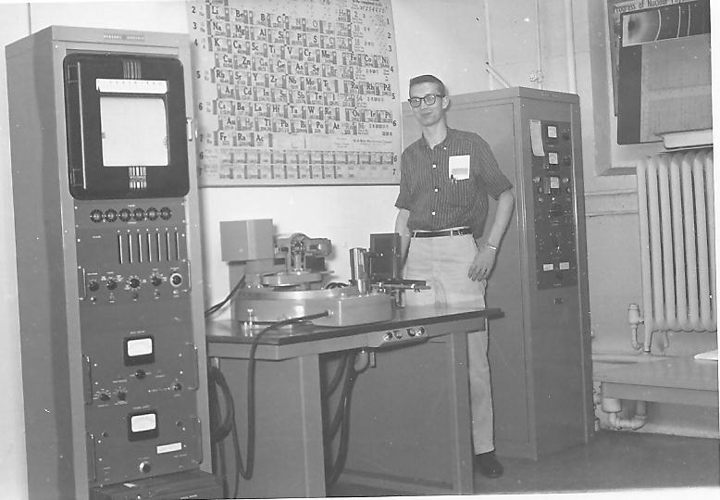
1962
Jim Stoffels

Slide 10
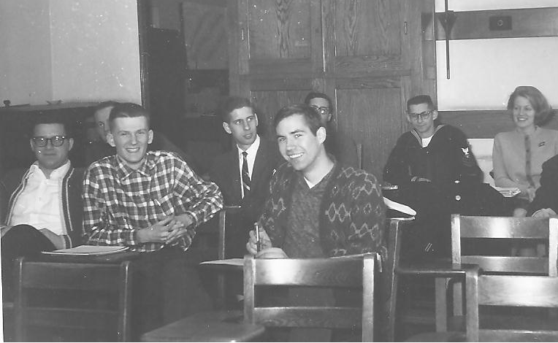
January 1965
Back Row: T. Michael O'Keefe, ?, David Haschka, SJ., Joseph Vargo, Catherine Brust, Front Row: Thomas Danninger, Robert Keller, Donald Wolkerstorfer

Slide 11
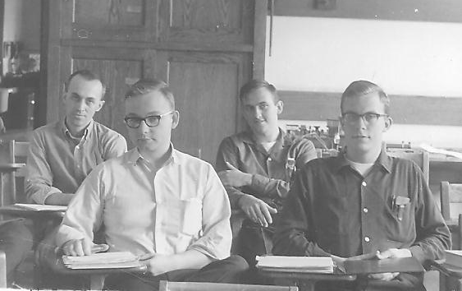
1964
Darrell Diem, James Rich, James Kolata, Peter Ryge

Slide 12
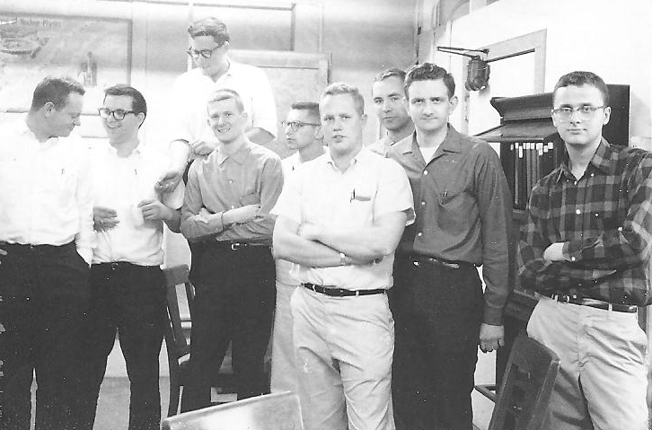
1965
Phys 121 X-Ray Lab

Slide 13
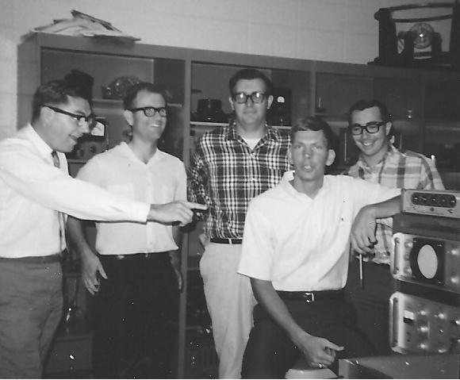
1968

Slide 14
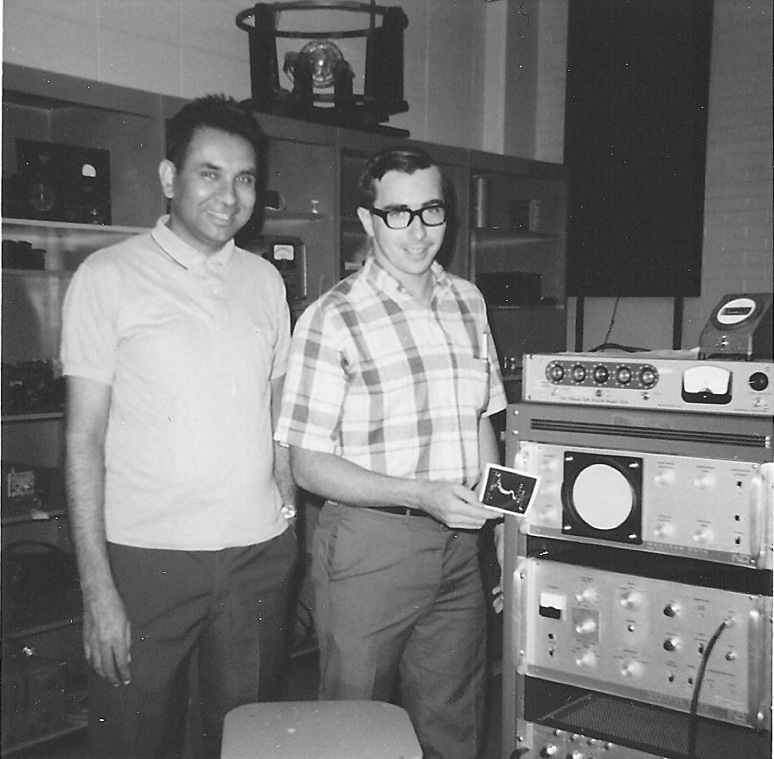
1968

Slide 15
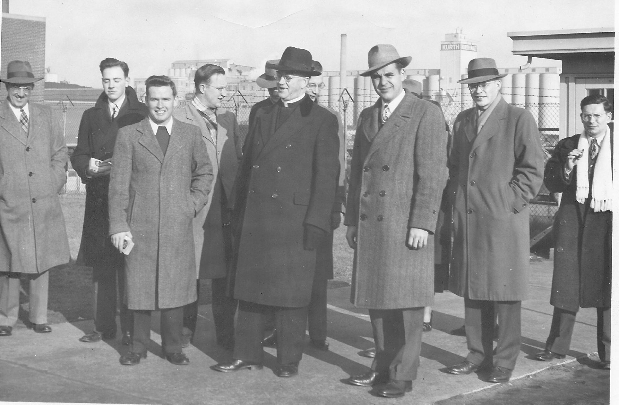
~1970

Slide 16
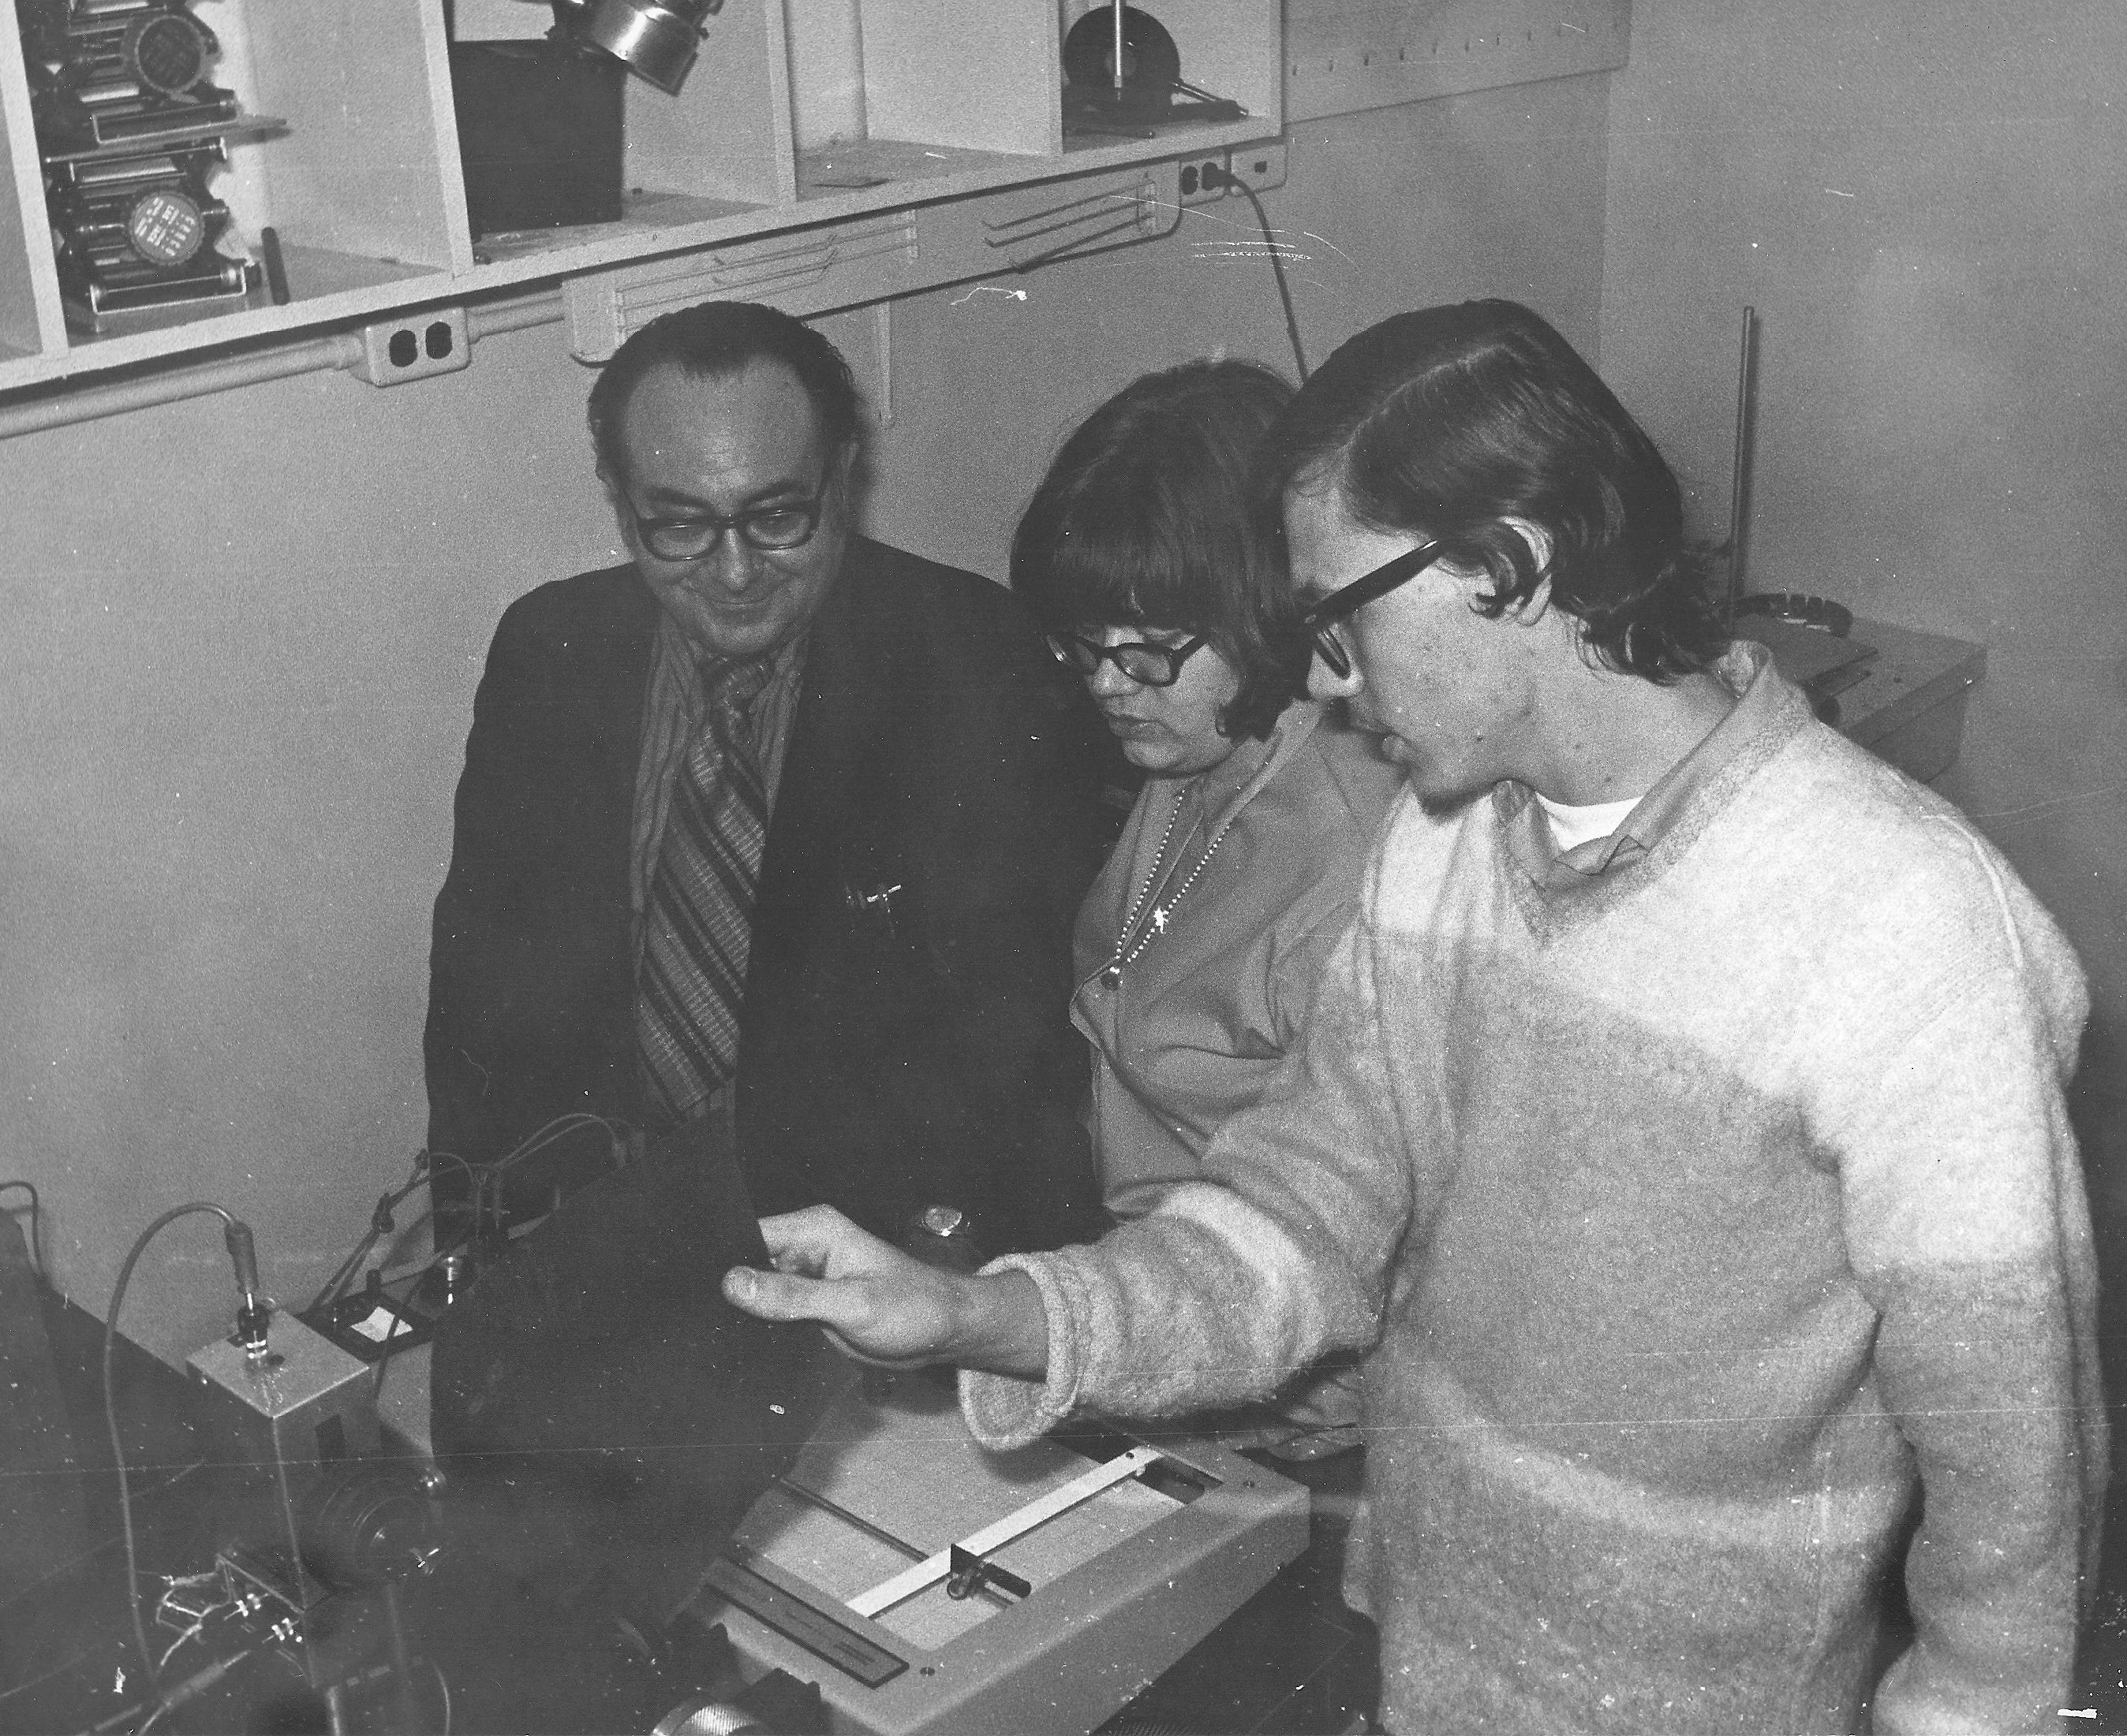
Frank Karioris, Sue Ratkowski, Chris James

Slide 17
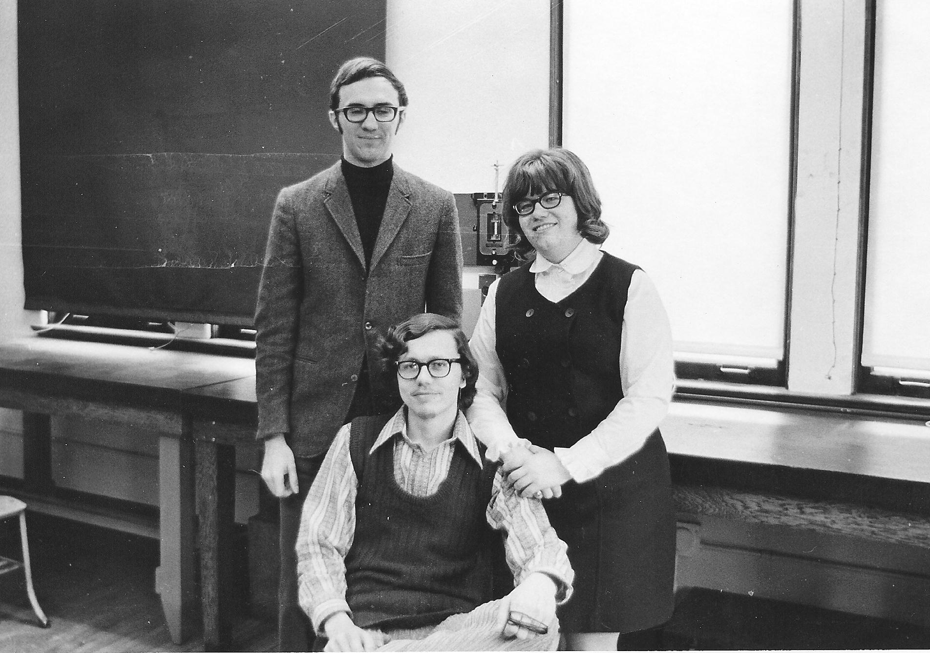
1972
James Pendzick, Chris James, Sue Ratkowski

Slide 18
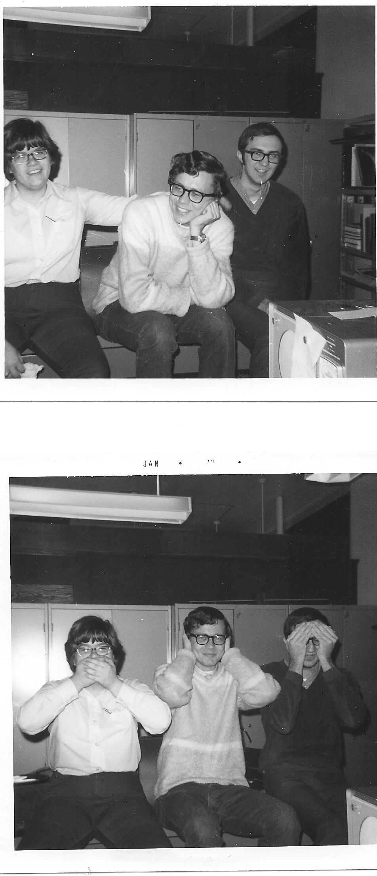
1972
Sue Ratkowski, Chris James, James Pendzick

Slide 19
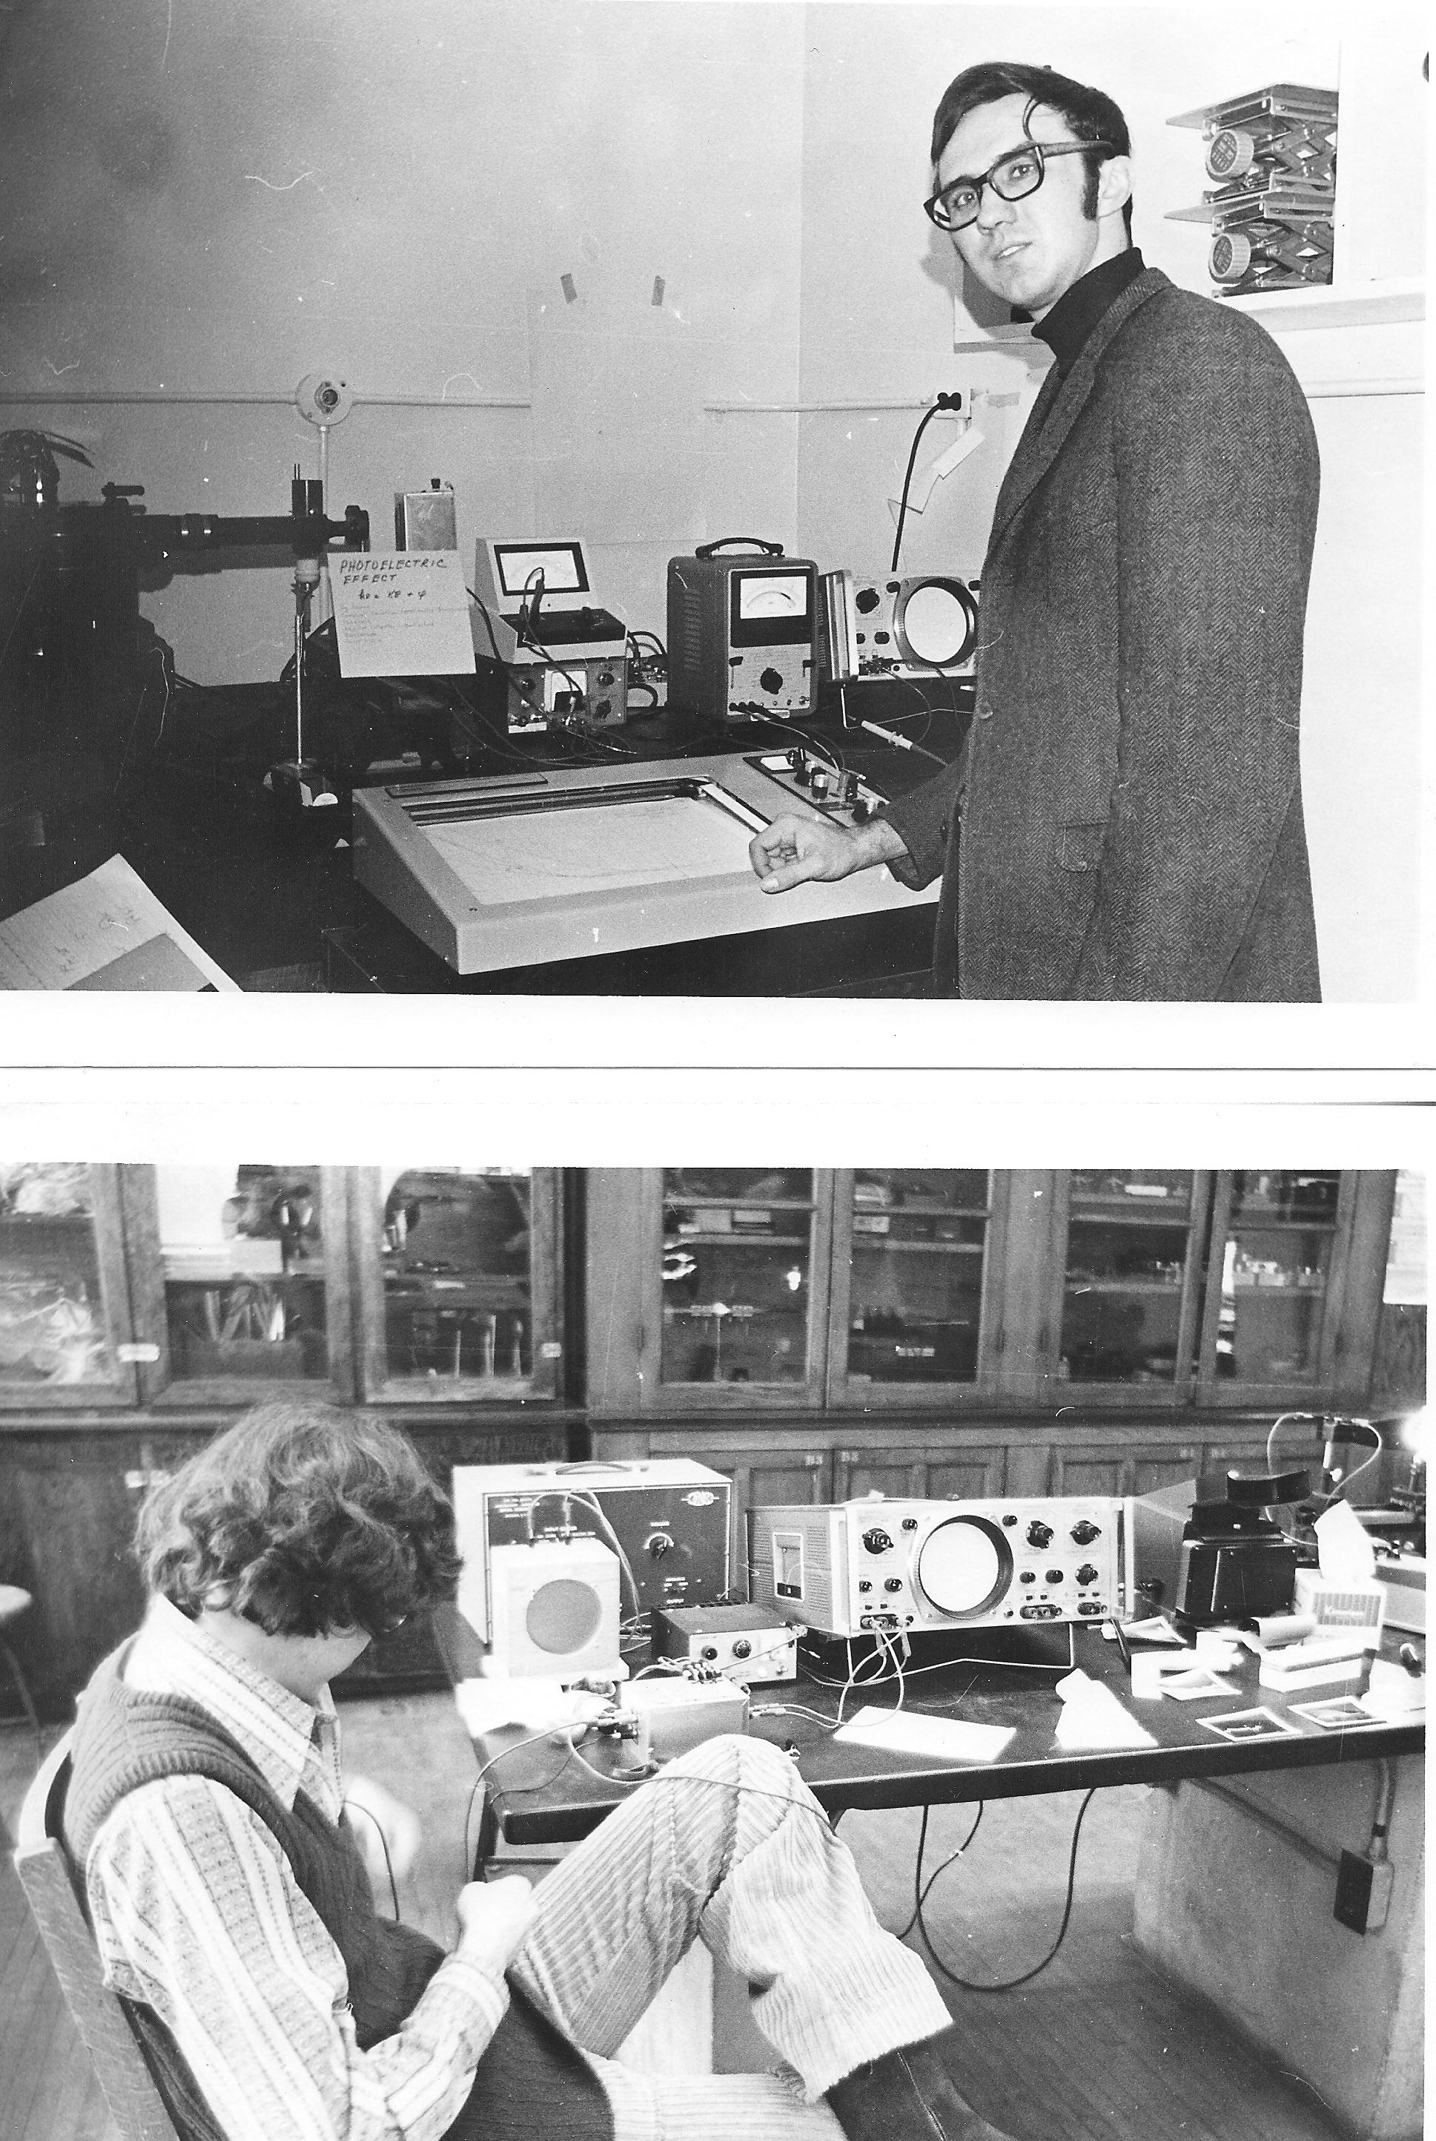
James Pendzick

Slide 20
Chris James

Slide 21
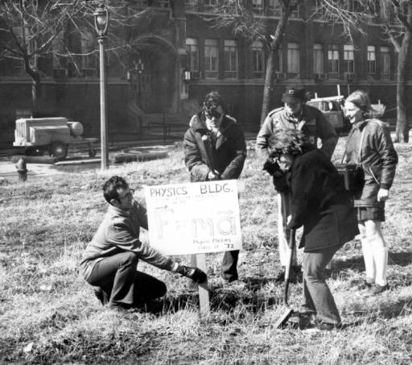
Physics Students at groundbreaking 1972

Slide 22
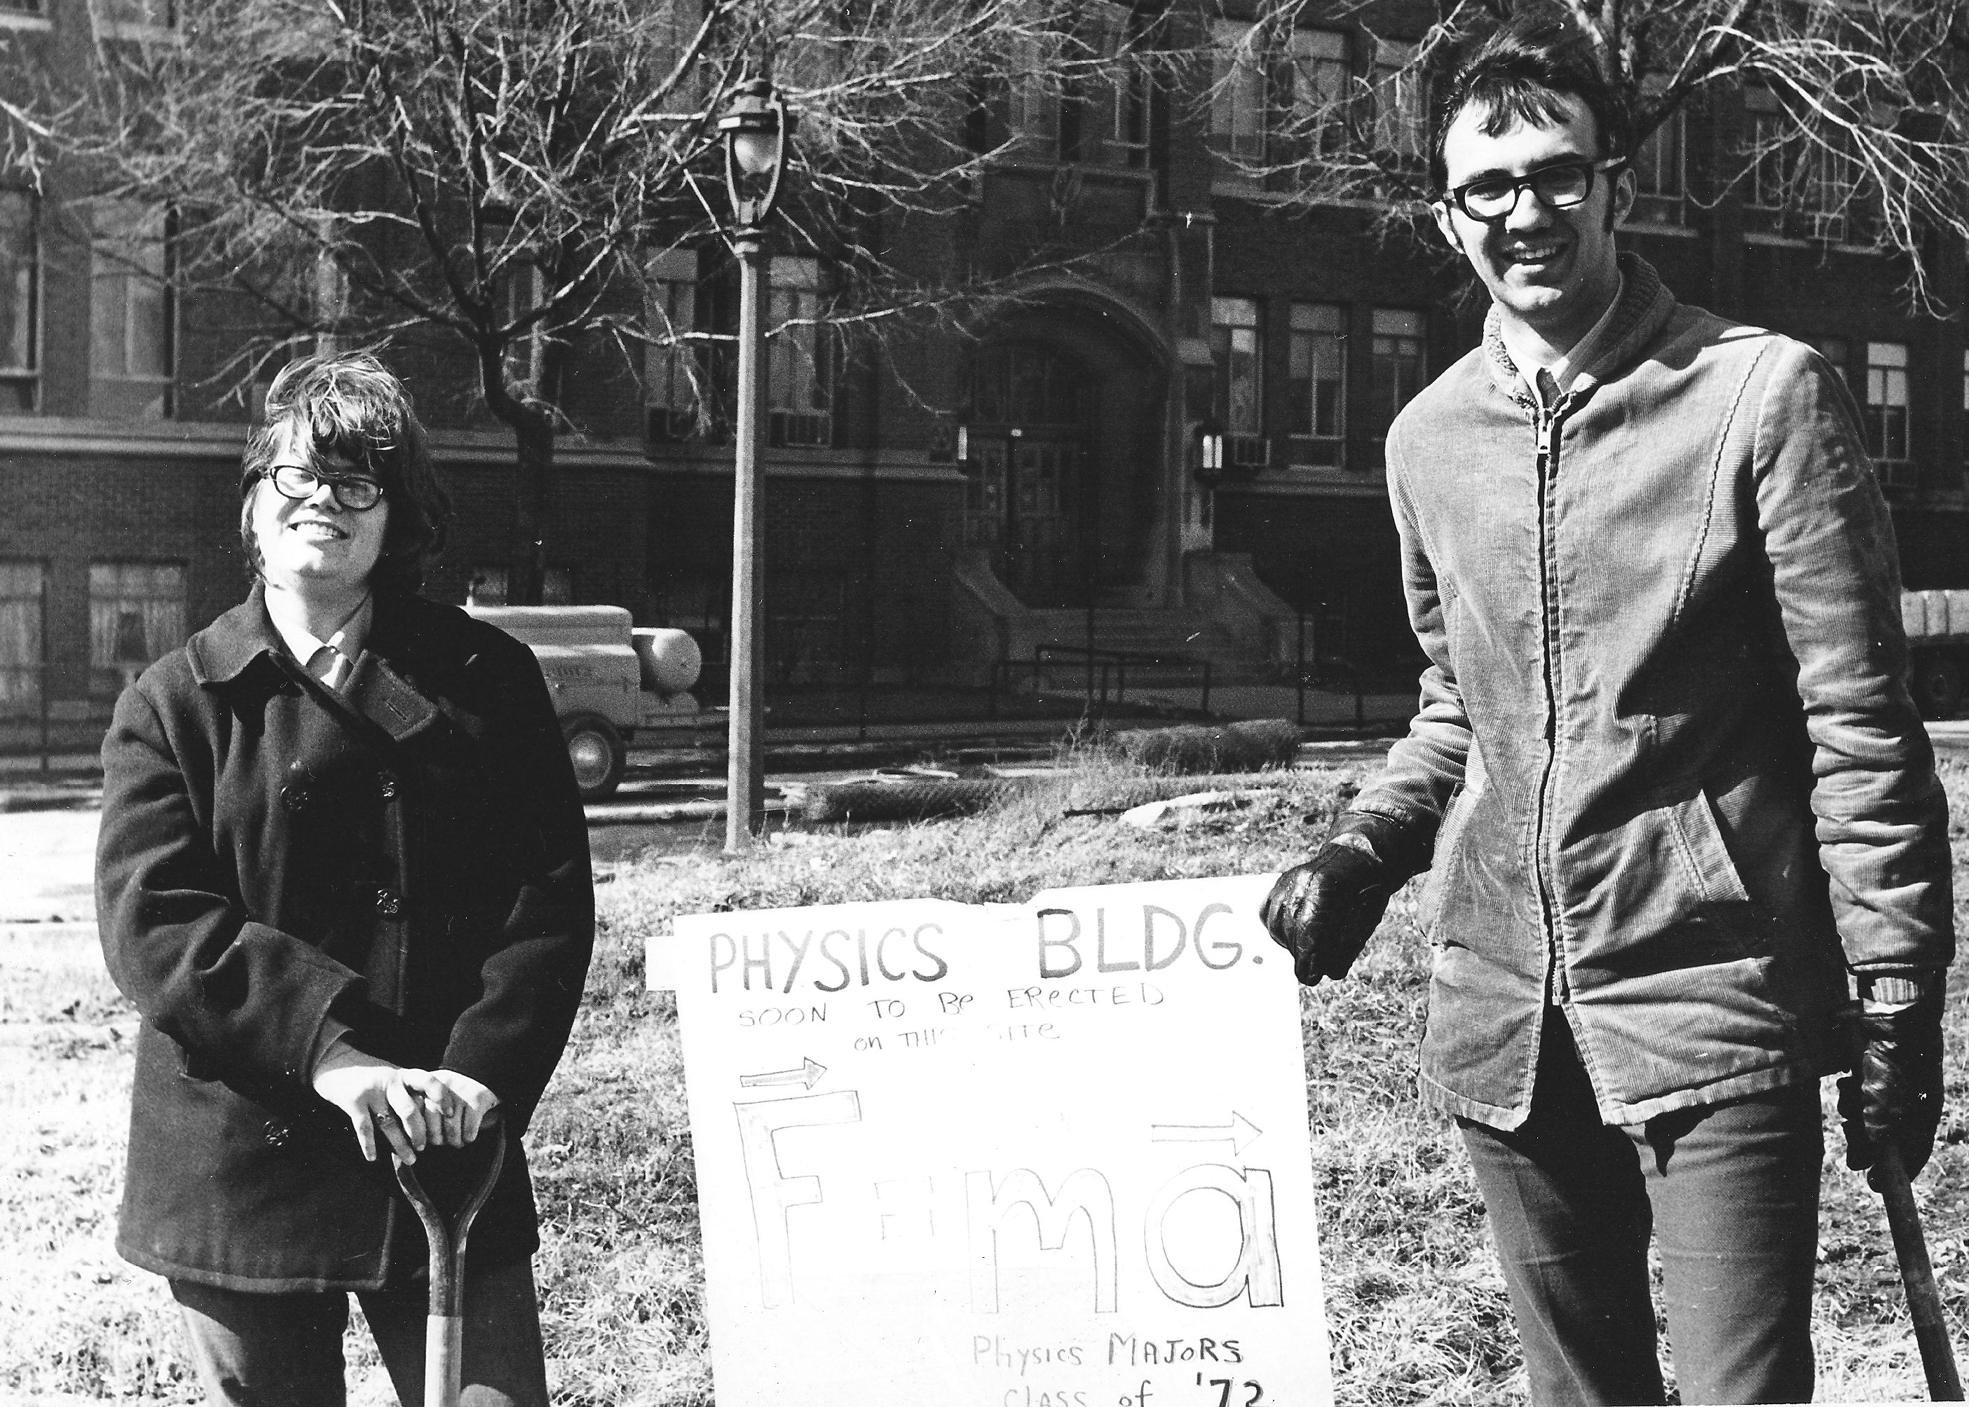
Sue Ratkowski and James Pendzick

Slide 23
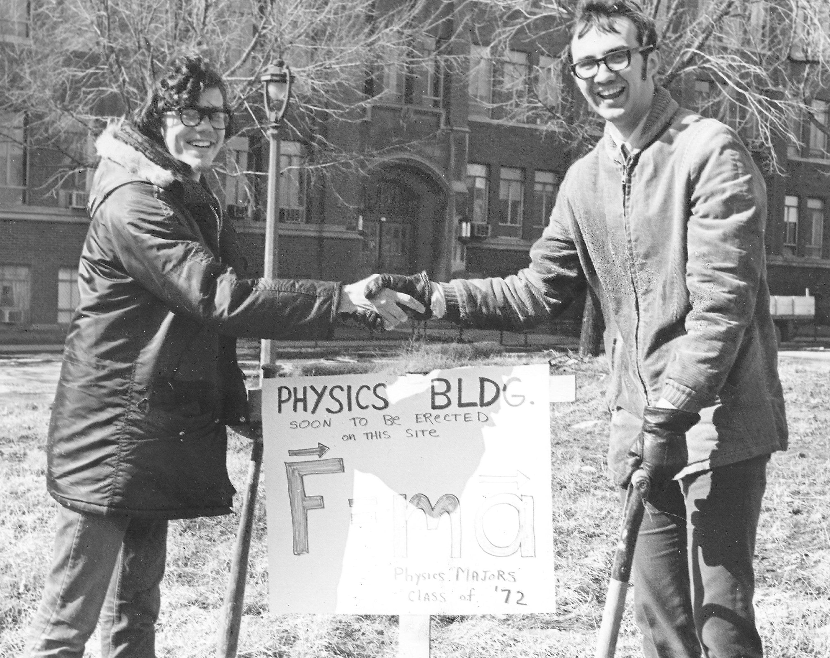
Chris James and James Pendzick

Slide 24
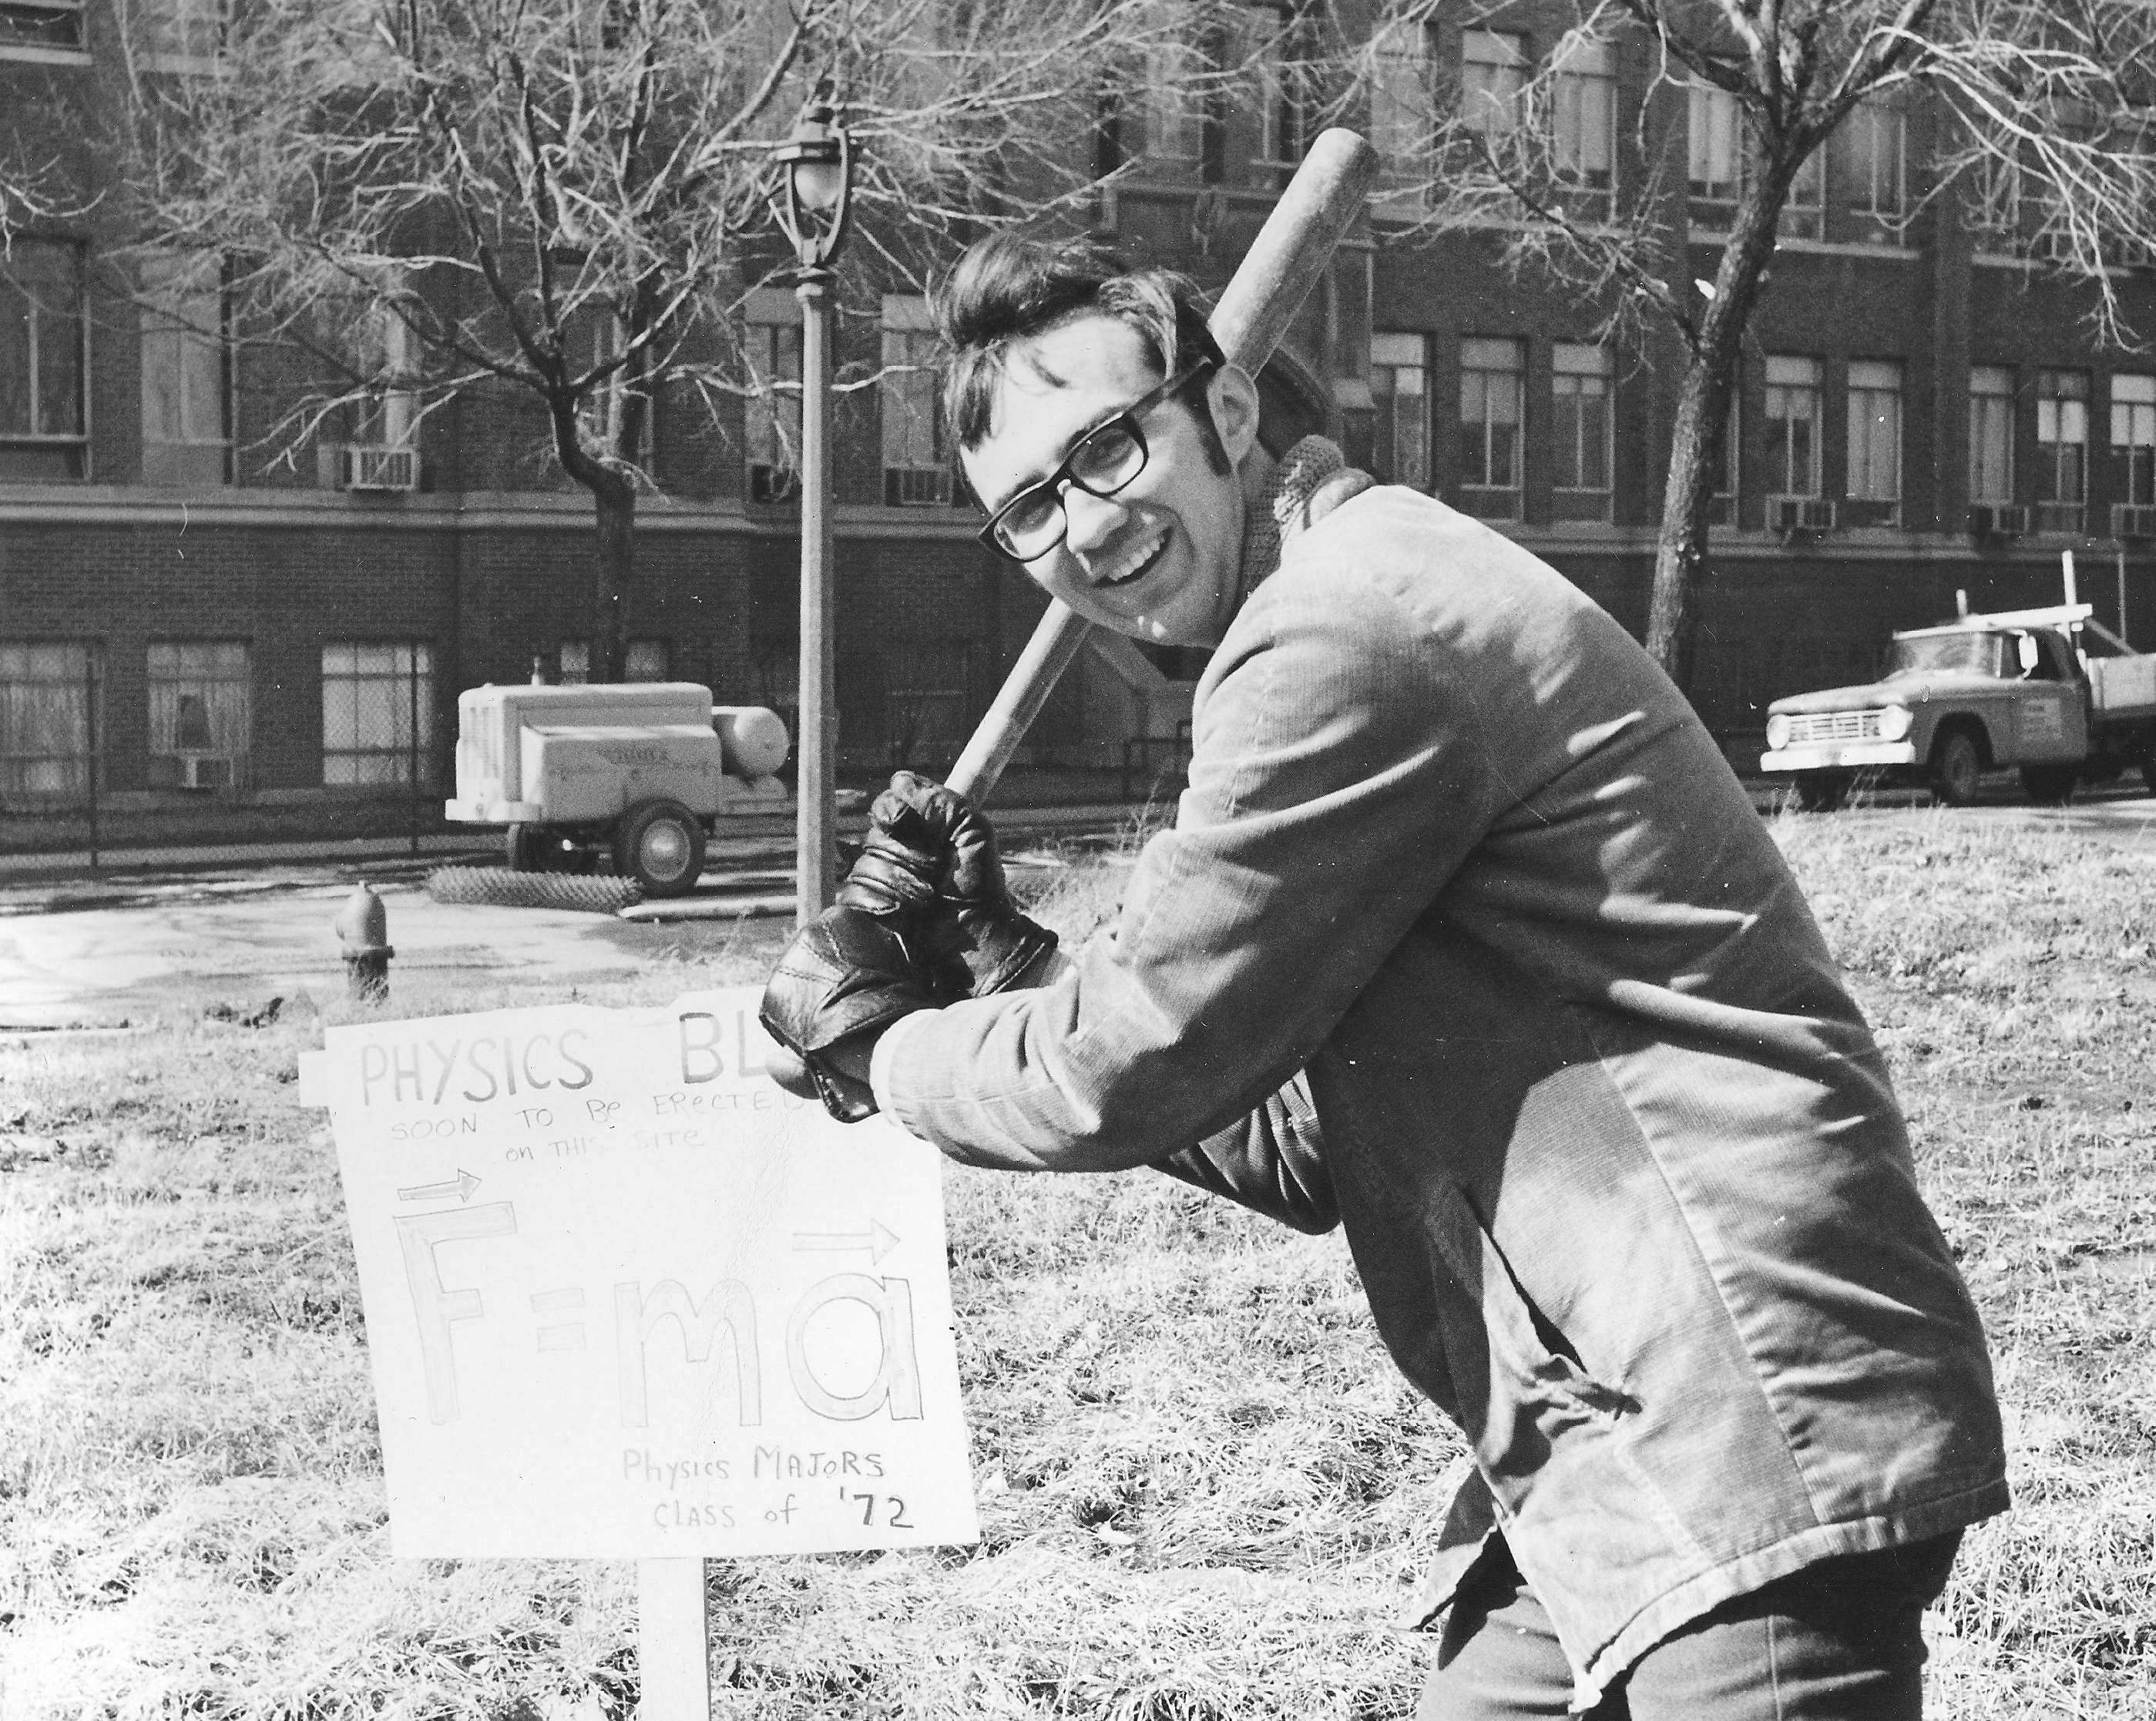
James Pendzick

Slide 25
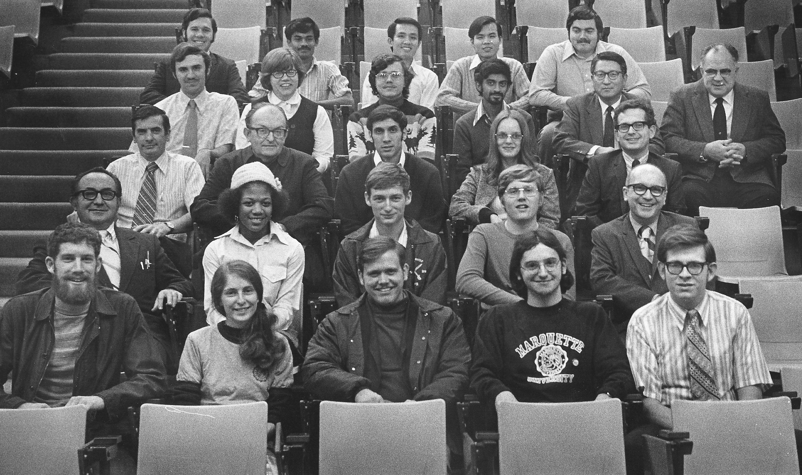
Sue Ratkowski
Gary Essmann
Physics Department
October 1972

Slide 26
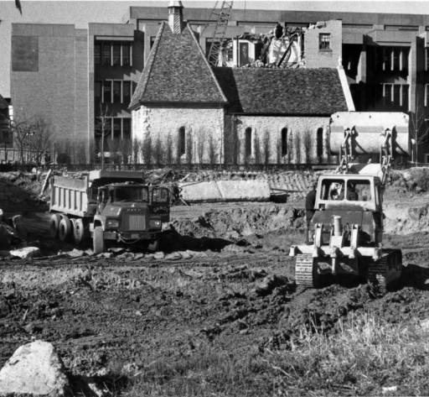
1972

Slide 27
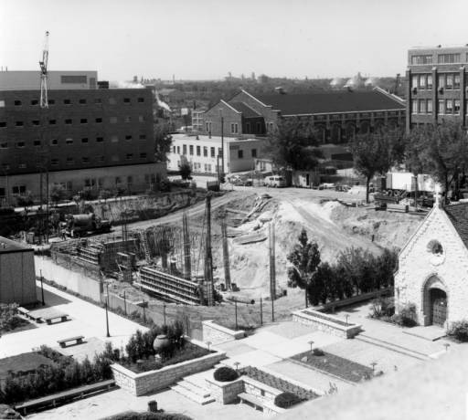

Slide 28
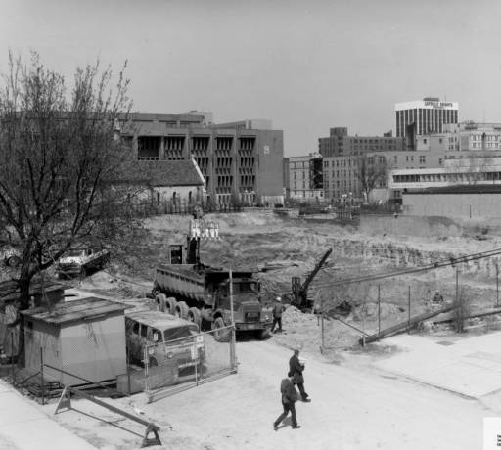

Slide 29
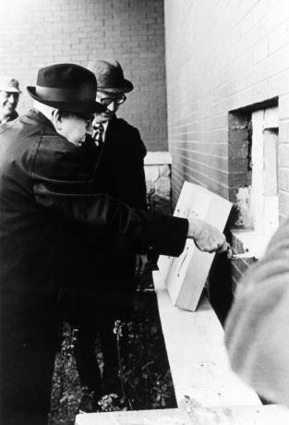
1973
Edward J. O’Donnell, S. J.
at cornerstone ceremony

Slide 30
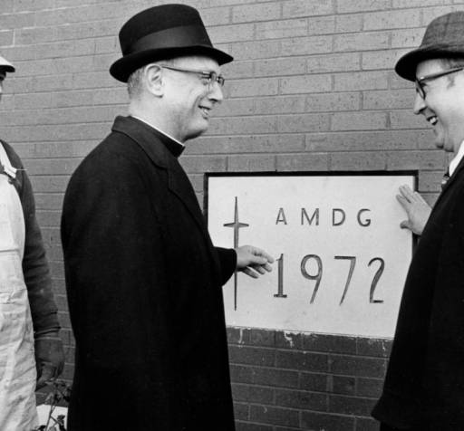
John P. Raynor, S.J., and Ralph Schulz
1972

Slide 31
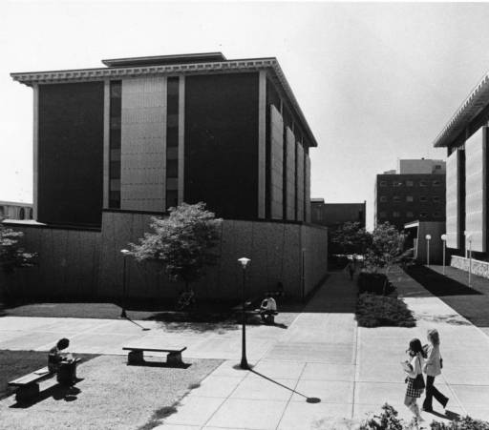

Slide 32
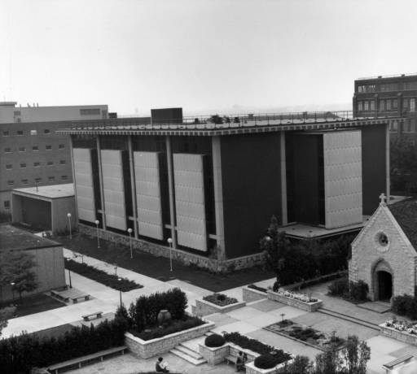
1973

Slide 33
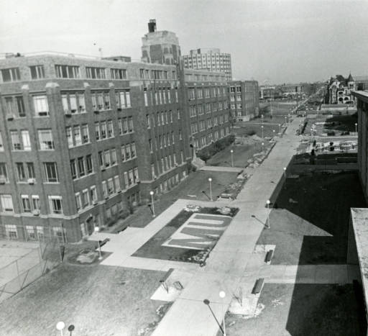

Slide 34
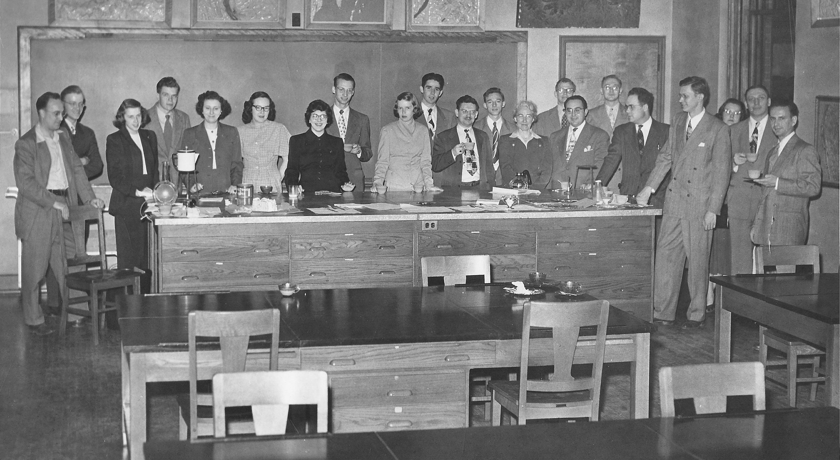
MU Physics Department ~1970

Slide 35
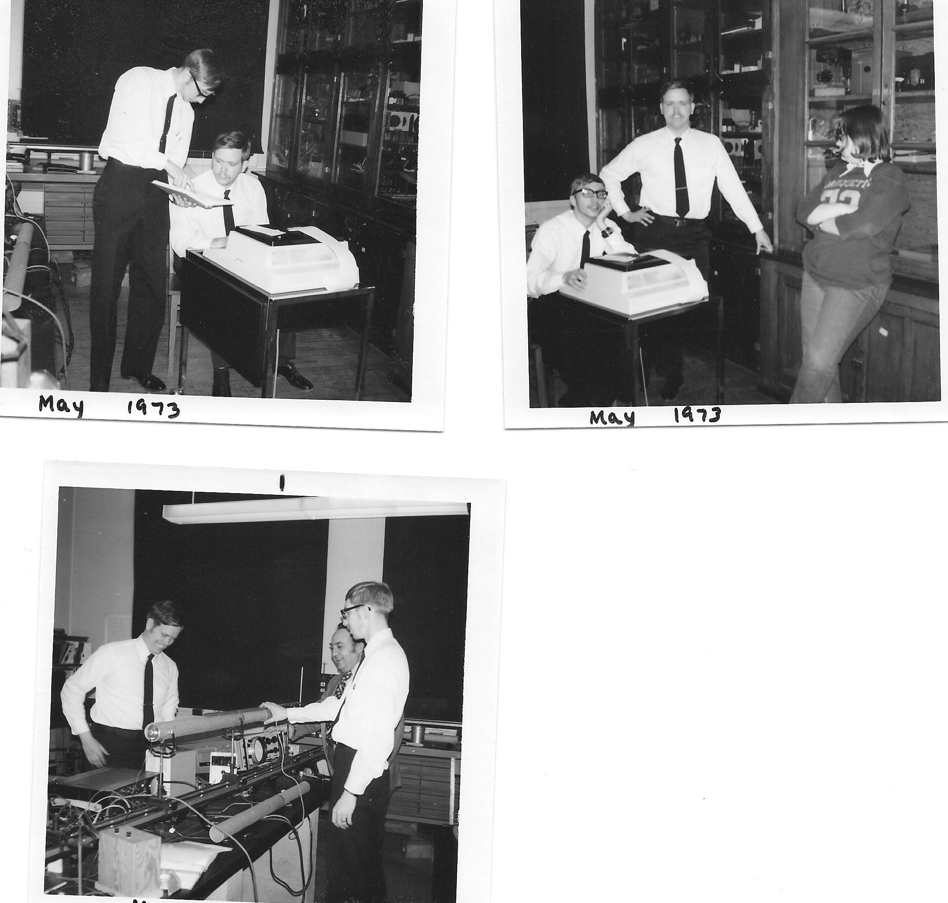
Robert Hugo, Budd Brown,
Sue Ratkowski
1973

Slide 36
Robert Hugo, Frank Karioris, Budd Brown
1973

Slide 37
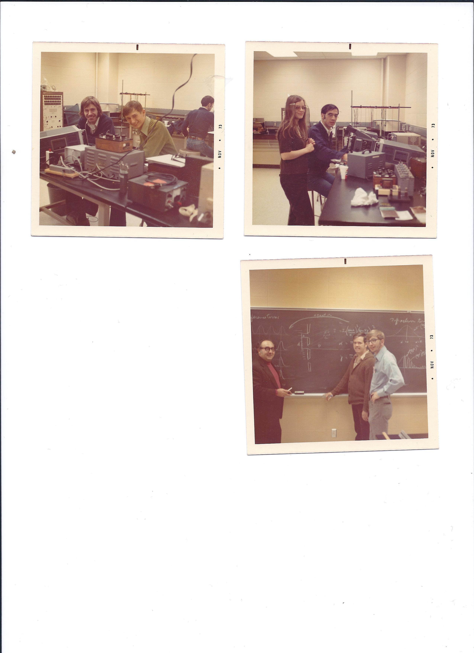
Andy Kluka, George Ridgeway
1973

Slide 38
Debra Schwacher
Stephen Jarvis
1973

Slide 39
Frank Karioris, Budd Brown, Robert Hugo,
1973

Slide 40
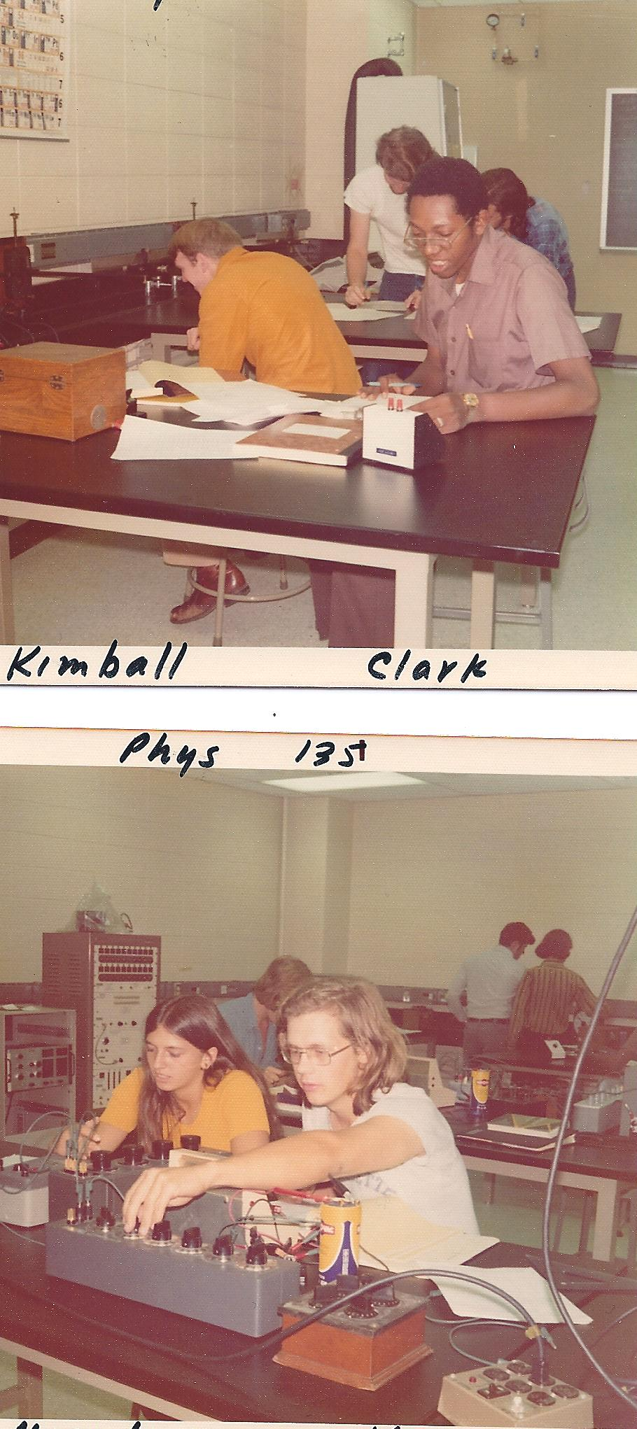
Mark Kimball, Ramsey Clark
1973

Slide 41
Clarine Magedanz, Thomas Keuch 1975

Slide 42
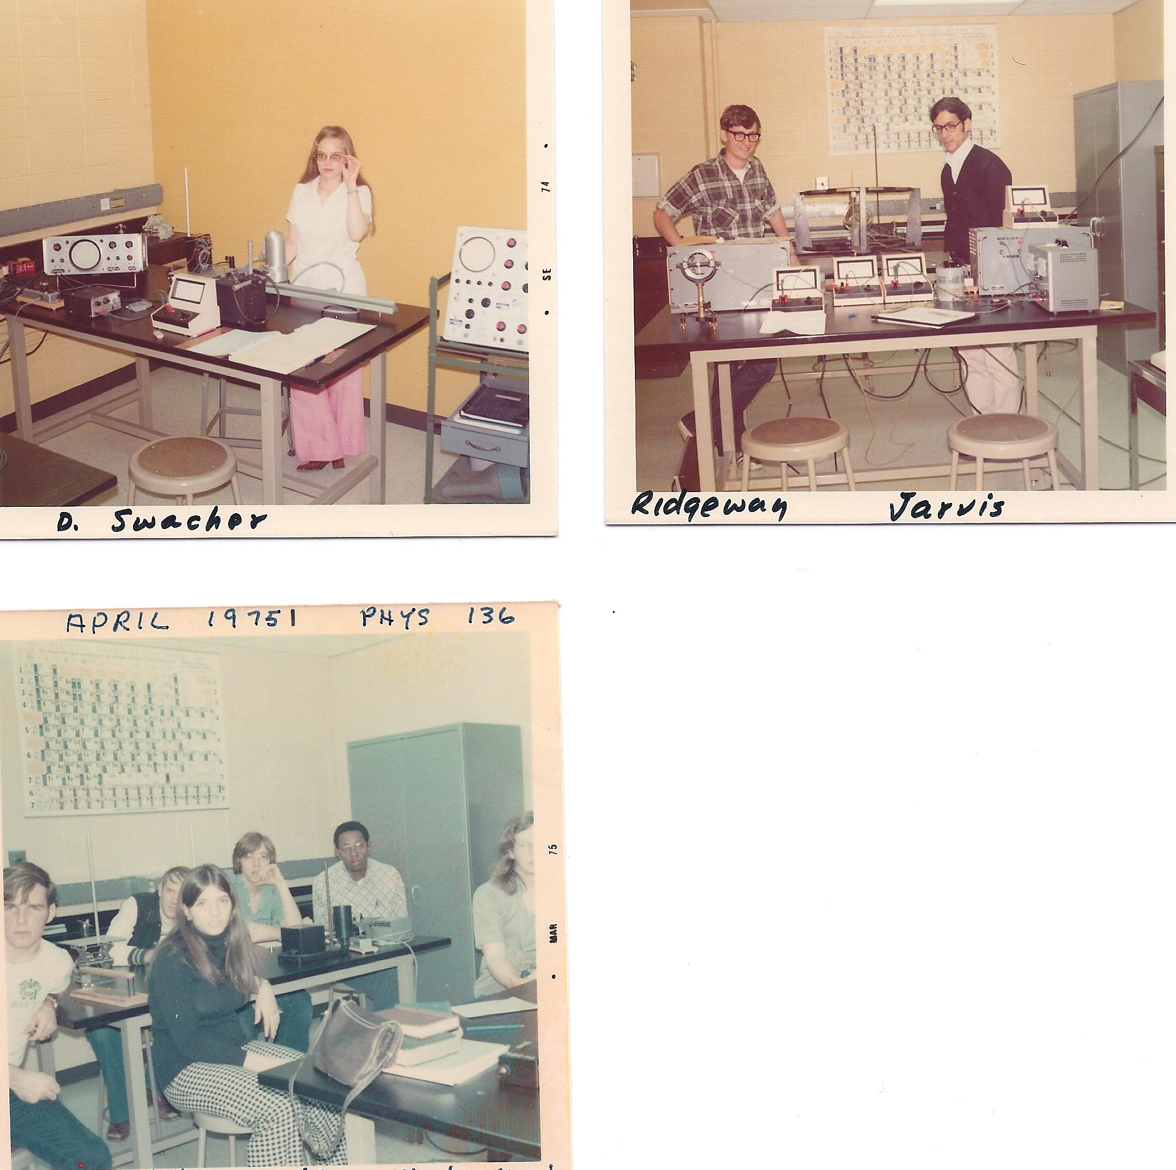
Debra Schwacher 1975

Slide 43
George Ridgeway, Stephen Jarvis 1975

Slide 44
George Lochbraum, Mark Kimball, Clarine Magedanz, Theodore Leeson, Ramsey Clark
1975

Slide 45
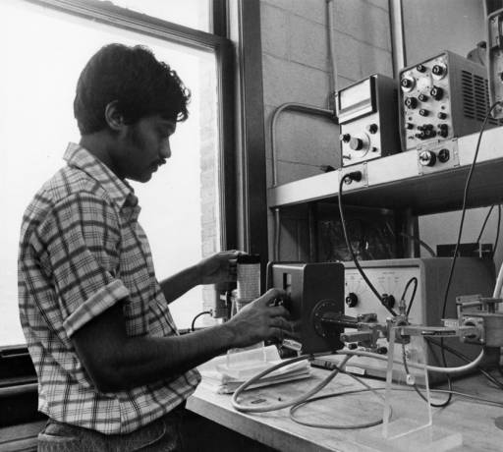
1975

Slide 46
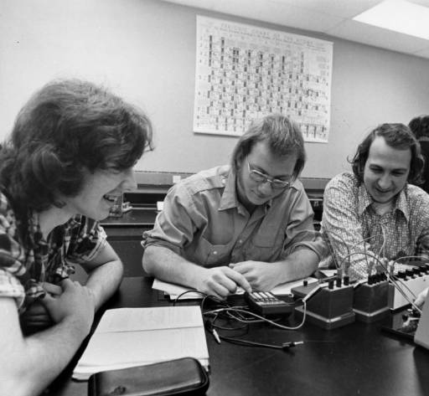
1975

Slide 47
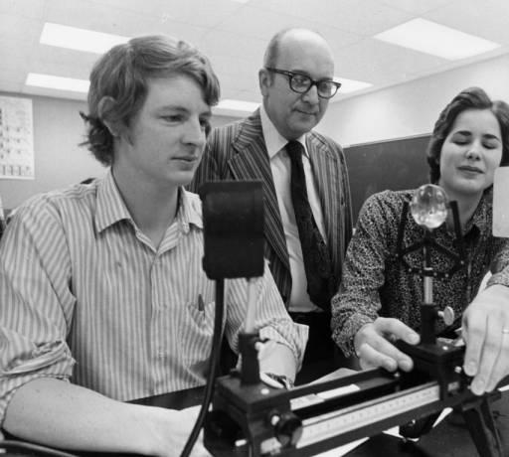
1975

Slide 48
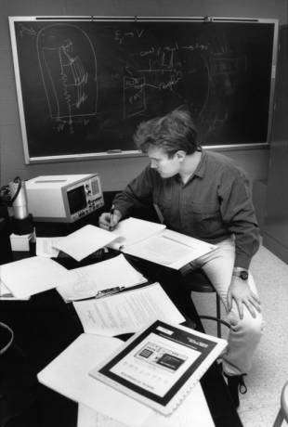

Slide 49
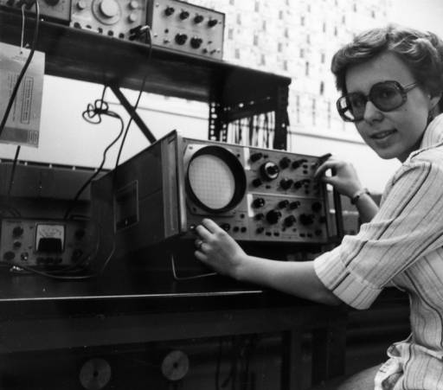
1976

Slide 50
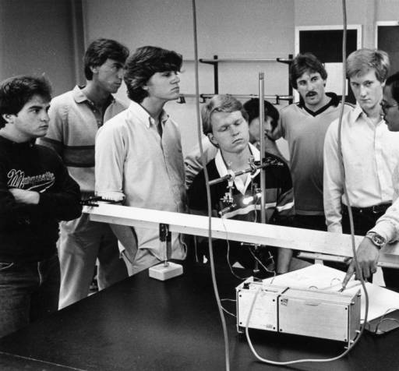
1984

Slide 51
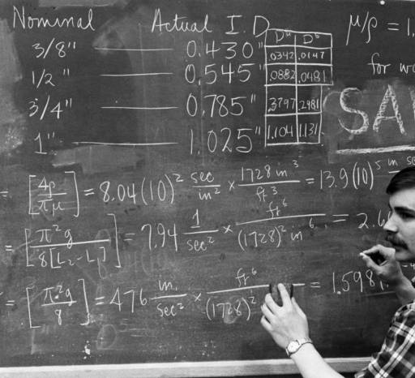

Slide 52
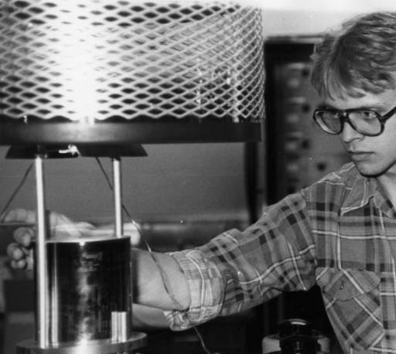

Slide 53
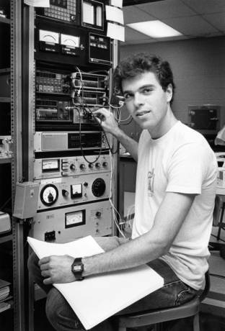

Slide 54
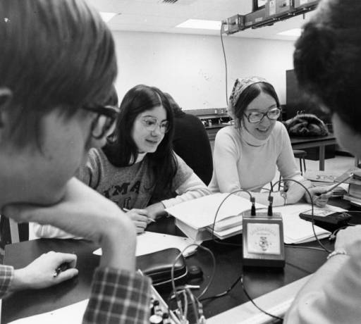

Slide 55
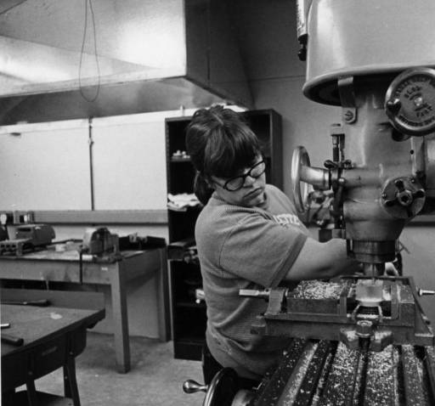

Slide 56
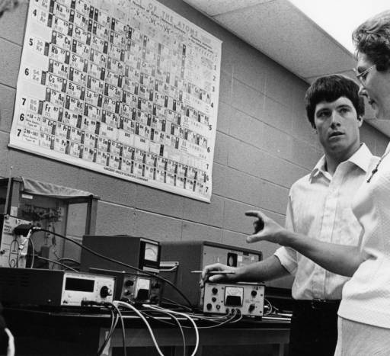

Slide 57
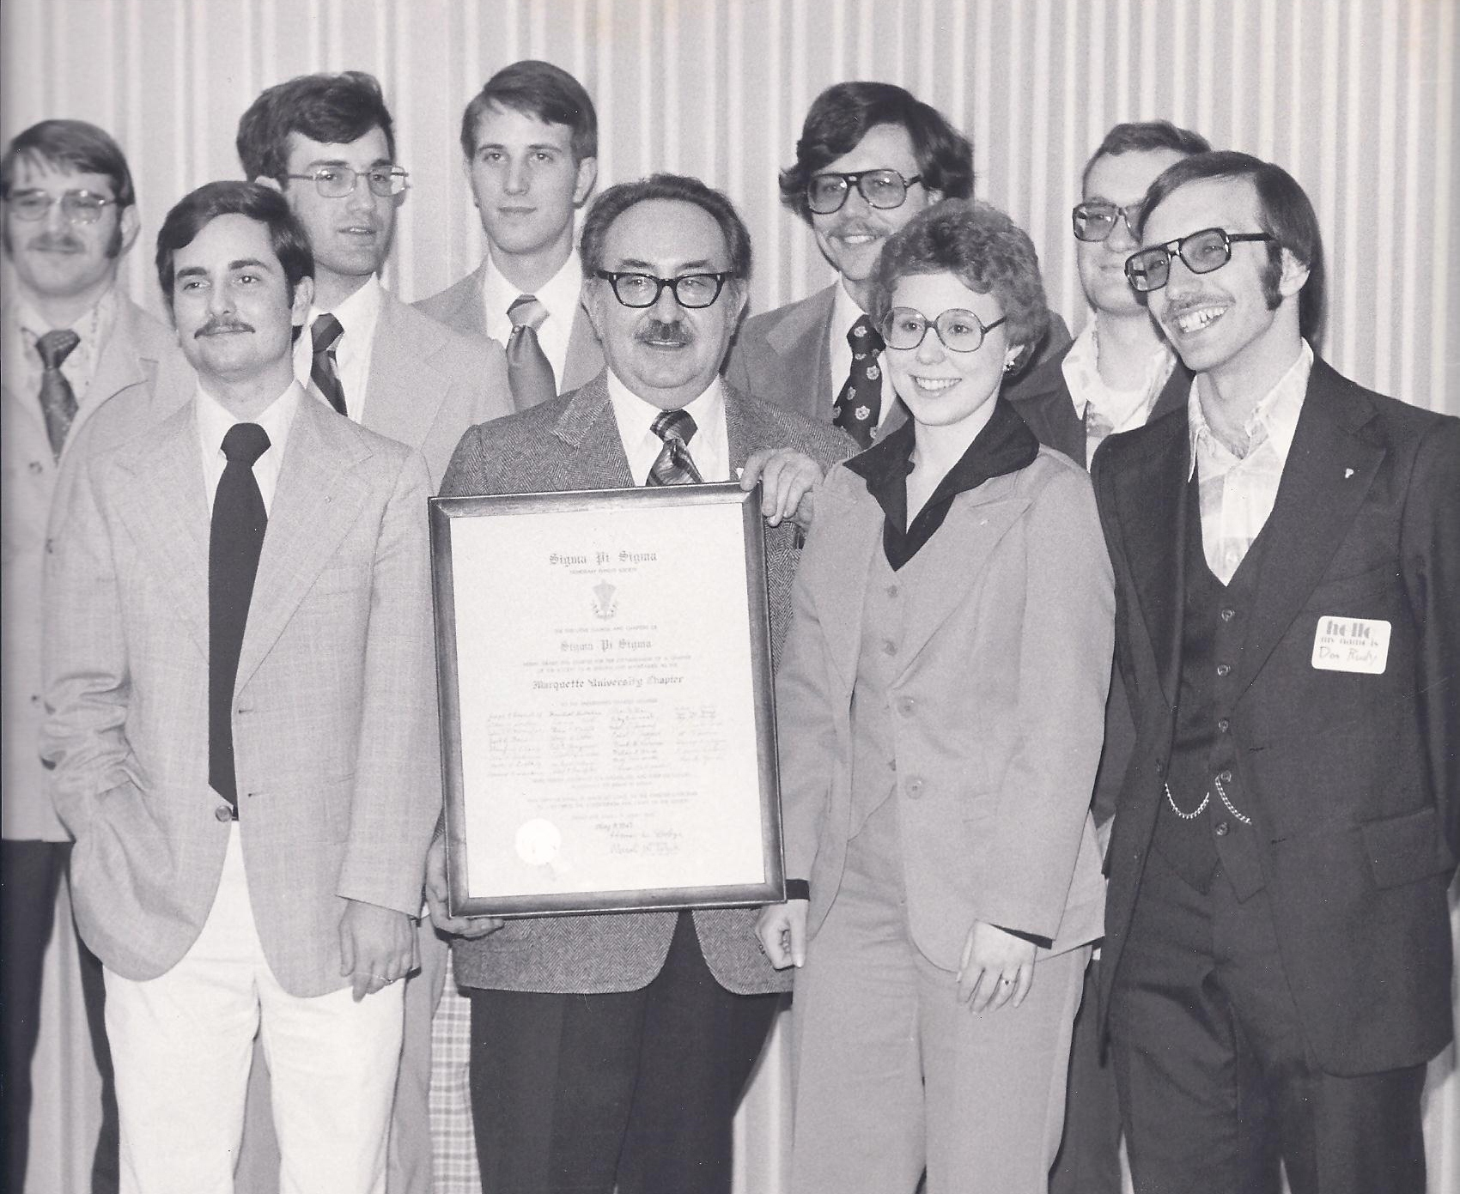
Paul Lett
SPS Chapter
April 7, 1978
Back Row: Keith Trischan, Michael Cherney, Paul Lett, Chris James, Cliff Kelley
Front Row: Norm LaFond, Frank G. Karioris, Andrea Spruck, Donald Rudy

Slide 58

1982
Frank Karioris, Wasantha Wijesundera, A. Bari Siddique, Ummey Khalida Begum

Slide 59

1983
Ken Mendelson, Father Burch, S. J., Wadda al-Hinai, Frank Karioris, Kuuck Lee

Slide 60

Lecture Demonstrations - November 1984
Richard Dittman and Glenn Schmieg

Slide 61

Lecture Demonstrations - November 1984
Richard Dittman

Slide 62

Phys 162 1986-87

Slide 63

Physics Department Picnic 1987-8

Slide 64


Slide 65

1989

Slide 66

1989

Slide 67

1989

Slide 68

Electronics Lab
~1985

Slide 69
Physics Department Picnic
1987

Slide 70
Sister Feldott
1987

Slide 71

Peter Bandettini
Jim DeRoso
Bob Crowley
Jane Burrows
Sister Feldott
Ki Lee
Frank Karioris
Anne Schaefer
Ken Mendelson
SPS Reception 1987

Slide 72
Smio Tani
Frank Pedrotti
Roy Day
Peter Santi
Joe Collins
SPS Reception
1990

Slide 73
SPS Reception
1991

Slide 74

November 1992
Weilin Gong and Kaustav Banerjee

Slide 75

Advanced Lab Fall 1992
David Huffman

Slide 76

November 1992
Jonathan Filter and James Phillips

Slide 77

1991-2
Joleen Kugi and John Karkheck

Slide 78
Graduation 1991-2
Joleen Kugi and Joe Collins

Slide 79
Graduation 1991-2
Joe Collins and John Karkeck

Slide 80
Graduation 1991-2

Slide 81
Graduation 1991-2

Slide 82

2002

Slide 83

2002

Slide 84

2002

Slide 85

2002

Slide 86


Slide 87


Slide 88


Slide 89


Slide 90


Slide 91


Slide 92


Slide 93

2002

Slide 94


Slide 95


Slide 96


Slide 97


Slide 98


Slide 99

Physics Department 2002

Slide 100

Awards Banquet 2003

Slide 101

Awards Banquet 2003

Slide 102

Summer Cookout
2008

Slide 103


Slide 104

Summer Cookout
2008

Slide 105

Summer Cookout
2008

Slide 106

2011

Slide 107

2011

Slide 108

2011

Slide 109

2011

Slide 110

2011

Slide 111

2011

Slide 112

2011

Slide 113

2011

Slide 114

2011

Slide 115

Women in Physics 2012

Slide 116

Physics Department 2012

Slide 117

Physics Club 2012

Slide 118


SPS Congress 2012
Orlando, FL

Slide 119

Wei Wu, Abigail Searfoss, Kyle Kimminau

Slide 120

SPS Congress 2012
Mike Nichols, Abigail Searfoss, Speaker Dr. Jocelyn Bell Burnell, Kyle Kimminau, Justin Provance

Slide 121



Poster presentations at SPS Congress by
Mike Nichols, Kyle Kimminau, and Nick Lopez-Canelas

Slide 122


January 2013
Holiday Party

Slide 123

January 2013
Holiday Party

Slide 124

January 2013
Holiday Party

Slide 125

January 2013
Holiday Party

Slide 126

January 2013
Holiday Party

Slide 127

Andrew Kunz received the 2013 Excellence in Faculty Advising Award!

Slide 128



Women in Physics celebrating Earth Day with a local Daisy Troop

Slide 129



Making birdhouses!

Slide 130


Slide 131

Physics Club at the Chicago Museum of Science and Industry!

Slide 132


Slide 133

The End!

