Slide 1
Exploring Psychology & How the Career Services Center can Help!
Kiley Sturgeon, M.Ed
Career Services Center
Marquette University
Notes:
Welcome
Happy to take questions as we go

Slide 2
Agenda
What can I do with a Psychology Major?
Finding a Career that Aligns with YOU
The Basics of Searching for Internships & Full-time Positions
How the Career Services Center can Help

Slide 3
What can I do with a Psychology Major?
Notes:
Welcome
Happy to take questions as we go

Slide 4
What can Psychology Majors do?
First, look at resources on CSC website to help
  What Can I Do with This Major?
Next, let’s see what others have done!
  First Destination Data
  LinkedIn
Finally, reach out to others & conduct informational Interviews
  LinkedIn
  Marquette Career Network

Slide 5
Finding a Career that Aligns with YOU!
Value-based decision-making
Influencing others
Beauty
Moral/spiritual fulfillment
Competition
Adventure
Safety
Pleasant environment
Helping society
Control
Imagination
Work/life balance
Organization
Confrontation
Respectability
Risk taking
Security
Helping others
Financial reward
Stability
Relationship building
Independence
Teamwork
Variety
Continuity
Power
Leadership
Knowledge
Change
Prestige
Creativity
Flexibility
Advancement
Autonomy
Avoiding stress
Diversity
Fast-paced
Job security
Physical activity
Travel

Slide 6
The Basics of Searching for Internships & Full-time Positions
Notes:
Welcome
Happy to take questions as we go

Slide 7
Preparing for Internship/Job Search
Get your Materials Ready
  Resume, Cover Letter, References
Track your Applications
  Position, Company, Date of Application
  Download PDF form of description

Slide 8
Job Search Strategies
Attend Events to learn from others!
Search Websites:
  Handshake
  Jobs that Help
  Idealist
  Nonprofit Opportunities
  Local, state, and federal government websites
  Indeed, Google, Linkedin and more!

Slide 9
How the CSC can Help!
Notes:
Welcome
Happy to take questions as we go

Slide 10
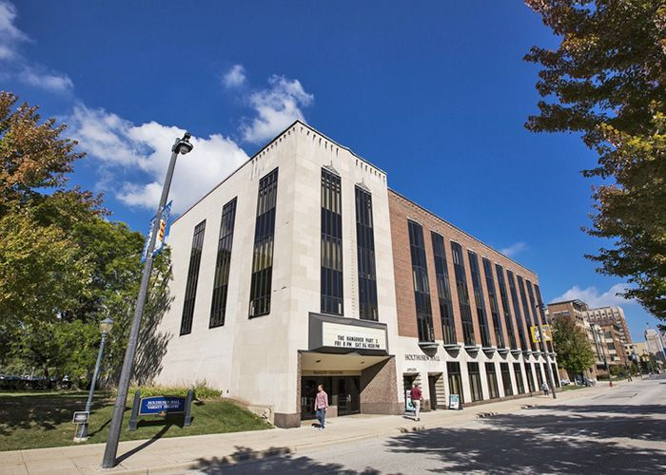
Marquette University Career Services Center
Holthusen Hall, First Floor
(414) 288-7423
career.services@marquette.edu
www.marquette.edu/career-services
Notes:
Comprehensive career services for UG/Grad students and alumni
Contact info

Slide 11

Services & Resources
Handshake
Career Counseling Appointments
Drop-in Services
Career Events
Reciprocity
Alumni Services
Notes:
Overview – in-depth description to follow

Slide 12

Career Counseling Appointments
Virtual and in-person option!
Career Exploration/Research
Job Search
Graduate/Professional School
Professional Document Review
Interview Assistance
Make an appointment with a Career Counselor
by calling 414.288.7423 or booking via Handshake

Slide 13
Drop-in Services
Professional Document Review (resume & cover letter)
Handshake Assistance
Brief Interview Practice
Business Cards
LinkedIn Photos
Academic Year: Monday through Friday, 12-1:45 p.m.

Slide 14
E-Services
Professional Document Review
  resumes@marquette.edu
Professional Profile Review (Handshake, LinkedIn)
  career.services@marquette.edu

Slide 15
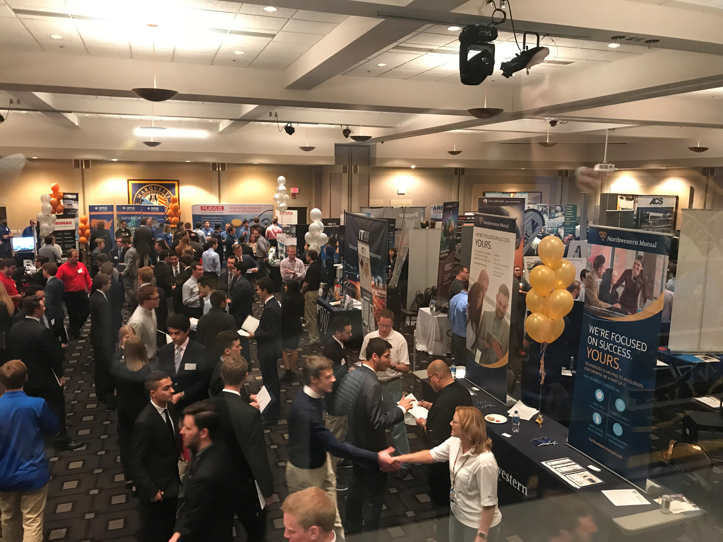
Career Programs
Events
  Employer Campus Events
  Career Services Events
    First-Gen Connect
    Stories of Service
    Uncommon Pathways- Spring 2023
  Fall Career & Internship Fair
  Careers for the Common Good- Spring 2023

