Slide 1

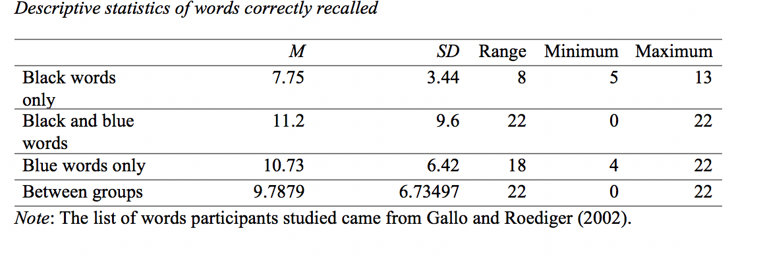
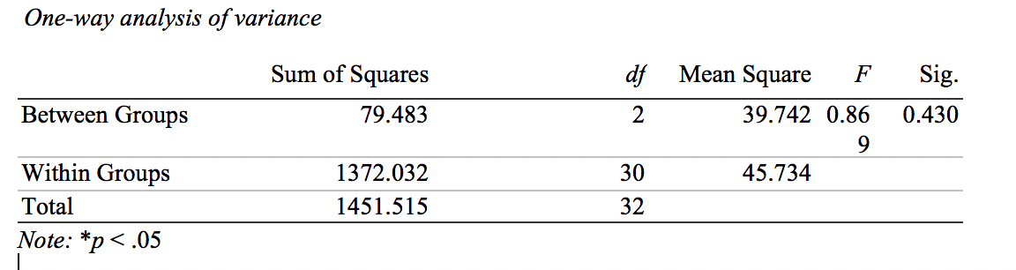
COLORED INK AND MEMORY
BRIDGET O’BRIEN
Marquette University
Introduction
The goal of the current study
College students often study using a variety of techniques.
People are able to best memorize a list of words when reading an achromatic or chromatic list, and worst when the list is color-incongruent (Olurinola & Tayo, 2015).
Perception and memory are related. As precision of color increases, information previously associated with the color is more likely to reappear (Olkkunen & Allred, 2014).
Short-term memory (STM) is the second of three stages employed by the human brain before information can be committed to memory (McLeod, 1970). As its name implies, information can only stay in the STM for a limited time, though, so not everything can be committed to long term memory.
The human brain is only capable of holding about seven items in the STM (Miller, 1956).
The goal of this study is to determine if using colored ink when taking notes affect ability to perform on a task involving recalling information from one’s working memory.
Hypothesis:
Participants studying a list with a portion of words written in blue ink would be able to correctly recall the most words compared to the other groups, where all of the words were typed in one color
Results
Table 1
Table 2
Figure 1
Researchers removed data (n=2) from the overall results and analyzed the data from the remaining participants (n=31) to run descriptive statistic measures and a one-way ANOVA. Descriptive statistics revealed overall data from all three groups (M=10.1613, Mdn=8.0000, R=23.0000, SD=0.85383). As visible in Figure 1, Group 2 had the highest average number of words correctly recalled (M=11.2, SD=9.6). Group 1 had the lowest average number of words correctly recalled (M=7.75, SD=3.44). Group 3 fell in between the other groups (M=10.73, SD=6.42). Despite these differences, the results were not significant, F(2,30) = 0.869, p = 0.430, as seen in Table 2.
Discussion
The results did not reflect the hypothesis. While Group 2 had the highest mean number of words recalled (M=11.2), the difference was not significant according to the one-way ANOVA.
The overall median number of recalled (M=8.0000) reflect prior research from Miller (1956) which stated that people can hold around 7 items in the STM.
The findings from this study also reflected prior research from Saaty and Ozdemir (2003) which states that it is unlikely that people will be able to memorize more than 7 items at a time.
The researchers expected that Group 2 would have a significantly higher score due to the use of selective coloring to add value to certain words. According to Olkkunen and Allred (2014), memory recall is higher for items that have been associated with higher importance and/or value. However, despite selective coloring, the participants in Group 2 did not score significantly higher than the groups who were only told to study a list of one color of words.
Limitations of this study included a small sample size, lack of true random sampling, and lack of time constraint enforcement.
Strengths of this study included use of proper measures, high internal validity, and high internal validity.
Further research could examine the relationship between time exposure and ability to correctly recall words from similar lists. Or, researchers could eliminate either Group 1 or Group 3, which both use one color word lists.
The results of this study have real-world implications that suggest that college students do not need to use different color inks when studying.
McLeod, S. (1970, January 1). Short Term Memory. Retrieved from https://www.simplypsychology.org/short-term-memory.html
Miller, G. (1956). The magical number seven, plus or minus two: Some limits
on our capacity for processing information. The psychological
review, 63, 81-97.
Olkkonen, M., & Allred, S. R. (2014). Short-Term Memory Affects Color
Perception in Context. PLoS ONE, 9(1). doi:
10.1371/journal.pone.0086488
Olurinola, O., & Tayo, O. (2015). Colour in Learning: It’s Effect on the
Retention Rate of Graduate Students. Journal of Education
and Practice, 6(14), 1–6.
Saaty, T., & Ozdemir, M. (2003). Why the magic number seven plus or minus
two. Mathematical and Computer Modelling, 38(3-4), 233
–244. doi: 10.1016/s0895-
7177(03)90083-5
Methods
Participants:
31 undergraduate students from a midwestern university (23 female) aged 18-21 (M= 20.0645, SD=1.43609) and a variety of ethnic backgrounds (51.5% White, 6.4% Asian, 12.1% Hispanic/Latino)
Measures:
Using convenience sampling, researchers emailed participants. Participants followed a link to a Qualtrics survey. Each participants was assigned to one of three different groups: one control with 28 black words, one list with 21 black words and 7 blue words, and one list with 28 blue words. Then, they wrote down as many as they could recall.
Procedure:
Each participant was only assigned to one of the three groups. After giving consent, participants were told to memorize the assigned list, then type as many as they could recall. Finally, a manipulation check and demographics form was completed.
References

