Slide 1



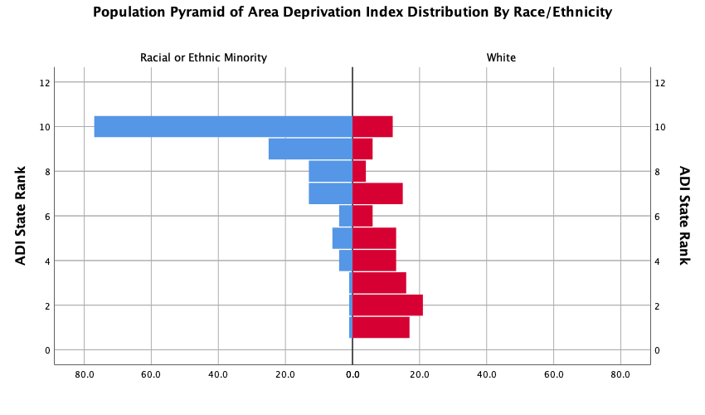
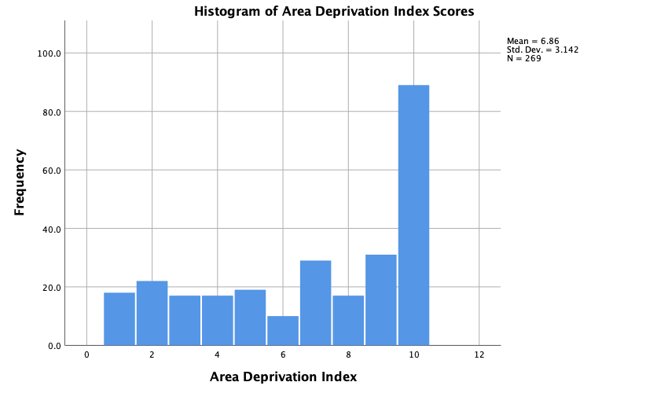
Does Home Impact Health?: Area Deprivation Index and Re-exposure to Trauma
Jill Finnel, Terri deRoon-Cassini PhD., Andrew Schramm PhD, and Lucas Torres PhD.
Introduction
Environmental variables (SES, race, behavior) impact physical and mental health outcomes
Disadvantaged neighborhoods increase susceptibility to trauma and experiences of mental health symptoms
Hypothesis: Individuals living in neighborhoods with higher Area Deprivation Indices will also report higher re-exposure to trauma
Data Analytic Plan
Hierarchical Linear Regression
  Step 1: Race/Ethnicity
  Step 2: Employment/Insurance Status
  Step 3: State Rank ADI
Discussion
ADI does correlate with re-exposure to trauma, but race could be a confounding variable
  Reason Hierarchical Regression did not show significant results
Census data indicates Milwaukee is a highly segregated city
  Location is a potential limitation of this study
Future studies should explore this relationship between ADI, race, and related health outcomes
  Race as related to trauma re-exposure
  Race as related to PTSD susceptibility
Methods
Participants: 493 patients at Froedtert Hospital admitted for traumatic injury
Area Deprivation Index: composite score allocated by zip code to measure economic well-being of a neighborhood
Life Events Checklist: self-report measure indicating exposure to trauma administered 6-mo after baseline
Browning, C. R., & Cagney, K. A. (2003).
Dulin-Keita, A., Casazza, K., Fernandez, J. R., Goran, M. I., Gower, B. (2012).
http://dx.doi.org/10.1136/jech.2009.092676
Garbarino J. (1999).
Goldsmith, P.R. (2009). doi 10.1353/sof.0.0193
Gopen, M., Cross, D., Ortigo, K. etc.
Herman, J. (1992). https://doi.org/10.1002/jts.2490050305
Hoffman, K., Aschengrau, A., Webster, T. F., Bartell, S. M., & Vieria, V. M. (2015).
Jennings, C. R. (2013). https://doi.org/10.1016/j.firesaf.2013.07.002
Johns, L. E., Aiello, A. E., Cheng, C., Galea, S., Koenen, K. C., & Uddin, M. (2012).
Loyd, J., Bond, A. (2018).
Morency, P., Gauvin, L., Plante, C., Fournier, M., & Morency, C. (2012).
Olagunju, A., Olatunji, A., Babatunde, F. (2013). http://0dx.doi.org.libus.csd.mu.edu/10.1002/pon.3234
Osofsky J. D. (1999). “The impact of violence on children.” Future Child. 9(3):33–49Schuck, A. M., Widom, C. S. (2019).
Ross, C. E., & Mirowsky, J. (1999). https://doi.org/10.1177%2F107808749903400304
Weathers, F.W., Blake, D.D., Schnurr, P.P., Kaloupek, D.G., Marx, B.P., & Keane, T.M. (2013). www.ptsd.va.gov
Results
Hierarchical Linear Regression did not show significant relationship between ADI and LEC scores; did show significance for ADI and Ethnicity/Race
Bi-variate correlations
  Significant correlation between ADI and Ethnicity/Race

