Slide 1
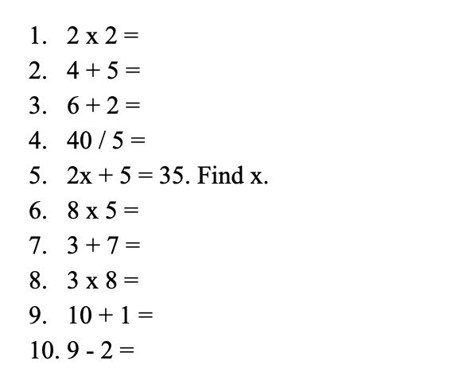
RELATIONSHIP BETWEEN MUSIC AND TEST-TAKING SPEED
JOANNA MAJ
Marquette University
Introduction
The goal of the current study is to determinate significance between background music and test-taking speed
Hypothesis: Researchers hypothesize that students who listen to music while taking a mathematics test will show an increase in test-taking speed
Literature:
Chang, F., Chang, H., Chen, C., Chen, P., Lai, H., & Peng, T. (2008).
Randomized crossover trial studying the effect of music on examination anxiety
Results show a significant effect that music decreases testing anxiety
Jancke, L., & Sandmann, P. (2010).
Music listening while you learn: No influence of background music on verbal learning
Results show no significant effect between background music and verbal learning
Results
Results show no significant difference between background music and an effect on test-taking speed. Results do not support the initial hypothesis.
The following statistical analysis was done to determine a relationship between background music and test-taking speed. An independent samples t-test was conducted to compare background music and no music on test-taking speed. There was not a significant difference in the scores for music (M=450.71, SD=146.18) and no music (M=454.24, SD = 172.95), t(-.090)=65, p<.928. Music did not score significantly higher or lower on speed than no music. Thus, the investigation strengthened the claim of the hypothesis, as listening to music does not increase test-taking speed.
Data Analysis
2 categorical variable (IV)
1 continuous variable (DV)
Independent samples t-test
Discussion
Researchers hypothesized that there is a significant difference between listening to music and test taking speed. The results of the investigation did not support the claim of the hypothesis, as listening to music did not significantly increase test-taking speed. Current literature is both consistent and inconsistent with findings. Consistent literature suggests verbal learning is not affected while students listen to background music while studying (Jancke, Sandmann 2010). Inconsistent literature showed decreased exam anxiety and speed in college students who listened to music while studying (Cournoyer, 2019).
Major methodological imitations include changes in testing location per researcher, age differences among participants, potential bias, and music preference. A change in testing areas did not account for outside factors including comfort, seating arrangements, and temperature of the room. An equal number of students from each grade level would give more consistent means for college students is an area of improvement for future research. Also, researchers were friends with the participants, so potential bias may have influenced the results. In future research, bias can be eliminated by recruiting anonymous participants. The final limitation is music preference. Music enjoyment was not a factor in this experiment which may have influenced results. Thus, music preference and test-taking speed is an area of focus for future research studies.
A major strength of the study includes a consistency in the pool of participants. All participants are undergraduate students and attend Midwestern Catholic University. The research also includes a large number of participants. 67 participants were recruited for the experiment. Another strength is the manipulation check used at the end of the study. Participants were asked to simply describe the test and whether there was background music present. A final strength includes the type of sampling. There was a representative sample of demographical data. An equal number of males and females were studied across all ethnicities to eliminate skewed data.
In future research studies, researchers can investigate different types of music enjoyed by each participant and determine whether the specific type of music increased test-taking speed on a simple mathematics test. In this research, results did not support the claim of the hypothesis. The results indicated that listening to music did not significantly increase test-taking speed. Concluding, no significant difference between listening to music and test taking speed resulted from this research experiment.
Chang, F., Chang, H., Chen, C., Chen, P., Lai, H., & Peng, T. (2008).
Randomized crossover trial studying the effect of music on
examination anxiety. Nurse Education Today, 28(8), 909-916.
DOI:10.1016/j.nedt.2008.05.011.
Cournoyer, E. L. (2019). The effect of background music on episodic
memory. American Psychological Association, 29(1), 22-34.
DOI:10.1037/t69846-000.
Jancke, L., & Sandmann, P. (2010). Music listening while you learn: No
influence of background music on verbal learning. BioMed Central
Limited, 6(3). DOI:10.1186/1744-9081-6-3.
Umzdas, S. (2004). An Analysis of the Academic Achievement of the
Students Who Listen to Music While Studying. Educational Research
and Reviews, 10(6), 728-732. DOI:10.5897/ERR2014.1742
Methods
Participants: 67 total participants (34 males and 33 females)
Independent Variables
Music – Song: The Hours by Philip Glass (Classical)
No Music
Dependent Variables
Conceptual – Speed
Operational – Math Fluency
Categorical – (Data inputted into SPSS) how much time it takes participants to complete math problems as recorded
Procedure
Consent of students
Researcher plays music for music group
Researcher administers a 100-problem math test
Researcher records time in seconds, while participant takes test
Debrief/Questions
Sample Mathematics Fluency Test:
References

