Slide 1
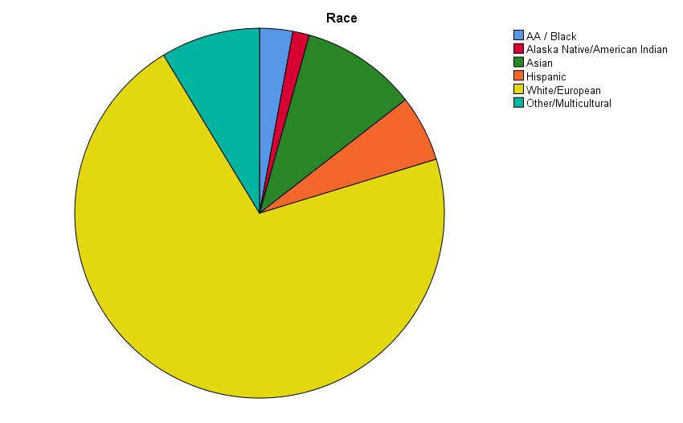
The Influence of Positive Intergroup Interactions on Willingness to Interact
Kate Gustafson & Dr. Nakia S. Gordon
Marquette University, Milwaukee, WI
Introduction
Stimuli
Results
For some individuals, interracial interactions can lead to anxiety and stress (Trawalter et al., 2009)
Interracial anxiety predicts one’s desire to avoid intergroup interactions (Plant, 2004)
Additionally, willingness to interact with an outgroup member depends heavily on the current affective state of the individual and the perceived predictability of the outgroup interaction partner (Samochowiec & Florack, 2010)
Exposure to images of intergroup violence increases negative affect while eliciting sympathy (Gordon & Chesney, 2016)
When viewing positive interactions, individuals appear to become “infected” with the emotions displayed by those engaging in the interaction (Wild, Erb, & Bartels, 2001) → “primitive emotional contagion”
What is unknown is whether positive interracial interactions can increase willingness to interact
H2: Willingness to interact did not differ between those who viewed positive interracial interactions compared to those who viewed negative interracial interactions
Ingroup (Control)
Interaction Desire
VAS score on “How much do you want to interact with your partner?” did not differ between studies.
Intergroup (Exp.)
PIQ Score
F(3,144)=1.44, p > 0.05
Increasing in closeness/positivity
Overall score on the Partner Interaction Questionnaire (PIQ) did not differ between studies.
Sample
F(3,137)=1.85, p > 0.05
H3: Exposure to interracial images led to greater positive emotions and less negative emotions compared to exposure to images of White males
Hypotheses
The sample consisted of 69 undergraduate psychology students. Of the 69 participants, fifty-two identified as female (75.4%) and seventeen identified as male (24.6%). The sample was 71.0% White, 10.1% Asian, 8.7% Multicultural, 5.8% Hispanic, 2.9% Black, and 1.4% American Indian.
Positive Emotions
H₁: Exposure to positive interactions between White men and Black men will increase willingness to interact compared to exposure to positive interactions between White males
(a) “How much do you want to interact with your assigned partner?”
(b) Overall score on the Personal Interaction Questionnaire (PIQ).
H₂: Exposure to positive interracial interactions will increase willingness to interact compared to exposure to negative interracial interactions
(a) “How much do you want to interact with your assigned partner?”
(b) Overall score on the Personal Interaction Questionnaire (PIQ).
H₃: Exposure to positive interracial interactions will increase positive emotions compared to exposure to positive interactions between White males
Numerical responses to VAS ratings on positive and negative emotions.
*
*
Those who viewed the interracial interactions rated higher positive emotions for Respect and Friendship images.
Results
F(1,67)=5.75, p < 0.05
Negative Emotions
H1: Willingness to interact did not differ between the conditions
Those who viewed the interracial interactions exhibited lower negative emotions for Baseline and Affection images.
*
*
Interaction Desire
Methods
VAS score on “How much do you want to interact with your assigned partner?” did not differ between conditions.
F(1,67)=4.62, p < 0.05
Future Directions and Implications
Overall, the initial hypotheses were partially supported
The results show that willingness to interact did not differ between conditions or based on whether the interaction images were positive or negative
However, those who viewed the positive interracial images did report higher positive emotions and lower negative emotions for two of the image types
Future research should potentially utilize physiological measures to better determine whether positive intergroup images can effectively decrease pre-interaction anxiety
Questionnaires:
Behavioral Measures
Willingness to Communicate Scale (WTC)
Desire to interact (0-6 NRS)
Implicit Association Task (IAT)
Partner Interaction Questionnaire (PIQ)
Emotion Measures
Emotion Regulation Questionnaire (ERQ-SF)
Generalized Anxiety Disorder (GAD)
Difficulties in Emotion Regulation (DERS)
VAS Emotion Ratings
t(60)=0.74, p = 0.46.
PIQ Score
Overall score on the Partner Interaction Questionnaire (PIQ) did not differ between conditions.
Emotions: VAS scale 0 = ‘not at all’; 10 = ‘extremely’
Connection to Others, Disgust, Sadness, Cheerfulness, Pity, Neutral, Happiness, Guilt, Arousal, Fear, Anger, Anxiety, Unity, & Sympathy
t(67)= -1.85, p = 0.07.
*p < 0.05

