Slide 1
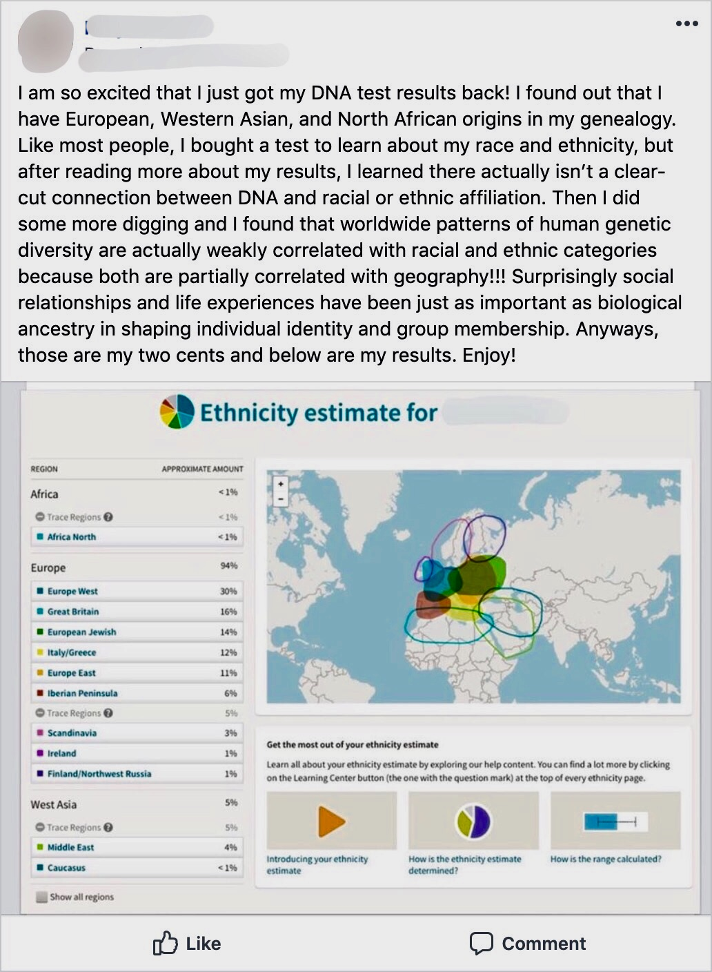
x
Does Contextualizing Genetic Ancestry Tests Prevent Increases
in Individuals’ Race Essentialist Thinking?
Koryn St. Clair, Simon Howard, Ph.D., & Kalen Kennedy
Department of Psychology, Marquette University
Implications
Introduction
Figure 1 Contextualized GAT Stimuli
Exposure to genetic ancestry tests (GATs) increases individuals race essentialist thinking (1).
Race essentialism is the belief that race is biologically determined (2).
Race essentialism has been strongly associated with (2)(3) :
- Endorsement of racial stereotypes
- Less desire for interracial interactions
- Less sensitivity for the struggle of disadvantaged racial groups
- Less concern with social inequalities
Given that exposure to GATs is likely to increase given their recent popularity, researchers may want to find ways to prevent increases in race essentialism after exposure to GATs.
Contextualization provides context to improve the understanding of a core concept in order to reduce complexity (4).
The current study explored if contextualizing GAT results prevents an increase in individuals’ race essentialist beliefs.
H₁ = Contextualizing GAT results will prevent an increase in race essentialism
Although sharing Genetic Ancestry Tests (GATs) results has become a common occurrence, lay individuals may not be knowledgeable on the context of GATs. Many are only aware of the biological means used to determine results and the quantified results which may be why exposure leads to an increase in race essentialism because of how GATs reinforce the idea that race is biologically determined. Providing context to GAT result was intended to reduce misconceptions.
Exposure to contextualized GAT results compared to GAT results without contextualization did not produce a significant difference in race essentialist beliefs, however there was a marginal effect. The non-statistically significant results may be due how the results were contextualized. In the future, researchers can explore alternate ways to contextualize GAT results.
Contextualized GATs produced similar RCS scores to the control group. This illustrates how contextualization if done more effectively has the potential to reduce the increase in race essentialism. However, a more influential method is required to yield significant results.
Since there are an array of negative consequences associated with high race essentialism (i.e. racial stereotyping) and GAT exposure is rapidly increasing, it is imperative that this topic be further explored because of its potential influence on beliefs about race (1).
Methods
Results
Participants: n=124 white undergraduates
Race Essentialism
Measures
Contextualization and Race Essentialism (N = 124)
Variable | Contextualized | Non-Contextualized | Control | f-value | p value
Race Essentialism | M = 4.376 SD =0.71 | M = 4.72 SD = 0.73 | M = 4.345 SD = 0.82 | 3.060 | 0.051
***p < .051
Future Directions
IV: Contextualization
Improving understanding of what GAT results are portraying
DV: Race Essentialism
Shortened version of Race Conceptions Scale (RCS; 2)
8 questions on a 7- point Likert scale
Example:
– “Racial groups are primarily determined by biology.”
Other Measures
Previous Exposure to GAT
Four questions will be asked assessing familiarity with GATs
Demographics
Age, Race/ethnicity, Gender, etc.
Future research can compare GAT consumers to those that are only exposed to GATs, to investigate if contextualization provided by companies is effective in preventing an increase in race essentialist thinking
Explore whether use of newly created scales to measure Race Essentialism that focus on the genomes provide more information regarding race essentialism
Explore stereotyping as a dependent measure for GAT contextualization, due to its association with race essentialism (1)
Investigate if GAT exposure influences individuals’ behaviors in interracial interactions
Procedure:
Cover Story
Contextualization
Assessment
Debrief
References
Participants were under the assumption that we were examining perceptions of social media posts
In line with the cover story, participants were assigned to 1 of 3 conditions and instructed to read seven social media posts and rate their appropriateness
Participants responded to the Feelings Thermometer, RSC, Previous Exposure to GATs, and Demographics
Participants were debriefed and thanked for their time
¹ Howard, S., St. Clair, K., & Kennedy, K.(2020). The influence of exposure to genetic ancestry tests on race essentialism. Unpublished manuscript
² Williams, M. J., & Eberhardt, J. L. (2008). Biological conceptions of race and the motivation to cross racial boundaries. Journal of Personality and Social Psychology, 94, 1033–1047. http://dx.doi.org/10.1937/0022-3514.94.6.1033
³ Bastian, B., & Haslam, N. (2006). Psychological essentialism and stereotype endorsement. Journal of Experimental Social Psychology, 42, 228-235.
⁴ Alpay, L.L., Verhoef, J., Te’eni, D., Putter, H., Toussaint, P.J., & Zwetsloot-Schonk, J. (2008). Can Contextualization Increase Understanding During Man-Machine Communication? A Theory- Driven Study. The Open Medical Informatics Journal, 2, 82 - 91.
A one-way between subjects’ ANOVA was conducted to compare the effect of contextualization on race essentialism
It was predicted that exposure to contextualized GAT results (M=4.376, SD =0.71) would lead participants to have lower levels of race essentialism than those exposed to non-contextualized GAT results (M=4.72, SD =0.73).
We predicted that contextualized GAT scores would be very similar to the control condition (M=4.345, SD =0.82) We predicted this because we believed contextualization would decrease the cognitive dissonance of those exposed to GAT results
Condition 1: Contextualized GATs Condition 2: Non-Contextualized GATs
Condition 3: Control

