Slide 1
Recap
PRB & Budget Justification
+ /▲ Discussion

Slide 2
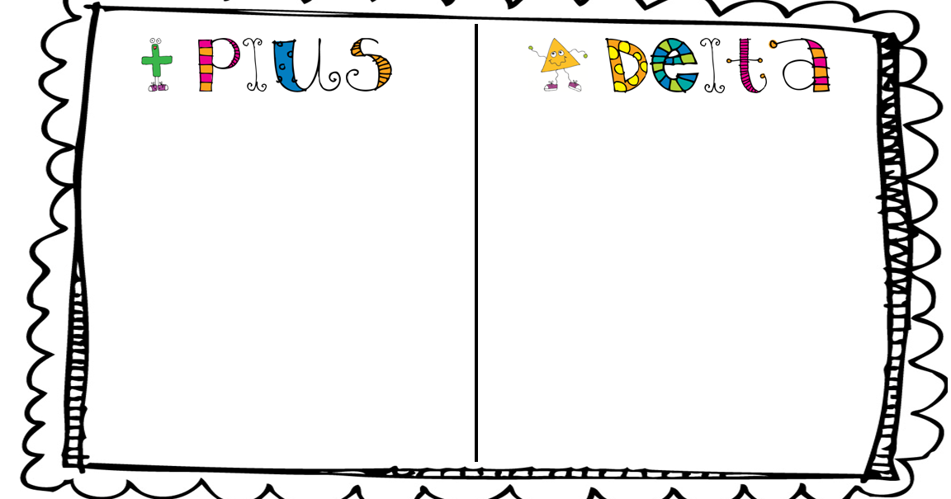


Why use the
Process?
It improves meeting productivity
By providing feedback on what works and what doesn’t, it helps you to make improvements and increase productivity.
It encourages open communication
Creating an open and safe environment where everyone can express their thoughts and ideas leads to a more productive and engaging meeting.
It increases accountability
By allowing everyone a chance to share their thoughts, everyone shares a sense of responsibility for the meeting’s outcome and will be more likely to hold each other accountable for making changes.
It helps to clarify priorities
By helping you reflect on what worked well and what needs improvement, it’s easier to prioritize what needs to be done next.
It boosts team morale
The process can help to boost team morale and foster a sense of collaboration and teamwork. This can lead to increased motivation and better results.

Slide 3
What went well during our discussion?
What didn’t go well?
Wendy made assumptions about previous knowledge (+/▲, PRBs)
No chance for folks to review/prepare

Slide 4
Recap of Discussion
Common formatting
  PD # to be added to LOI, PRB, Budget Justification, Folders, Scope of Work
PRB
  List key personnel by name and effort in months
  3% inflation applied for tuition when possible
  Travel - High level on PRB, detailed on NSF justification
  Rows NOT to be hidden when uploaded to Kuali
Budget Justifications
  Delete NA sections
  MU faculty description for all pay (NSF only)
  Mercy & Wendy to be consistent in how salary is represented for NSF
  Naturals to be added back in

