Slide 1
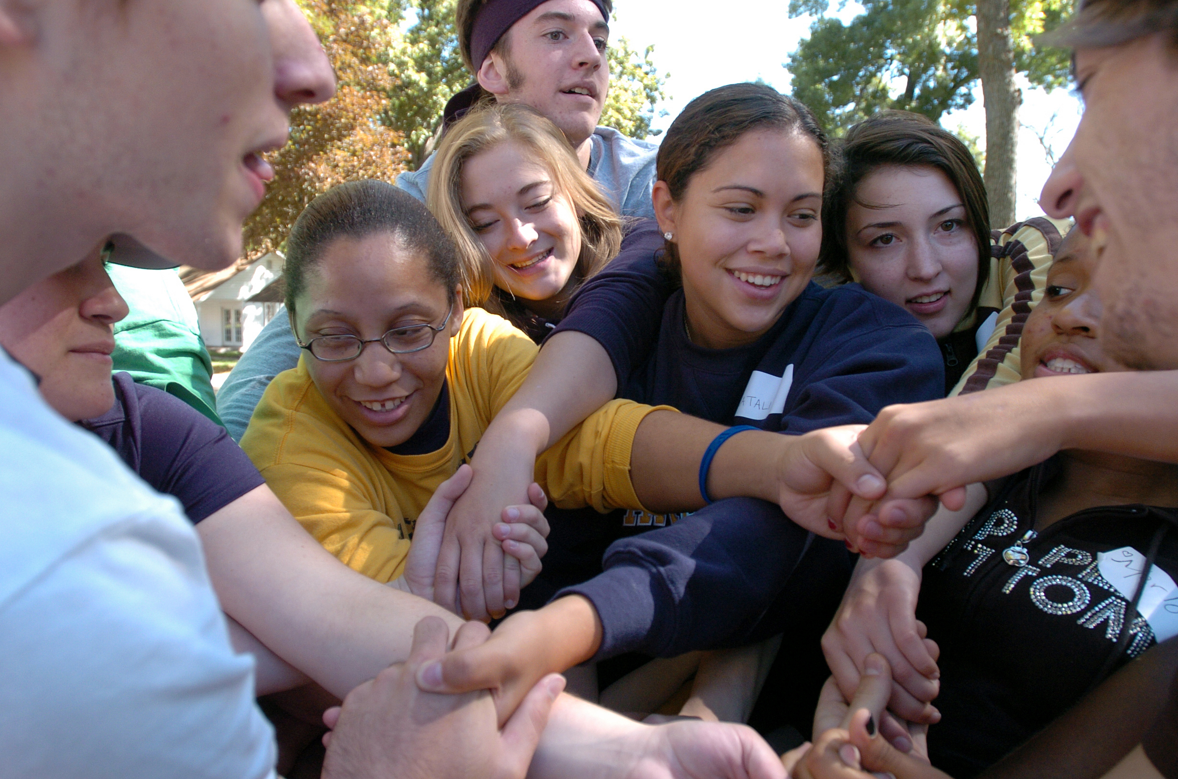

Notes:
Hi everyone! This presentation is all about Service Learning. By the end, you will know exactly what to expect from the Service learning experience and what your next steps should be to get started.

Slide 2
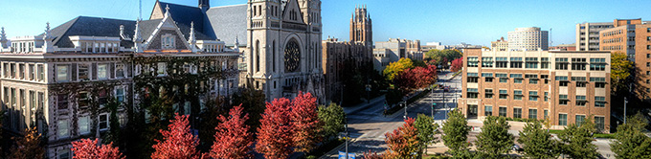
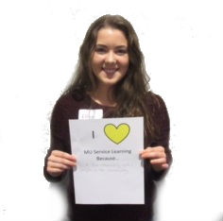
What is
Service Learning?
Content Knowledge
Skill
Development
Values Development text
An academic program part of the Center for Teaching and Learning
Students complete community service related to their courses
Enrich students’ academic learning, personal growth, and sense of civic responsibility
Notes:
Service Learning is different than community service because it is academic based and connects what you are learning in the classroom to real life experience. It is a program that is part of Marquette's Center for Teaching and Learning. Our goal is to enrich students’ learning, personal growth, and sense of civic responsibility.
Content Knowledge: Through service learning you can observe, question, and demonstrate course theories and concepts in real life situations which will help you better understand and retain the information.
Skill Development: Service learning provides the opportunity to refine skills that will be important in any workplace, like problem-solving, critical thinking, leadership, and professionalism…. and even skills that are particular to your professional goals like working with children and cultural competency.
Values Development: Think about how this experience will shape YOU! Your values, beliefs, vocational plan, and understanding of the world around you will be shaped by this experience.

Slide 3
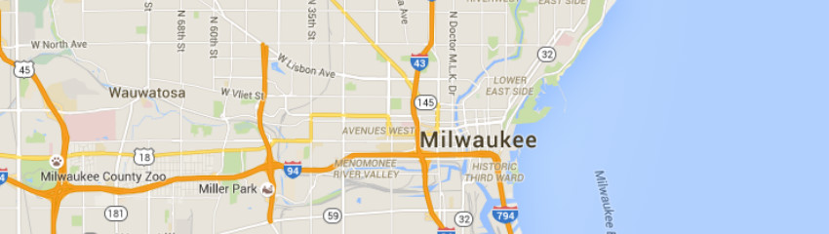
Why Do
Service Learning?
Hands-on experience that you cannot get from a classroom setting alone.
Gain a better understanding of social justice, inequality, and different cultures.
Create positive impact within Milwaukee and your own education by working with and building relationships with local organizations.
Grow and develop professional skills you can use in your future vocation.
Notes:
So why do we do service learning? Service Learning gives students the opportunity to combine classroom learning with hands-on experience. The goal is to apply concepts that you are learning in class to real-world settings. Additionally, through service learning, students can gain a better understanding of social justice, inequality, and different cultures, and especially how these concepts play out in Milwaukee. Service learning also helps to develop professional skills that you will be able to carry with you throughout your life, regardless of your future career. Skills such as communication, relationship building and cultural humility. Lastly, Service Learning exposes you to all that Milwaukee has to offer and positively impacts your education by working WITH local organizations and building relationships.

Slide 4

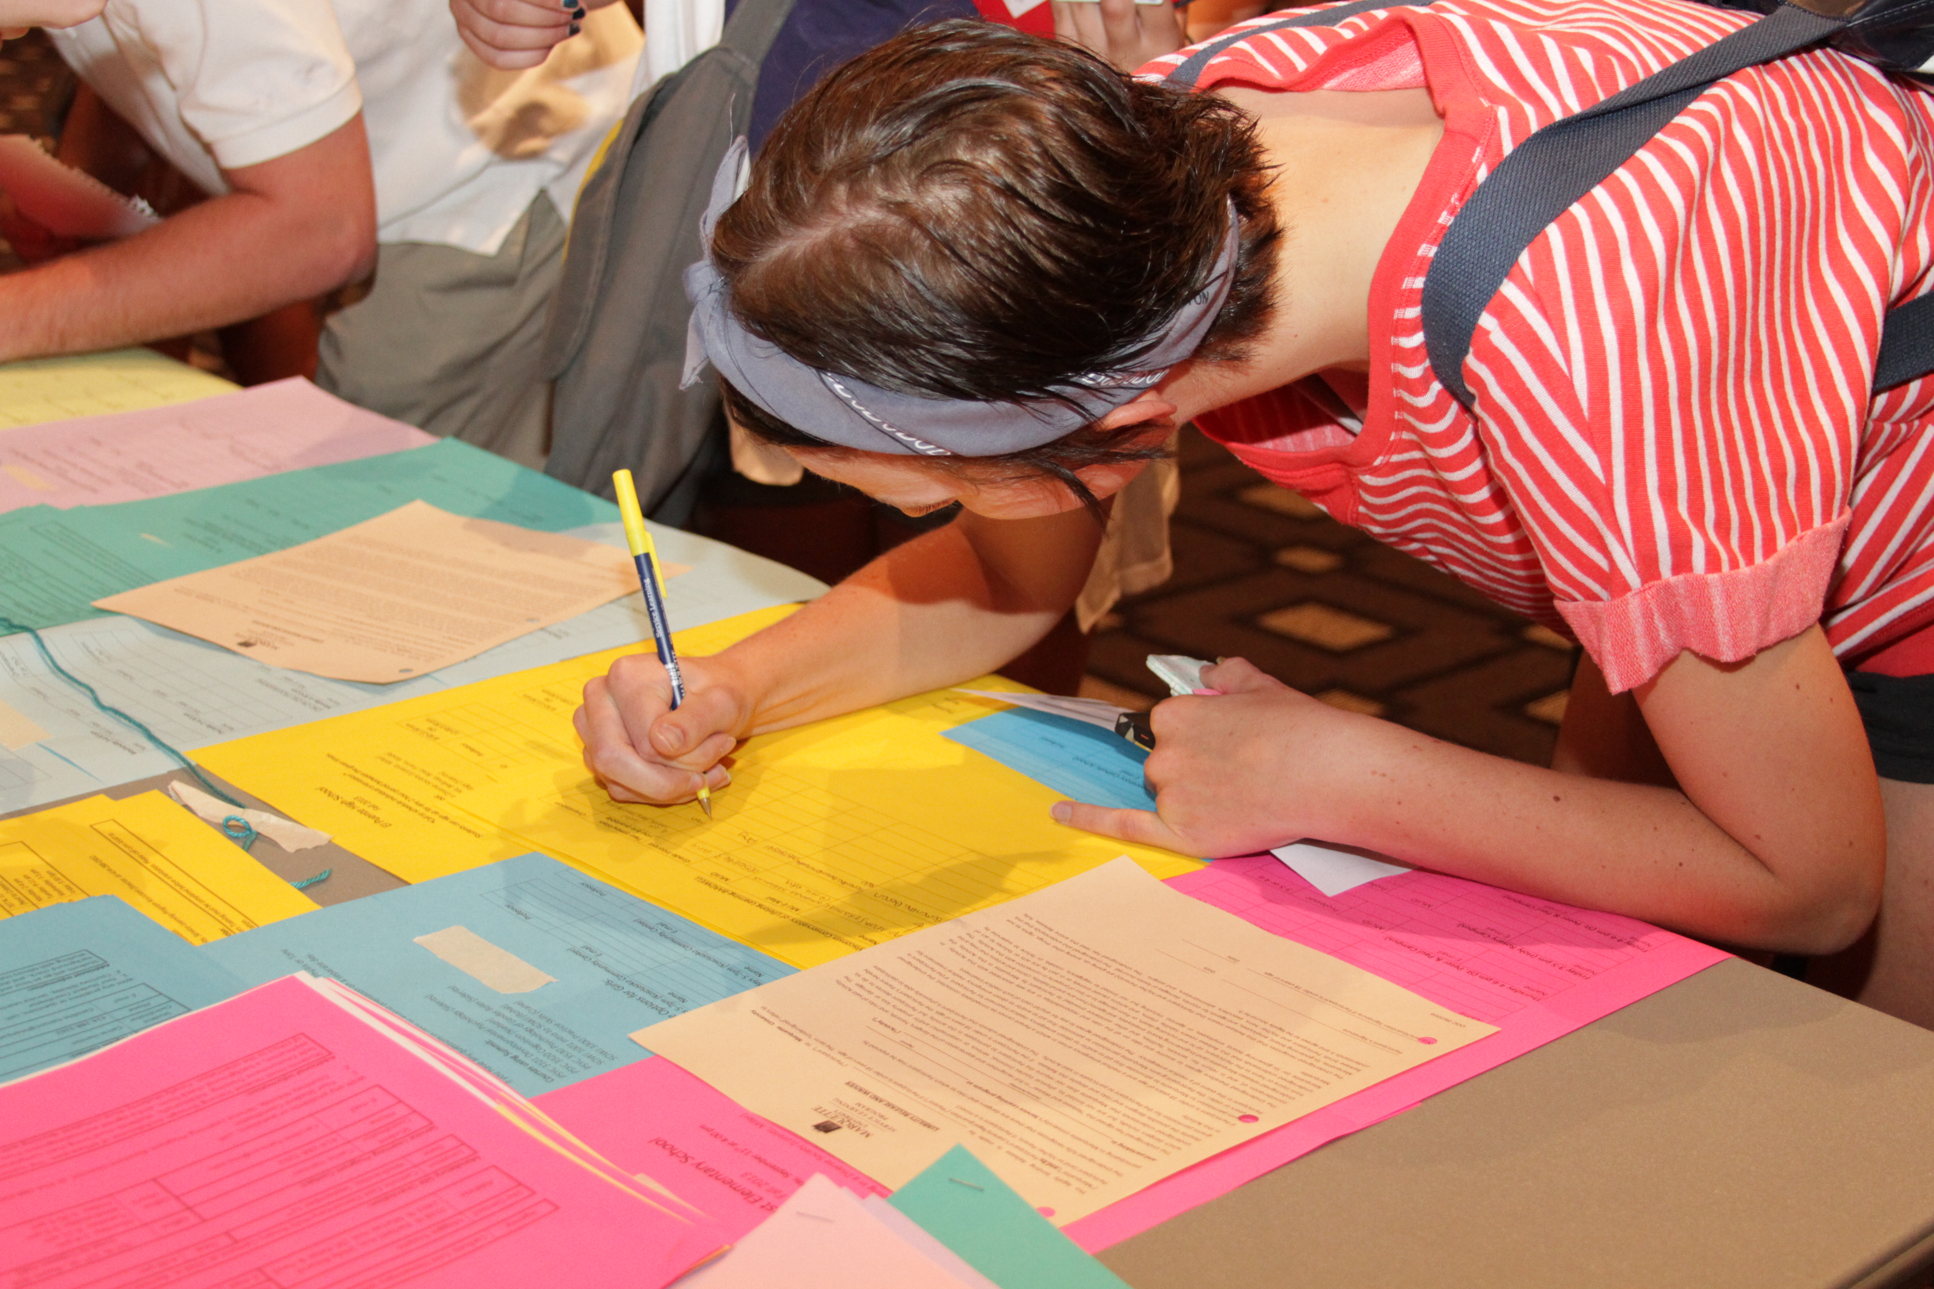
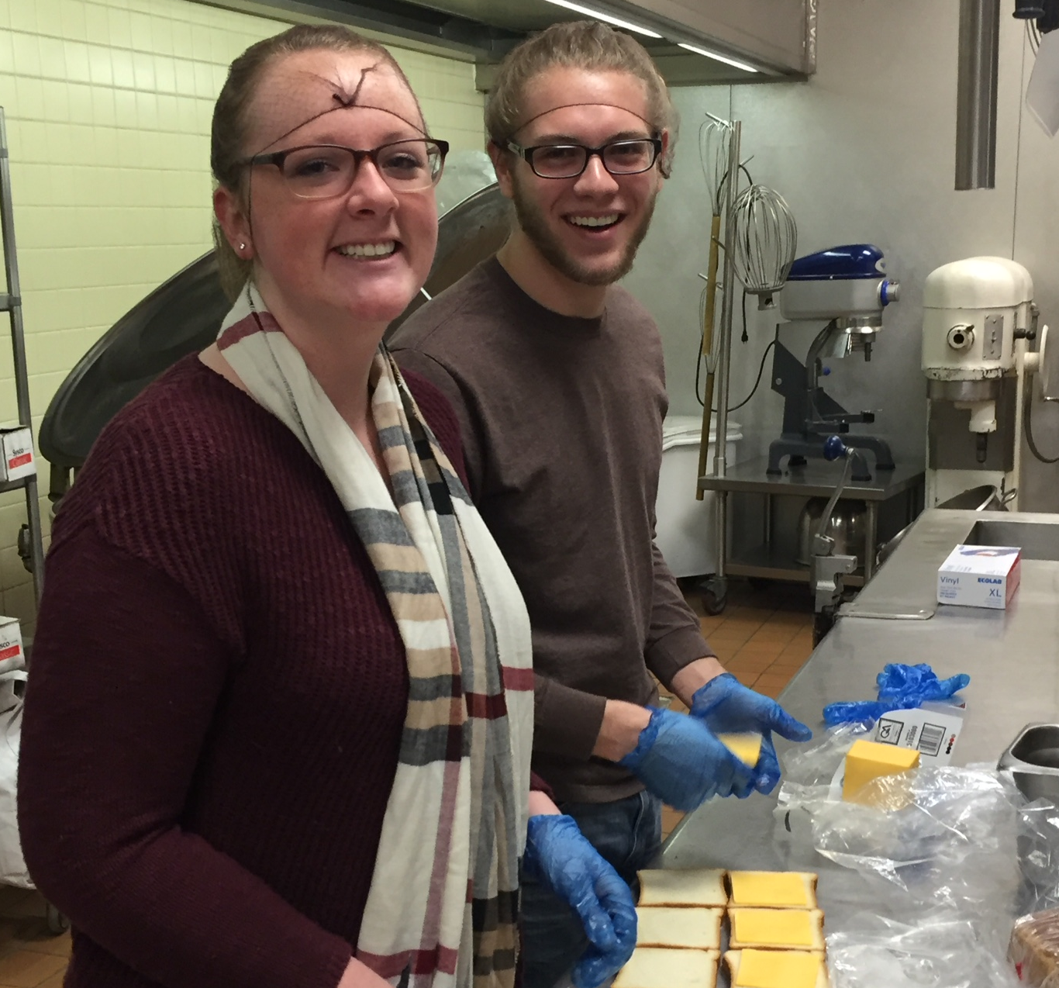
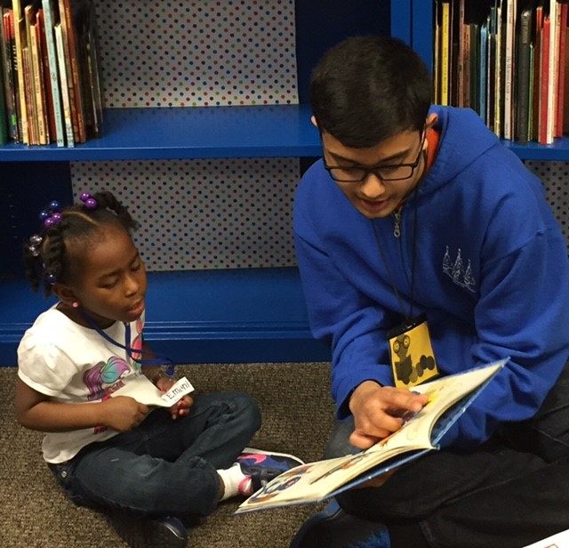
What is expected of you…
18-20 hours of service throughout the semester, (about 2-3 hours per week).
You must complete the entire semester through the last week of classes, even if you meet your hours requirement early.
Keep your course learning objectives in mind to make the most of your experience. If you are having a hard time making connections, ASK your professor or site contact.
Follow the rules and expectations of the sites. This includes dressing appropriately, completing necessary trainings and or background checks, etc.
Notes:
Students to complete between 18-20 hours of service throughout the semester, (about 2-3 hours per week).
You MUST complete the entire semester through the last week of classes, even if you meet your hours requirement early. Community partners have the expectation that service learners (that’s you) are committed and will be consistent in your attendance. This is service and it’s a job. Plan and make sure to tell your site contact of any anticipated absence. Service learners are not required to work over breaks but should let their site contact know ahead of time of any absence. Your site may have further instructions and expectations regarding absences during your site orientation.
As you do service keep your course learning objectives in mind to make the most of your experience. If you are having a hard time making connections, ASK your professor or site contact. Service Learning is more impactful if you can make connections between your class and course so, please speak up sooner rather than later.
Out of respect to our sites please follow the rules and expectations of the sites. This includes dressing appropriately, completing necessary trainings and or background checks, etc.

Slide 5
More Expectations…
Register ON TIME
Ask questions BEFORE it is too late
Check Email Daily
Working With Community Partners
  Take a “No Savior” Mentality
  Building Relationships
  Communication
  Attitude
  Commitment/Level of Engagement
  Phone Usage
Notes:
Register On Time
You are given a week to register. You are expected to REGISTER ON TIME.
Ask Questions
The Service Learning Program team is here to help you. Please ask questions the moment you don’t understand something AND make sure you read information thoroughly. Are we magical unicorns? Maybe, but it’s rare we can make magic happen when you wait until the “final hour” to ask questions or let us know you have a challenge. This experience is part of your class; waiting until the last moment or saying “I didn’t know” when you could have asked a question-is not a good excuse. Student Coordinators are your fellow peers, and we understand that managing school, work, and activities can be stressful. Please ask questions when you do have them- do NOT wait. We are here to help and would much rather take the time up front to fix something than wait until the last minute.
Check Email Daily
You should check your MU email several times a day and respond in a timely fashion. On the flipside of this request, we also ask for your patience. Community partners may not respond right away because of their respective workload, HOWEVER, please make sure you do your part to respond.
Working With Organizations/Sites/Community Partners
We recently conducted some deep dive interviews with several community partners to assess our partnership. Themes from our interviews have informed additional expectations and things you should think about during your service learning experience:
Take a “NO SAVIOR” Mentality
Many of you have engaged in volunteer work during your high school years and in your own time. The Jesuits are all about helping those in need. Having pity for those in need or centering oneself are often associated with volunteer and service work. Volunteers may think they have nothing to learn from those who they are helping, or they use the oppression experienced by marginalized folks as evidence of how “blessed” they are. All of this is problematic and prevents us from being aware and taking an action-oriented approach to getting rid of oppressive systems. You are not doing service learning to save anyone. Local communities in Milwaukee do not need your pity and they are not experiencing oppression to help you feel more blessed. While you are technically considered a volunteer, you are doing this experience to combine your classroom learning with work in the Milwaukee community. This means you should do more learning and processing from this experience. Community partners are considered co-educators and they do want help you understand their work with the hopes you will be actively engaged in remedying oppressive systems in our society. They also could use the support, skills, and talents of college students. This experience is bi-directional.
Building Relationships
If you don’t get anything else out of this service learning experience (again, the first objective of this experience is to combine what you are learning in this course with service), you should start the path of being able to build relationships with people who are not like you. Relationship building and being able to work with a variety of different people is a skill and it’s a quality many of future employers look for. Think about how you show up when you go to the organization and the stereotypes and narratives you have about the community that can impact how you build relationships. This experience should strengthen your ability to talk with, support, socialize, learn, and listen. You may not be best friends with the people you work with (and you probably won’t)-but there should be an appreciation of getting to know someone who is not like you. You should learn more from the organization and people you work with after this experience.
Communication with Community Partners
It’s a privilege to work with our community partners. Collectively they provide much of the needed resources for communities to thrive despite the oppressive systems that exist. Their work is plenty. Please make sure you ask questions, share with them your service learning course objectives, and what you hope to get out of this experience. They want to make sure your skills and talents match up with what they are asking you to do. Most importantly, communicating any challenges you are having (if any) and any logistical information (for example, days you may have to miss work) is equally important. Because of the workload of many community partners, they may not get back to you right away. Just make sure you are responding in a timely fashion. If you have challenges with communication, let us know ASAP. We often tell students to give community partners at least a week to respond to you.
Attitude
Some of you may be excited about this opportunity, indifferent (don’t really have strong feelings for or against) about this experience, and some of you are only doing service learning to get a good grade in this course. Community partners know the difference between students who are only serving because of a course grade and those who take the experience seriously. We really want you to be aware of your attitude when working with our community partners. Not only are you representing Marquette, but you are also representing yourself and showing your level of professionalism through your attitude. You create an unnecessary level of work for the community partner when you work begrudgingly or don’t approach this experience with healthy attitude. We can help you find an organization that aligns with your interests, so this experience doesn’t seem like a chore you don’t want to do.
Commitment/Level of Engagement
Community partners can tell when you are not committed and when you are not engaged with the jobs/tasks/assignments you are tasked to complete. If you find that a task/job responsibility at the organization does not align with your skill set or are uncomfortable, please let us know right away. Again, work through the entire semester, even if you complete your hours early. Lack of consistent attendance with no communication or regard for the work of our community partners reflects poorly on you and is frankly, disrespectful. Don’t be disrespectful.
Phone Usage
Many community partners commented on MU students’ phone usage with prevented students from being fully engaged at the organization. Unless the organization is asking you to use your phone, do not use your phone when you are working at your site or check with your site about their phone usage policy. We noticed there were a couple of reasons why students are more engaged with their phone than working with a site: 1. working in a different environment is new and some students feel intimidated, 2. students may feel bored, 3. students don’t know what do-they feel a little confused, or 4. they literally don’t want to do service learning and are only at the organization for the purpose of getting a good grade. If you find yourself in any of these situations, please discuss with your site contact or contact us. Sometimes, we work with community partners to revamp job tasks/responsibilities for students or students find additional work to assist with to better stay engaged at their site. We are happy to help you figure out ways to stay engaged at your site and communicate any challenges with your site contact. Be respectful of your time but most importantly, the community partner’s time.

Slide 6

Transportation and Safety
EagleExpress does not travel outside the normal route.
More resources for directions to your site:
maps.google.com
ridemcts.com
Make use of the Umo Mobility app to help schedule your bus routes. Your Student Coordinator can also help to arrange carpools.
Whenever you travel to a part of the city that is unfamiliar to you, be aware of your surroundings. Watch the Service Learning Safety Video prior to your site orientation at: http://www.marquette.edu/servicelearning/safety.shtml
Safety resources:
  MUPD Non-Emergency 414-288-6800
  MUPD Emergency 414-288-1911
Other resources if willing to pay:
  Lyft, Uber, Taxi
Notes:
Most service learners take the bus to their service sites, although driving, taking an uber, and walking are all options depending on the distance to your site. If you’re new to the bus system in Milwaukee, the ride MCTS app is a great resource that shows bus routes and times. You can put in the address you’re starting at, the address of your site, and the time you want to be at the site, and the app will tell you exactly what bus to catch, where to catch the bus and at what time. As someone who had never ridden the bus before coming to Marquette, I totally understand how overwhelming taking the bus can be, but the MCTS app walks you through exact steps and is very user friendly. If you are nervous about taking the bus, please email someone from our office, and we can walk you through exactly how to do it. The whole point of Service Learning is to get out and see Milwaukee, and what better way to do that than riding the bus! In addition, if you are nervous to ride the bus alone, please reach out to your Student Coordinator, and they can potentially help to set up a buddy system if there are others going to your site. For more information, you can check out the Safety video on our website or attend DPS safety trainings.

Slide 7
COVID-19 Safety Update
COVID is still a thing y'all!
Some sites may require a COVID vaccination.
Vaccination or no vaccination, students must adhere to any mask mandates, capacity limits, and PPE requirements at organizations and follow all safety guidelines provided by the organization.
Some sites may continue offering virtual service learning opportunities in addition to in-person opportunities.
FYI: Community partners are still pivoting, figuring out a new normal, and playing “catch up”.
Notes:
Students will receive information on specific requirements related to COVID-19 when they register for service learning. Each site/community partner may have different guidelines. Students are responsible for asking questions and getting clarification if they don’t understand the COVID guidelines at their site.
Some organizations may require a COVID vaccination. Be prepared to provide proof of a vaccination or discuss any allowances or requirements for people who are not vaccinated due to medical reasons. If you do not/cannot have the COVID vaccine and the organization does not allow you to work with their organization, be prepared to find another organization. Our staff can help match with another organization, if needed.
As students be prepared to walk into organizations who are figuring out a new normal or playing “catch up”. For example, many of our school and youth serving organizations will need support with tutoring. If you register to work with a school or youth serving organization, be prepared to assist younger students with academic work. The pandemic had a huge impact on how K-12 students learned and many schools are working extra hard to ensure their students catch up. Keep in mind the impact the pandemic has had marginalized communities and the work of local organizations. Pivots are still happening. MU service learners should exercise patience, be adaptable, and ask questions when needed.

Slide 8
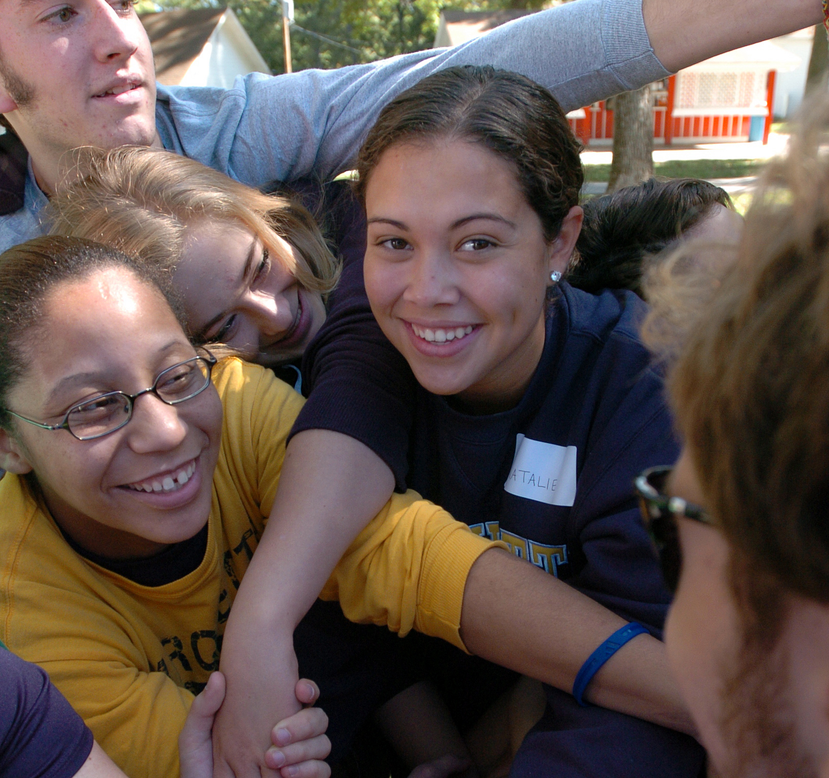
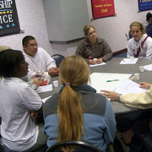
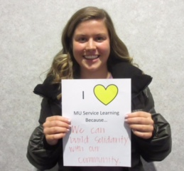
Reflection Sessions
As part of Ignatian pedagogy, reflection both allows students to discuss their experiences and challenges them to “dig deeper” and increase their awareness of social injustices.
All reflection details can be found on our website at: http://www.marquette.edu/servicelearning/ReflectionSessions.shtml
Students can register/RSVP for Reflection Sessions through their service learning course on MUEngage:
  Only RSVP for 1 Reflection Session
  Students who register have seat/space priority
  If a reflection session is offered twice-please only sign up and attend one of the sessions. Do not attend the same topic twice.
Note: A Little Context: Introduction to Milwaukee and Your Role in the City, was created especially for students new to Service Learning. In this session you will be introduced to the greater Milwaukee community and your role as a service learner in this city.
Notes:
As a Jesuit university, we place a strong emphasis on reflection. Reflection challenges us to “dig deeper” and increase our awareness of social injustices, and it gives us a chance to talk with others about their unique Service Learning experiences. Check with your professor to find out if you are required to attend a reflection session.
Some reflection session topics are offered twice. If the same topic is offered twice, please ONLY ATTEND one of the days and times that reflection session topic is offered.
If you are going to attend a session, you must RSVP in order to reserve a place at the reflection. RSVPing to the session that you want to attend early is very important, especially this semester. We are limiting the number of students at each reflection to support productive conversations, so be sure to register for the reflection session that works best for you and your schedule ASAP. If you arrive more than 15 minutes late or leave more than 15 minutes early, your attendance won’t be counted; these sessions are between an hour and 15 and an hour and 30 minutes long, so be sure to budget enough time to attend the whole session.
You are encouraged to register NOW for reflection sessions. Sessions tend to fill up quickly. Again, only those who have RSVP’d will have priority access.
If you are not familiar with service learning, you can prepare yourself further by attending the Service Learning 1001 Reflection Session, but if you have participated in the Service Learning 1001 Reflection Session in past semesters, you do not need to participate again.

Slide 9
Fall 2023 Reflection Sessions:
A Little Context: Introduction to Milwaukee and Your Role in the City
R1: I Want to Help Others: Ethical Considerations for Service and Volunteerism
R2: The Impact of Implicit Bias
R3: The Privilege of Health Care
R4: The Impact of my Service Learning
Special Offering: Human Library
Please remember to RSVP for your choice of sessions through your service learning course on MUEngage
Please only register for 1 reflection session. If you would like to attend 2, please notify the Service Learning Program
Arriving more than 15 minutes late or leaving more than 15 minutes early will not be counted as a reflection attendance.
Notes:
Here is a list of the reflection sessions that we have planned for this semester! Like we mentioned before, make sure to RSVP to the session you would like to attend. You RSVP on MUEngage, and there is a presentation on our website walking you through exactly how to do that.

Slide 10
Important Dates
Registration Starts:
Wednesday, Sept. 6 at 12:00pm
Registration Ends:
Wednesday, Sept. 13 at 5:00pm
The Service Learning Program staff will be in the office ready to take phone calls or emails on September 6th for students having trouble registering on MUEngage. Students can still call or email any time Monday-Thursday 9am-5pm or Friday 9am-4pm.
Notes:
You have one week to register for service learning. Registration on MUEngage will open on Wednesday September 8th at noon and will close on Friday September 17th at 5:00pm. The Service Learning Program staff will be in the office ready to respond to phone calls and emails on September 8th. Our office is open for questions on a weekly basis Monday through Thursday 9am to 6 pm and Friday’s 9 am to 4 pm.
If you register for a site and your schedule changes, and the day and time you registered for no longer works in your schedule, you can cancel and re-register for a site. However, after the registration date closes, you will need to contact our office regarding registration. We encourage you to register before September 17th because after that date you will have to reach out to us in order to sign up for a site. If you have any questions surrounding registration, we have a presentation walking you through exactly what to do, and we also have an instructional guide posted on our website.

Slide 11
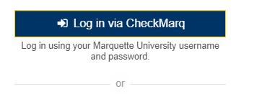
Registration
We have instructions on how to register properly for service learning and we need to review those instructions!
REGISTER THROUGH YOUR SERVICE LEARNING COURSE and not a volunteer opportunity posted by the community partner.
Log into MUEngage right now!
Search “Give Pulse Marquette” or go to our website “Marquette Service Learning”
Notes:
We can’t stress enough the importance of reading and following directions when registering for service learning opportunities. We have written and video instructions on the service learning website. Please read and/or view the registration instructions BEFORE you register.
When you register for service learning, you want to register THROUGH YOUR SERVICE LEARNING COURSE. (*show students on the computer where they would find their service learning course after they log-in MUEngage using their check marq credentials).
Community partners often post volunteer opportunities on MUEngage. Do not register through a community partner. Register through your service learning course. If you register for a volunteer opportunity created by the community partner, your professor won’t have record of that registration and will not see the impacts (i.e. hours) you logged. Again, familiarize yourself with instructions on how to properly register BEFORE registration opens.

Slide 12
Things You Should Know…
We need you to pay attention and read thoroughly the follow-up email AFTER you register.
Service starts AFTER your orientation, any background check clearance, and/or trainings
DO NOT contact organizations before registration or try to arrange your own placement with organizations that are partners with the Service Learning Program.
DO NOT register for more than one site placement!!
Again…read, listen, or view the MUEngage instructions listed on the Service Learning Program website.
Notes:
Follow Up Email/Message from SC
Once you register, you will receive a follow-up email from your Student Coordinator. The Student Coordinator is a student staff member (like me) that will make sure you have all the information needed to get started with your service. The follow-up email will contain any paperwork and/or trainings you need to complete BEFORE you start your service. It is your responsibility to read the email and follow instructions. This email will also have information on your orientation date.
Pay attention to orientation dates and follow instructions
If you have any confusion or clarifying questions please reach out sooner than later as many deadlines are time sensitive.
Your service will start AFTER your orientation.
Contacting Sites On Your Own
We’ve had a lot of challenges in the past with students contacting sites, trying to arrange their service learning. This has caused numerous problems because students don’t know the relationships, we have with community partners and often contact the wrong person. Or they try to bypass the process already established. Please follow our directions for registration. If you have trouble with registration, please contact us ASAP. Avoid personal frustration and confusion.
Do Not Register for more than one site placement
If you register for more than one site placement, we will delete your registration.
Instructional Videos
AGAIN (lol)…We cannot emphasize enough the importance and helpfulness of watching the instructional videos and/or reviewing the guides our staff has created for you to register and log impacts properly. They are step-by-step guides that will make the process go smoothly. If we sound like a broken record, it’s because we still have students who don’t read the instructions and/or ask questions. Please read instructions and ask questions for clarification.

Slide 13
More Things You Should Know…
Other MU Sponsored Volunteer Programs
Two or more Service Learning Courses
Site/Organization Not Listed for Course
Logging Impacts
Multiple management systems
Notes:
Other MU Sponsored Volunteer Programs
If you are currently part of or interested in serving with volunteer opportunities with a different MU Program (e.g. Midnight Run or MU Volunteer Corps), you must go through their respective sign-up process. You may have to complete additional paperwork with the Service Learning Program office and get approval from your professor. Contact us to make sure you can count hours from another MU volunteer program for service learning.
2+ Service Learning Courses
If you have two or more service learning courses, you only have to complete 20 hours of service at one site. If there is an organization that is listed for one course but not the other on MUEngage, get verbal approval from the professor of the course that organization is not listed for and register for the event under the service learning course that it is listed under. Log your hours under the course that listed the opportunity and you share those hours with your other course. Instructions on how to do this is in the Instructional Guide. Keep in mind that the site should pertain to both of the Service Learning courses.
Site/Organizations Not Listed for Course
If you are interested in working with a site that is not listed as a site that has been pre-approved by your professor, please reach out to us at the Service Learning office. Volunteer opportunities that you are already taking part in may count as Service Learning, but please reach out to us if you are interested in an agency not listed on your professor's list because there are additional forms that you will need to fill out.
Impacts/Hours
Keeping track of your service learning hours, which MUEngage refers to as Impacts, is a very important part of service learning. You must record all your impacts on MUEngage in order to receive credit for your service. Instructions on how to do this are in the instructional guide on the service learning website. Student Coordinators work with community partners/organizations/sites to verify your hours. Make sure your Student Coordinator’s name is listed as the verifier for your impacts. When you register and receive your follow-up email, your Student Coordinator can answer questions regarding impacts. Log your hours weekly and keep them up-to-date especially during midterms and finals. Having up-to-date hours allows us to verify your service with your site more easily and be able to clarify any miscommunications. We would not want hours that you completed be disputed simply because you failed to upload them. If you need instructions on how to add impacts you can go to our Marquette website for specific instructions and video tutorials. When you don’t log your impacts, you are telling your professor you are not doing service learning. If service learning is a requirement for your course, not logging impacts will impact your final grade.
Multiple Volunteer Management Systems
Keep in mind that community partners also have their own volunteer management systems, so you may find yourself recording impacts in MUEngage and still logging in volunteer hours with your site placement (for example, if you volunteer at an MPS school). At the end of the semester, you can email a printout of your logged hours to your Student Coordinator and that can serve as verification of your service learning hours in MUEngage.

Slide 14

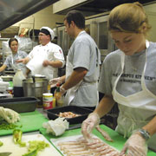
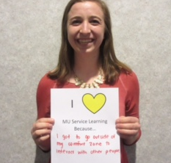
Tips for Success
Late Sign-Ups/Switching Sites
  Late Registration Policy- After September 13th, late sign-ups will be considered but not guaranteed until September 29th. After September 29th, the student will be responsible for securing their own placement or will need to drop the class.
Background Checks, Important Paperwork, and Trainings
Falsifying Hours
Final Grades
Are You An Athlete?
Notes:
Late Sign-Ups
There are no early sign-ups for sites. You have until September 17 at 5pm to sign-up for a site; any time after September 17, you must get approval from the Assistant Director.​
​​
Background Checks, Important Paperwork, and Trainings
Many sites require background checks, important paperwork, and trainings. We can’t stress the importance of waiting until you receive a follow up email from your Student Coordinator for further instructions and following those instructions. Please make sure you read and follow instructions when it comes to completing any paperwork. Any delay in submitting paperwork or doing trainings will delay your start date for service. ​
​
Falsifying Hours
You must log in your impacts on MUEngage . All hours are verified. Please do not falsify hours online! We will verify all hours with your site. If you falsify impacts/hours, it is considered academic dishonesty and we will inform your professor.​
​
Final Grades
Finally, remember that the service learning office does not administer final grades. We only report and verify the hours you completed to your professor. If you do not have the number of hours required, you need to talk with your professor about the impact on your grade. ​
Are you An Athlete?
Athletes often worry about finding time for service learning. If you have trouble finding a site that works with your schedule, please email or call the service learning program office and we can work with you.

Slide 15
Next Steps:
Watch, read, or listen to the MUEngage instructional videos to learn how to create your MUEngage Profile (if you haven’t already)
Preview reflection sessions and register to secure your spot.
Start Previewing service-learning opportunities in your service-learning class in MUEngage (check frequently)
Register for Service Learning online starting Wednesday, September 6th at 12:00pm (call or email if you have challenges registering)
Notes:
So, what now? That was a lot of information, so here are your next steps:
First, create your MUEngage Profile (if you haven’t already) .
Next, start Previewing service learning opportunities in your service learning class in MUEngage (check frequently, as they might be updated.
Preview reflection sessions and register now to secure your spot.
Finally, register for Service Learning online starting Wednesday, September 8th at 12:00pm. Call or email the service learning office if you have challenges registering.

Slide 16
Questions?
Website:
mu.edu/servicelearning
Email:
servicelearning@marquette.edu
Call:
414-288-3262 or 414-288-3264
Follow us on Social Media!
Instagram: @mu.servicelearning

