Slide 1

Independent Placements

Slide 2
What is an Independent Placement?
Sites that are not partnered with the Marquette's Service Learning Program. Not sure if a site is partnered with the Service Learning Program?
We have a list of sites that we partner with on our website: https://www.marquette.edu/service-learning/muengage.php
To complete service learning hours with a site not partnered with the Service Learning Program, you must get approval from your professor. Have you filled out the form?
We have the form on our website: https://www.marquette.edu/service-learning/muengage.php
Send the completed form to servicelearning@marquette.edu
Notes:
An Independent placement is a site that does not partner with the Marquette University Service Learning Program. Not sure if a particular site partners with the Service Learning Program? Check the link on this slide for a list of the Service Learning Program partner sites. For your independent placement to count for your class, you need to have that site approved by your professor. Be sure to fill out the form on our website and return it to us ASAP! You can email the forms to servicelearning@marquette.edu.

Slide 3
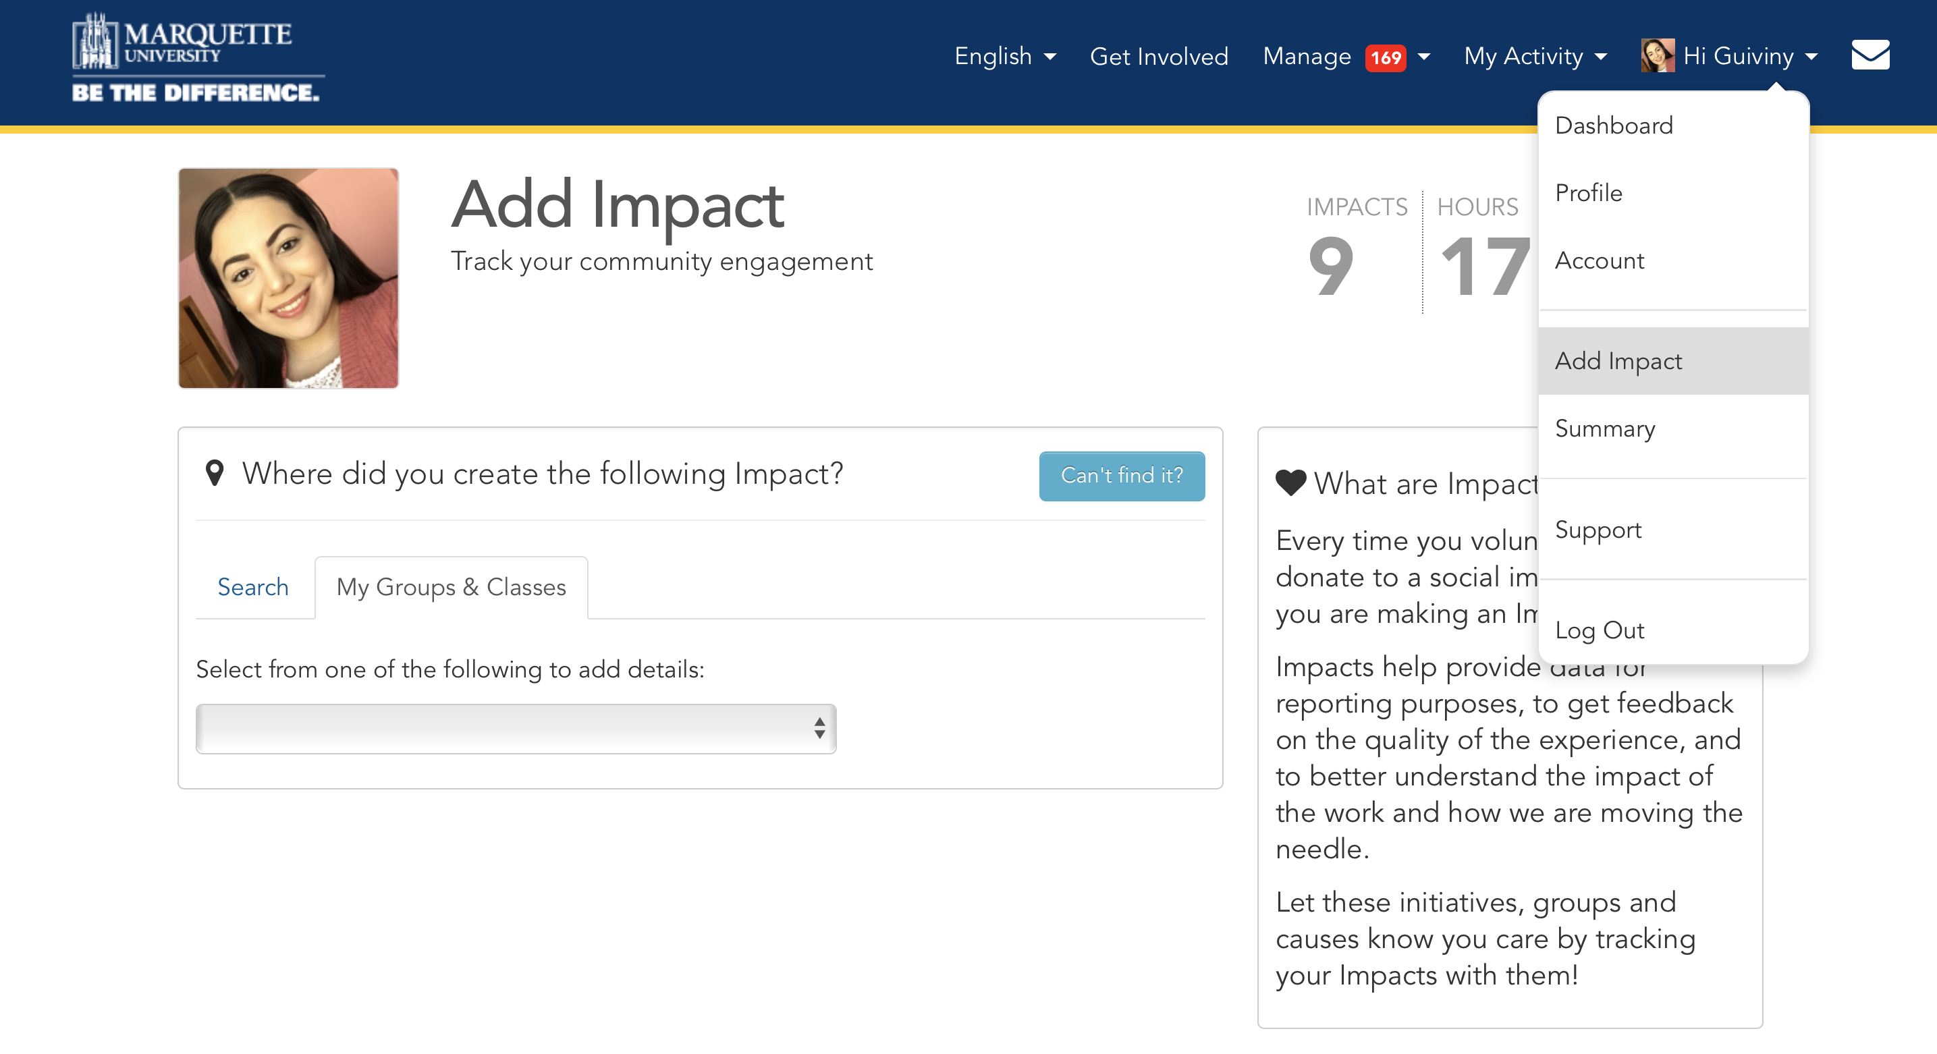
How to Add Impacts
Notes:
First , go to MY DASHBOARD and click the DOWN ARROW next to your name. Click ADD IMPACT, then Click on the blue, CAN’T FIND IT?

Slide 4
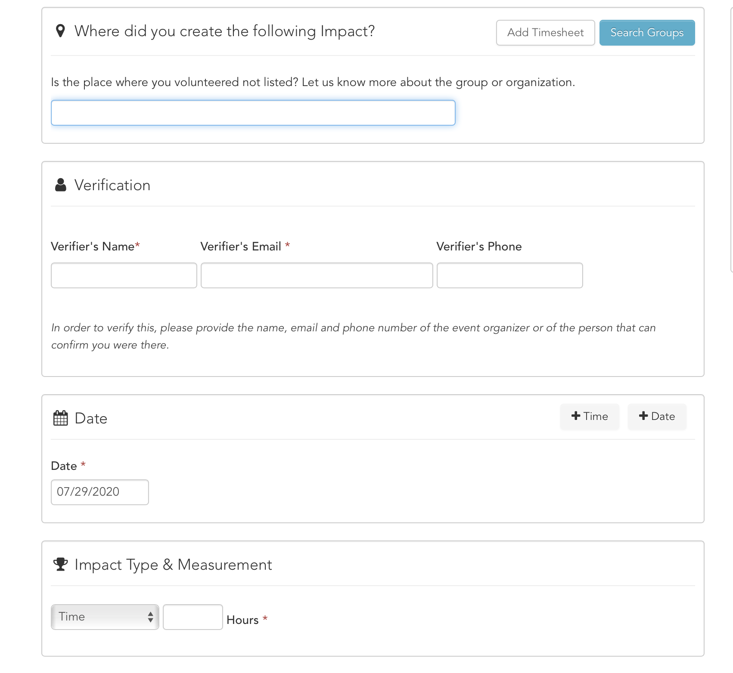
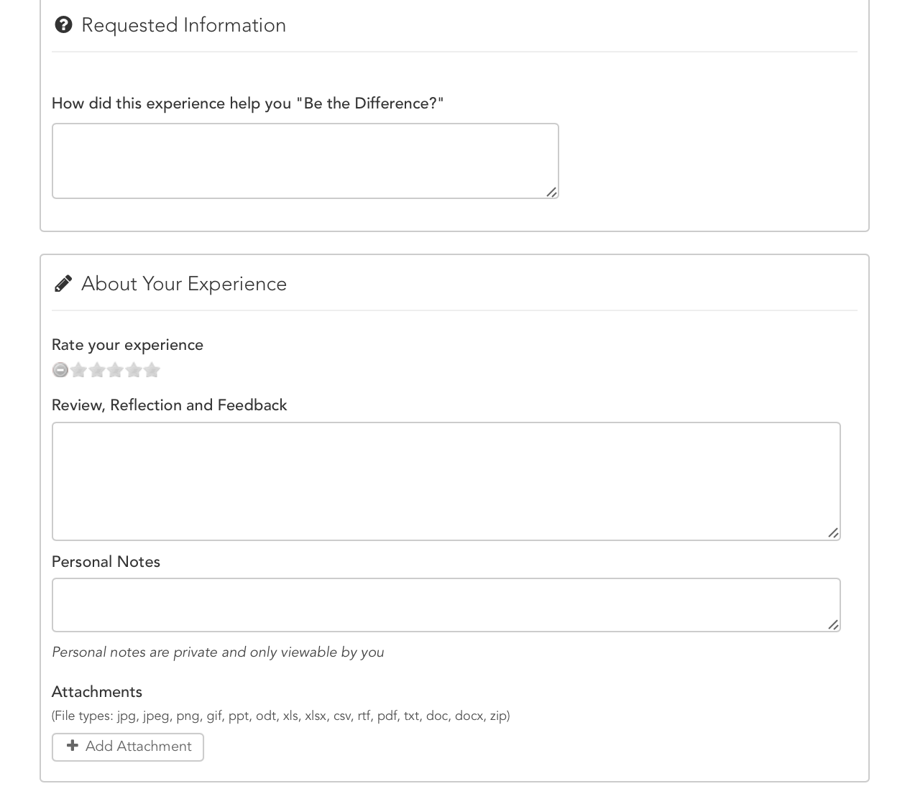
How to Add Impacts
Notes:
Type in the Group (i.e. Organization’s Name) Name that you are attending for your service learning. Under Verification, type in the Name, Email, and Phone Number of your site supervisor (a person who can verify you completed your service learning hours). All information is verified by the Service Learning Staff.
Under DATE, enter the date for service. Click TIME and enter the time of service. You will need to do this EVERY TIME you are completing service at the organization. Under IMPACT TYPE AND MEASUREMENT, select TIME, then add the number of hours you completed on that specific day of service. Next, Under Requested Information, you can choose to answer the questions. Under ABOUT YOUR EXPERIENCE, you can choose to rate the experience and add any personal notes. That additional information is optional to fill out.

Slide 5
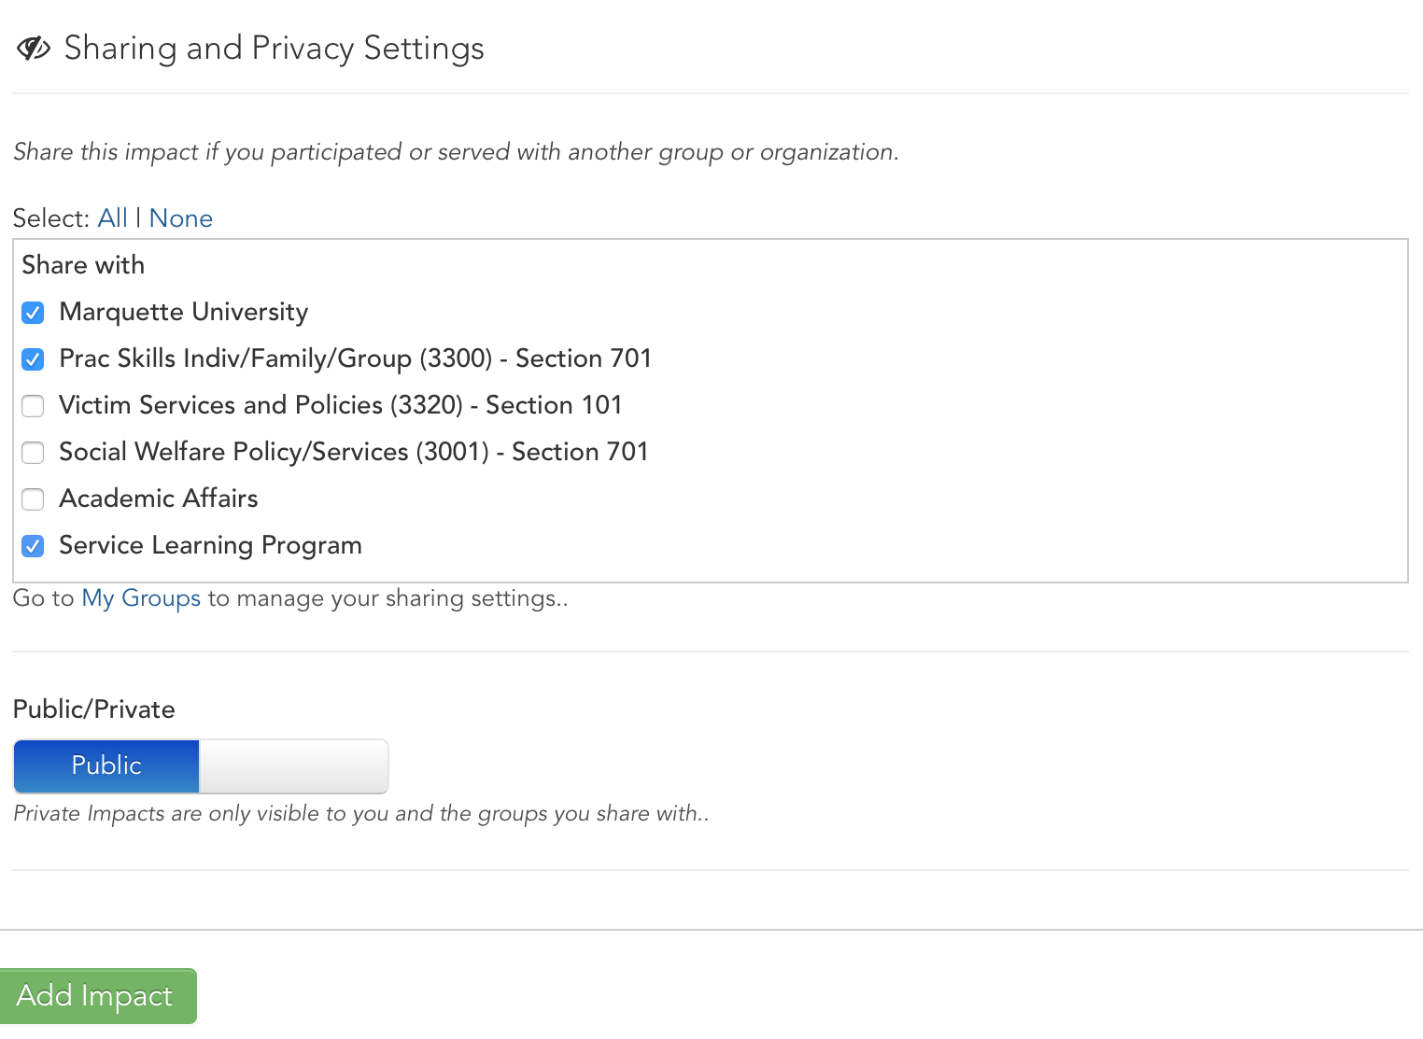
How to Add Impacts
Notes:
Under SHARING AND PRIVACY SETTINGS, make sure you select the groups (i.e. your service learning courses) to share your service hours. If you do not share the hours with your service learning course, your professor will not see your service learning hours. Finally, Click ADD IMPACT!

Slide 6
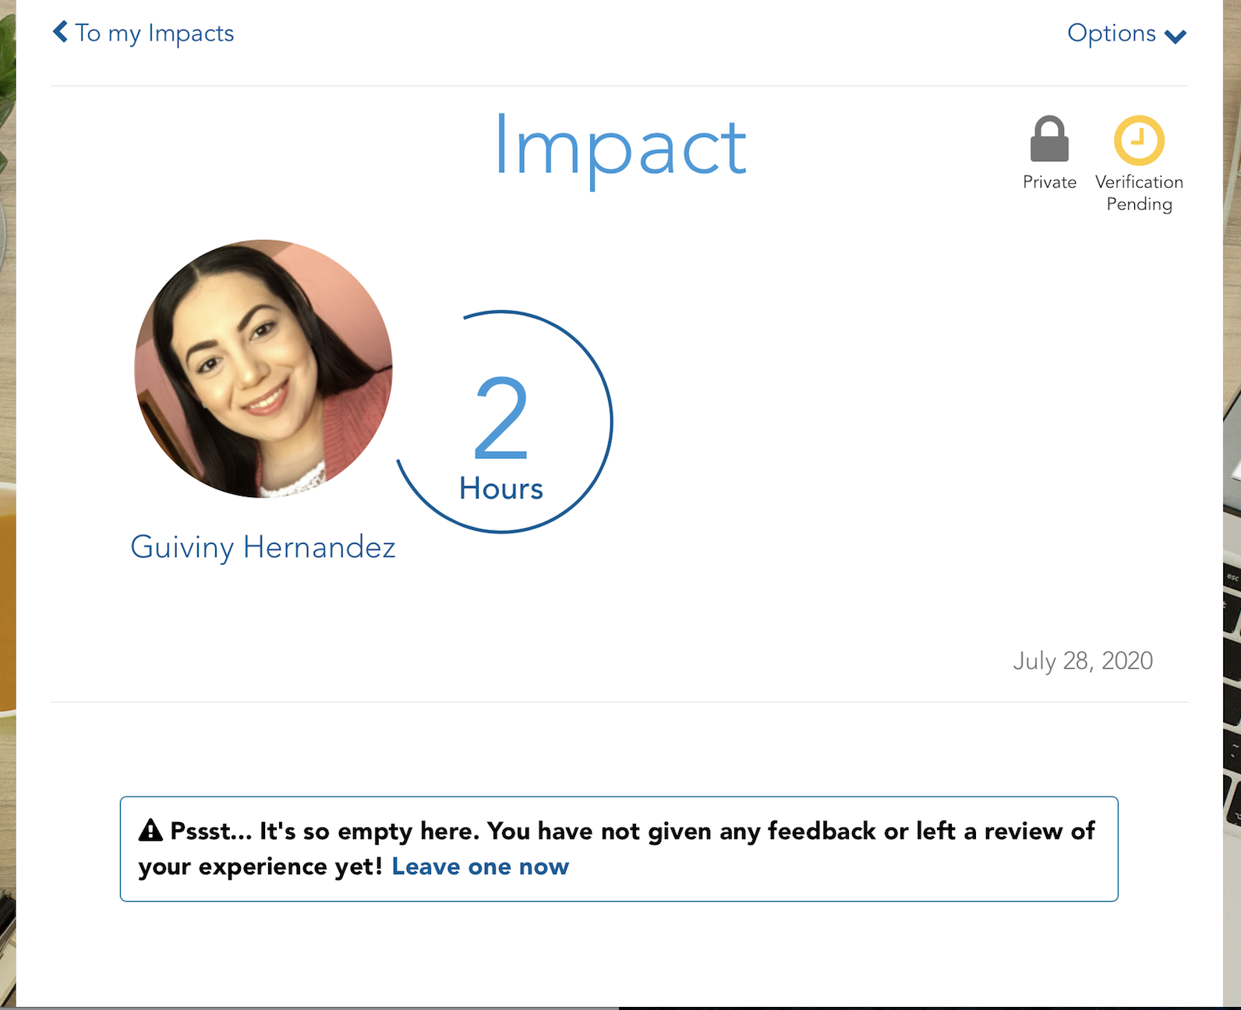
Confirmation
Notes:
Once you have added your impact, you will be taken to a confirmation screen. The Student Coordinator in charge of verifying your hours will confirm your attendance with your site then verify the Impact.

Slide 7
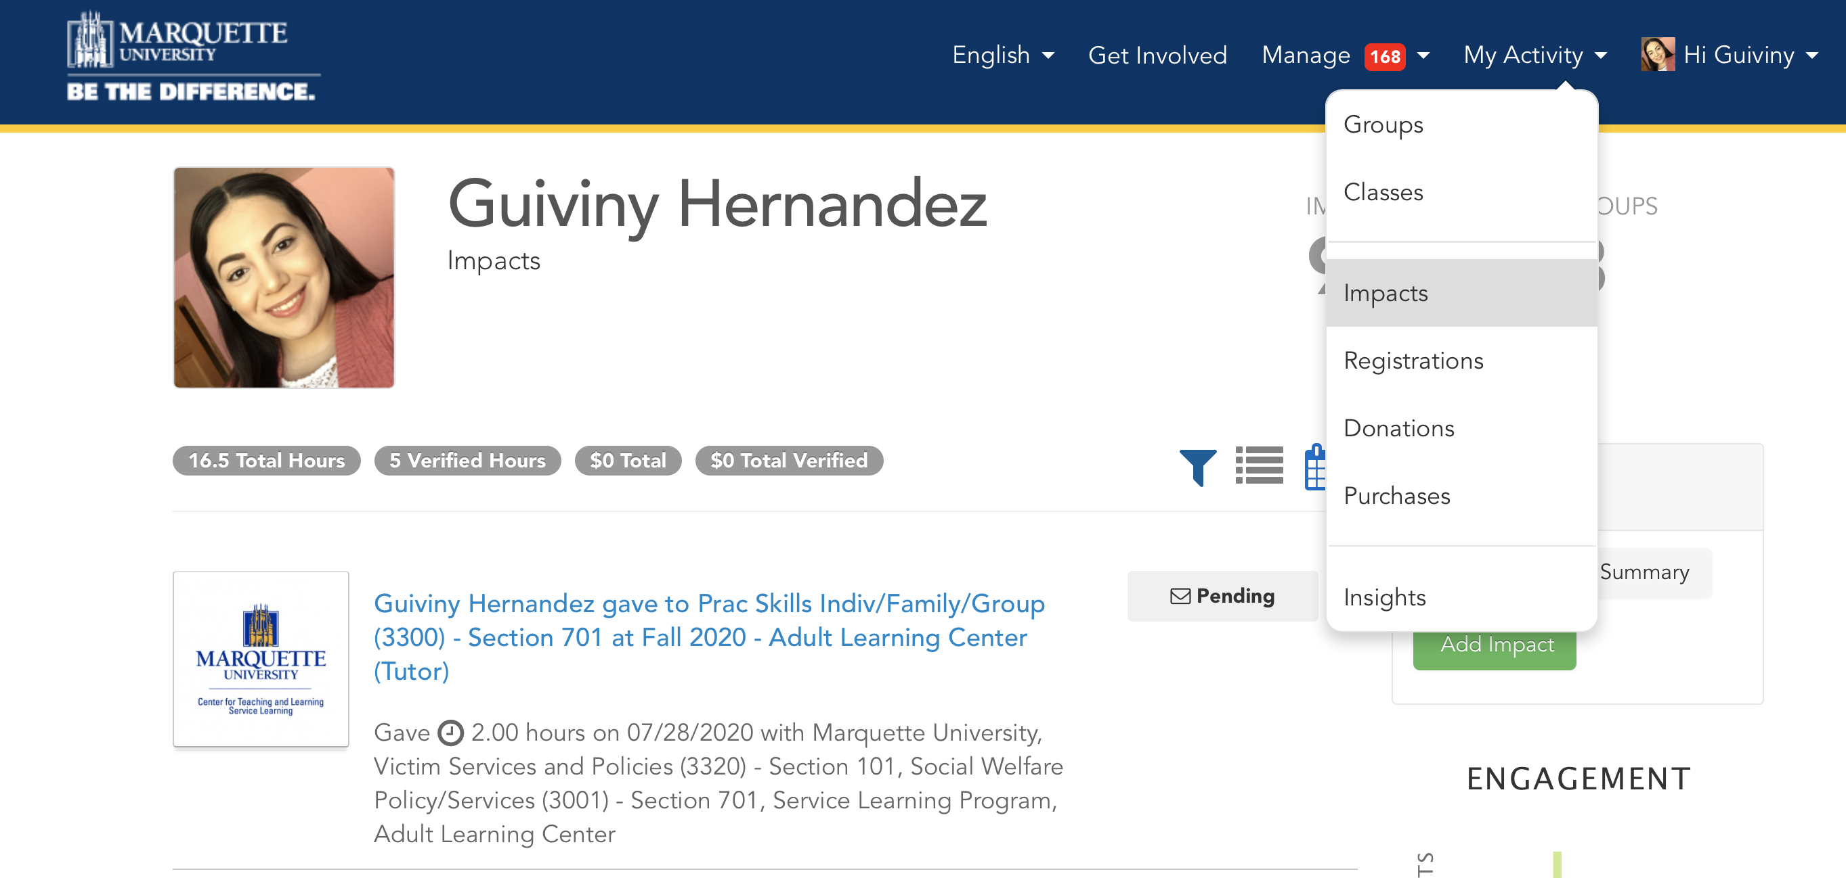
Editing Impacts
Notes:
If you mistakenly entered the wrong amount of impact hours or need to update your impacts, you can edit this change yourself. Go to the impacts on the dropdown under your name.

Slide 8
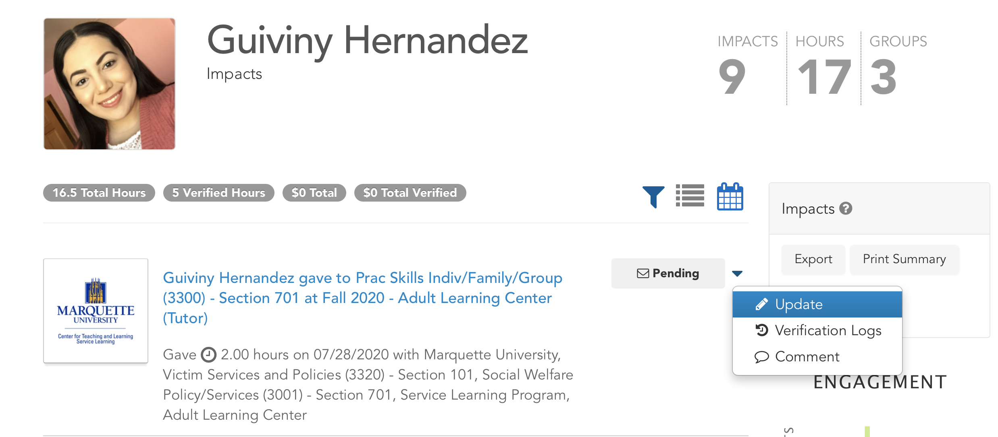
Editing Impacts
Notes:
Find the impact that you need to change, and on the right side, there will be a dropdown arrow. Go to the tab that says “Update.” From there, you can make any changes you need, or you can scroll to the bottom of the page to delete the impact, using the red “delete” button.

Slide 9
Need more help? Check out more resources on our website!
https://www.marquette.edu/service-learning/muengage.php
Email us: servicelearning@marquette.edu
Notes:
You can also find all this information in the student MUEngage guide that is on our website. It is linked below in the description, and if you find yourself struggling with anything, please consult the guide before reaching out to our office. If you still do have questions, however, after watching this video and reading through the guide, please feel free to reach out to us at servicelearning@marquette.edu.

