Slide 1

How To Register for Reflection Sessions
Notes:
Many professors require their students to attend at least one reflection session. To attend these sessions, you MUST register for the session before the date of the reflection. Registering for a reflection is like registering for a Service Learning opportunity.

Slide 2
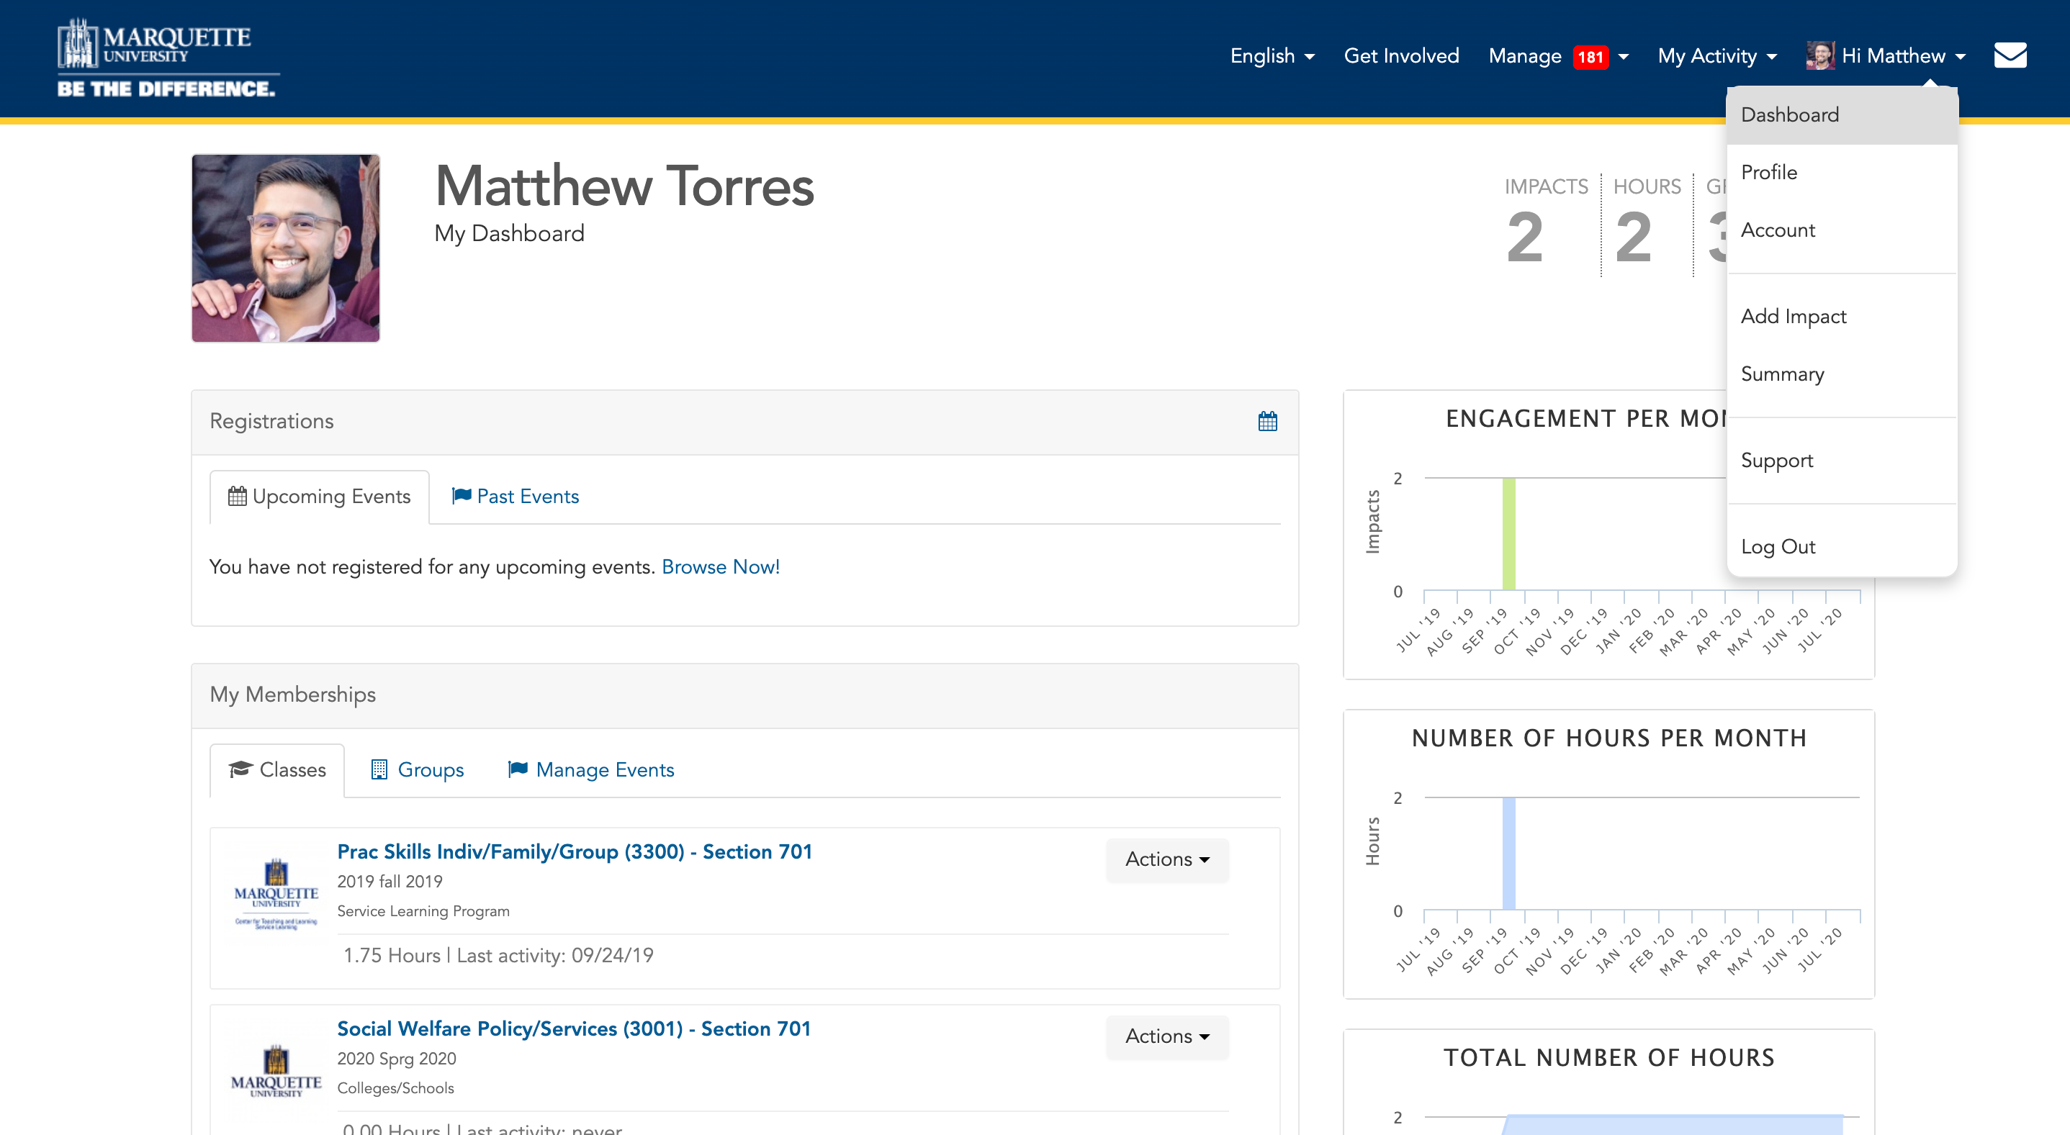
Finding the Sessions
Notes:
Your first step is to log in to MUEngage using your CheckMarq credentials and to find your course group. To find your course group, click on your name in the top bar on the right-hand side and select DASHBOARD from the dropdown menu. Then select your class from the memberships tab.

Slide 3
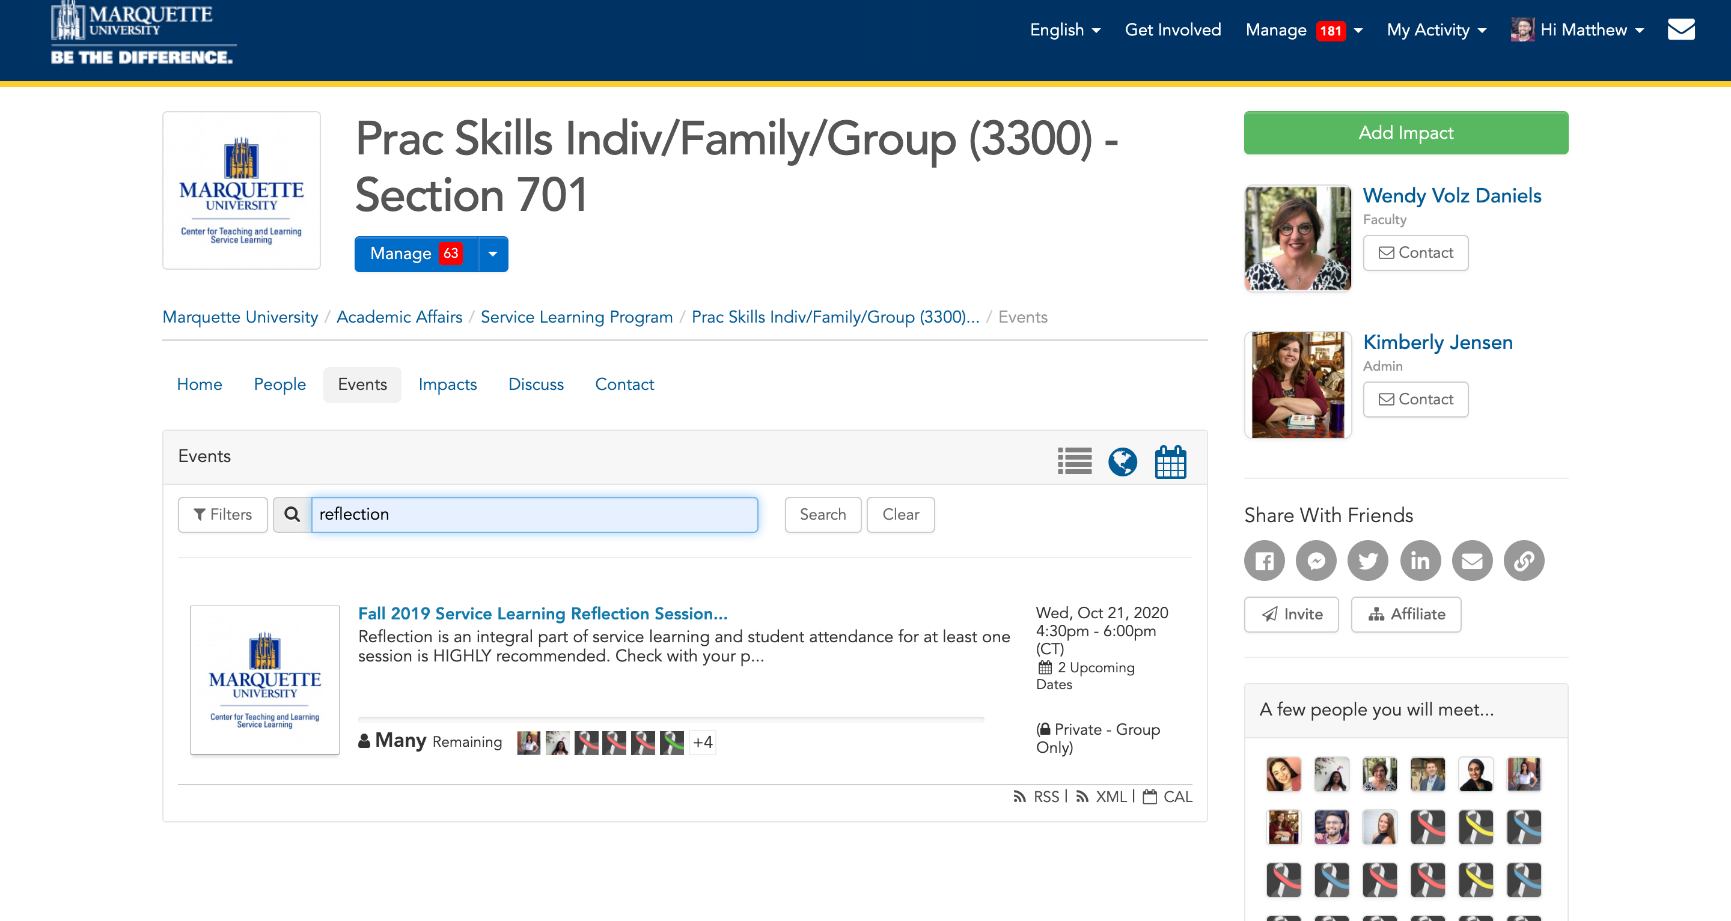
Finding the Sessions
Notes:
Search for REFLECTION in the EVENTS section and click on the title of the event.

Slide 4
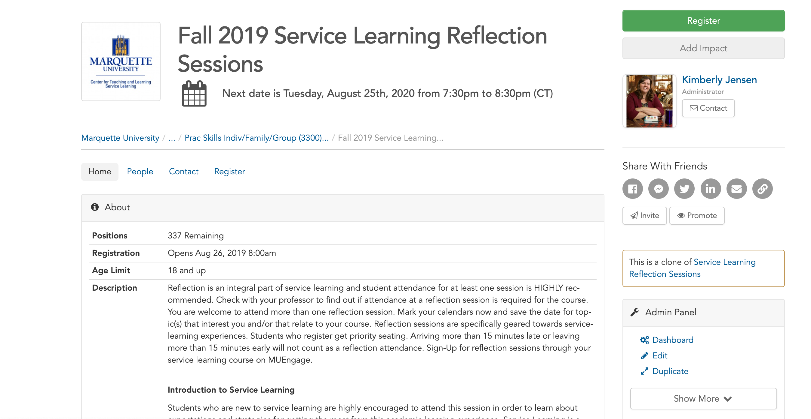
Registering
Notes:
then click the register button in the upper right corner.

Slide 5
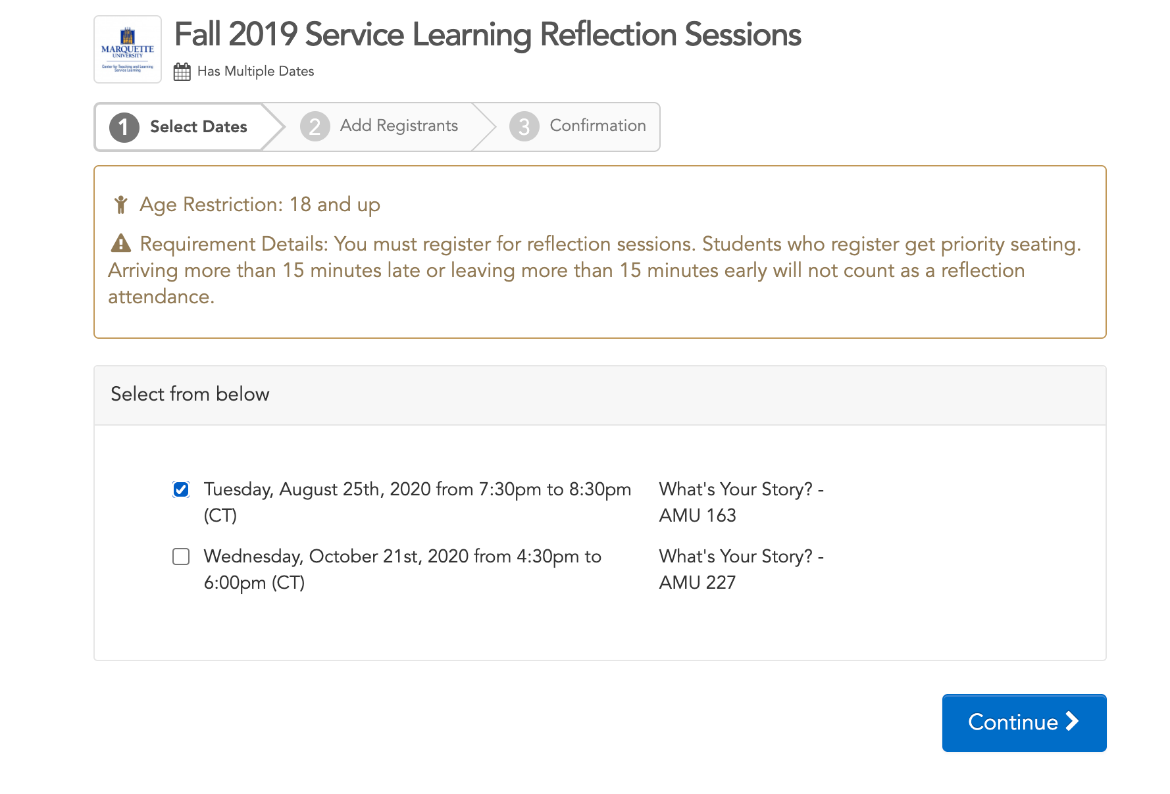
Registering
Notes:
Next, you will have to select the date you plan to attend the reflection session. The date, time, and location of the reflection session will be listed. Then click the continue button at the bottom of the page.

Slide 6
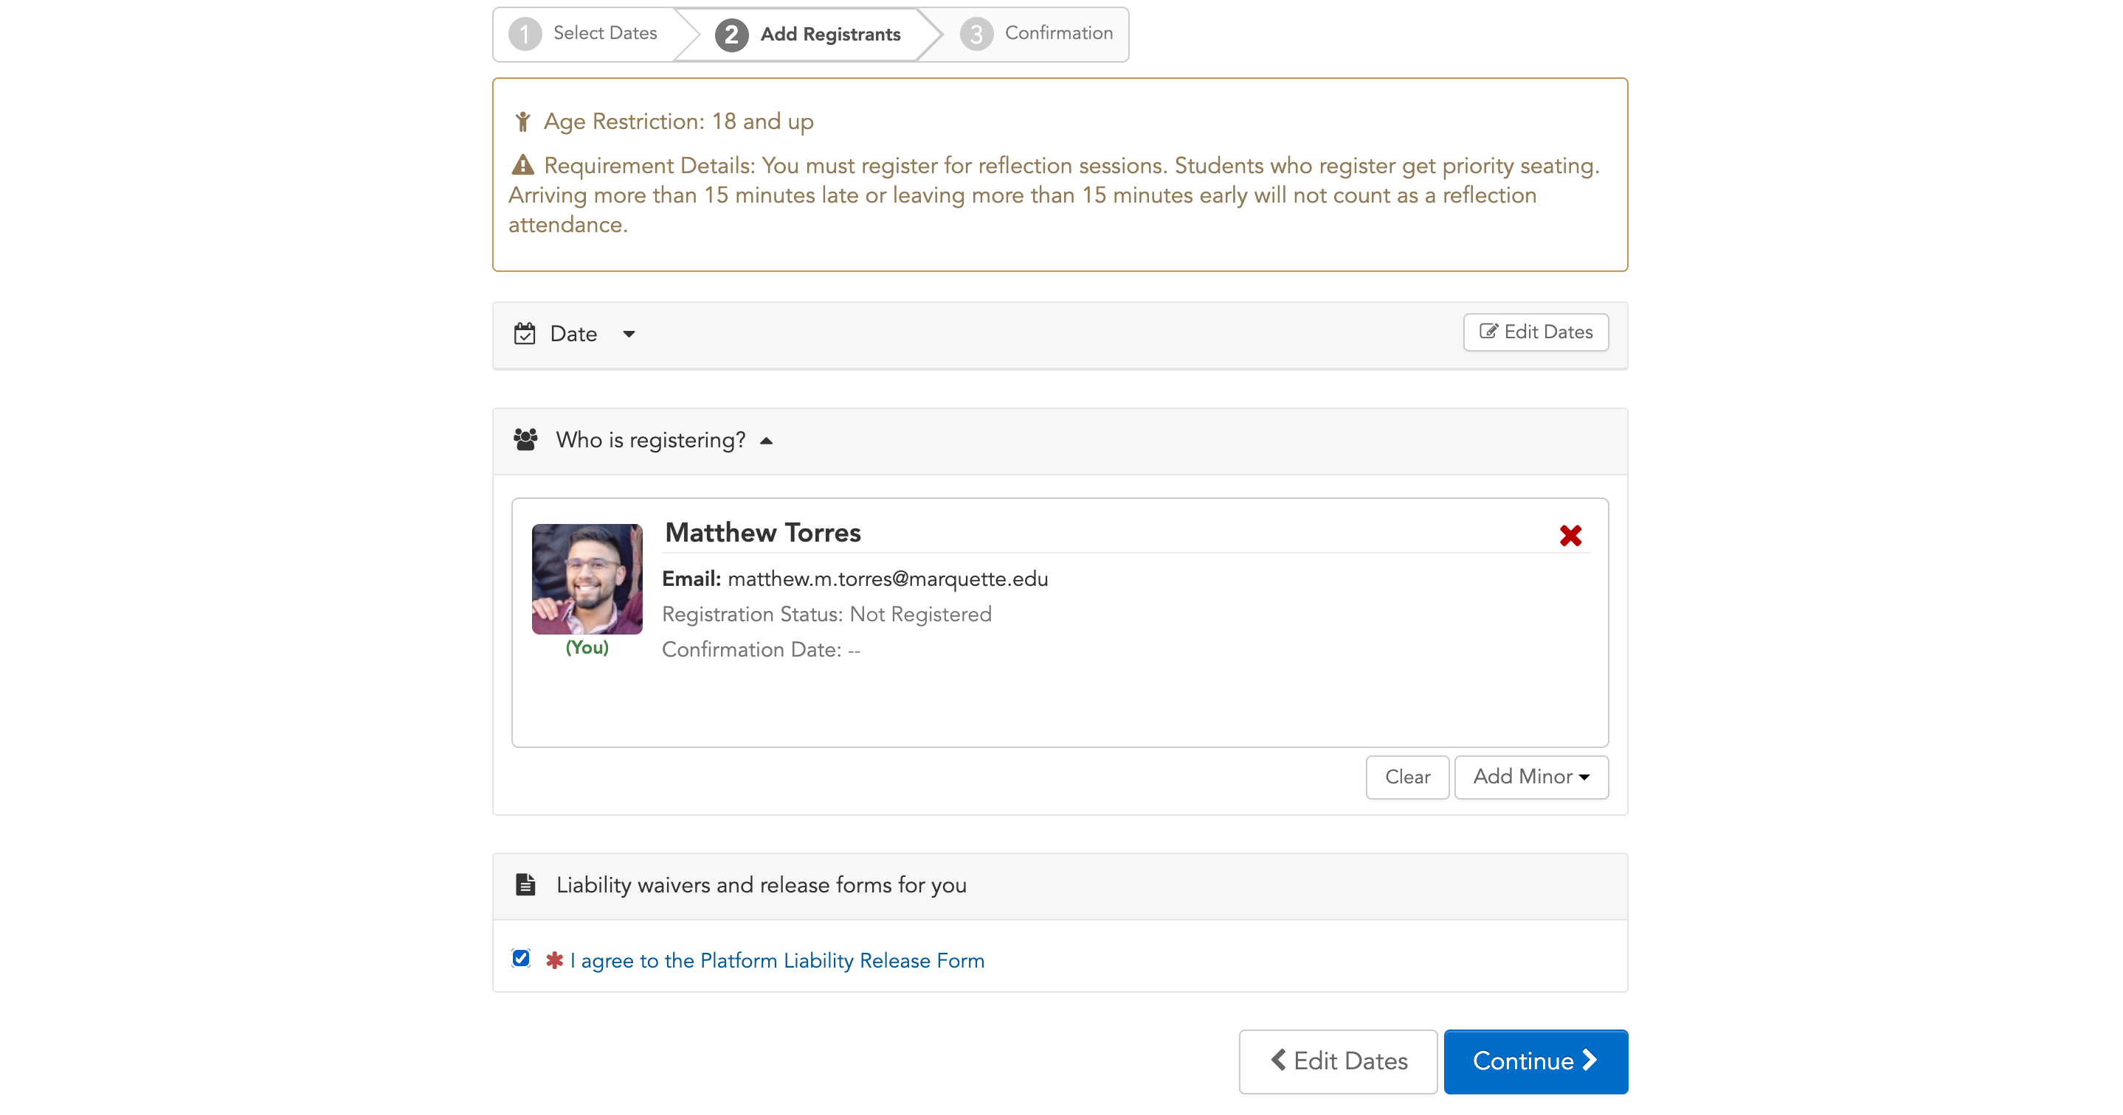
Registering
Notes:
In the "add registrants" tab, you will need to check the box provided and agree to the liability waiver.

Slide 7
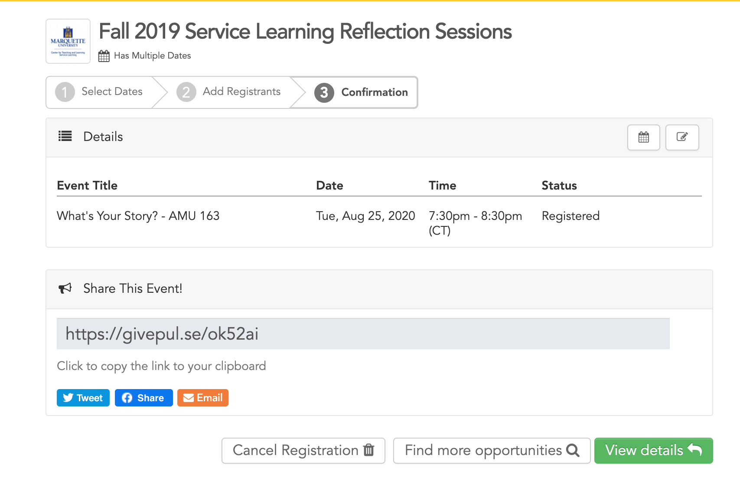
Confirmation
Notes:
Finally, you will be taken to the confirmation page. After confirming that the information is correct, you are all done!

Slide 8
Need more help? Check out more resources on our website!
https://www.marquette.edu/service-learning/muengage.php
Email us: servicelearning@marquette.edu
Notes:
You can also find all this information in the student MUEngage guide that is on our website. It is linked below in the description, and if you find yourself struggling with anything, please consult the guide before reaching out to our office. If you still have questions, however, after watching this video and reading through the MUEngage Instructional Guide, please feel free to reach out to us at servicelearning@marquette.edu.

