Slide 1



MARQUETTE UNIVERSITY
SERVICE LEARNING PROGRAM

Slide 2
What is service learning? | Service learning allows students to engage with community-based organizations that directly relate to their academic coursework, creating a space for students to integrate classroom knowledge with practical experience to grow both their understanding and application of their course
Where do you participate in service learning? | Service learning can take place in various settings, including local communities, nonprofit organizations, schools, and other community-based agencies. We partner with a range of community organizations to provide students with diverse and impactful service opportunities in Milwaukee.
What is the purpose of service learning? | The primary focus of Marquette's Service Learning Program is the learning aspect. While the service provided should benefit the community agencies, the program prioritizes placing students in roles where they can directly experience, observe, and practice the concepts they are learning in the classroom. This approach ensures that students gain significant educational value from their service experiences to engage in activities that enrich their academic, professional, and personal growth.
What do you gain from service learning? | Academic Enhancement: Deepens understanding of course material by applying it in real-world contexts. Skill Development: Builds critical skills such as leadership, teamwork, problem-solving, and communication. Personal Growth: Encourages self-discovery and personal development. Civic Engagement: Fosters a sense of social responsibility and commitment to community service. Career Preparation: Provides practical experience and networking opportunities that are valuable for future career paths.

Slide 3

TRANSPORTATION
Marquette’s Resources
Personal Resources
Safety Resources
Make use of the Umo Mobility app to help schedule your bus routes.
Reach out to the Student Coordinators if you need help arranging carpools, setting up a bus buddy group, or walking group to your site.​
You may use the EagleExpress but remember it does not travel outside the normal routes or times for service learning.​
Students may use rideshare apps like Lyft or Uber if they are willing to spend their own money.
Students may use various GPS systems to guide them to their service sites including Google Maps, RIDE MCTS, Apple Maps, etc.
Always be aware of your surroundings.
Watch the Service Learning Safety Video prior to your site orientation at: http://www.marquette.edu/servicelearning/safety.shtml
MUPD Non-Emergency 414-288-6800​
MUPD Emergency 414-288-1911​

Slide 4
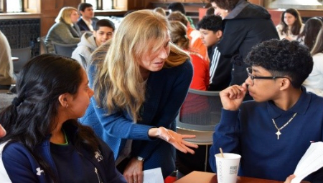
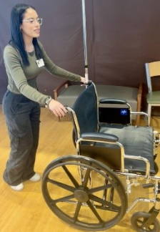
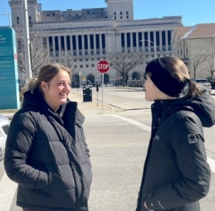
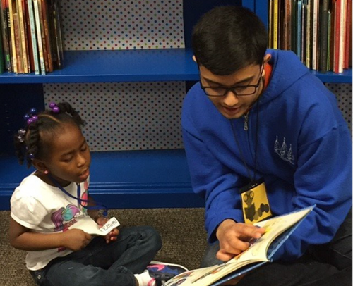
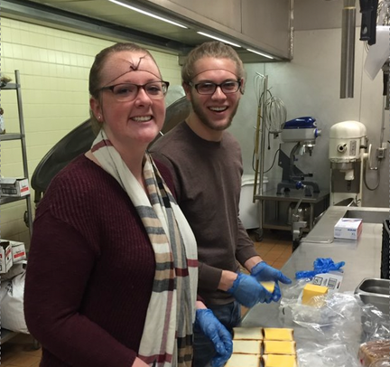
OUR EXPECTATIONS
Commit to 18-20 hours of service over the semester (approximately 2-3 hours per week).
Ensure your participation spans the entire semester, even if you fulfill your hours early.
Align your actions with course objectives; seek guidance from your professor or site contact if you’re struggling to make connections.
Uphold site expectations, ensuring appropriate dress and completion of mandatory training or checks.

Slide 5

REFLECTION SESSIONS
Students may be required to attend one reflection session throughout the semester.
Reflection sessions allow students to make sense of their interactions with others, understand the broader context of service. These sessions provide a space to connect our thoughts, feelings, and practical experiences, fostering a deeper understanding of ourselves and our community.

Slide 6
REFLECTION SESSION INFORMATION
MKE 1001
Learn about Milwaukee’s rich history and discover your role within the community through a documentary and discussion. This session aims to deepen your understanding of the city's strengths and challenges.
Wednesday, September 17, 4:00-5:30pm, AMU 227
Tuesday, September 23, 3:00-4:30pm AMU 157
Connecting to Community
Discover how to truly engage with your service site and the vibrant community around you. This semester, we’ll explore how to break the ice, build meaningful relationships, and ensure ethical, mutually beneficial service. Let’s disconnect from our devices and connect with people—learning, growing, and making a real impact together.
Monday, October 6, 5-6:30pm AMU 157
Thursday, October 9, 9-10:30am, AMU 157
Bursting the MU Bubble: Why Service Learning Matters
It’s easy to stay in the “Marquette Bubble,” but true growth happens outside of it. This session invites you to reflect on how service learning has challenged you to engage with real-life issues in Milwaukee. Let’s discuss what you’ve seen, learned, and how these experiences are shaping your understanding of the city and yourself.
Tuesday, October 21, 5:30-7:00pm (VIRTUAL)
Sunday, October 26, 3-4:30pm (VIRTUAL)
Is All Fair in the Game of Life?
Join us for the Game of Life board game experience. Together we will explore how different social factors can influence our ability to succeed in life. After the simulation game, we will unpack our experiences with the game and compare that to what we are observing, seeing, and hearing out in the community.
Monday, November 3, 3-4:30pm AMU 227
Friday, November 7, 2:30-4:00pm, AMU 227
Jesuit Values in Action
Join us as we reflect on what our Jesuit education is trying to teach us and the life it calls us to lead as “Men and Women (People) for and with Others.” How might our service learning experience be a pivotal point in our discernment and formation?
Wednesday, November 12, 12-1:30pm, AMU 227
Monday, November 17, 4:30-6pm, AMU 157
Tuesday, November 25, 11-12:30pm, AMU 227

Slide 7

IMPORTANT DATES
Registration opens September 3rd at 12pm and ends September 10th at 5pm.
Safe Environment Trainings are September 11th from 2-5pm (Lunda Room) or September 12th from 12-3pm (AMU Ballroom). This is only required if serving at a Catholic institution or school.
Late registrations will need to meet with the Director or Assistant Director for placement. After September 26th, we will no longer be placing students.

Slide 8


LOGGING HOURS
Log your impacts after each visit to your site.
Make sure you log your impacts to ALL the correct places.
Ex: You logged at your site & logged under your t template on MUEngage.
​
Hours will be verified twice during the semester- during midterms and finals. Ensure your hours are updated regularly, so your professors get an accurate report​.
If you have multiple classes, share your impacts with all of your classes that require service learning. ​

Slide 9
INDEPENDENT VOLUNTEER AND CURRENT VOLUNTEER FORMS
Independent Placement Form | Students wishing to complete service learning at a organization that does not partner with the Service Learning Program.
Key Points | Check the Current Community Partner list to see if your organization partners with the Service Learning Submit the form to our office in order to log your hours for credit and submit a signed timesheet for verification. Both logging hours in MUEngage and submitting a timesheet are mandatory to receive credit. Timesheets must be submitted by the last week of classes. Professor must sign off on the form before it can be processed by our office Email the form to servicelearning@marquette.edu or turn it in in person at the 707 Building, Suite 303.
Current Volunteer Form | Students choosing to volunteer/continue volunteering at an organization that is partnered with the Service Learning Program
Key Points | Professor must sign off on the form before it can be processed by our office. Email the form to servicelearning@marquette.edu or turn it in in person at the 707 Building, Suite 303.

Slide 10
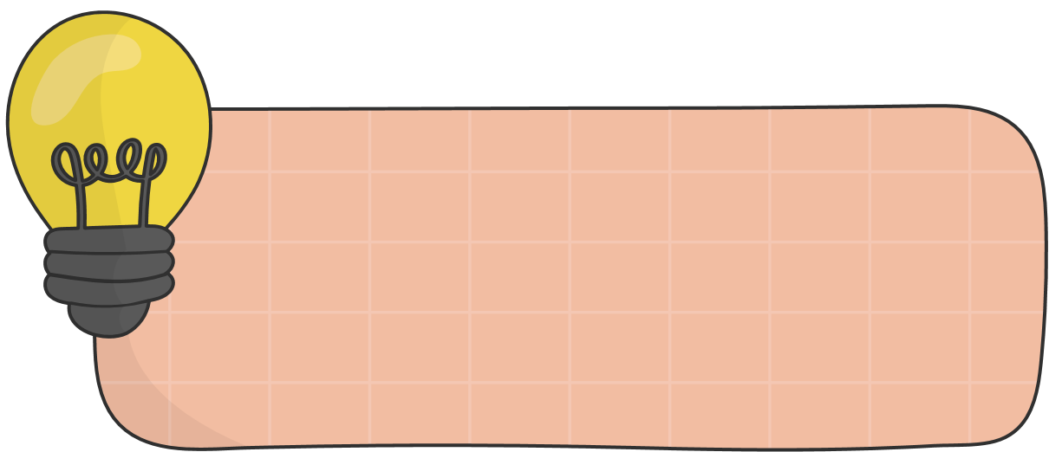







BEST PRACTICES FOR STUDENTS
CHECKING EMAILS DAILY
BUILDING RELATIONSHIPS
LIMITING PHONE USAGE
MAINTAINING A POSITIVE ATTITUDE
COMMUNICATING EFFECTIVELY
COLLABORATING WITH COMMUNITY PARTNERS
NOT ADOPTING A SAVIOR MENTALITY
DEMONSTRATING COMMITMENT AND ENGAGEMENT

Slide 11

STILL CONFUSED?
Watch the instructional video on MUEngage on the Service Learning Website.​
Reach out to the Service Learning staff with any questions as soon as possible​

Slide 12


NEED MORE INFO?
Instagram:
@mu.servicelearning
General Email:
servicelearning@marquette.edu
Phone Numbers:
414-288-3262
414-288-3264
Staff Contact Information:
https://www.marquette.edu/service-learning/about-us.php

